Slide 1


Phonics and Reading
at Walter Infant School and Nursery

Slide 2
Walter the Reading Lion
Today we going to share how we teach children to read at Walter Infant School and Nursery
We will also be able to suggest ways in which you can support your child in learning to read at home.

Slide 3
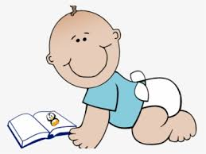
7 Aspects of Reading
Learning to read is a journey that begins as soon as your child is born:
Early Literacy Skills
Phonological and Phonemic Awareness
Alphabetic Principle
Phonics
Fluency
Vocabulary
Comprehension

Slide 4
The Simple View of Reading
Reading can be broken down into two processes or dimensions: word recognition and language comprehension. Phonics helps with word recognition or decoding words so they can be read.
Phonics does not help develop language comprehension; the understanding of what is being read. This is done through questioning and discussion before, during and after reading a book or text.

Slide 5
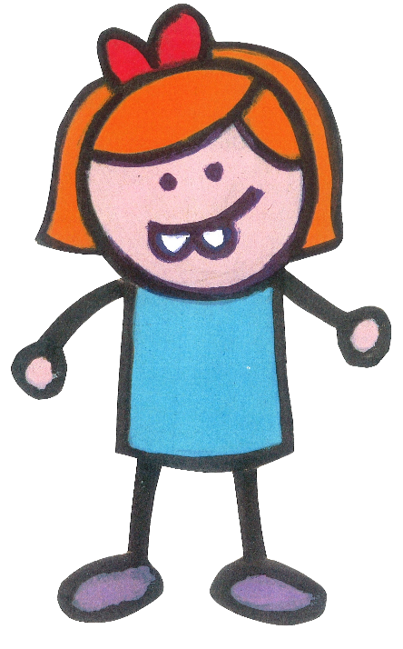


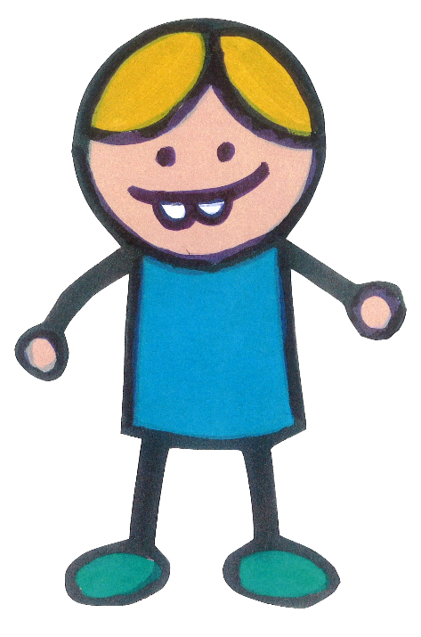
The Simple View of Reading
The children at our school join Year 1 with a variety of skills and abilities; our teacher assessments help us to learn what the children know already and what they need to learn next. We use the Simple View of Reading to help us decide which skills we need to focus on first.

Slide 6







Print to Meaning
Phonics gives the children a strategy needed for word recognition only. Language comprehension is primarily developed through our Guided Reading sessions. Phonics is about turning the marks on the page, the symbols or letters into a sound. Below are some examples of this. What do the following symbols mean?

Slide 7

What is Phonics? Why is it so important?
Phonics is a strategy used for word reading or decoding; we also use it for spelling.
Phonics is the prime method for decoding (reading) and encoding (spelling) newly encountered or unfamiliar words.

Slide 8

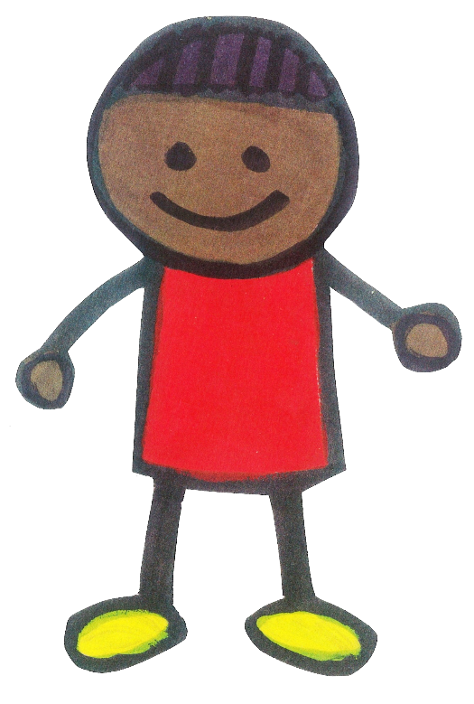
What is synthetic phonics?
Why is it called synthetic?
Because…Synthetic can mean fuse, integrate, mix, alloy, merge, arrange or blend.
Synthetic phonics is the breaking down of words
into their smallest possible sounds:
c-a-t d-o-g ph-o-n-i-c-s
It is expected that all schools will use a Systematic Synthetic Programme to teach phonics: we use our own based on Letters and Sounds 2007.Our children are able to succeed and become readers and we get very good results in the Phonics Screening Check at the end of Year 1.

Slide 9
Technical Vocabulary
Letters – the 26 letters of the alphabet.
Vowel – the letters a, e, i, o, u.
Consonant – all the letters that are not vowels.
Grapheme – the written representation of a sound or phoneme made up of one or more letters.
Phoneme – the smallest possible units of sounds that makes up a word.
Digraph – two letter grapheme (ea, ay)
Trigraph – three letter grapheme (igh, ear)
Quadgraph – four letter grapheme (eigh)
Split digraph – where the letter ‘e’ at the end of the word changes the vowel sound, e.g. snake, flute or mike.
Common exception words – words that are not so easily; or impossible to decode using phonics.
Grapheme-Phoneme correspondence (GPC) – the process of identifying that a grapheme represents a phoneme or sound.
Segment – breaking down words into their smallest possible phonemes or phonemes.
Blend – to join the phonemes or sounds together to make a word.
Decode – when phonics is used for reading.
Encode – when phonics is used for spelling.

Slide 10


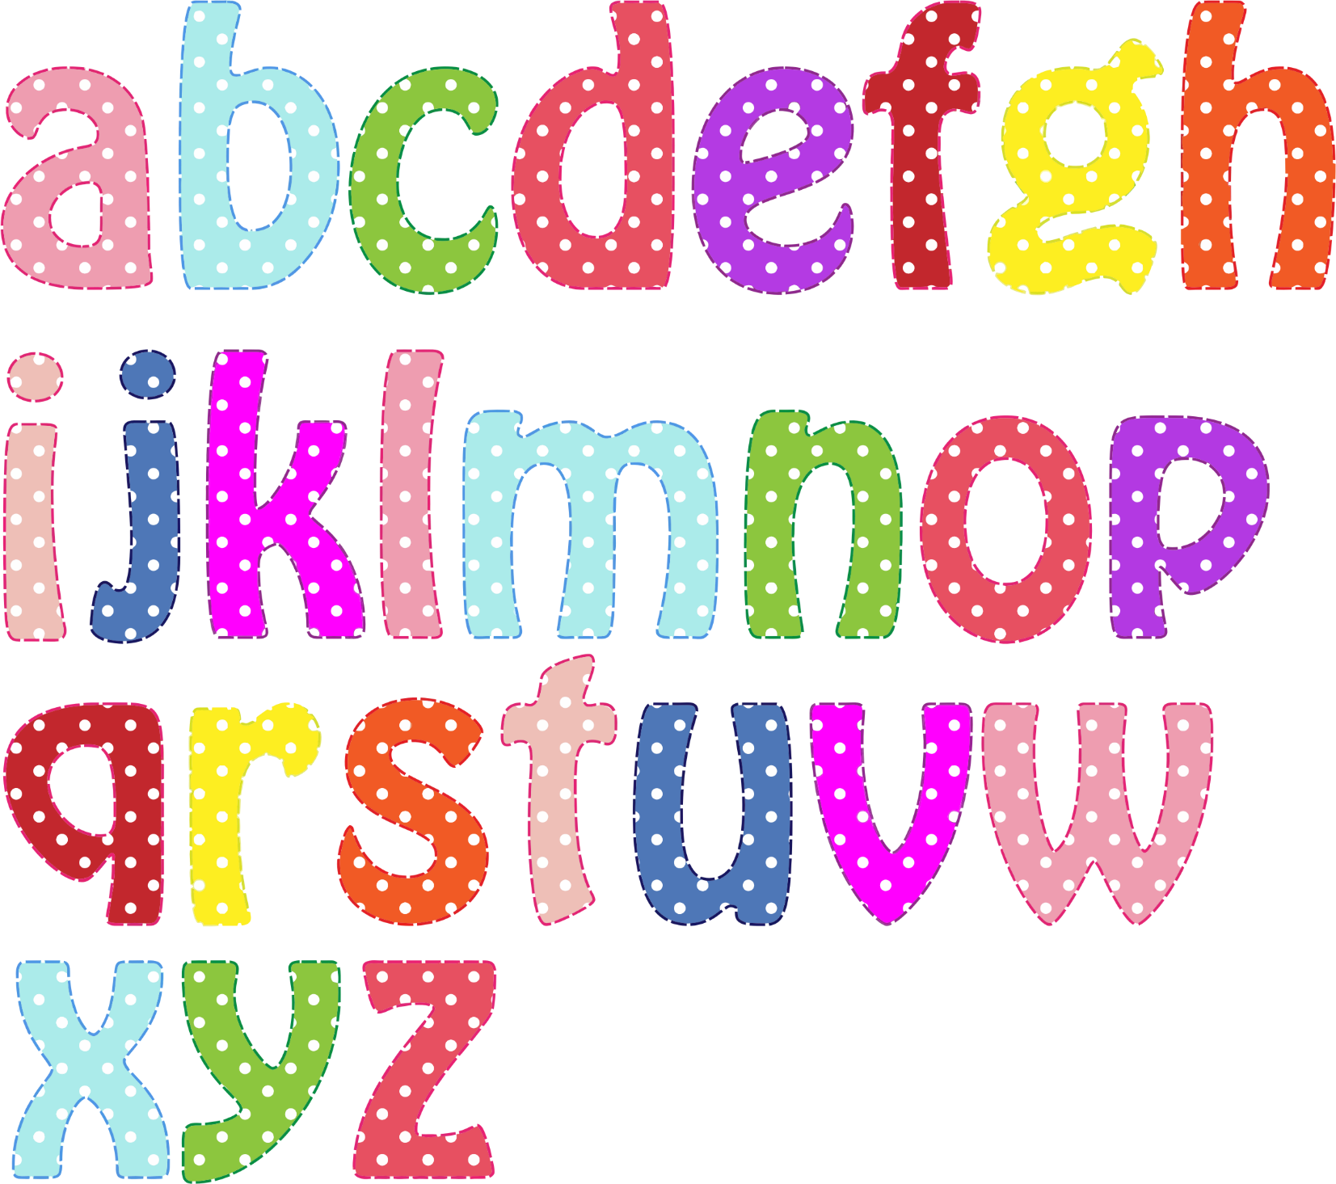

The English Language
There are 26 letters
in the alphabet.
40+ phonemes or sounds in the English language, accounting for regional dialects.
Over 200 graphemes or written representations of these sounds. Sounds or phonemes can have one or more grapheme for example the sound s can be spelt with an ’s’ or a ‘c’.
Notes:
There are 26 letters in the alphabet.
40+ phonemes or sounds in the English language, accounting for regional dialects
Over 200 graphemes or written representations of these sounds. Sounds or phonemes can have one or more grapheme for example the sound s can be spelt with an ’s’ or a ‘c’

Slide 11
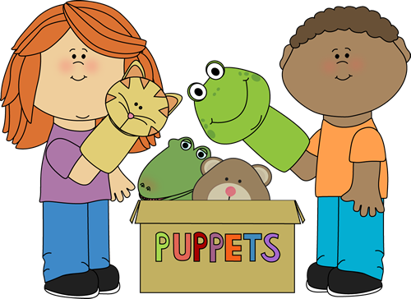
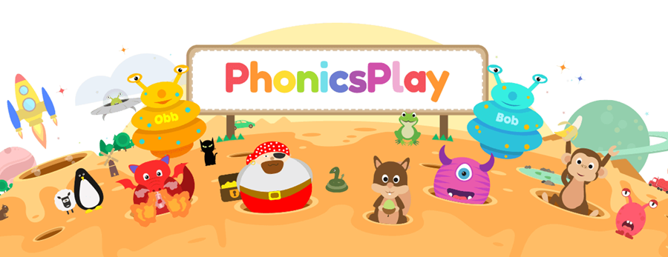
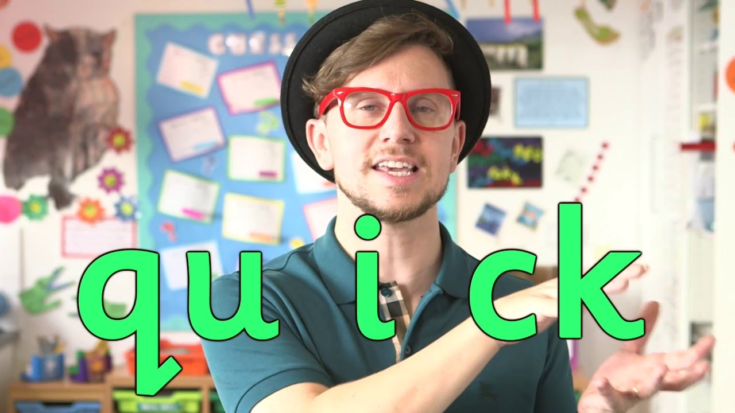
Enunciation and Pronunciation of Phonemes
It is very important to make the sound of each letter or group of letters correctly; we are going to teach you how in a moment or two!
We teach the children how to move their mouths and tongues to pronounce the sound.
If children have speech and language difficulties this will be much harder for them to do, so they will receive additional support.
Mr Thorne is an expert and definitely worth viewing.
We subscribe to a website called Phonics Play to help us; parents can access the site too.
https://www.youtube.com/channel/UC7sW4j8p7k9D_qRRMUsGqyw
Notes:
There are 26 letters in the alphabet.
40+ phonemes or sounds in the English language, accounting for regional dialects
Over 200 graphemes or written representations of these sounds. Sounds or phonemes can have one or more grapheme for example the sound s can be spelt with an ’s’ or a ‘c’

Slide 12

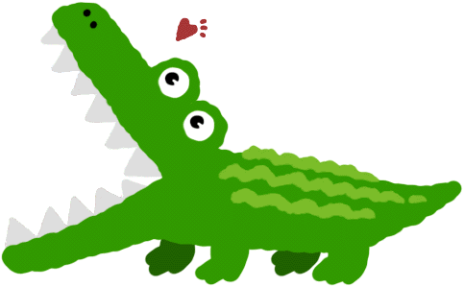
The Added Schwa
This is where things get complicated!!!!!!
The schwa sound is the ‘uh’ sound. It exists in many words in the English language. It is an unstressed vowel sound, where the vowel is neither long or short. It is the most common vowel sound; everyone at school has to be careful not to add it on when saying a phoneme.
m = “mm” and not “muh”
s = “ss” and not “suh”
Also, remember to keep the phonemes ‘clipped’ so they are not elongated. Think of them them as short and snappy.
m = “mm” and not “mmmmmm”
s = “ss” and not “ssssssssssss”
Notes:
There are 26 letters in the alphabet.
40+ phonemes or sounds in the English language, accounting for regional dialects
Over 200 graphemes or written representations of these sounds. Sounds or phonemes can have one or more grapheme for example the sound s can be spelt with an ’s’ or a ‘c’

Slide 13
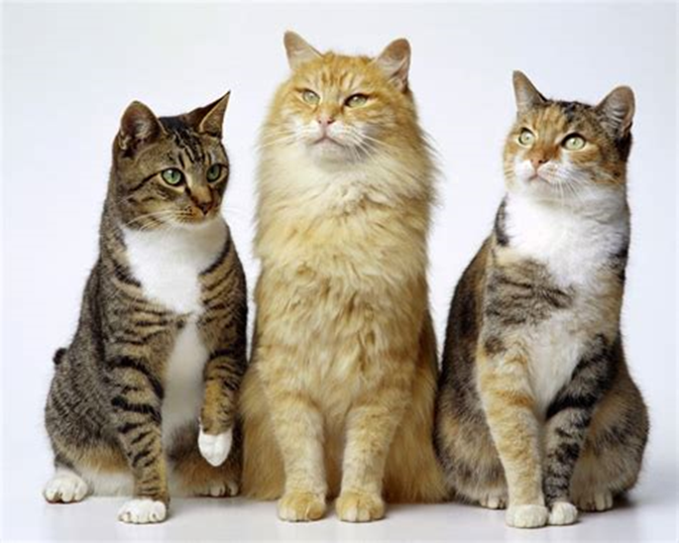

Letters and Phonemes
There is a difference between letters and phonemes. Think of the word ‘letter’ as the name of the letter and the ‘phoneme’ as the sound it makes; BBC’s Alphablocks illustrates this very well. Do not be afraid to use these interchangeably. Use the letter name when discussing what letters make up a digraph, for example ‘or’ is made up of the letters o and r not ‘oh’ and ‘rrr’ and makes the sound “aw”. Here are some examples with the “k” sound or phoneme.
This is the letter “kay” and it makes the sound “k” as in kite. | This is the letter “see” and it makes the sound “c” as in cat. | This is the digraph “ck” as in wick. It is made up of the letters “see” and “kay”. | This is the digraph “ch” as in school. It is made up of the letters “see” and “aitch”
k | c | ck | ch
Notes:
There are 26 letters in the alphabet.
40+ phonemes or sounds in the English language, accounting for regional dialects
Over 200 graphemes or written representations of these sounds. Sounds or phonemes can have one or more grapheme for example the sound s can be spelt with an ’s’ or a ‘c’

Slide 14
Sound Buttons
We can add sound buttons to words to help the children to segment and blend. We use a dot for a single letter grapheme, a dash for a multi-letter grapheme and a curve for a split digraph. Here are some examples:
c a t
s h o p
t a p e
Notes:
There are 26 letters in the alphabet.
40+ phonemes or sounds in the English language, accounting for regional dialects
Over 200 graphemes or written representations of these sounds. Sounds or phonemes can have one or more grapheme for example the sound s can be spelt with an ’s’ or a ‘c’

Slide 15


The Letter H!
The letter H or h causes a lot of controversy. People call this letter different things. To settle any disagreements at Walter Infant School and Nursery, we would like everyone to say it as “aitch” and not “haytch”.
Ohh look its ‘aitch’!
Notes:
There are 26 letters in the alphabet.
40+ phonemes or sounds in the English language, accounting for regional dialects
Over 200 graphemes or written representations of these sounds. Sounds or phonemes can have one or more grapheme for example the sound s can be spelt with an ’s’ or a ‘c’

Slide 16
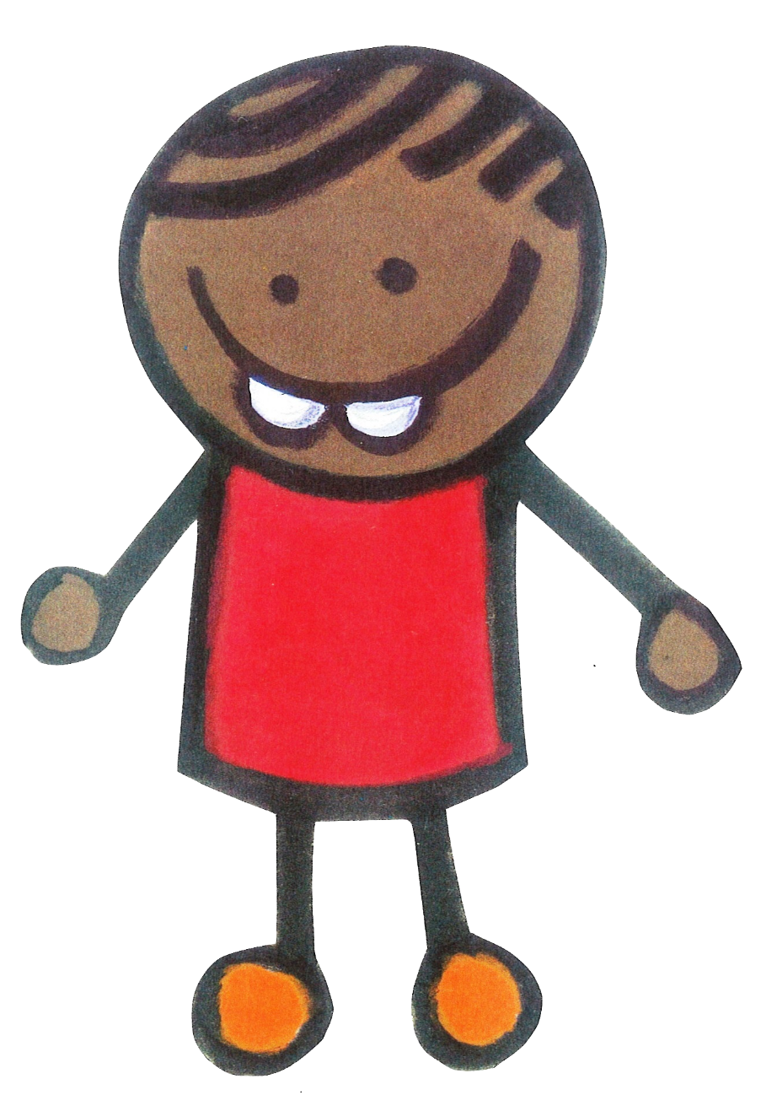




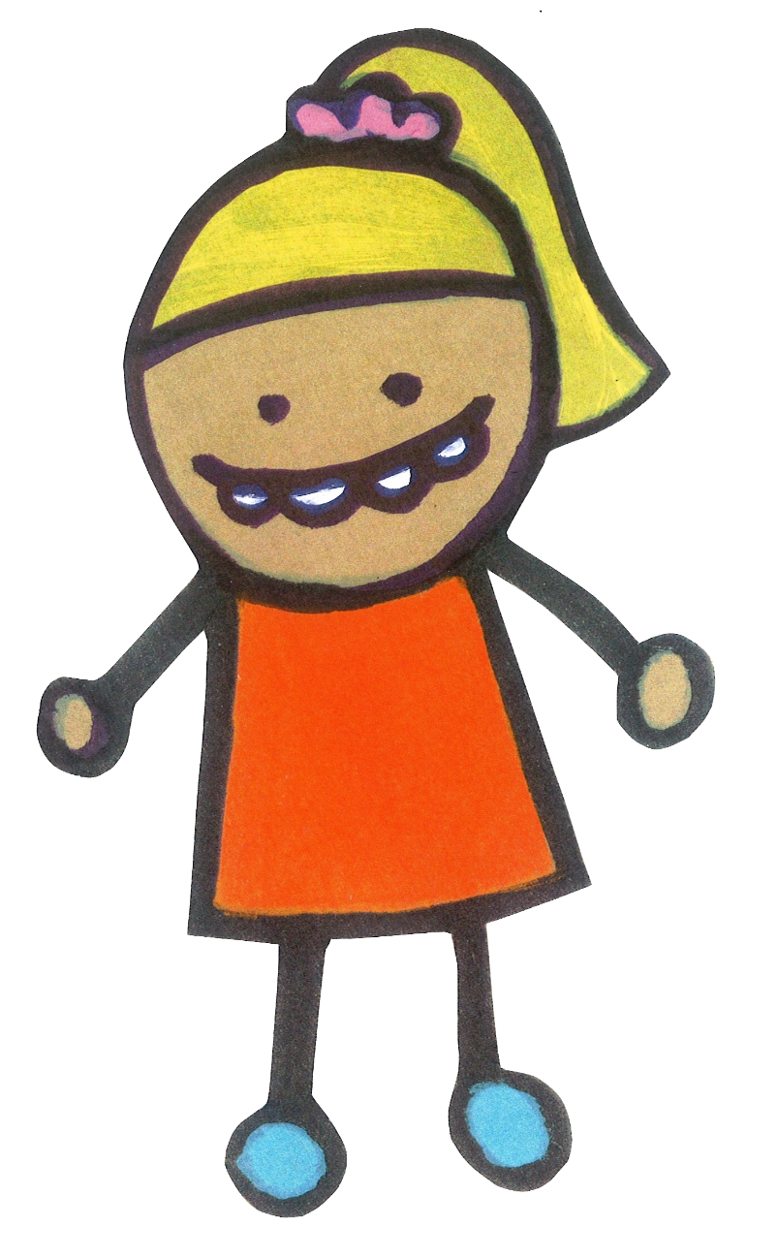
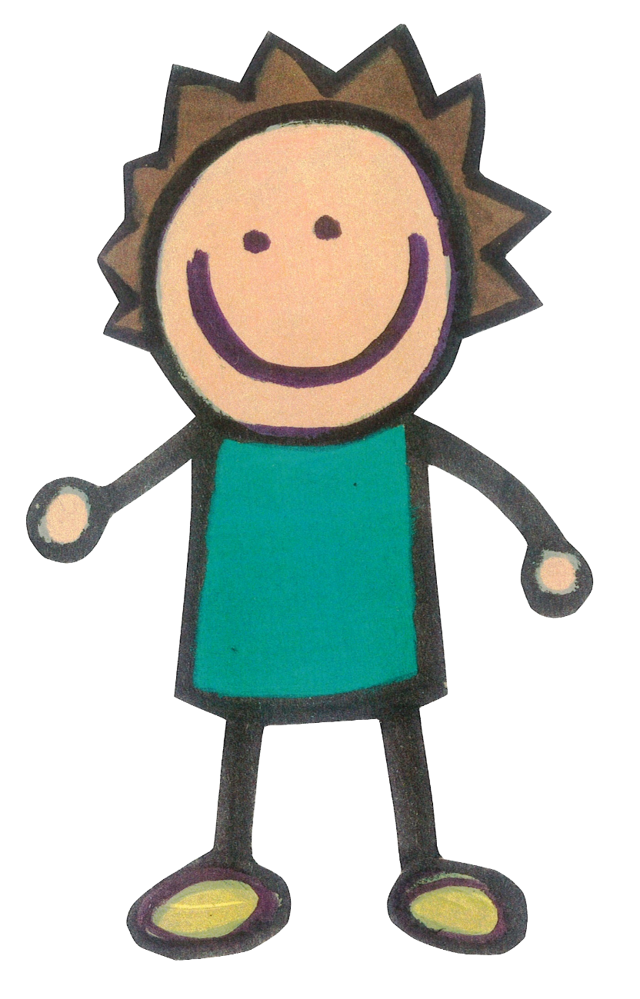

Phonic Sessions
The children in Dove, Magpie and Woodpecker are taught phonics as a class so they can all learn together. The children who need more help to make sense of phonics will have additional small group learning as well.
Notes:
There are 26 letters in the alphabet.
40+ phonemes or sounds in the English language, accounting for regional dialects
Over 200 graphemes or written representations of these sounds. Sounds or phonemes can have one or more grapheme for example the sound s can be spelt with an ’s’ or a ‘c’

Slide 17






Letters and Sounds and Phases
We follow the Letters and Sounds guidance, which we supplement
with the resources on the www.phonicsplay.co.uk website.
Letters and Sounds breaks the teaching of Phonics down into Six Phases.
Notes:
There are 26 letters in the alphabet.
40+ phonemes or sounds in the English language, accounting for regional dialects
Over 200 graphemes or written representations of these sounds. Sounds or phonemes can have one or more grapheme for example the sound s can be spelt with an ’s’ or a ‘c’

Slide 18
Phase One
Aspect 1 – Environmental Sounds Going on sound walks Making or matching animal sounds Listening for sounds that are all around us Sounds of different weather | Aspect 2 – Instrumental Sounds Exploring sounds using instruments Matching sounds to their instruments Playing instruments alongside stories Making loud and quiet noises | Aspect 3 – Body Percussion Clapping patterns What sounds can we make with different body parts? Develop an awareness of sound patterns and rhythms
Aspect 4 - Rhythm and Rhyme Telling rhyming stories Singing nursery rhymes Counting or clapping the syllables in words Odd one out games, for example cat, dog, mat. | Aspect 5 – Alliteration Listening for the first sound in a word Matching objects that begin with the same initial sound Playing I-spy games | Aspect 6 – Voice Sounds Exploring different mouth movements Making different vocal sounds Using robot voices to sound out words (c-a-t)
Aspect 7 – Oral Blending and Segmenting Games that involve breaking down words into sounds or phonemes and blending. Segmenting words together and then blending.
Notes:
There are 26 letters in the alphabet.
40+ phonemes or sounds in the English language, accounting for regional dialects
Over 200 graphemes or written representations of these sounds. Sounds or phonemes can have one or more grapheme for example the sound s can be spelt with an ’s’ or a ‘c’

Slide 19
Phase Two
Children begin to learn that letters make phonemes or sounds. They are taught the 19 most common phonemes. They learn how to blend and read CVC (consonant-vowel-consonant) and VC words. They also learn some common exception words.
Notes:
In Phase 2 the children learn the first sounds or phonemes. The learn to read and spell words containing these graphemes and phonemes.

Slide 20

s

Slide 21

a

Slide 22

t

Slide 23

p

Slide 24

i

Slide 25

n

Slide 26

m

Slide 27

d

Slide 28

g

Slide 29

o

Slide 30

c

Slide 31

k

Slide 32

ck

Slide 33

e

Slide 34

u

Slide 35

r

Slide 36

h

Slide 37

b

Slide 38

f

Slide 39

ff

Slide 40

l

Slide 41

ll

Slide 42

ss

Slide 43
Phase Three
Children are introduced to the remaining phonemes. This includes a wider range of digraphs and trigraphs. The children are also taught more common exception words.
Notes:
In Phase 3 the children learn more graphemes and phonemes, including more digraphs and trigraphs. They learn how to read and spell longer words.

Slide 44

j

Slide 45

v

Slide 46
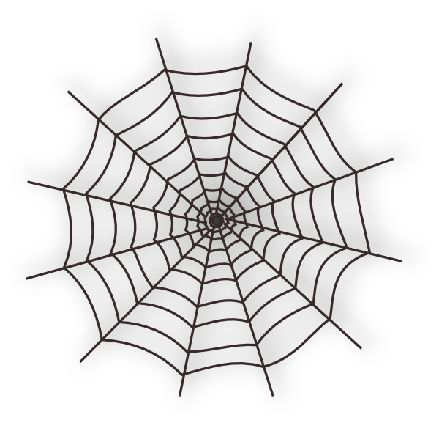
w

Slide 47

x

Slide 48

y

Slide 49

z

Slide 50

zz

Slide 51
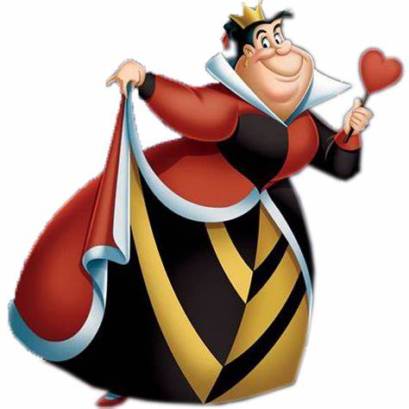
qu

Slide 52
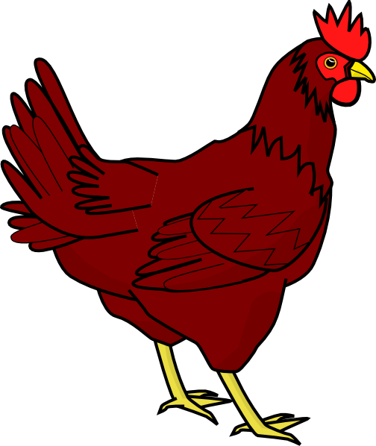
ch

Slide 53

sh

Slide 54

th

Slide 55

ng

Slide 56

ai

Slide 57
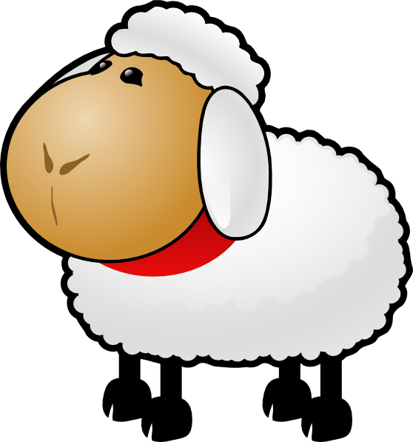
ee

Slide 58

igh

Slide 59

oa

Slide 60

oo

Slide 61

oo

Slide 62

ar

Slide 63

or

Slide 64

ur

Slide 65

ow

Slide 66
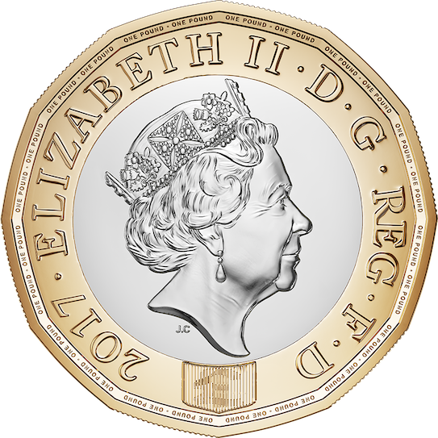
oi

Slide 67

ear

Slide 68
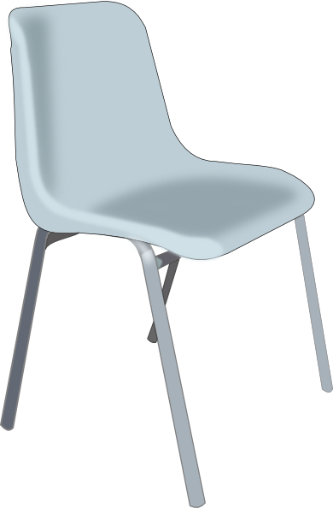
air

Slide 69

ure

Slide 70

er
This phoneme should be
taught as ‘uh’ and not ‘ergh’.

Slide 71
Phase Four
During this phase children are not taught any new phonemes. From now on the teaching and learning of phonics is focused on consolidating the skills necessary for decoding and encoding new words.
The children begin to use phonics to decode and spell much longer words. They are taught words which have adjacent consonants, including CCVC and CVCC words. The adjacent consonants can sometimes be tricky to hear or sound out, for example: milk; belt; fact. They also learn some additional common exception words. Multi-syllabic words are also introduced.
Notes:
Phase 4 is mostly revision of the previous phases. Adjacent consonants are also learned, as they can be difficult to hear in certain words, such as milk or drop.

Slide 72
Common Exception Words
Common Exception Words used to be called tricky words.
They are words that cannot usually be decoded or encoded using phonics although there are some exceptions e.g. out, looked.
Phase 2 | Phase 3 |  | Phase 4 |  | Phase 5
I | he | are | said | little | oh
no | she | her | have | one | Mrs
the | we | was | like | were | people
to | me | all | so | there | their
go | be | they | do | what | called
into | you | my | some | when | Mr
 |  |  | come | out | looked
 |  |  |  |  | asked
 |  |  |  |  | could

Slide 73

The Reading Framework
Teaching the foundations of literacy
at Walter Infant School and Nursery

Slide 74
Learning to read books @ Walter…

Slide 75

We love books at Walter Infant School and Nursery!

Slide 76

Why Reading Matters
Reading is an essential skill for life. At Walter Infant School and Nursery we dedicate ourselves to ensuring our children are all readers by the time they leave for Junior School. Reading brings social, cultural and economic value to a person’s life. If a child cannot read, it can have a life long impact.

Slide 77

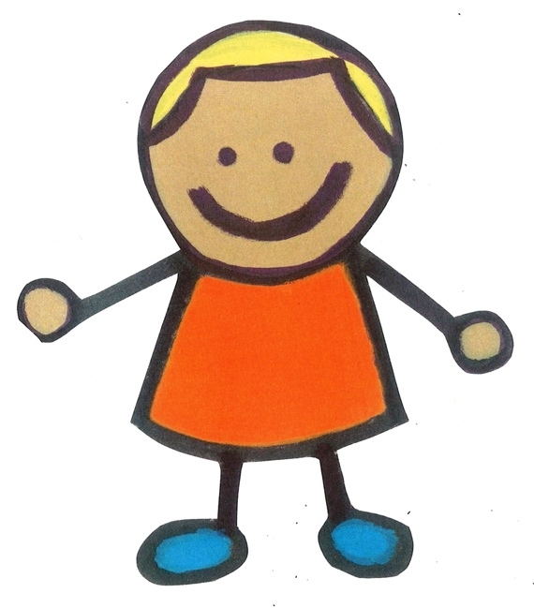
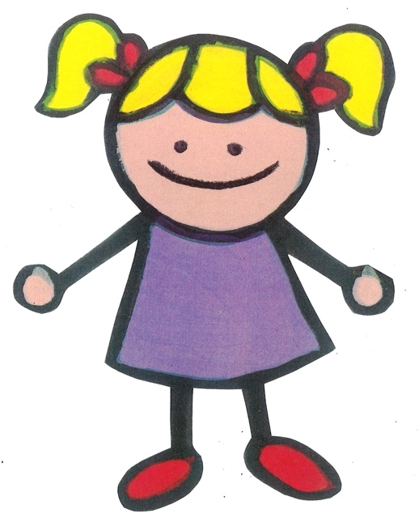
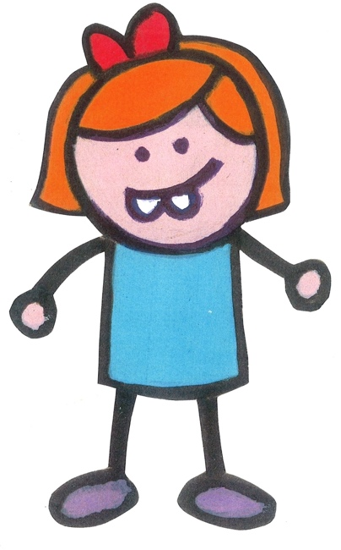
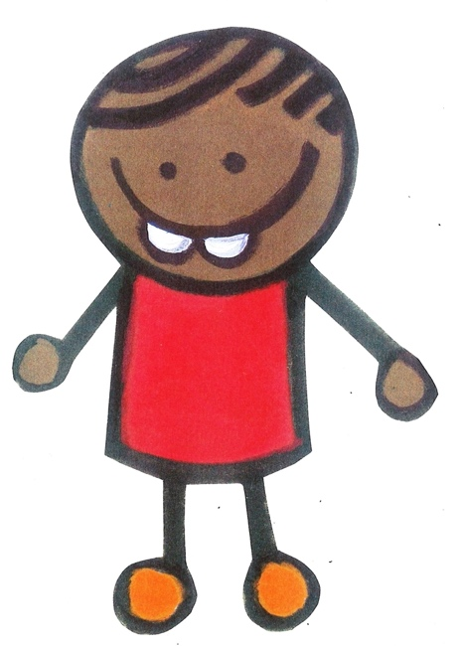
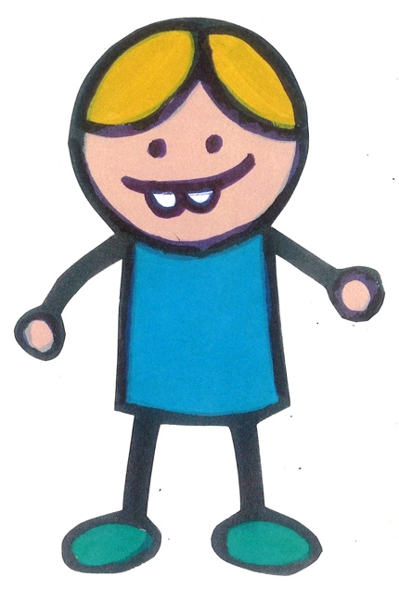
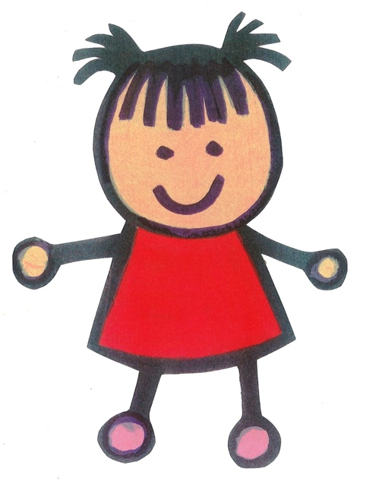
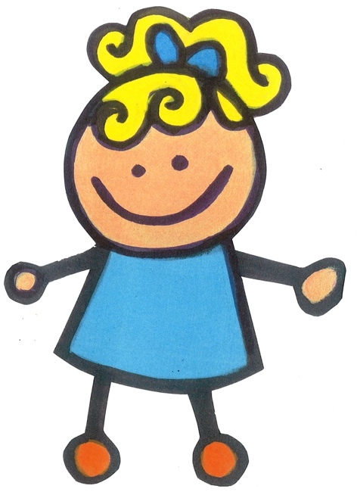
The Department for Education
In 2021The Department for Education released a new piece of guidance on reading and developing early literacy skills.
This guidance is to help schools teach children to read; it is broken down into 6 sections, which we have summarised and contextualised for our school.

Slide 78

Section 1: The Importance of Reading
and a Conceptual Model

Slide 79

Developing Children’s Spoken Language
The skills for reading develop before children encounter a book. This is driven by the quality of a parent’s talk and the child’s exposure to language and images.
Children need to hear lots of different talk; conversations, instructions, questions, suggestions. They will spend time listening to others, they will absorb the talk around them, mimic it and practise making different sounds and using new words.
We have hundreds of toys and books to stimulate speaking as we try to make all our learning fun.

Slide 80

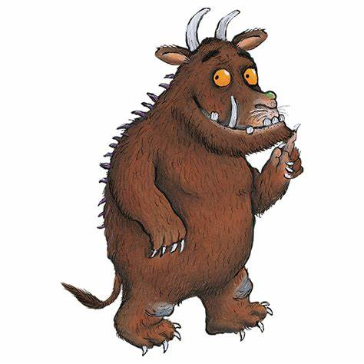
Talking about books brings ‘particular advantages’.
At Walter Infant School and Nursery, we have plenty of
opportunities to share and discuss books.
Our Big Curriculum for Little People is designed around good quality fiction and non-fiction books as well as real life experiences.
Guided Reading sessions provide wonderful opportunities for the children to talk to each other about what they have read.
Story Time: adults read pictures books aloud to the children giving opportunities for the children to interact with the text and join in with refrains! “There’s no such thing as a Gruffalo!”

Slide 81

Children Reading for Pleasure
We foster a love for reading at school; please do the same at home. Explain to your children how much you love to read and regularly share books with them. Talk about your favourite books. Some children will prefer fiction and some will prefer non-fiction. We have a wide variety of both

Slide 82
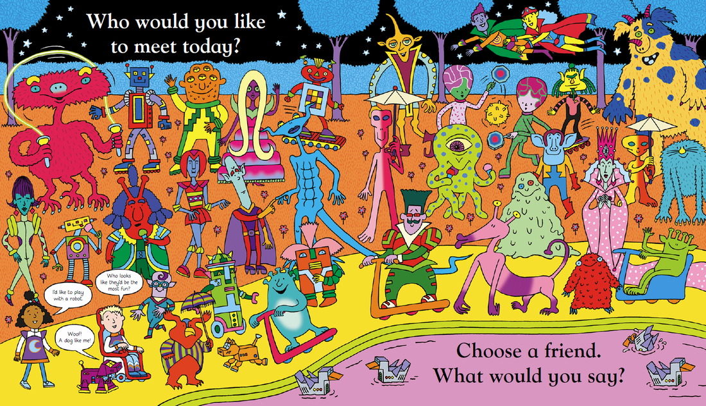
Section 2: Language Comprehension

Slide 83
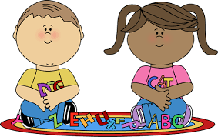
Developing Children's Spoken Language
We want our children to love coming to school so we make learning as much fun as possible; all our classes in Key Stage 1 have lots of role play and small world play to encourage fun interactions between the children

Slide 84
EYFS ELGs for Listening and Speaking
ELG: Listening, Attention and Understanding | ELG: Speaking
Children at the expected level of development will: Listen attentively and respond to what they hear with relevant questions, comments and actions when being read to and during whole class discussions and small group interactions; Make comments about what they have heard and ask questions to clarify their understanding; Hold conversation when engaged in back-and-forth exchanges with their teacher and peers. | Children at the expected level of development will: Participate in small group, class and one-to-one discussions, offering their own ideas, using recently introduced vocabulary; Offer explanations for why things might happen, making use of recently introduced vocabulary from stories, non-fiction, rhymes and poems when appropriate; Express their ideas and feelings about their experiences using full sentences, including use of past, present and future tenses and making use of conjunctions, with modelling and support from their teacher.

Slide 85

The New EYFS Development Matters
Document has Talk Across the Curriculum! This emphasises its great importance, particularly in the early stages on development.
The word talk appears 90 times in the development matters document and word listen 53 times.
https://assets.publishing.service.gov.uk/government/uploads/system/uploads/attachment_data/file/1007446/6.7534_DfE_Development_Matters_Report_and_illustrations_web__2_.pdf

Slide 86

Back and Forth Interactions
We do all of these at Walter Infant School and Nursery
thinking out loud, modelling new language for children
paying close attention to what the children say
rephrasing and extending what the children say
validating the children’s attempts at using new vocabulary and grammar by rephrasing what children say if necessary
asking closed and open questions
answering the children’s questions
explaining why things happen
deliberately connecting current and past events (‘Do you remember when…?’)
providing models of accurate grammar
extending children’s vocabulary and explaining new words
connecting one idea or action to another
helping children to articulate ideas in well-formed sentences.

Slide 87
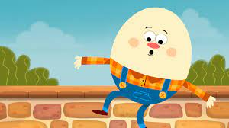
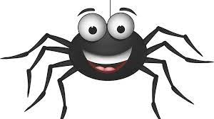

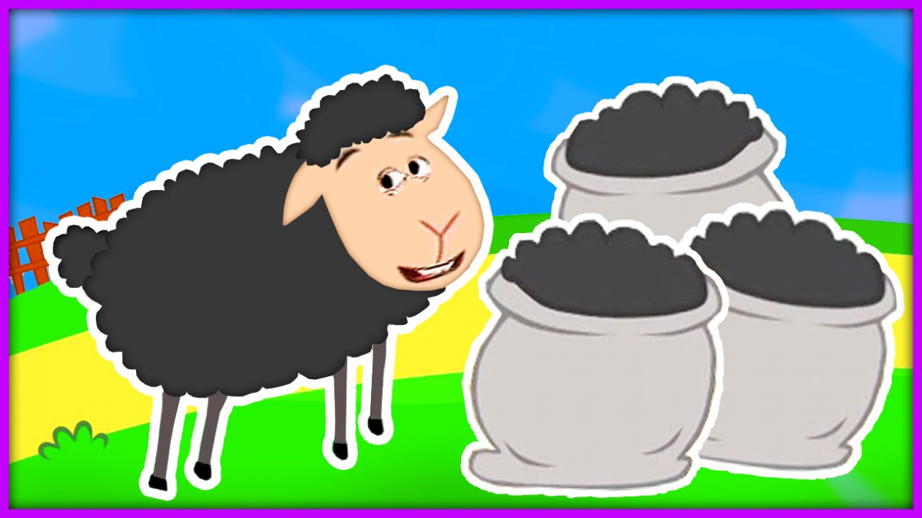
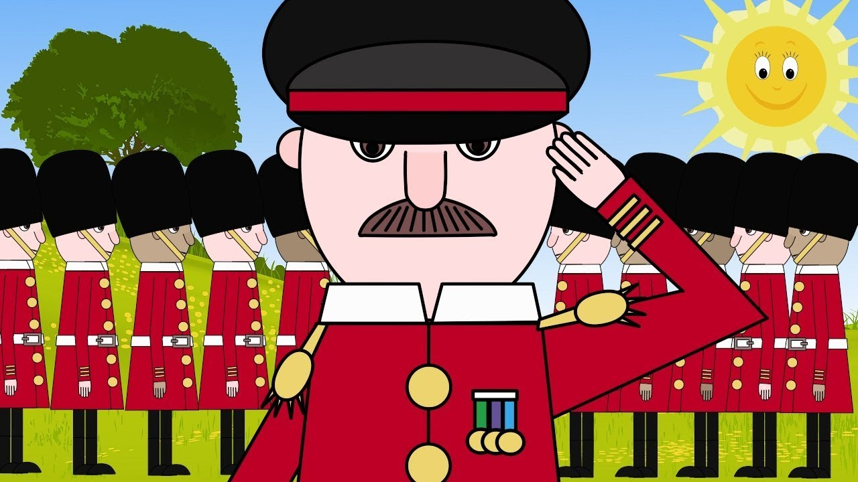
Poetry and Rhyme
Adults in school can build children’s strong emotional connection to language through enjoying rhymes, poems and songs, it is great to learn poems ‘off by heart’ as a group or class to recite to others
The predictability of rhymes in poems and songs help children to memorise and re-use newly acquired words and phrases.
Learning poetry and songs through ‘call and response’ allows children to join in gradually. Each repetition strengthens their vocabulary, embedding new words.
Word knowledge exists on a continuum. As each word is acquired in a young child’s vocabulary, it moves from the barest familiarity to an in-depth knowledge of that word, with all manner of associations and contexts.
As the children say each word of a poem, the rhythm of the lines helps to convey the meaning and the mood. Children pick up the rhythm and, by speaking more slowly, gain awareness and control of their voices.
We have a set of ten core rhymes at Walter which the children begin to learn in Robin: Learning rhymes, poems and songs is an end in itself. However, learning poems including traditional nursery rhymes such as ‘Hickory Dickory Dock’, ‘Little Jack Horner’ and ‘Baa Baa Black Sheep’ can also heighten children’s awareness of the individual sounds within words through alliteration, repitition and rhyme. For instance, because rhymes share the same end sound, they alert children to the contrast of the phonemes at the start of each word, as well as the repeated phonemes at the end, as in ‘dock’/‘clock’, ‘Horner’/‘corner’ and ‘Incy’/‘Wincy’.

Slide 88
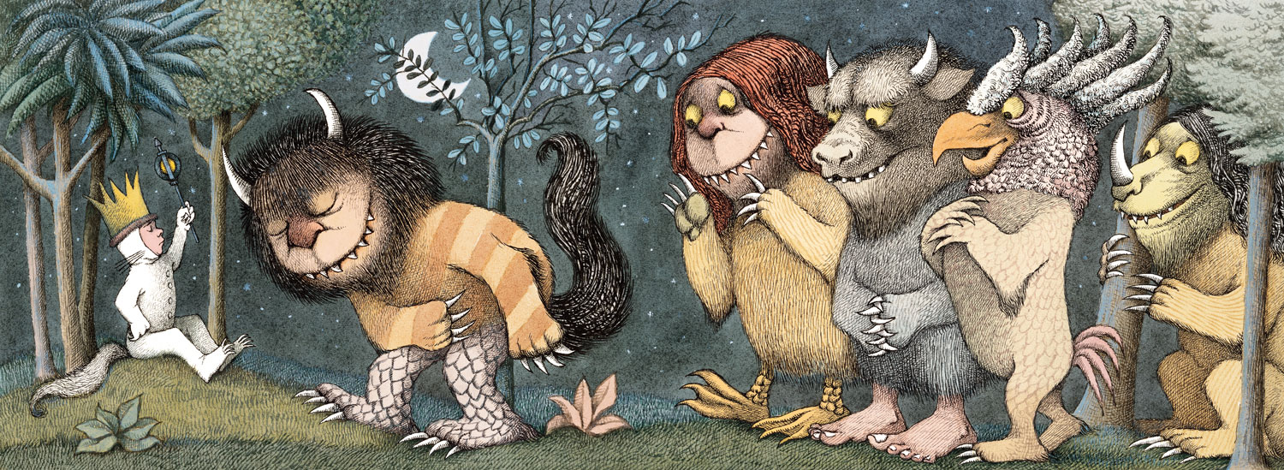
Section 3: Word Reading and Spelling

Slide 89

Phonics
As you already know, phonics is taught daily at Walter Infant School and Nursery. It is modelled, taught and rehearsed as the prime method for spelling and reading new words.
We ensure that we are using the same ‘language’ or technical vocabulary across the school when we are teaching phonics so that there is no confusion!

Slide 90
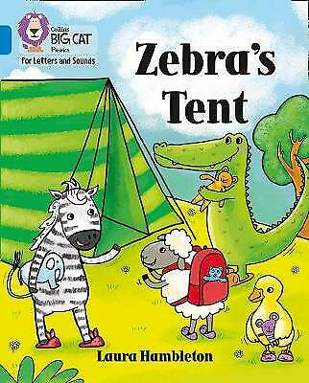
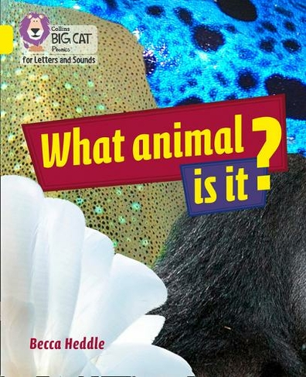
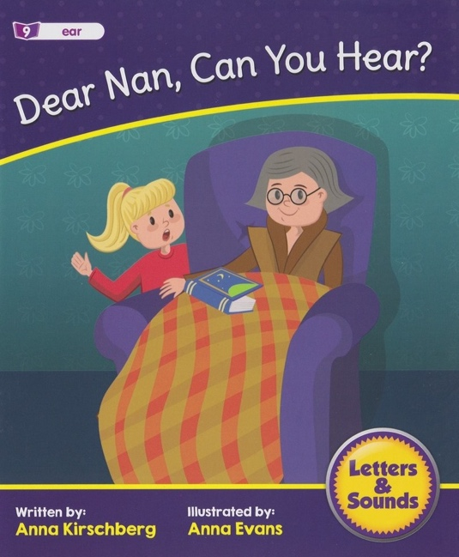
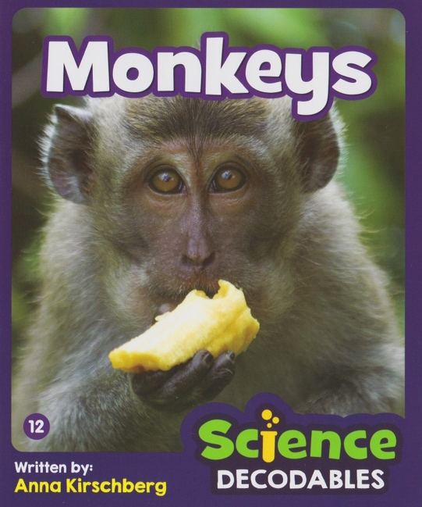
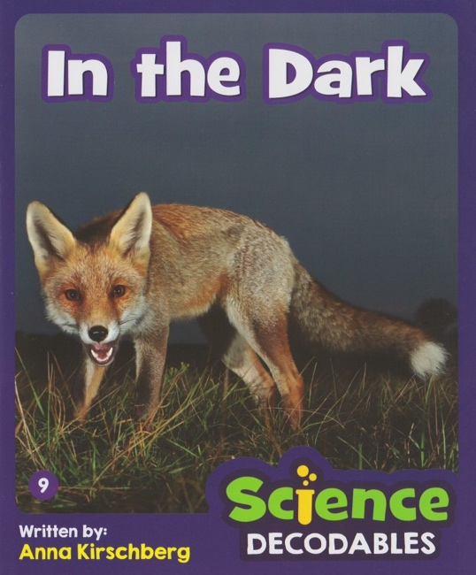
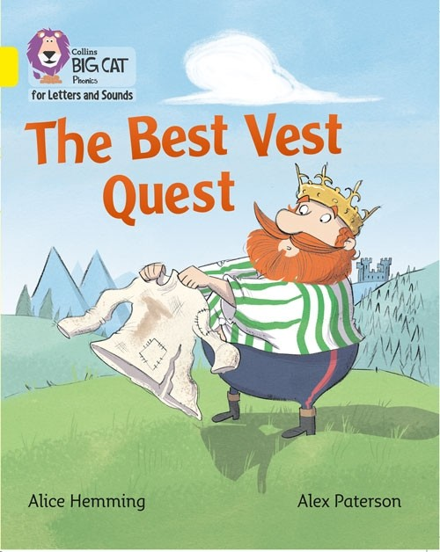
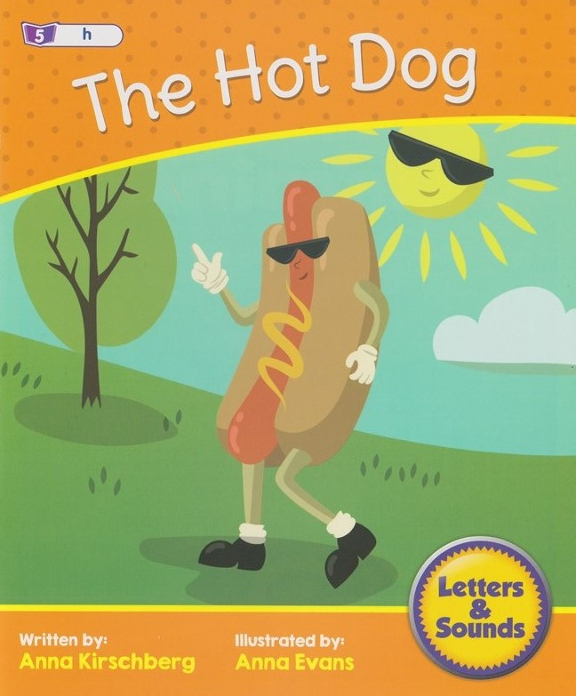
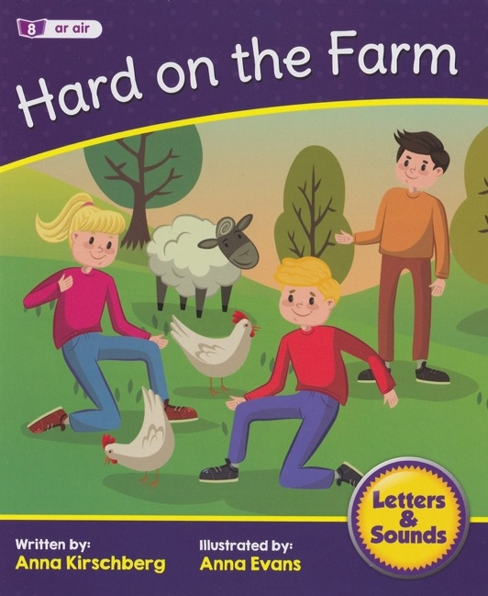
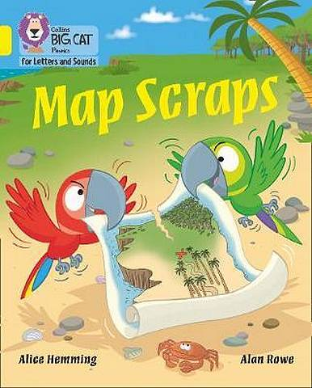
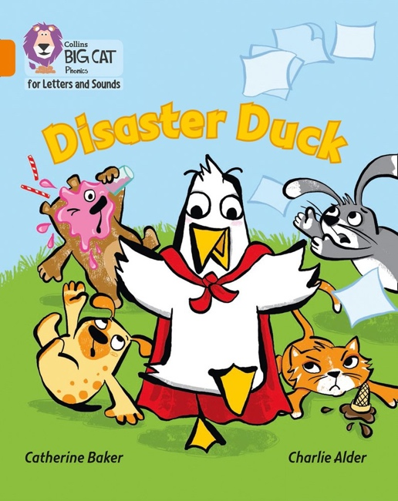
Decodable Books @ Walter Infant School and Nursery

Slide 91
The Walter Reading Hub
We have developed a website called the Walter Reading Hub.
The website has information, hints and tips on how to teach your child reading at home. We have loaded it with videos which include, phonics lessons and the adults in school reading and sharing books. The website also links into the Big Cat eBook Library, which the children can access at home.
https://wisreading.weebly.com/

Slide 92
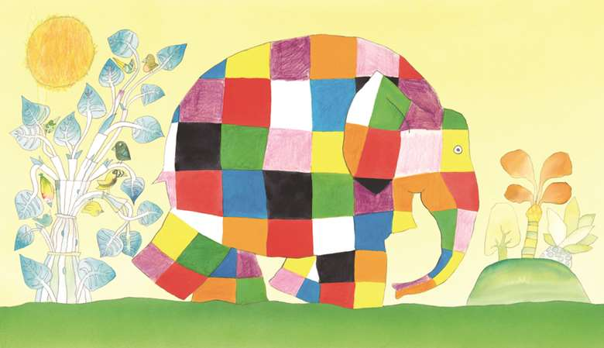
Section 4: Children at
the Risk of Reading Failure

Slide 93

Our lowest attainers or lowest “20%” of readers receive a personalised provision to suit their needs and learning ability. This might include reading more easily decodable texts, smaller phonics or reading groups or additional reading throughout the week. This is to help them to continue to make progress with their reading.

Slide 94
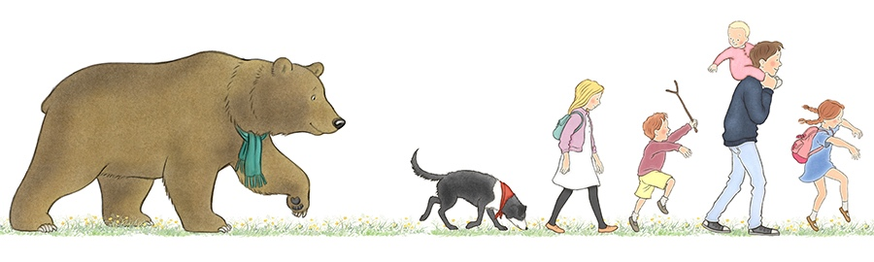
Section 5: Leadership and Management

Slide 95

Mrs Wheeler, our Head Teacher
Headteachers are ultimately responsible for building the reading culture in their school and ensuring that the teaching of reading is as effective as possible. They have to make sure that all their staff, including the special educational needs co-ordinator, and their ITT trainees, have the knowledge, skills, understanding and professional support to teach reading effectively and thus transform children’s life chances.

Slide 96
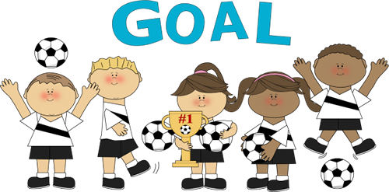
A Team of Experts within our School
We have an amazing team of experts in our school; Mrs Wheeler leads English in School and Mrs Starbuck leads phonics BUT everyone is an expert here and that is reflected in our data. All are staff our committed to ensuring that our provision is differentiated to meet the needs of all our children and our year group leaders ensure that our children have access to wonderful resources, all of which are treated with the otmost respect by children and adults alike.

Slide 97


We teach reading across the curriculum!

Slide 98
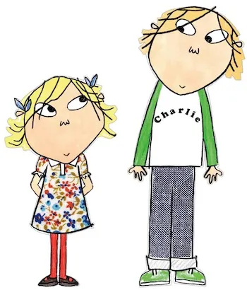
Section 6: Building on the foundations with older pupils – a summary
Cultural Capital
It is our aim that no child will leave us at the end of Year 2 without being able to read! Sadly, some children will have barriers that prevent them from learning at the same pace as their peers; but we will do all we can to enable them to love books and enjoy the process of being read to and with.
Essentially, it discusses that it is more challenging for older children to learn to read and develop their early literacy skills. Therefore, it is essential that we get it right at Walter Infant School and Nursery before they move on. We need our children to be Junior School Ready when they leave us!

Slide 99
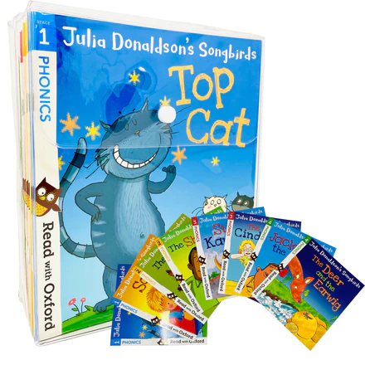
Reading Books that go home
To begin with in Foundation Stage 2, the children will bring home phonically decodable picture books with simple and repetitive phrases and sentences.

Slide 100
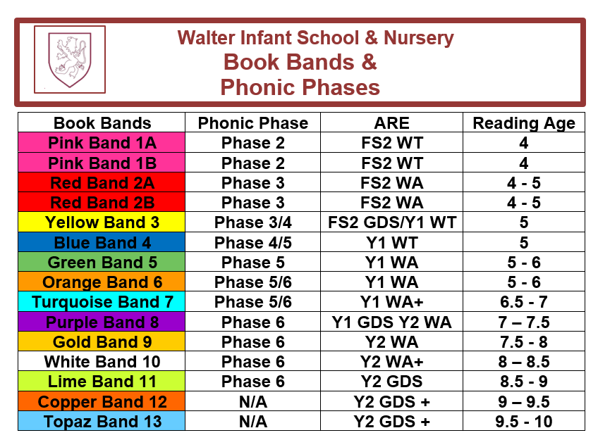
Book Bands and Phonic Phases
The children will be taught to read in groups through Guided Reading Sessions in school. They will learn from a book that is banded at the suitable level for teaching reading to the group, so that it challenges the children, introduces new vocabulary and information but also has lots of familiar words and punctuation.
The children will bring home the pre-ceeding colour so that they are able to read 90% of the text but it may still be challenging. The children choose their own books to take home along with their reading record. The books they read at home are matched to the phonic phase in which they are secure.

Slide 101

How can you help your child learn to read?
Talk to them as much as you can using a variety of vocabulary and expression
Share signs and labels wherever you go
Show them how much you love books and share books as often as you can
Learn your phonics too!
Spend time reading to your child, with your child, and listening to them read and not just at bedtime!
Choose a time that works well for you both to share the home reading book (which your child will have chosen for themselves)
Try and develop a routine, the same time and space, getting comfortable and only focus on reading (but not for too long, 10 minutes is more than long enough)
Keep the reading record up to date so we know that you are reading with you child at home

Slide 102

Asking questions
Help them understand what they have read by asking questions before, during and after you read with them or listen to them
Before (knowledge of books) ~ Can you point to the title? What do you think this story might be about? What does the blurb tell us?
During (comprehension and prediction) ~ What is happening in the pictures? What has happened so far? What might happen next? What sort of character is…? How do you know?
After (comprehension and opinion) ~ Did you like this book? What did you like most about it? What happened in the story?

Slide 103

Reading together and decoding new words
Children will use many cueing strategies to help them read the words on the page: they should always try to use the phonics to decode.
You can help by saying “What is the first sound?” Can you sound out (segment) the phonemes?” e.g. shop ~ sh-o-p etc
Do not let your child struggle for too long if they can’t blend the sounds together. Do record the word they found difficult in the reading record.
There will be common exception words in the books that they should not find too tricky to recognise.
If the book is too difficult please mention it in the reading record so that we can check the book is well matched to our SSP.

Slide 104

Any Questions?

