Slide 1
Advent
Walter Infant School and Nursery

Slide 2
What is advent?

Slide 3
A Walter Advent Calendar

Slide 14
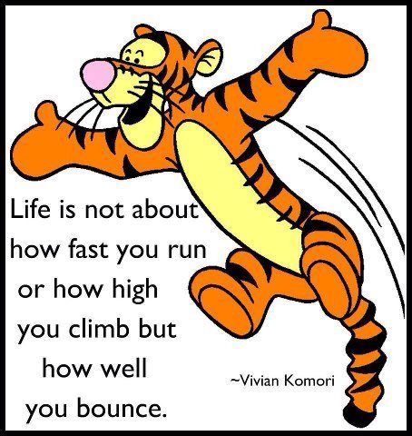

Slide 20
