Slide 1

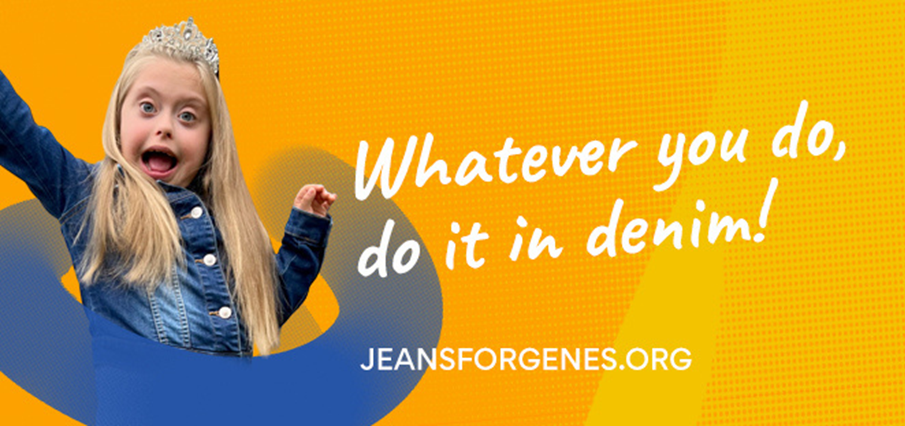
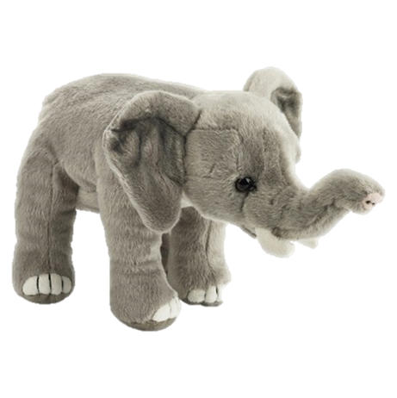
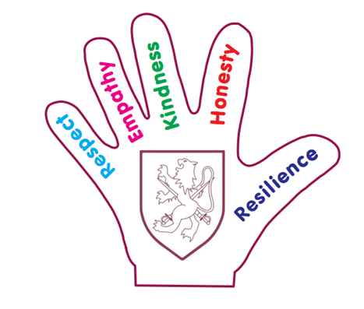

Slide 2
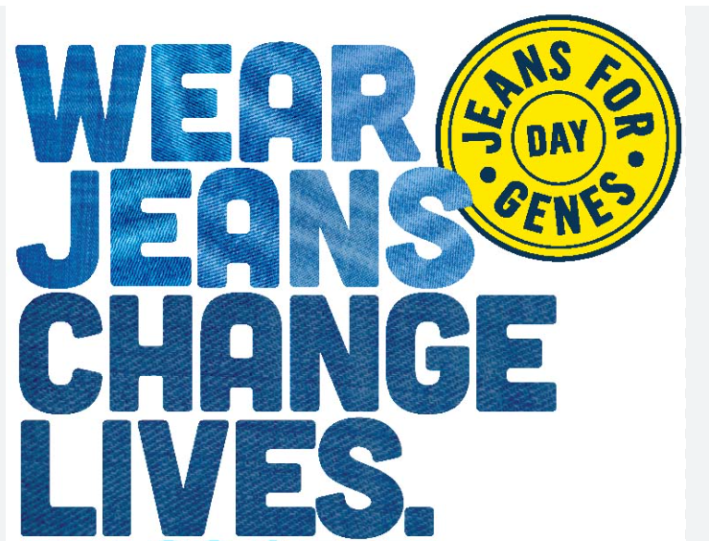

Slide 3
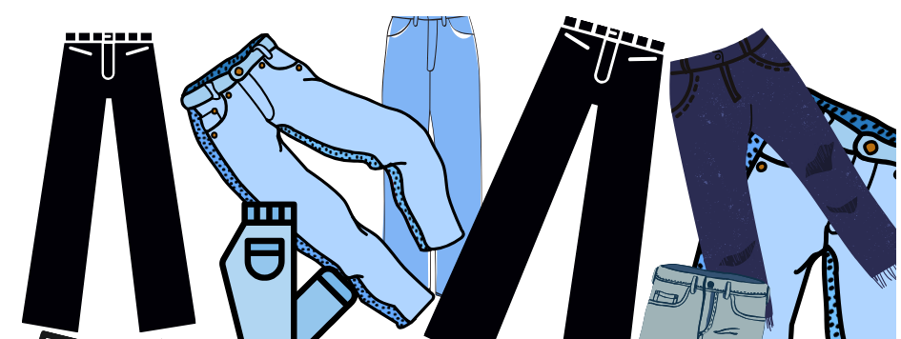


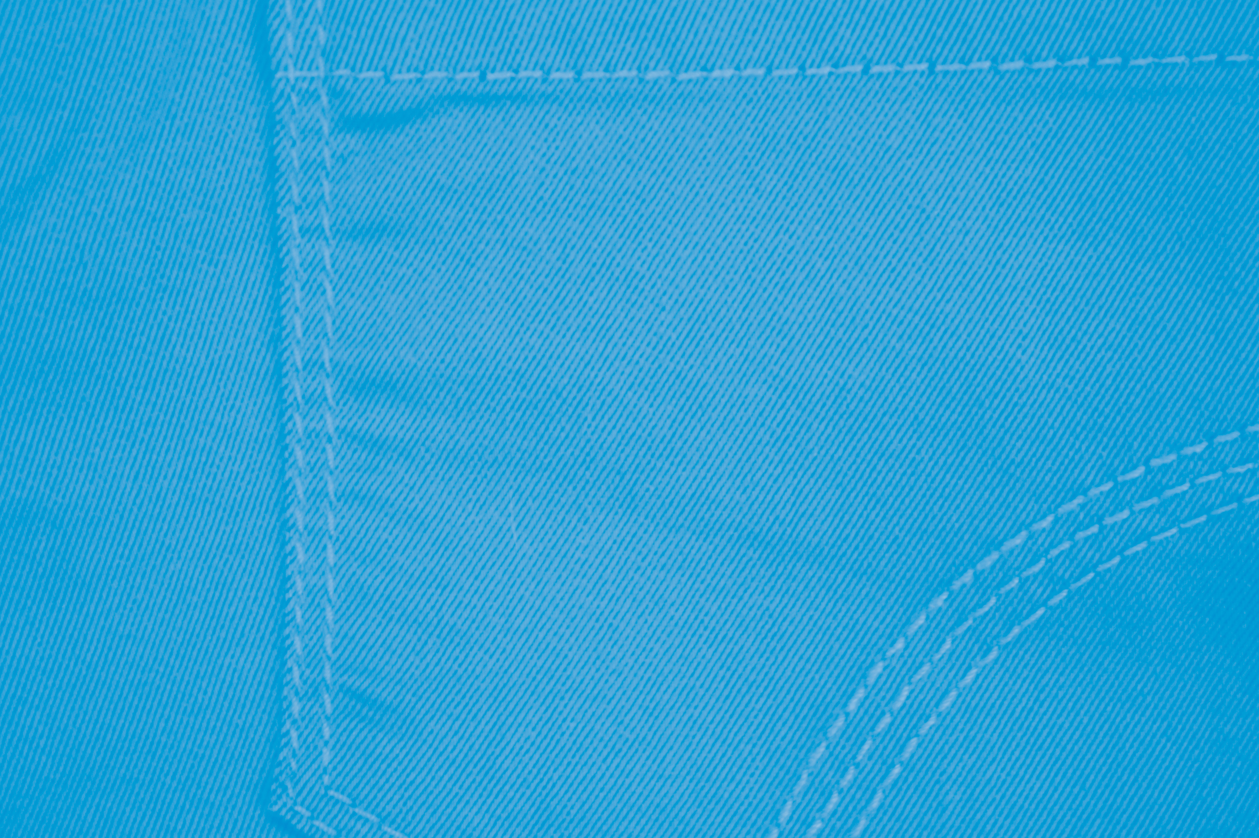
Two words that sound the same…

Slide 4
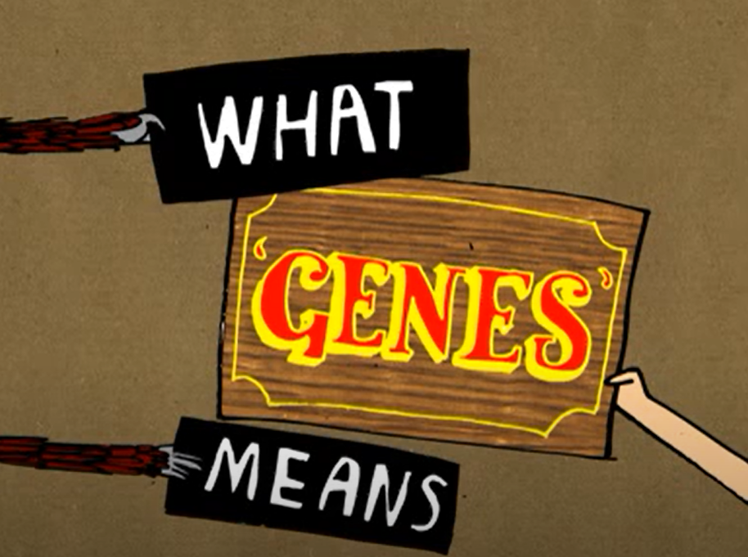
What 'genes' means - a Jeans for Genes Day film (youtube.com)

Slide 5
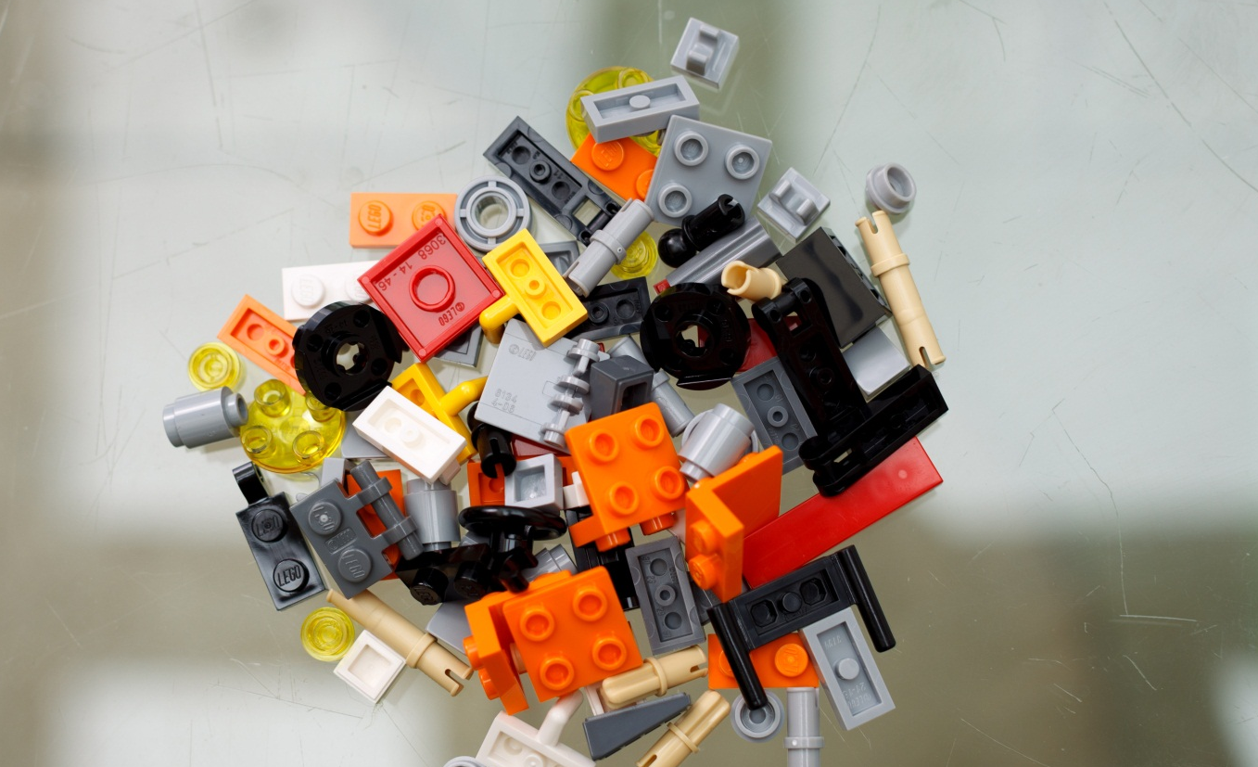
Genes are like…
Notes:
Do you know what the picture above shows? What do you use these pieces for?

Slide 6
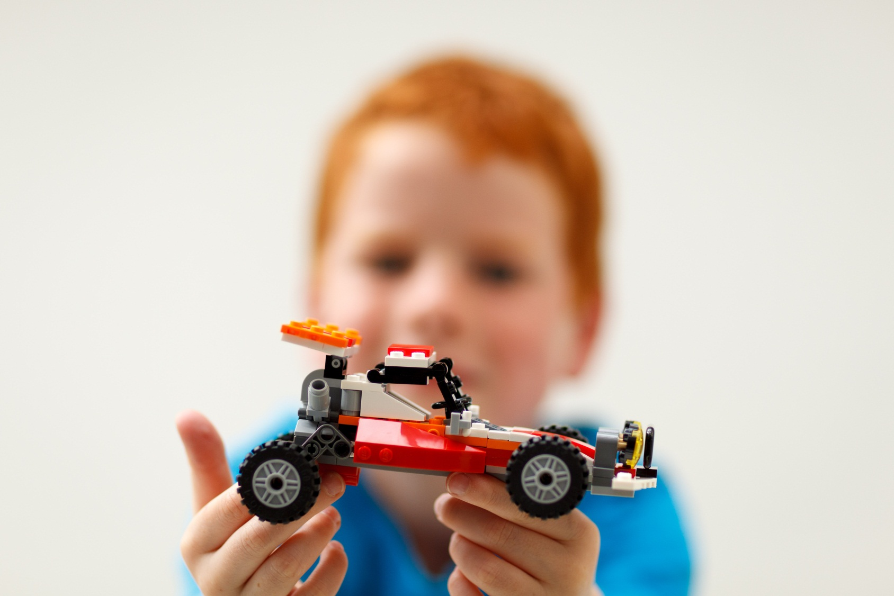
…LEGO!
Notes:
Instructions tell us how to put the pieces of Lego together to build objects.
Your genes work a bit like these instructions. Before you were born, your genes helped decide things like where your arms and legs should go, whether you are going to have blue eyes or brown eyes and how your body works.

Slide 7
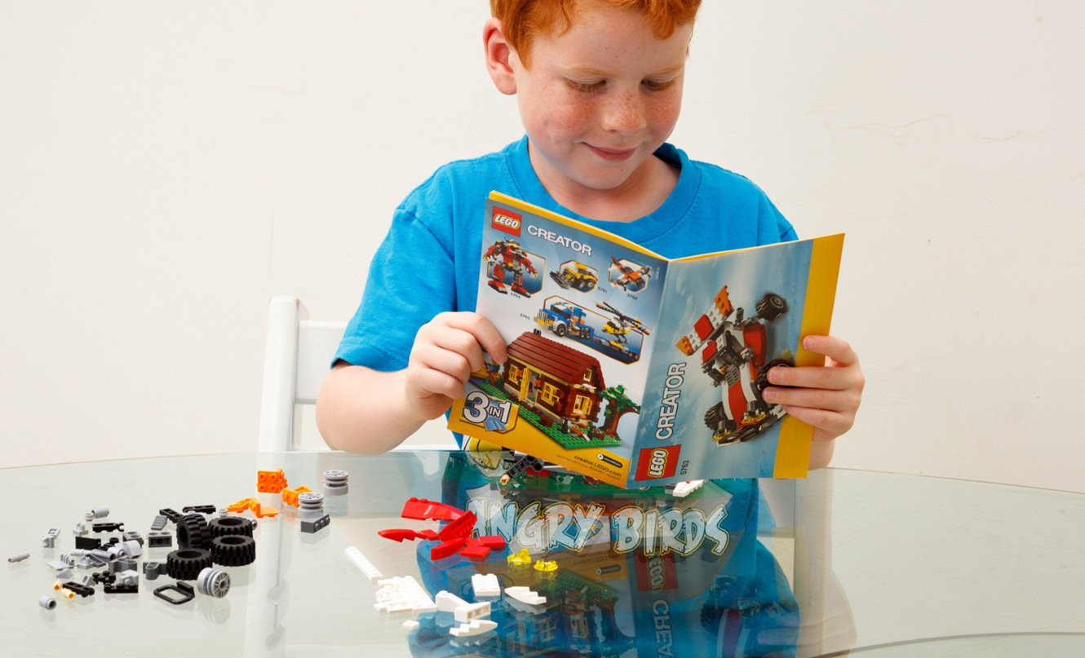
Instructions for the body
Notes:
Instructions tell us how to put the pieces of Lego together to build objects.
Your genes work a bit like these instructions. Before you were born, your genes helped decide things like where your arms and legs should go, whether you are going to have blue eyes or brown eyes and how your body works.

Slide 8
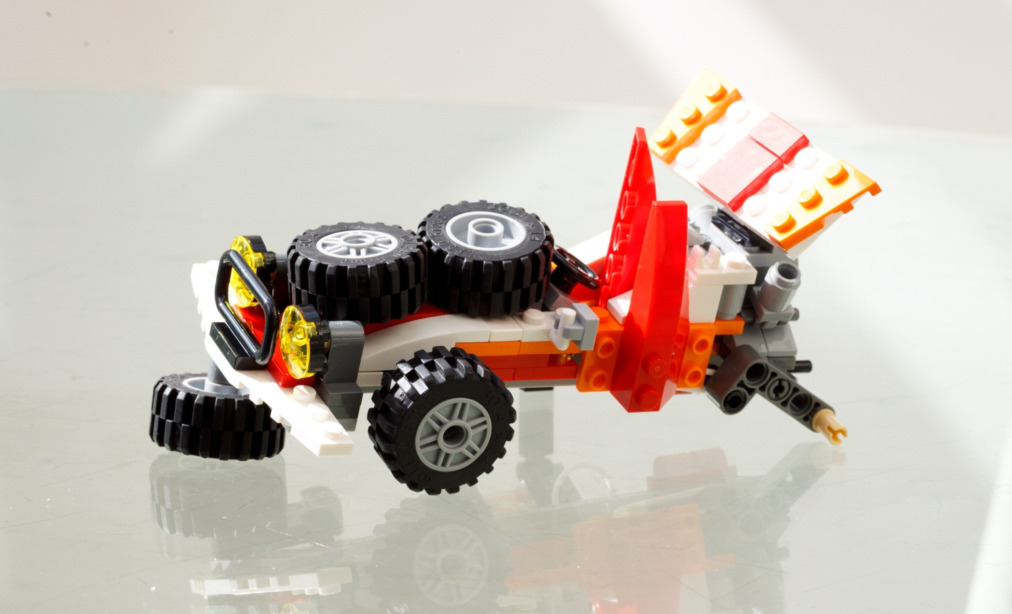
What happens when something is missing?
Notes:
Uh oh. It looks like something has gone a bit wrong with our Lego racing car! Can anyone tell me what has happened? Our model-maker has put wheels on top of the car! And it looks to me that our model-maker has also forgotten the wheel completely at the back! Do you think he is going to be able to drive very far? No!
If something goes wrong when you are building your model, or there is a page missing in your instructions then you can end up with a model that looks different or doesn’t work properly.

Slide 9
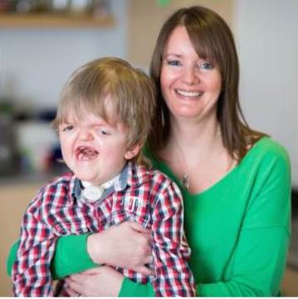
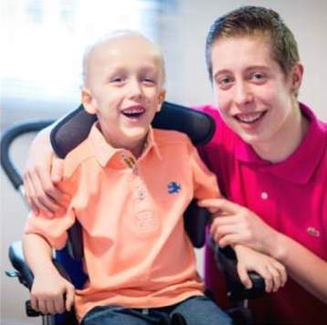
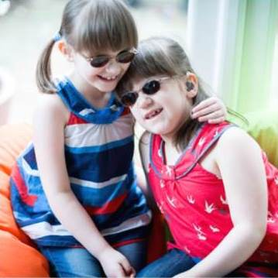
What happens when there is a problem with the instructions in our bodies?
Billy, aged 6, has
APERT SYNDROME
The BONES in his head didn’t join up properly, now he has trouble BREATHING and SEEING
Mason, aged 4, has SOTOS SYNDROME
His body GROWS too quickly so he finds it hard to MOVE and is unable to TALK
Hannah and Katie, aged 7, have ALSTRÖM SYNDROME
They have very fragile
HEARTS and will soon be unable to SEE or HEAR at all
Notes:
Sometimes, in our bodies, when parts of the instructions are missing, these genes that make up our body can go wrong too. If it’s only a little mistake, like a red lego piece instead of a yellow lego piece, then it might just mean someone’s body works in a different way to yours or that they look a little different from you. But if something very important is missing, like the wheel of our model racing car, then this can cause a more serious problem with the way someone’s body works for example they might not be able to walk or see.
The smiling children on the screen all have different genetic disorders, where the instructions from their genes weren’t quite right, resulting in their bodies not working in the same way as yours does.
By wearing our jeans today and bringing in £1, we are raising money for children with genetic disorders.

Slide 10
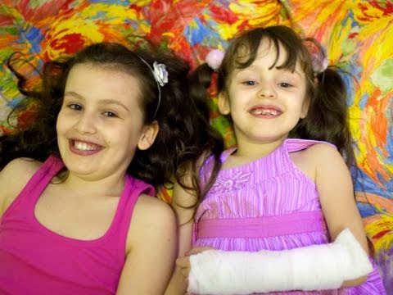
Tiana and Star’s story
Tiana & Star's story - a Jeans for Genes Day film (youtube.com)

Slide 11
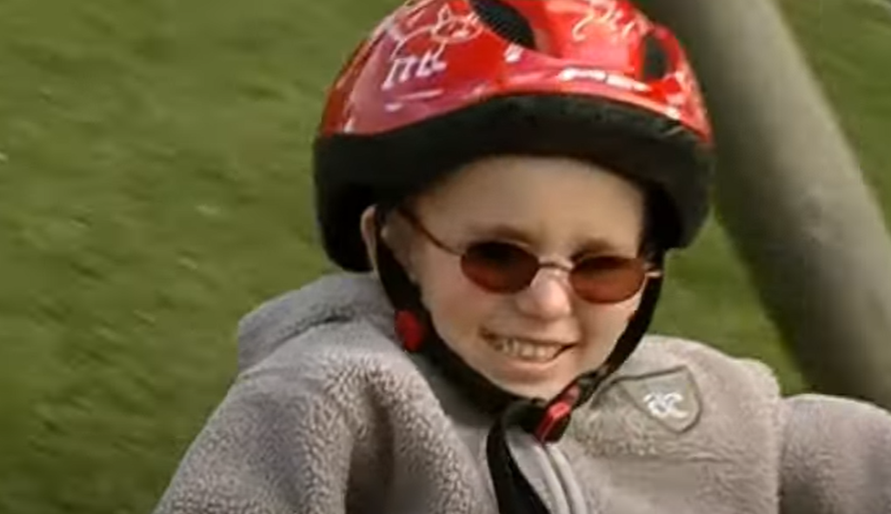
My Special Brother Thomas!
Ellie & Tom's story - a Jeans for Genes Day film (youtube.com)

Slide 12
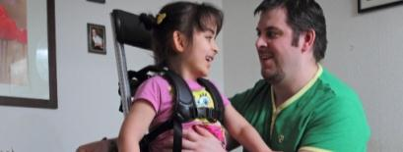
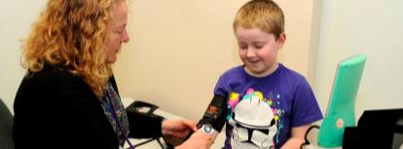
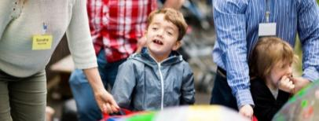
Our money makes a real difference…
Equipment, like a specialist wheelchair, or frame
Nursing and care services
Respite or a well-deserved holiday

Slide 13
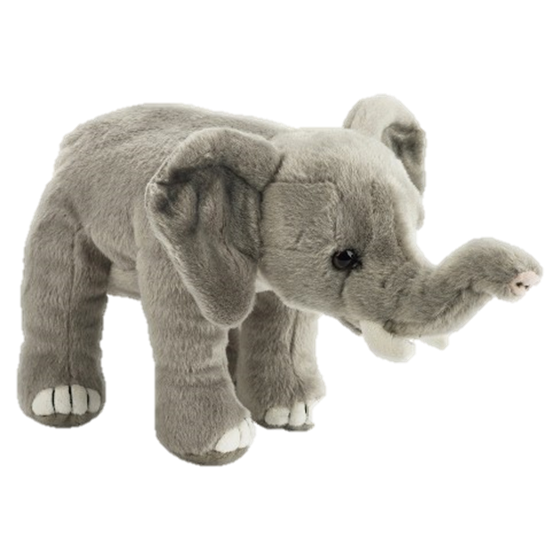

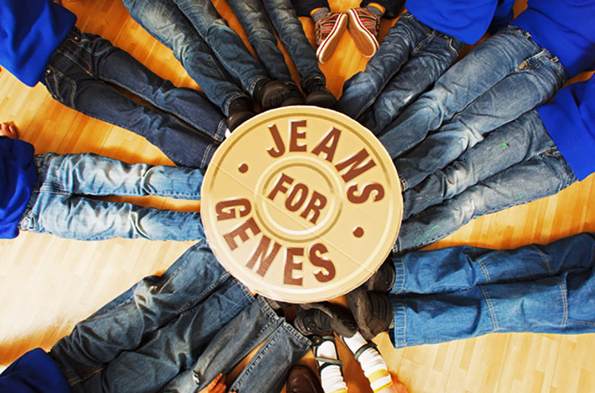
David Dundas - Jeans on (youtube.com)

Slide 14

Star of the Week

Slide 15

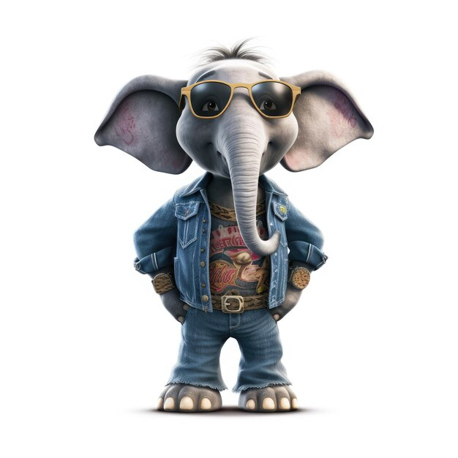
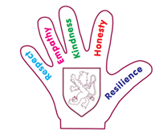
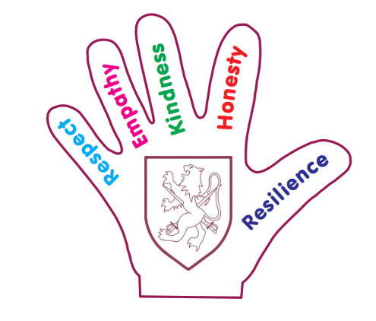

Values badges

Slide 16
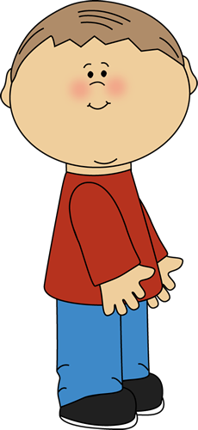
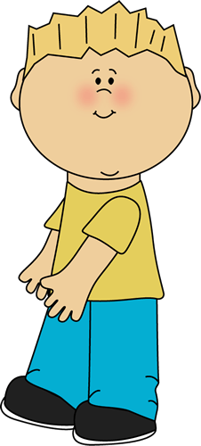
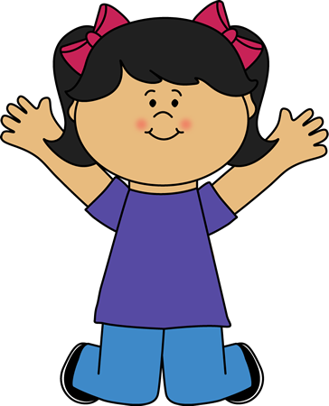
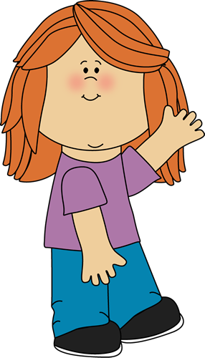
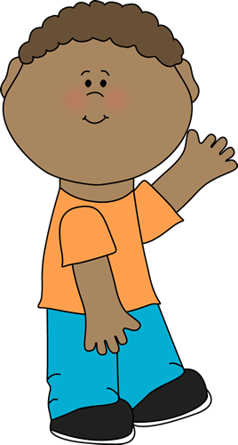
Together We Stand
Together we stand lyrics

