Slide 1
Welcome to Walter Infant School
and Nursery
Foundation Stage 1 ~ Robin Class
‘To be the best I can be!’

Slide 2
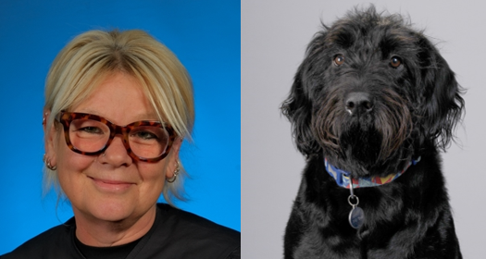
Headteacher’s Welcome
Walter Infant School and Nursery is unique; we call ourselves a BIG school for little people. The staff team at Walter Infant School and Nursery are committed to making our school a very happy place for our wonderful children to learn and play.
We are a Values-based School and our values of respect, kindness, honesty, empathy and resilience run through our school like a gentle, calming river, ensuring that our children feel safe, loved and cared for.
Our school motto is “To be the best I can be!” We nurture our children to become the best version of themselves, celebrating all of their differences and learning alongside each other so that we can all do more, know more and remember more!

Slide 3
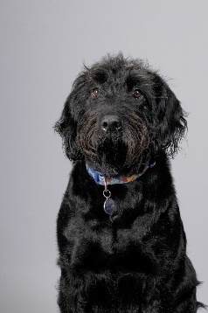
Walter ~ School Dog
We have a school dog called Walter; he is a miniature labradoodle (but he has grown into a big dog), he is four years old. The children love him and he has helped many children overcome a fear of dogs. If your child is scared of dogs, or allergic to dogs, please let us know.
‘Pupils find this school inspirational. They are captivated by the child-friendly environment, knowledgeable teachers and Walter, the school therapy dog and friend to all. Everything about this school is deliberately designed to meet the needs of its pupils – and it does.’
Ofsted ~ 2024

Slide 4
Ofsted ~ OUTSTANDING!
‘Pupils have a deep understanding of the school’s high expectations, which are consistently taught right from the Nursery. They delight in wearing their hard-earned values badges.’

Slide 5
Our Rationale
Our BIG Curriculum! At Walter Infant School and Nursery we consider ourselves to be a “BIG School for LITTLE PEOPLE”. We have designed a ‘BIG’ curriculum to excite, inspire and foster a desire to learn; we want our children to know more about the world around them and to be happy, confident and successful.
We will encourage our children to have very positive behaviours for learning and to ask BIG questions and for our staff team to support our children in finding authentic, age-appropriate answers to those questions and inspire them to want to know more.
Our children will learn through real-life and practical experiences, as well as through wonderful, awe inspiring fiction texts in which they can ‘see themselves’ and exciting and purposeful non-fiction texts.
Our children will learn inside and outside the classroom, fulfilling and exceeding the requirements of national age-appropriate curriculums in a stimulating, fun and memorable way.

Slide 6
What the current Robin children say…
This year I have really enjoyed “all of the toys, there are so many. I love PE with Jack because we play fun games, like the one where we have to throw balls over the benches. My teachers help me so much.”
Jesse, age 4
“I love all my teachers because they are so kind and I just love them. I think I would love to give them some chocolate. I like PE because it is so much fun. I like climbing and doing the monkey bars.”
Edith, age 3
“I like playing on the bikes, driving round on them. I have made friends and I play with them. My favourite games are mermaids and princesses.”
Emma, age 4

Slide 7
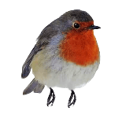
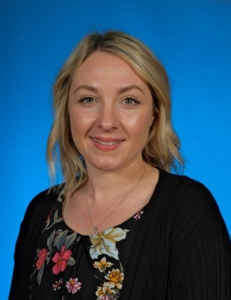
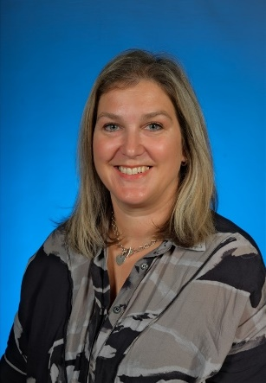
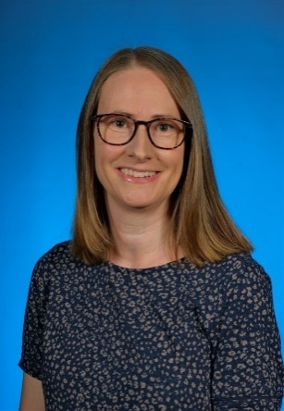
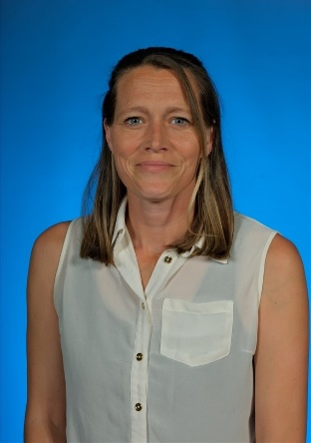
The Foundation Stage 1 Team
Mrs Goddard
Robin Class Teacher / FS SEND Lead
Mrs MacLeod
Early Years Practitioner
Mrs Bennette
Foundation Stage Leader
Mrs Simpson, Mrs Bowles and Miss Gosling ~ Learning Support Assistants and Lunch Club Assistants

Slide 8
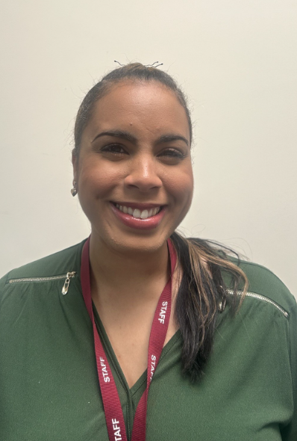
SEND Team
The Foundation Stage 1 Team
Mrs Goddard
Foundation Stage SEND Lead
Miss Gosling, Mrs Briggs and Miss Rennalls ~ SEND Learning Support Assistants

Slide 9
Our Daily Routine
Robin gate will open at 8:30am and close promptly at 8:40am
After this time, children will need to be signed in at the main office
Children will independently walk into the classroom and start putting their belongings away – there will be an adult inside to support them.
Children will sit down for register after exploring the resources
Whole class input – this could be a story, group singing, or a Literacy or Maths input
Small groups and independent learning – both inside and outside of the classroom!
Phonics
Home time for our morning children and lunch time for the children who attend for 30 hours
This routine is repeated in the afternoon – an adult will greet the children at 12:30pm at the Robin gate.

Slide 10
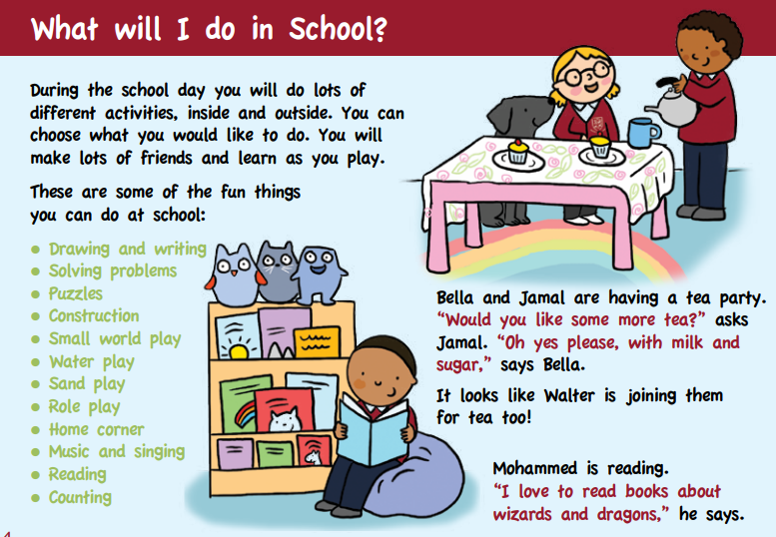
How will your children learn at Walter Infant School and Nursery?

Slide 11
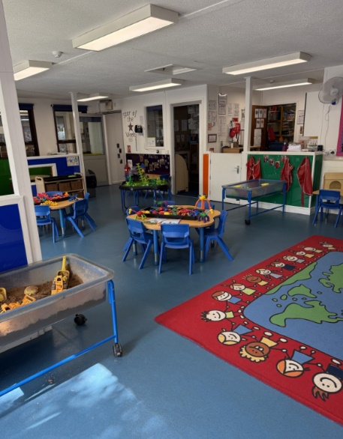
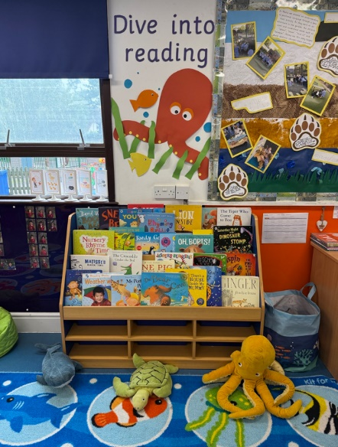
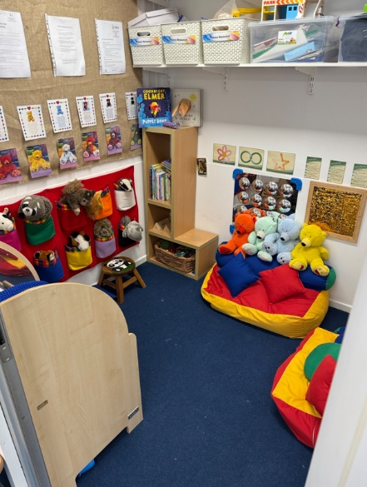
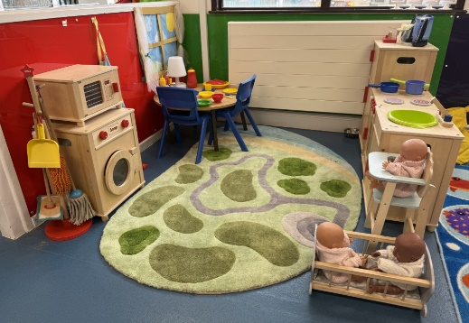
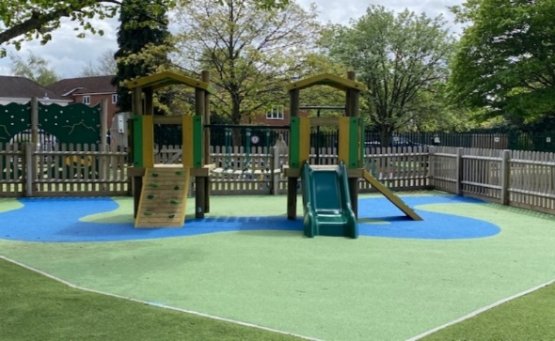
The learning opportunities we provide in Foundation Stage build upon the interests of the children and the things they wish to learn about, partnered with the expertise and creativity of the staff, all of which is reflected in the classrooms and outside learning spaces.

Slide 12
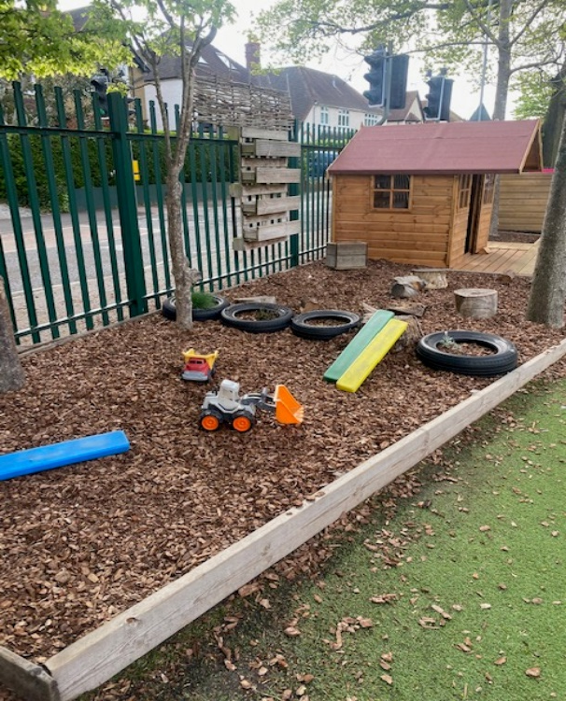
At Walter Infant School and Nursery the children have the opportunity to learn in an environment that is exciting, stimulating, awe-inspiring and memorable.

Slide 13
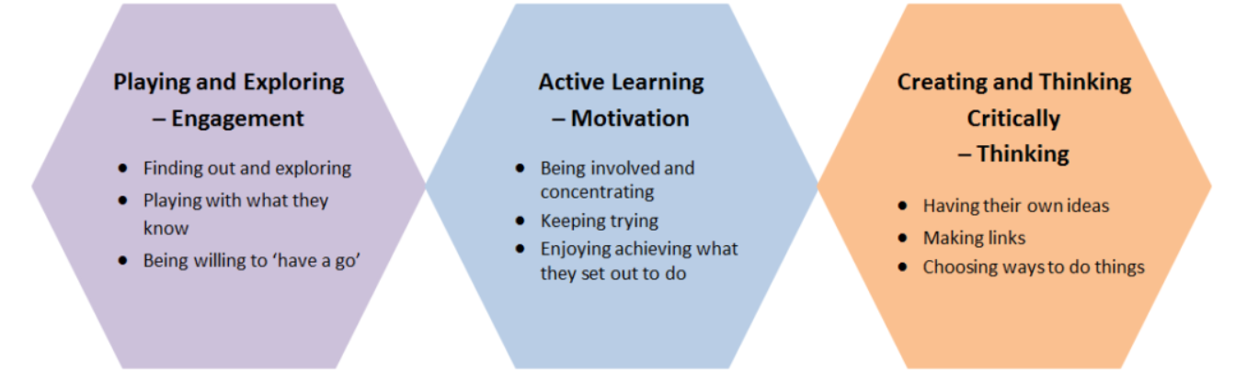
Characteristics of Effective Learning
Ready
Willing
Able
Notes:
Importance of environment: Opportunities we set up: adult directed – one things comes across is that modelling, guiding, talk with children.
Prime areas are time sensitive – must acquire in EY, as if delayed as consequences in terms of development. Physically bigger but soc/emo struggle. PD – need to develop core strength & refine movements – need to dev 0-5
CLL – research last 10 yrs comm importance – narrow the gap/ chn behind/ in terms of deve – key indicator of what chn can ach at KS1 and KS2 (DM & Ofsted fmwk – statements run through like a stick of rock): Cof EL
Outcomes in reading are dependent on characteristics of effective learning (CoEL), in addition to phonic knowledge – learning to read is difficult, so children need to be able to persevere, be willing to have a go, and not be put off when they make mistakes.
Outcomes in writing are also linked to CoEL as well as to physical development; not just fine motor skills, but upper body and core strength are essential if a child is to be able to write comfortably.
A focus on communication and language is essential if we are to enable children to write meaningfully and for a purpose. As Britton said, “Early literacy floats on a sea of talk”. If a child is unable to sequence and articulate their thoughts in a meaningful way, writing will be very difficult. This is where creative development and role play come into their own. In fact, role play is highlighted as an important feature of early years practice in Bold Beginnings, unfortunately, it isn’t mentioned in the recommendations. Communication and language are also linked to outcomes in maths. Children will find problem-solving and reasoning about numbers and shapes highly problematic if they do not have the right vocabulary, ability to process and confidence to express their thoughts.
Finally, the often overlooked “understanding the world” impacts on outcomes in reading, writing and maths. If children are to be able to really understand texts, to infer, deduce and make predictions, as real readers, they need to understand the world which they are reading about. If they are to write for a purpose, they need to have something to write about. If they are to use maths in meaningful contexts, they need to fully experience and understand those meaningful contexts. He says the what is really important: what they learn is equally important as how you go about it. It has to have equal focus. If a child is involved dynamically in what they are learning then they will demonstrate connections, and creative thinking and motivation in learning more about it. So, the content and progression is equally important as how they learn it.

Slide 14
EYFS
There are 17 Early Learning Goals which we will be working towards throughout the duration of Foundation Stage 1 and 2. These are used to inform our planning and curriculum and what we aim for all children to achieve by the end of Foundation Stage 2.
Notes:
Importance of environment: Opportunities we set up: adult directed – one things comes across is that modelling, guiding, talk with children.
Prime areas are time sensitive – must acquire in EY, as if delayed as consequences in terms of development. Physically bigger but soc/emo struggle. PD – need to develop core strength & refine movements – need to dev 0-5
CLL – research last 10 yrs comm importance – narrow the gap/ chn behind/ in terms of deve – key indicator of what chn can ach at KS1 and KS2 (DM & Ofsted fmwk – statements run through like a stick of rock): Cof EL
Outcomes in reading are dependent on characteristics of effective learning (CoEL), in addition to phonic knowledge – learning to read is difficult, so children need to be able to persevere, be willing to have a go, and not be put off when they make mistakes.
Outcomes in writing are also linked to CoEL as well as to physical development; not just fine motor skills, but upper body and core strength are essential if a child is to be able to write comfortably.
A focus on communication and language is essential if we are to enable children to write meaningfully and for a purpose. As Britton said, “Early literacy floats on a sea of talk”. If a child is unable to sequence and articulate their thoughts in a meaningful way, writing will be very difficult. This is where creative development and role play come into their own. In fact, role play is highlighted as an important feature of early years practice in Bold Beginnings, unfortunately, it isn’t mentioned in the recommendations. Communication and language are also linked to outcomes in maths. Children will find problem-solving and reasoning about numbers and shapes highly problematic if they do not have the right vocabulary, ability to process and confidence to express their thoughts.
Finally, the often overlooked “understanding the world” impacts on outcomes in reading, writing and maths. If children are to be able to really understand texts, to infer, deduce and make predictions, as real readers, they need to understand the world which they are reading about. If they are to write for a purpose, they need to have something to write about. If they are to use maths in meaningful contexts, they need to fully experience and understand those meaningful contexts. He says the what is really important: what they learn is equally important as how you go about it. It has to have equal focus. If a child is involved dynamically in what they are learning then they will demonstrate connections, and creative thinking and motivation in learning more about it. So, the content and progression is equally important as how they learn it.

Slide 15
Adult-Led Activities
Children will have whole class inputs and then will be able to practise the skills learnt in a small group with an adult
Small group work will be focused on writing, reading, maths, speaking and listening activities and will be tailored to the children’s stage of learning
Daily phonic sessions
Weekly PE session for 30 hours children

Slide 16
Child Initiated Learning
Children will be learning through play and exploration
Learning through play will be supported and extended by our carefully planned and resourced learning environment as well as through interaction with adults
Children will be given opportunities to develop the skills they have learnt during adult led activities with increasing independence
Children will have the opportunity to choose their own learning opportunities and follow their interests
They will be able to explore our outside environment at most times and in most weathers!

Slide 17
Communication and Language
Listening, Attention and Understanding
Speaking

Slide 18
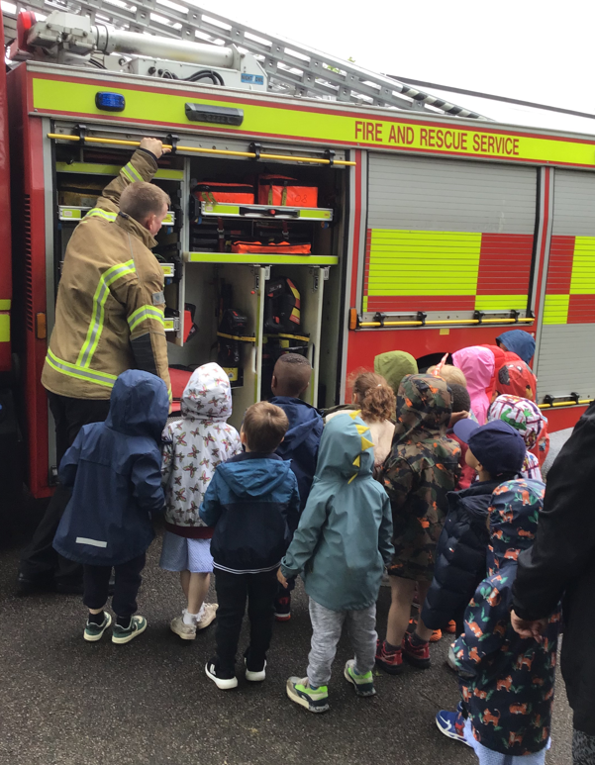
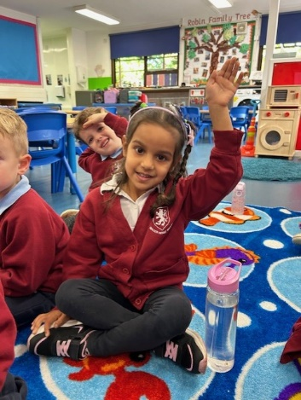
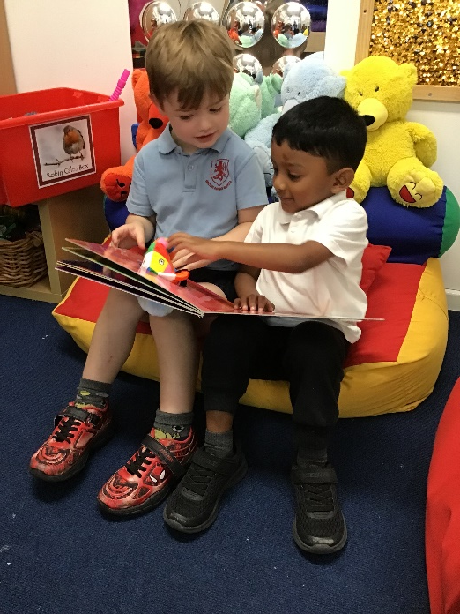
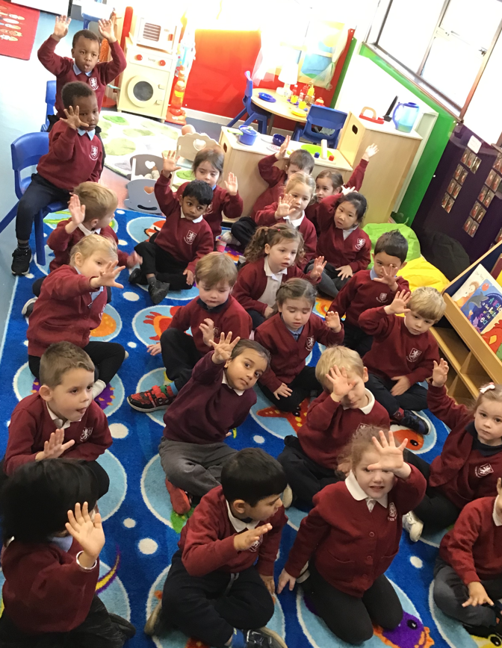
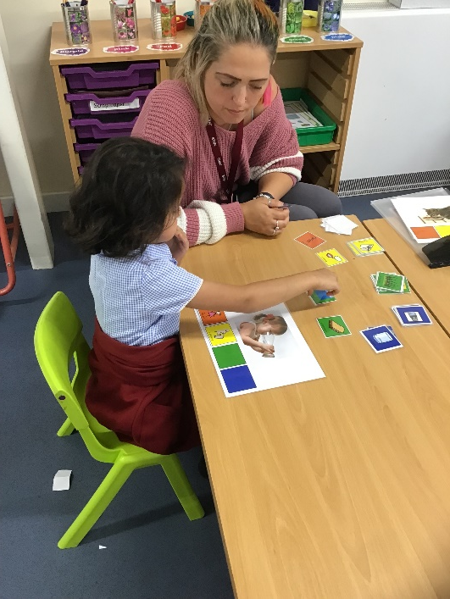
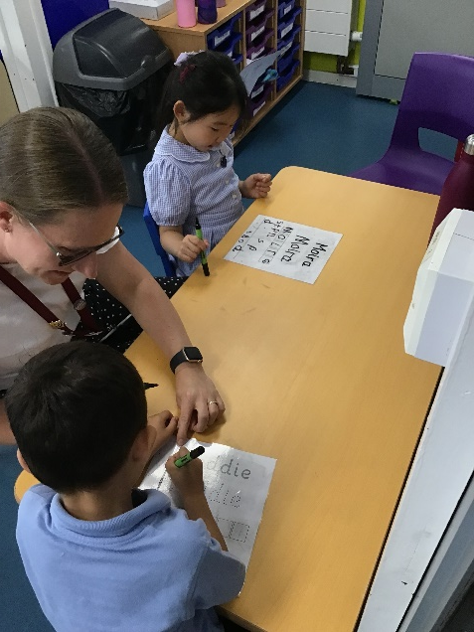

Slide 19
Personal, Social and Emotional Development
Self-Regulation
Managing Self
Building Relationships

Slide 20
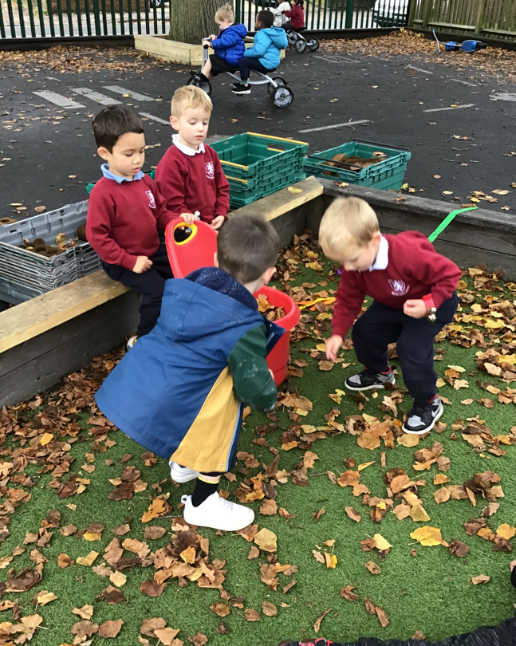
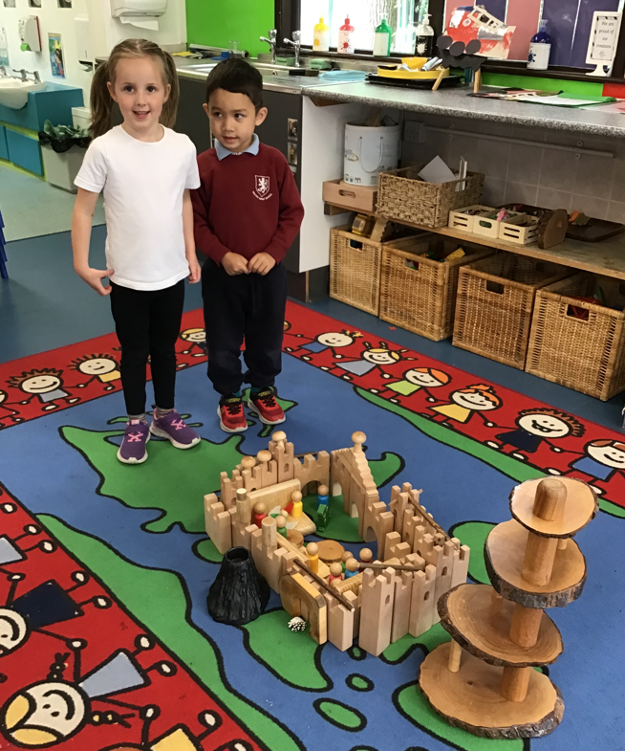
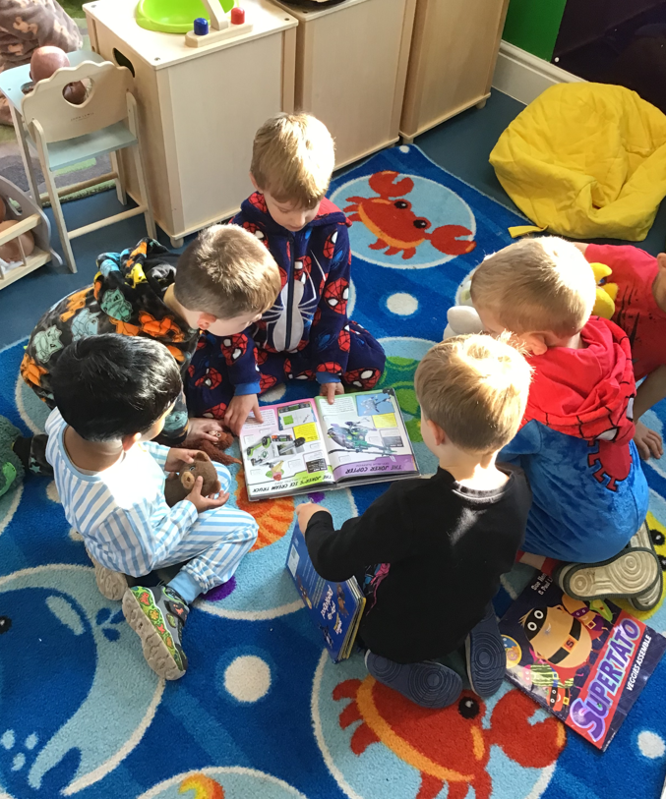
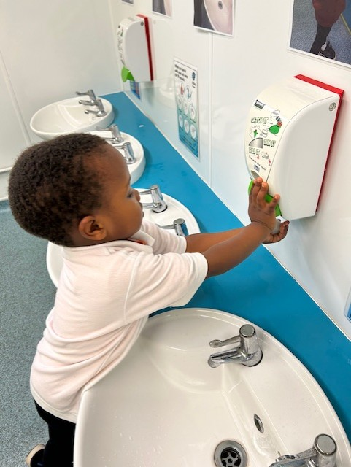
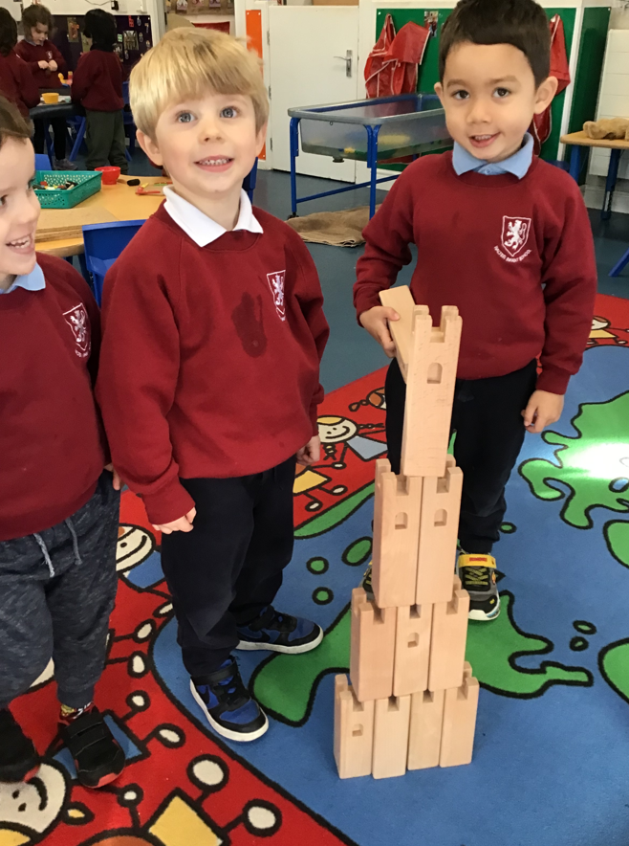
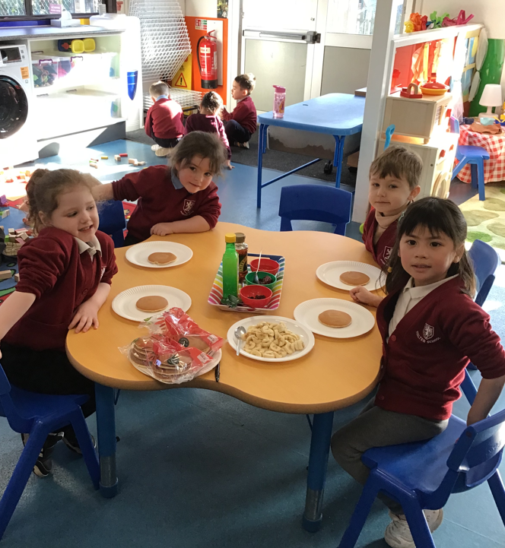
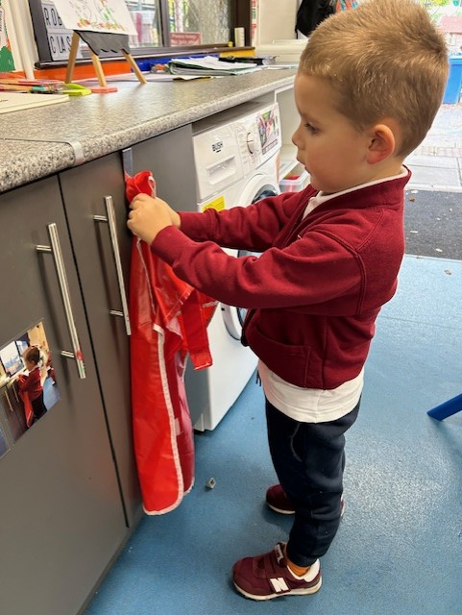

Slide 21
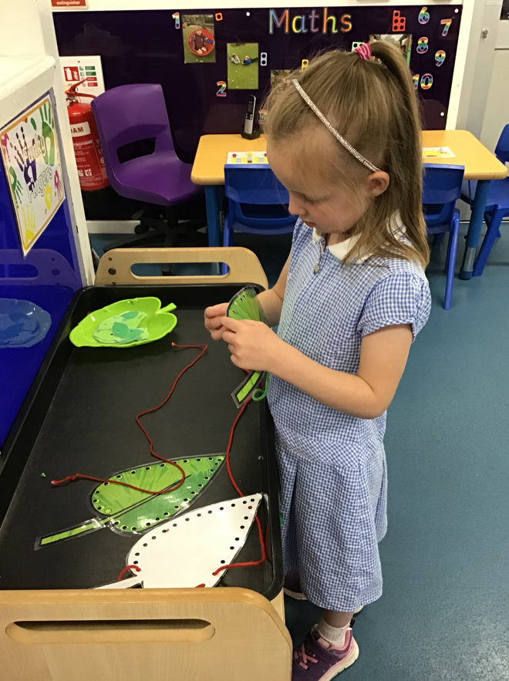
Physical Development
Gross Motor
Fine Motor

Slide 22
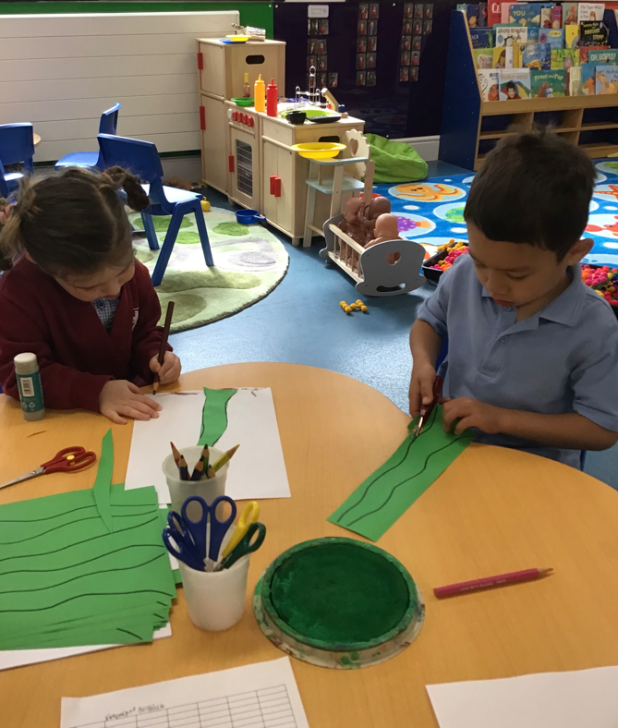
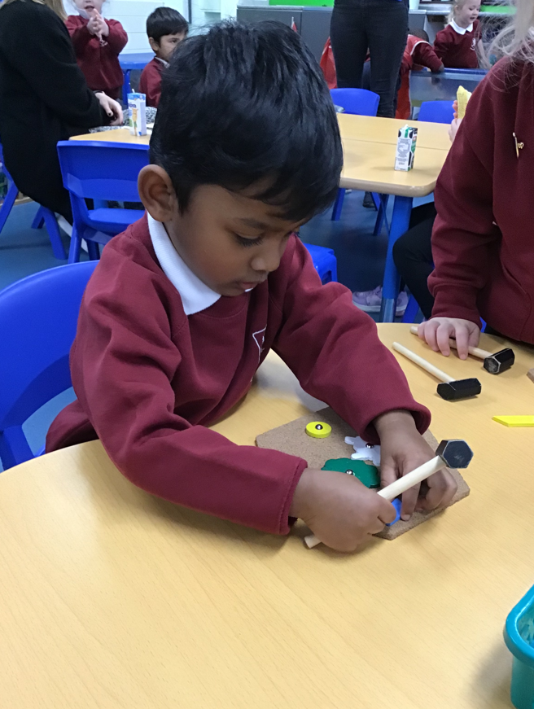
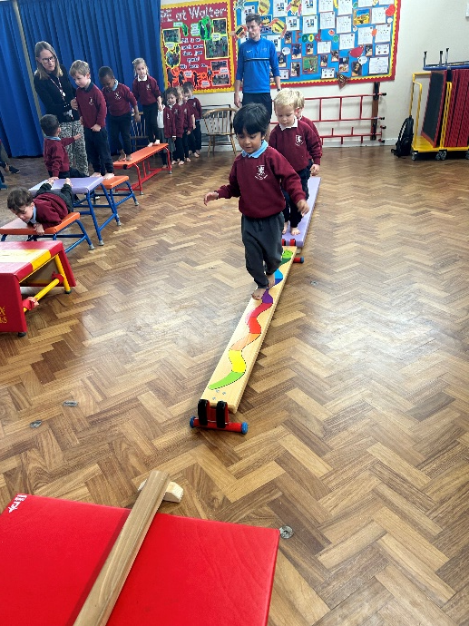
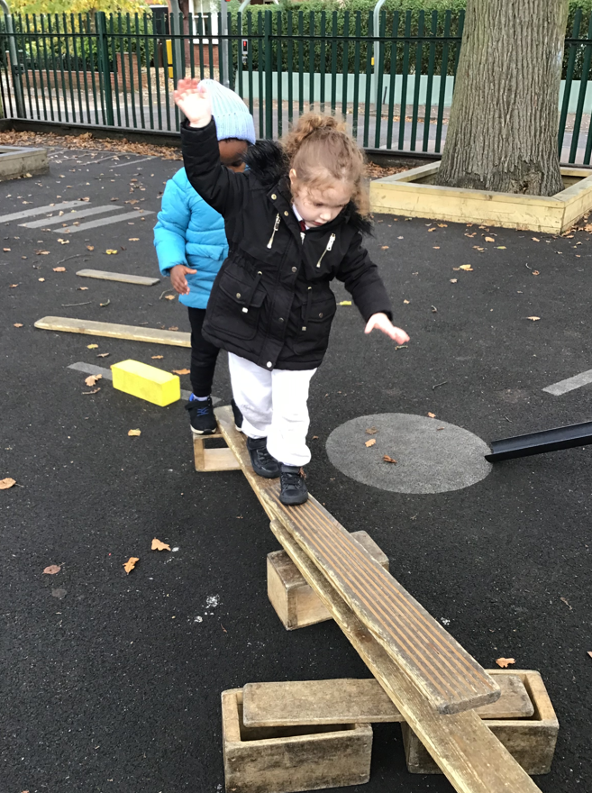
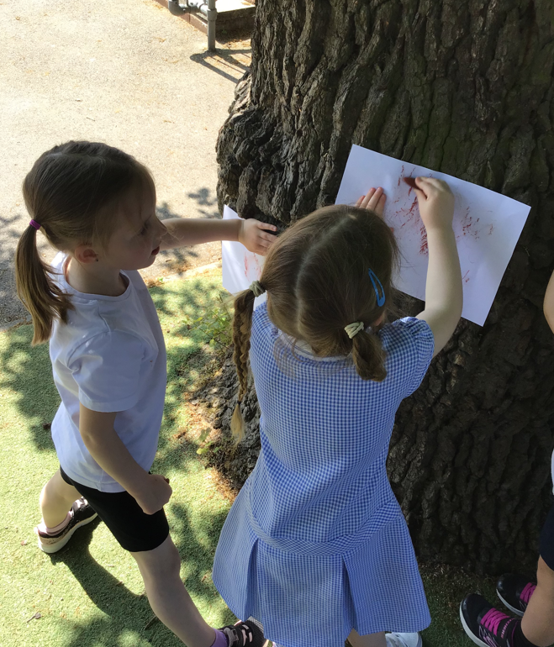
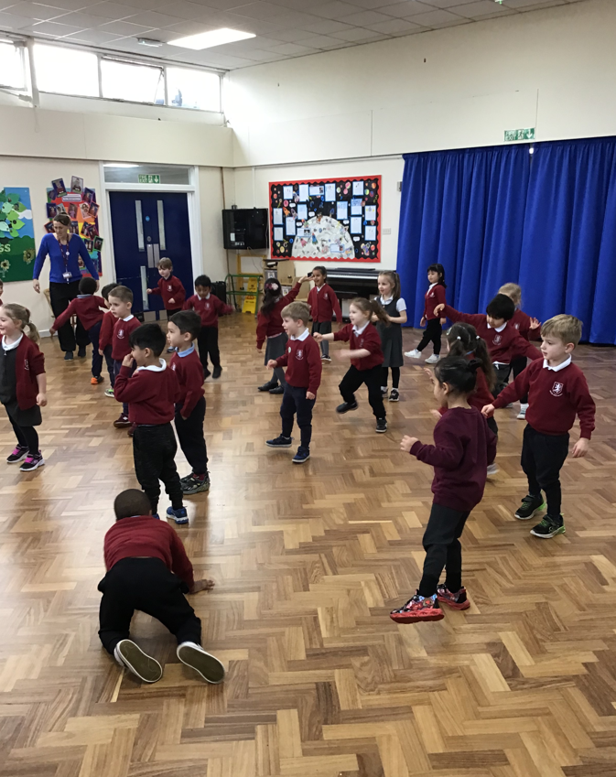

Slide 23
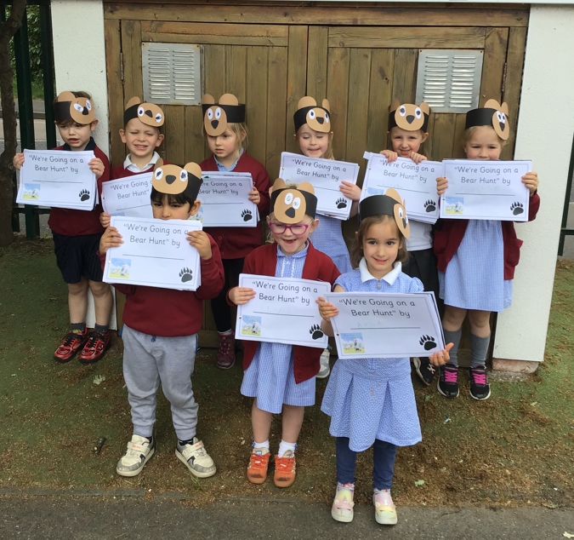
Literacy Development
Comprehension
Word Reading
Writing

Slide 24
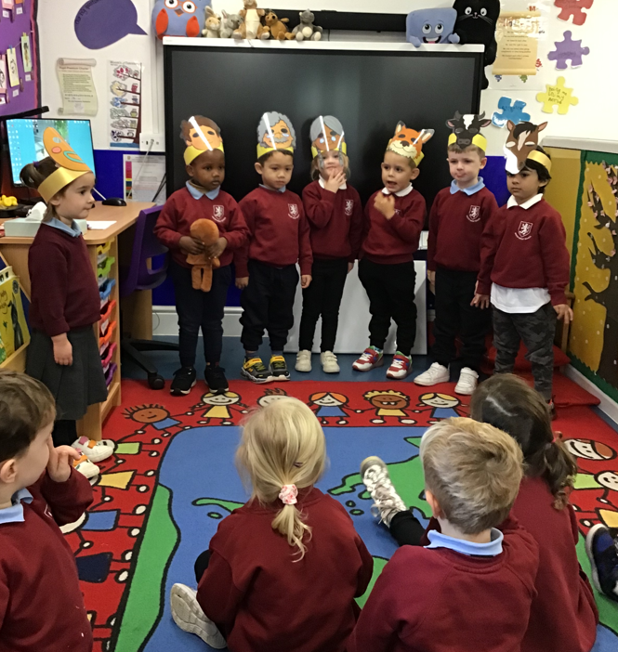
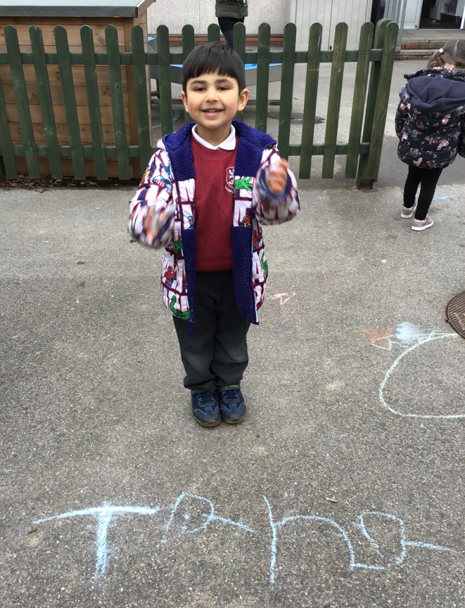
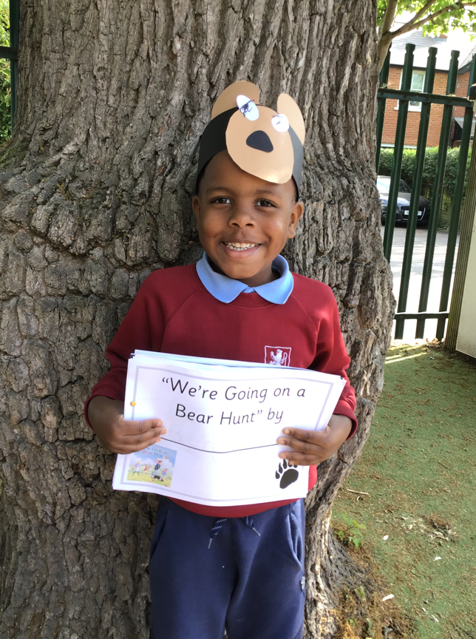
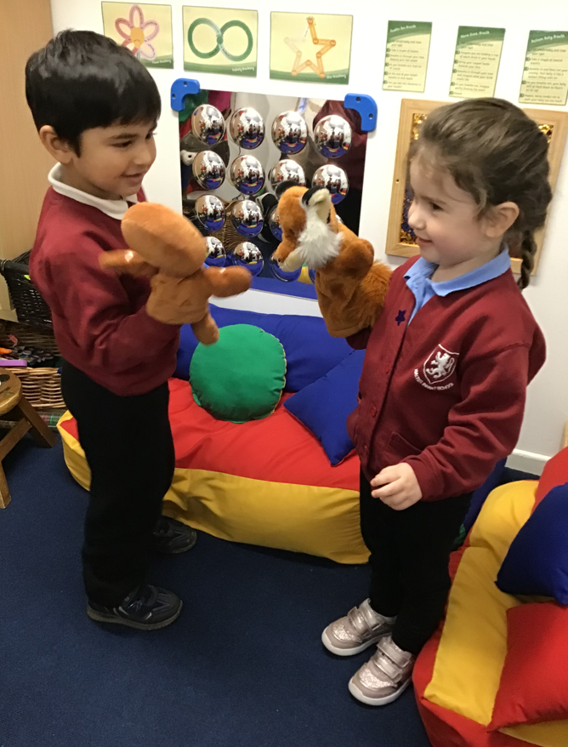
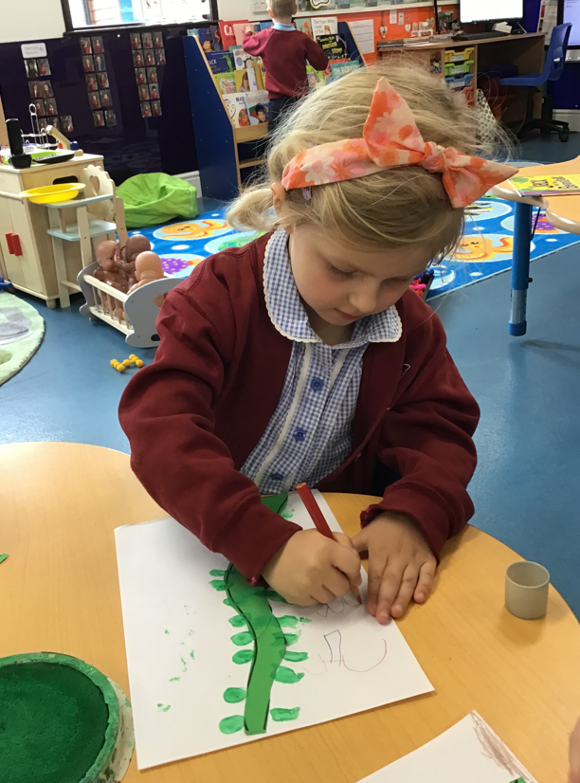

Slide 25
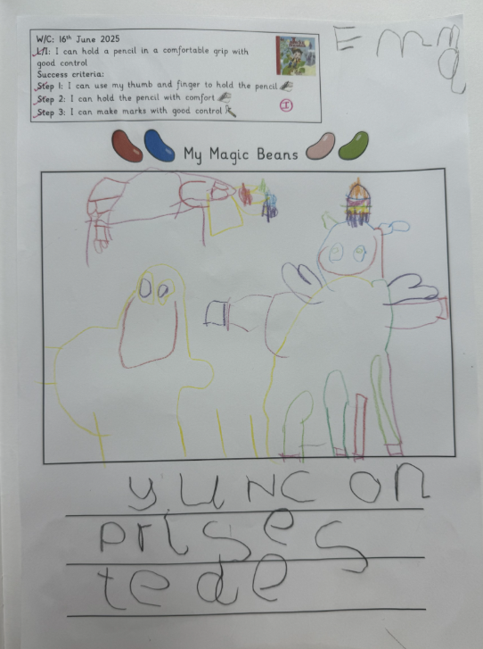
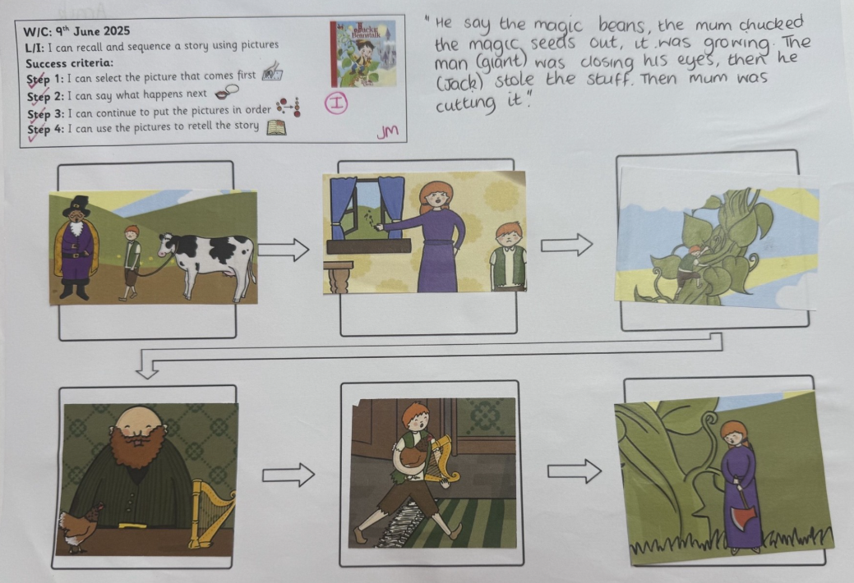
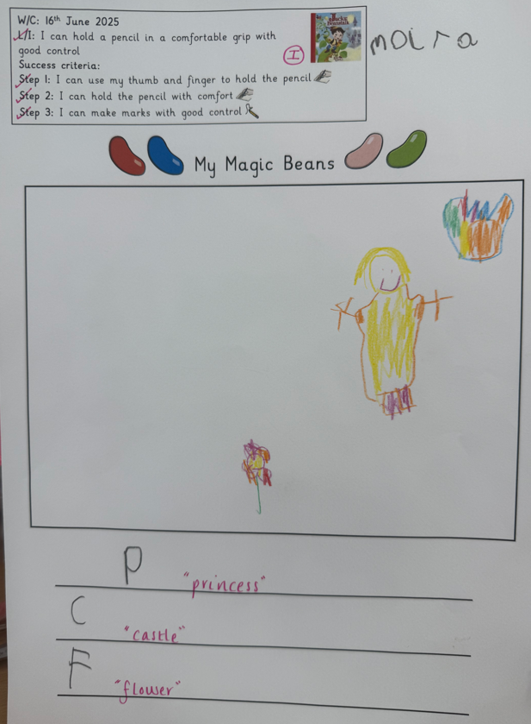
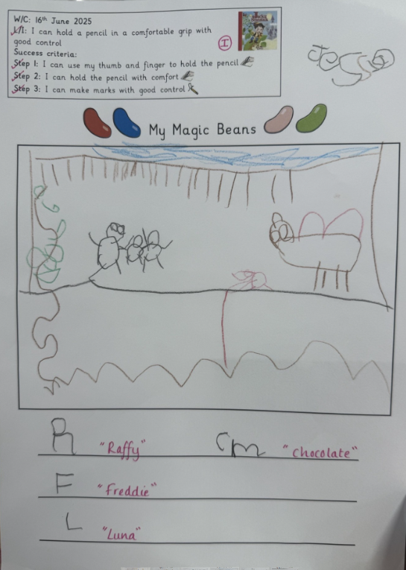
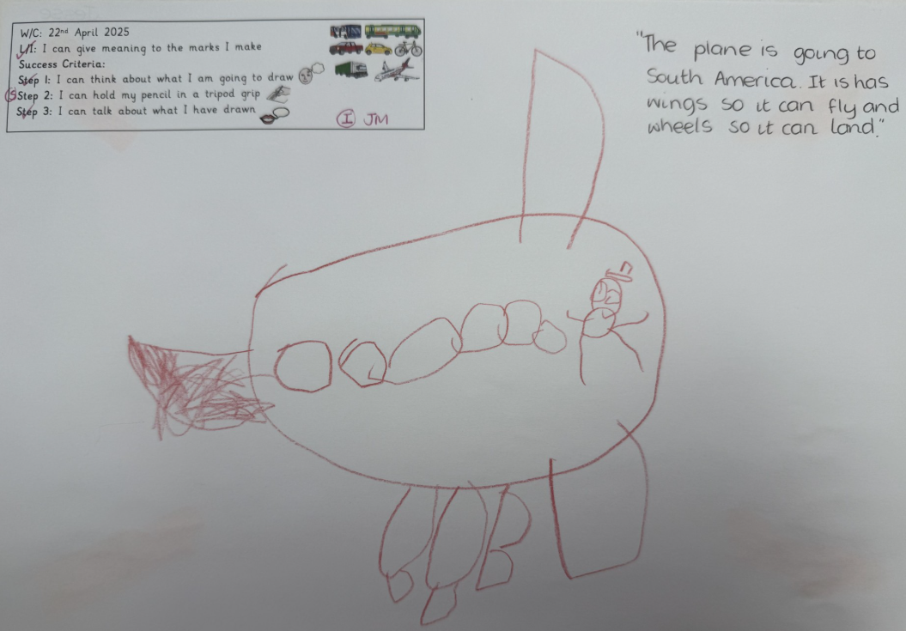

Slide 26
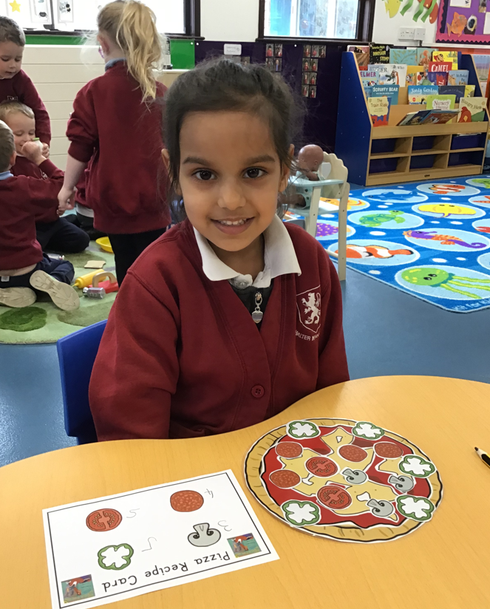
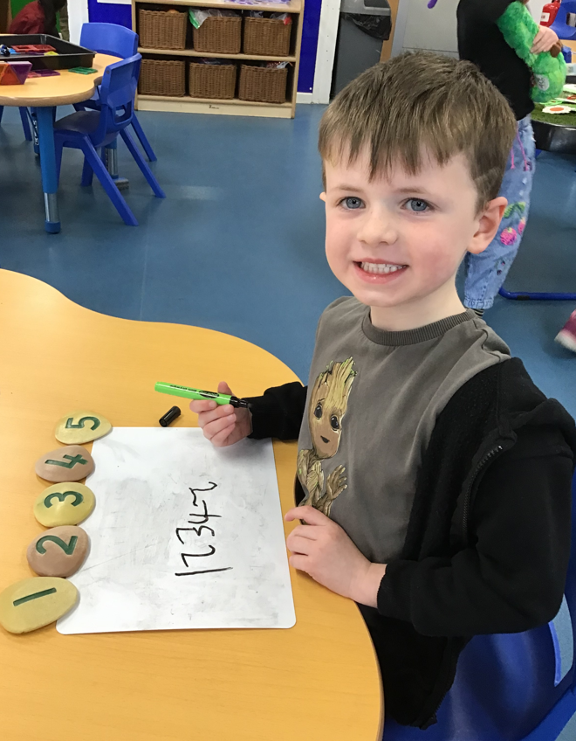
Mathematical Development
Number
Numerical Patterns

Slide 27
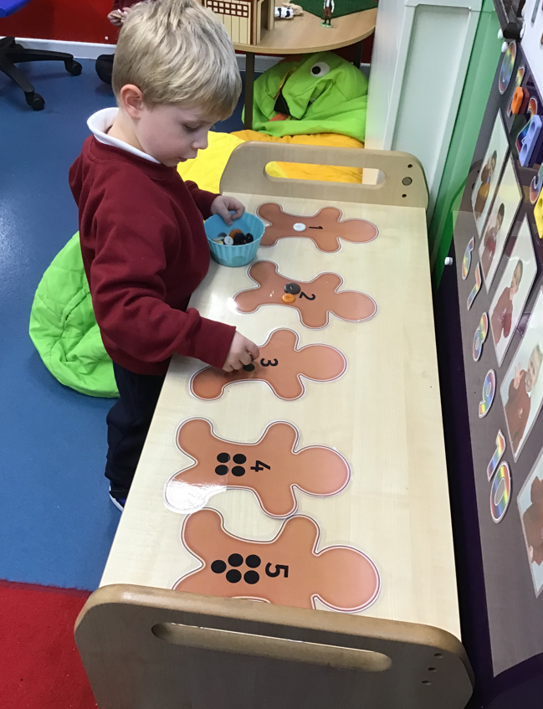

Slide 28
Understanding the World
Past and Present
People, Culture and Communities
The Natural World

Slide 30
Expressive Arts and Design
Creating with Materials
Being Imaginative and Expressive

Slide 32
Working Together
Please can you:
Keep us informed of any changes that may impact on your child, for example, a new baby or moving homes
Read, sign and comply with our Home School Agreement
Update personal details, including telephone numbers and home address
Ensure that any prescribed medication your child needs is presented at the school office and is correctly labelled and in date. (We will not accept it if not).

Slide 33
Working Together
Please be punctual at the beginning and end of the day
Please let us know if you will be late to collect your child from school by phoning the school office
Please inform us of the adults who will collect your child from school ~ we operate a password system
Please ensure your child attends school unless they are poorly
Please do not take holidays in term time

Slide 34
Healthy Schools
So that we can be a healthy school;
Please inform us if your child is unwell, or will be absent from school by telephone or email every day they are absent. If we do not hear, we will contact you for safeguarding purposes
Please keep your child at home if they are unwell
If your child has sickness or diarrhoea they must stay at home for 48 hours!
Please ensure your child has a named water bottle in school everyday
Do not bring any products into school that contain nuts, including peanut butter, pesto or coconut

Slide 36
Milk and Fruit/Vegetables
Every child in our Nursery is entitled to free milk
Please register directly with Cool Milk if you would like your child to have milk in school
Every child will be offered a piece of fruit or a vegetable snack each day, which is provided free of charge
Please inform the school office of any allergies or intolerances to food or drink

Slide 37
School Lunches
Children from either our morning or afternoon session can also attend for lunch in our lunch club to extend their provision to 4 hours a day. This is for an additional cost of £7.00 per day (spaces are limited).
Please ensure that if you are packing a lunch for lunch club, that you include food your child enjoys eating. They will need to be able to feed themselves although we will help with opening packets. Please do not include any sweets or nuts.
We have recently introduced hot meals for our children in Robin Class! These cost £2.65 per meal and each day there is a main meal option, a vegetarian option and a jacket potato, complimented with a choice of vegetables / salad and a pudding. We are able to cater for dietary requirements / preferences. A form will be given to you by a member of staff in Robin Class and will need to be returned back to Robin Class staff. Please note this is a flexible arrangement.

Slide 38
School Lunches

Slide 39
Walter Infant School and Nursery Values

Slide 40
Our Values

Slide 41
Expectations for Behaviour
Treat each other with respect
Be kind and polite to everyone
Tell the truth
Look after the school and the things in it
Move around the school sensibly
Always try your best

Slide 42
Our School Uniform
Please send you child to school in clothes that are easy for them to manage by themselves; we suggest elasticated waits for trousers, joggers, shorts or leggings. These can be navy, black or dark grey (please do not choose lighter blues or light grey and no patterns).
You can choose pinafores or summer dresses (tights can be hard to manage in the winter) some children wear cycling shorts under their dresses.
Polo shirts can be white, sky blue or navy blue depending on your preference; they all look smart.
The children can have cardigans or sweatshirts; these must be burgundy. We sell second hand ones via our PTA or you can order from Gooddies ~ information to order uniform is in your pack.

Slide 43
Our School Uniform

Slide 44
Trainers with Velcro are best!

Slide 45
Being Ready for Robin
You can help prepare your child for school by encouraging their independence as much as possible and being positive when talking about school.

Slide 46
Being Ready for Robin
Help your child to go to the toilet all by themselves, including wiping and handwashing.

Slide 47
Being Ready for Robin
Encourage your child to manage their own clothing such as coats and jumpers ~ but of course we will help (hence no laces!)

Slide 48
Being Ready for Robin
Practise recognising their name or the first letter of their name.
If practising writing their name (this is not an expectation) please remember to only use a capital at the beginning e.g. Ada, Billy, Clara, Dhruv, Emily etc

Slide 49
Being Ready for Robin
Please label all of their clothes ~ check out ‘Stickins’ as they really do work
Always send in a coat – we will go outside in all weathers.

Slide 50
Any questions?
We are so looking forward to your children joining us; we recognise what a big event this is within your family unit and we want to get it right for you and your child.
We hope you have had the opportunity to have a look around the Foundation Stage to see the learning environment.
If you think of anything at all that you didn’t ask or need to know, just get in touch by phone or email.

