Slide 1
Black History Month
Black Lives Matter 2021

Slide 2
Black History Month
We have been learning about people of colour who have been able to make a difference to the lives of other people of colour and to all other people too.
Some of those people made a difference by choice
Some of those people made a difference by chance
BUT they all made a difference!
AND we can make a difference too… we can make sure that we never judge people by how they look or the colour of their skin.

Slide 3
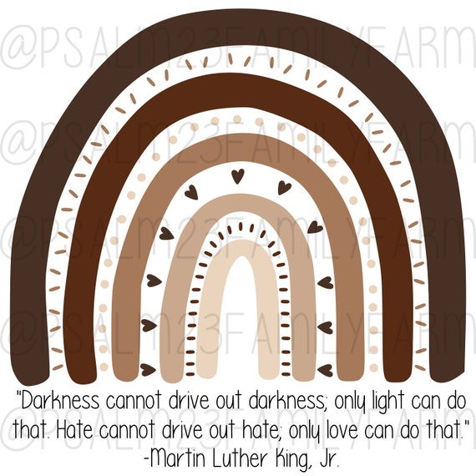

Slide 4
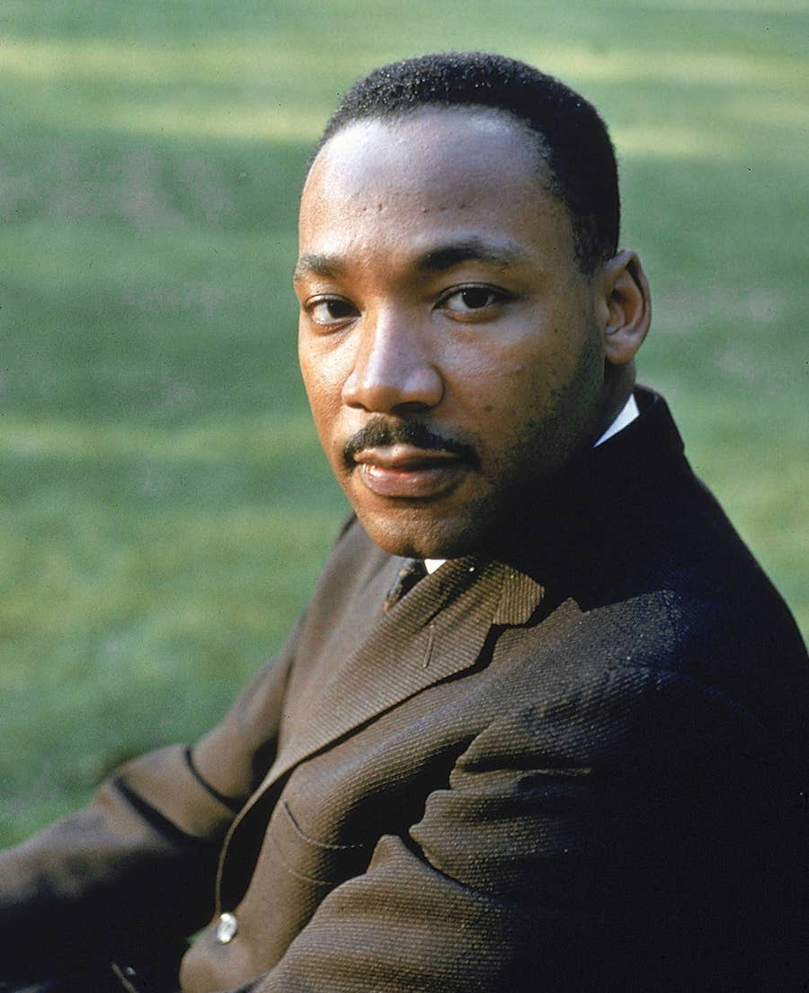

Slide 5
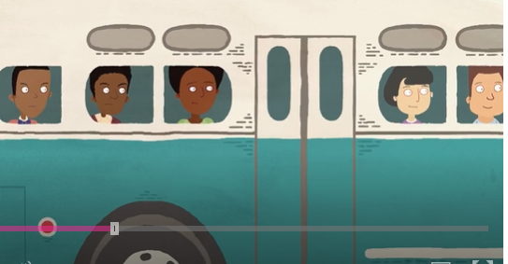
Martin Luther King Jnr.
https://www.bbc.co.uk/cbeebies/watch/cbeebies-house-black-history-heroes

Slide 6
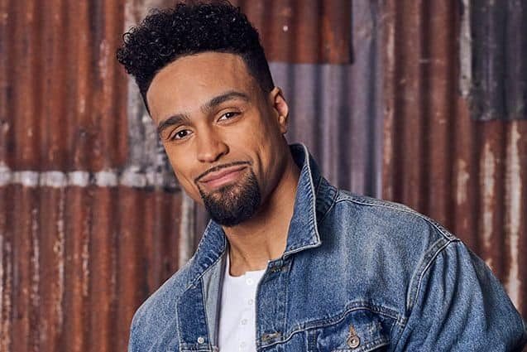
Ashley Banjo said he didn’t plan to be an activist…..
But a year ago he changed his mind and decided to make a big difference with his dance troupe DIVERSITY!
https://www.youtube.com/watch?v=kzFNKFitHjw

Slide 7
Do you know these people of colour? They come from different walks of life and have different heritages and are from different times in history.

Slide 8
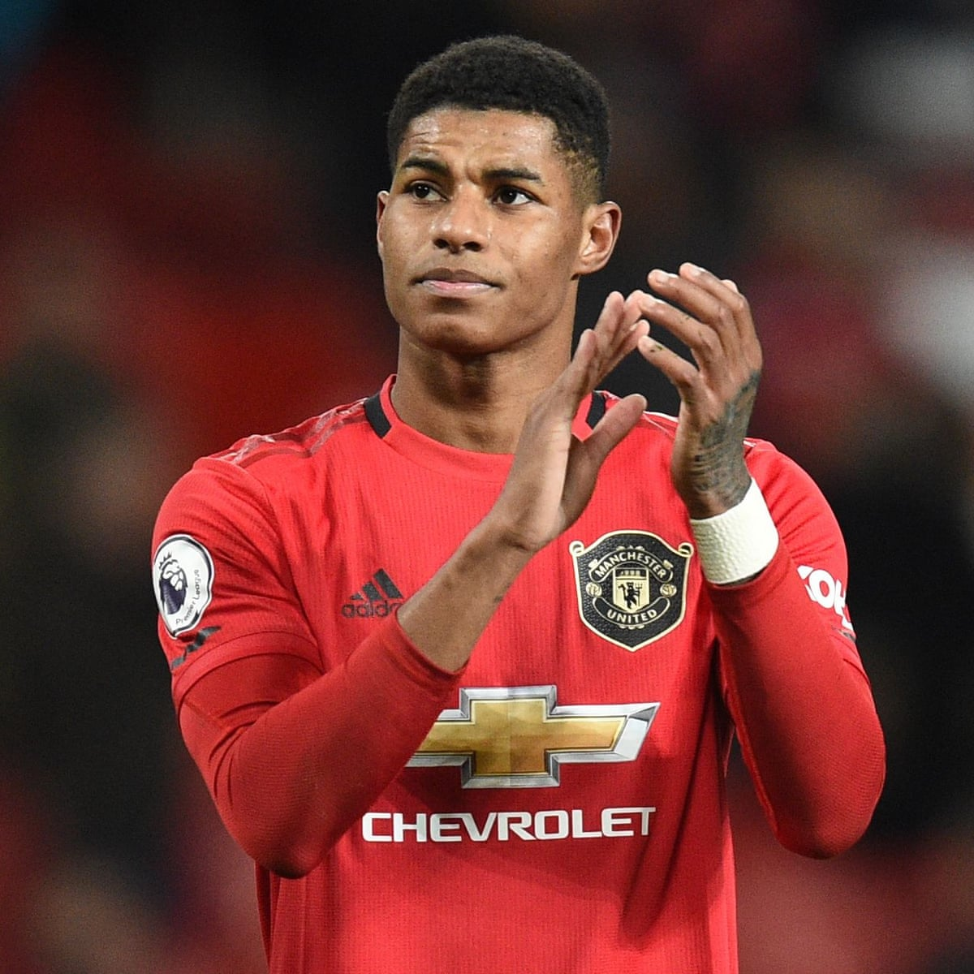
Marcus Rashford

Slide 9

Dr Ranj Singh

Slide 10
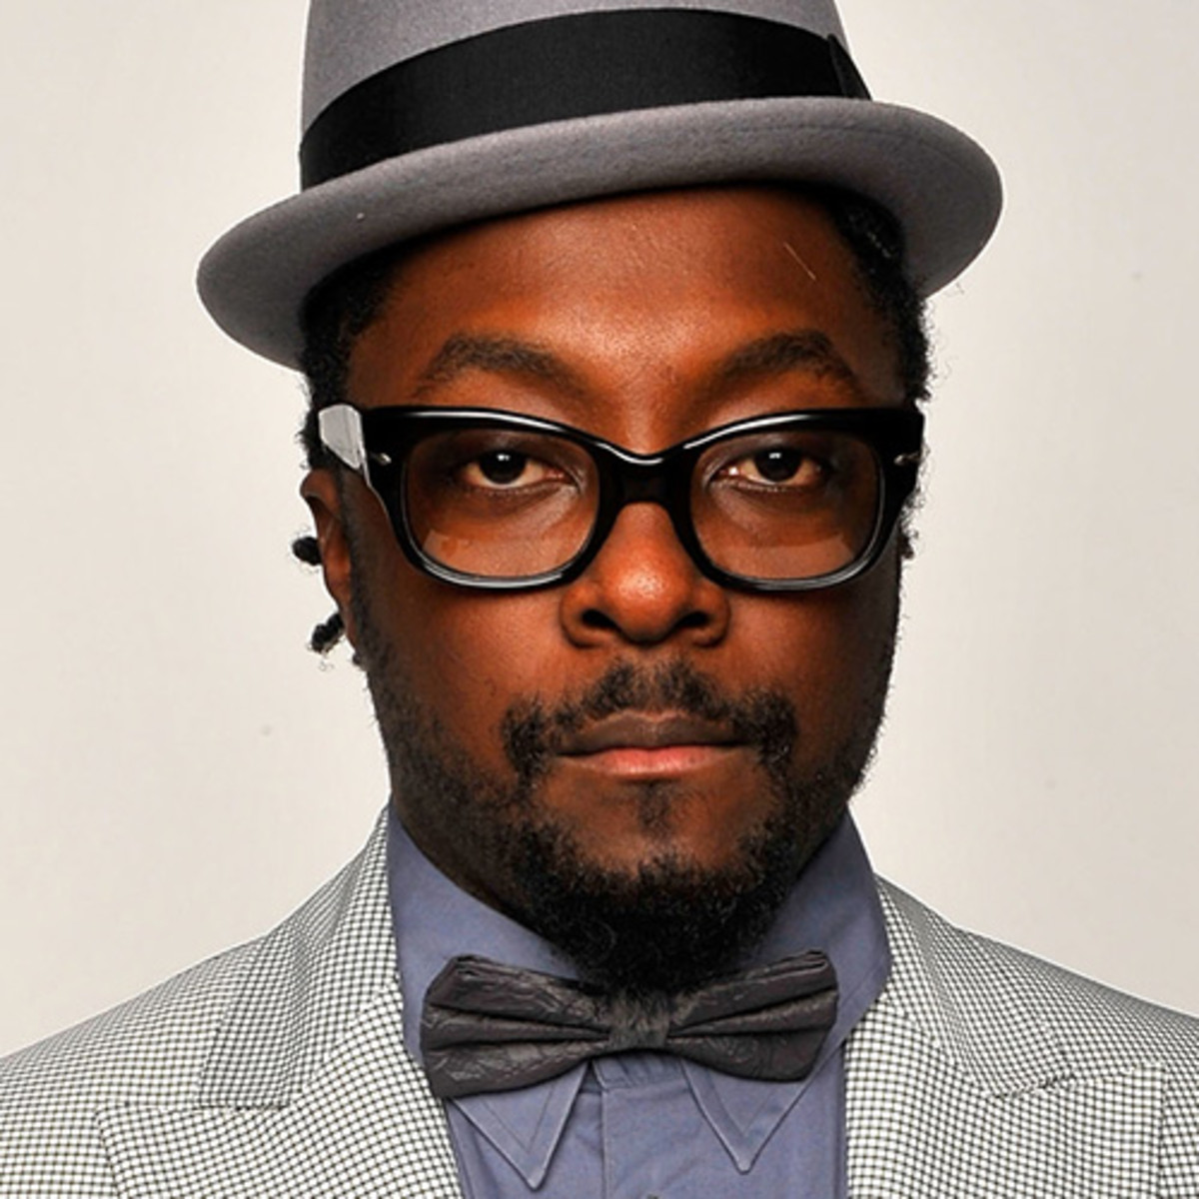
will.i.am

Slide 11
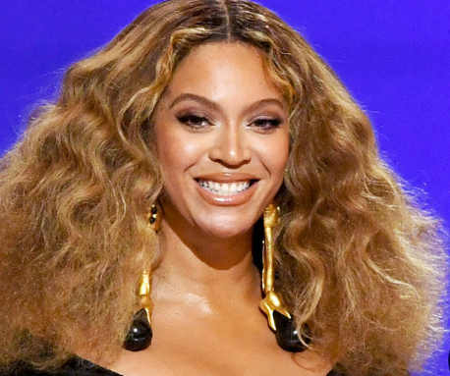
Beyonce

Slide 12
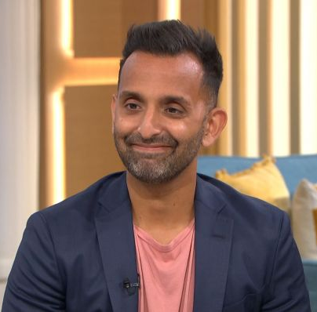
Dr Amir Khan

Slide 13
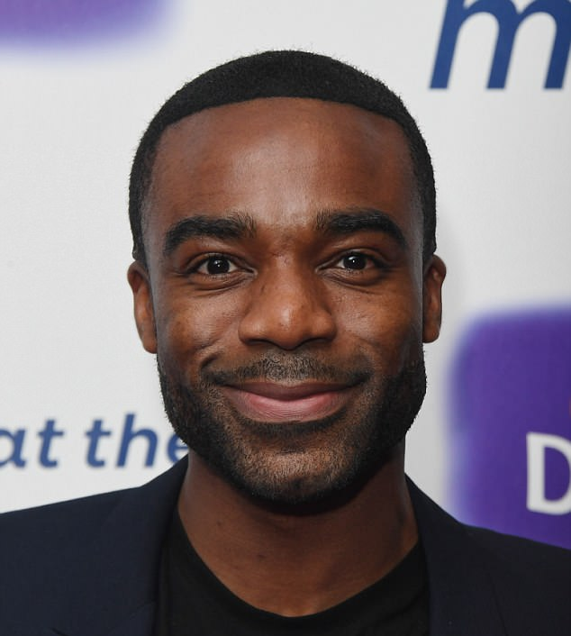
Ore Oduba

Slide 14
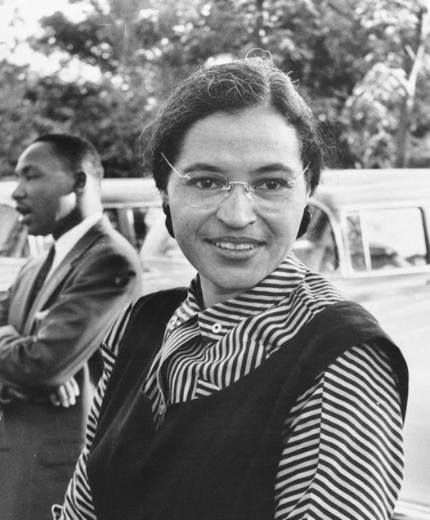
Rosa Parks

Slide 15
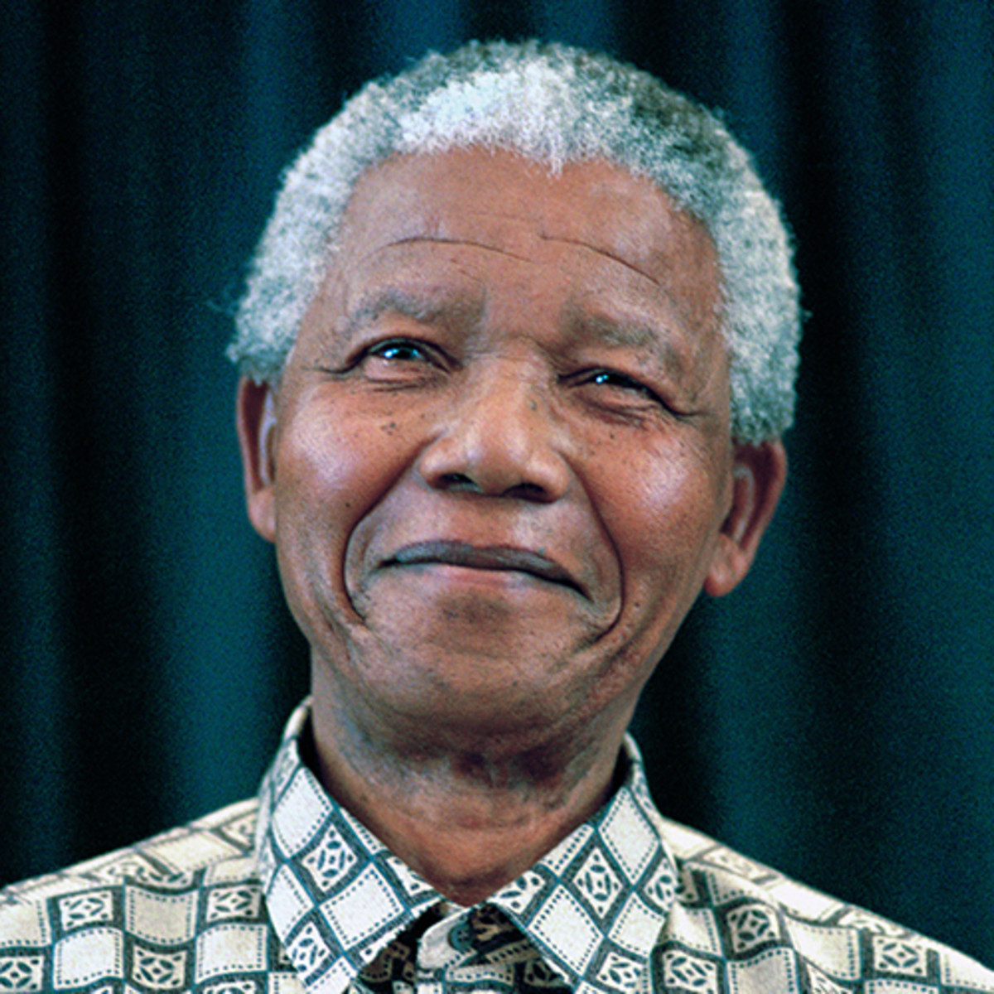
Nelson Mandela

Slide 16
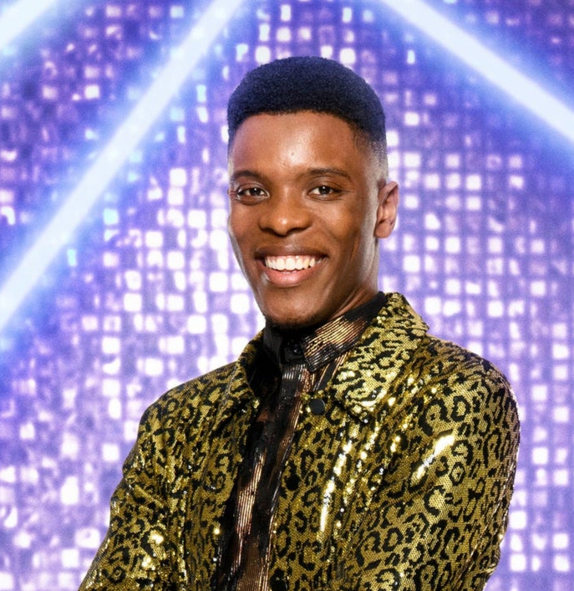
Rhys Stephenson

Slide 17
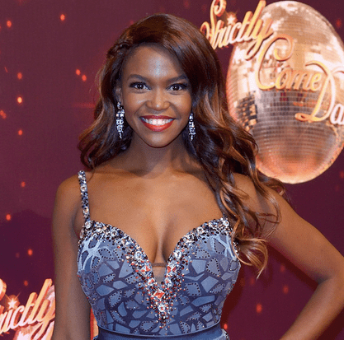
Oti Mabuse

Slide 18
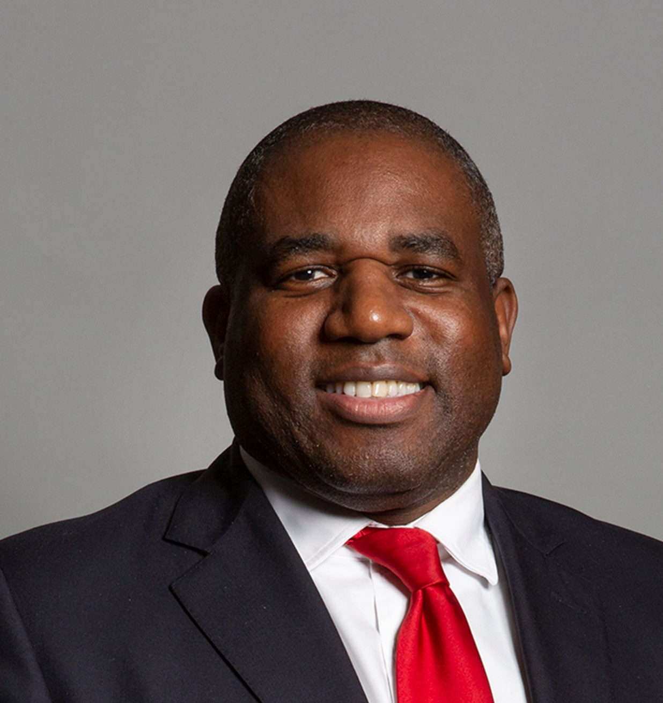
David Lammey

Slide 19
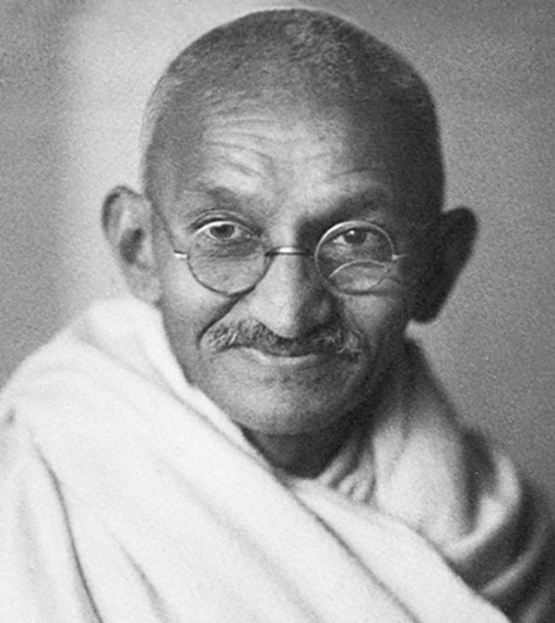
Mahatma Gandhi

Slide 20
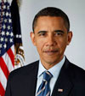
Barack Obama

Slide 21
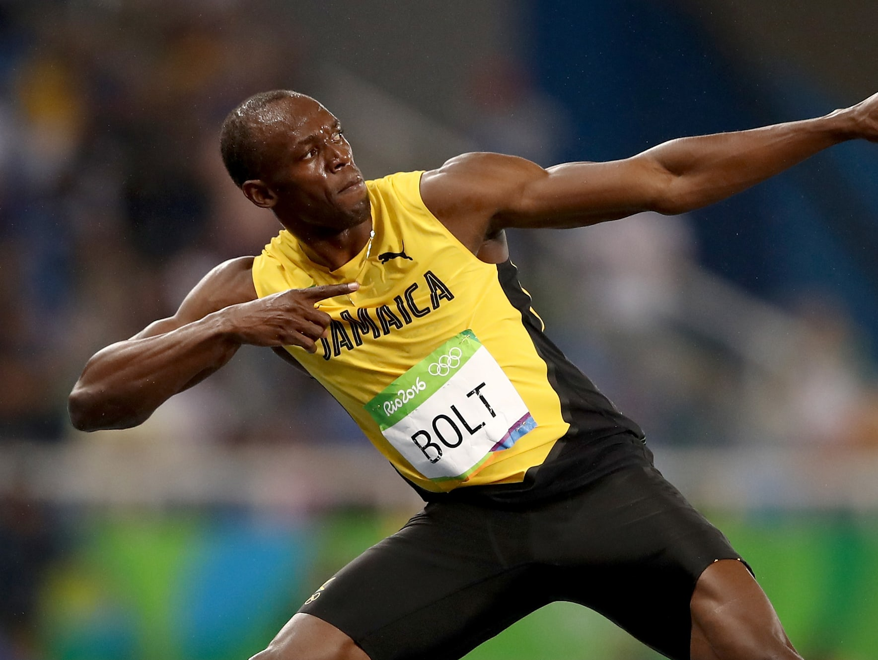
Usain Bolt

Slide 22
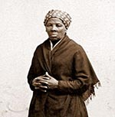
Harriet Tubman

Slide 23
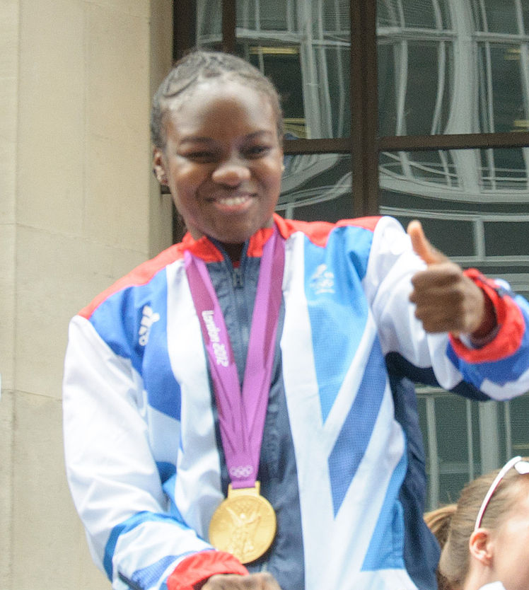
Nicola Adams

Slide 24
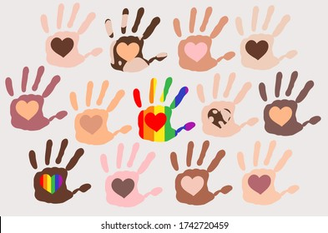
I could keep going…showing more and more pictures BUT I wonder what you have learned from this…..

Slide 25

Star of the Week!

Slide 26
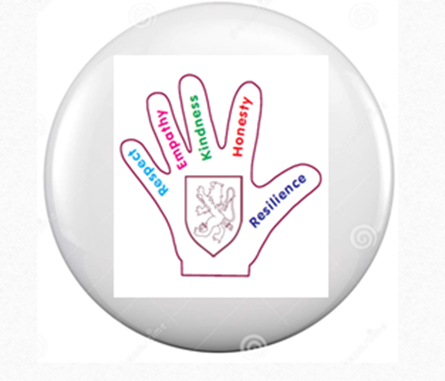
Values Badges

Slide 27
The children are our future!
https://www.youtube.com/watch?v=55476dCgSsw

