Slide 1
Notes:
Notes for Teachers:
The Number Day assembly plan and presentation can help teachers to explain why their school is taking part in Number Day and how everyone can make a difference by having fun with numbers and using maths activities to help raise money.
To be presented in class the two weeks leading up to Number Day
By the end of the class assembly pupils will:
Understand the purpose of Number Day to: a) raise money for the NSPCC b) have fun with numbers and promote a positive “can do” attitude to maths.
Understand about the work of the NSPCC as a charitable organisation and how we help children and young people
Feel motivated and proud to make a difference
Be excited about their Number Day Activities
[Don’t forget to display the NSPCC Number Day posters / printable bunting around the class – these are available at www.nspcc.org.uk/numberdayresources]

Slide 2
https://www.youtube.com/watch?v=P0eLoV2My6Y
Notes:
Notes for Teachers:
The Number Day assembly plan and presentation can help teachers to explain why their school is taking part in Number Day and how everyone can make a difference by having fun with numbers and using maths activities to help raise money.
To be presented in class the two weeks leading up to Number Day
By the end of the class assembly pupils will:
Understand the purpose of Number Day to: a) raise money for the NSPCC b) have fun with numbers and promote a positive “can do” attitude to maths.
Understand about the work of the NSPCC as a charitable organisation and how we help children and young people
Feel motivated and proud to make a difference
Be excited about their Number Day Activities
[Don’t forget to display the NSPCC Number Day posters / printable bunting around the class – these are available at www.nspcc.org.uk/numberdayresources]

Slide 3
Notes:
Key Messages:
Hands up - who enjoys playing board games or cards? Or watching, “Countdown”, “Pointless”, “Catchphrase”, “Tipping Point” or “The Cube”.
Ask the children if they enjoy watching and playing Number based games and quizzes and to explain why they enjoy these games and programmes. They may offer answers such as “They are fun/interesting”. “I like watching them with my friends and family” or you can learn from them.
Take a variety of responses and use their answers to draw out what they can learn from playing such number games.
The children may offer answers like: “You can learn about counting, adding, subtracting, taking turns, strategy etc..”
Try to establish the link between the ideas of number games and the enjoyment and learning about maths. Once you feel you have established a context for introducing the subject of the assembly, tell them that on Friday 4th February (or on another day that suits) everyone in school will have the chance to enjoy some number games and maths activities to celebrate Number Day and that “All over the Country’ other schools will be doing the same: celebrating how much fun maths can be”.

Slide 4
Notes:
Once the children are interested and motivated to take part in Number Day, explain to them that there is another reason why taking part is so important to them – they will “have the opportunity to raise money for thousands of children all over the country who are being helped by a charity called the NSPCC”.

Slide 5
Notes:
The NSPCC is a charity who want every child to a safe and happy childhood.

Slide 6
Notes:
Explain that your school will be joining hundreds of other schools across the UK to take part in Number Day and to raise money for the NSPCC
Ask if anyone has heard of the NSPCC ? Does anyone know what the initials NSPCC stand for?

Slide 7
Notes:
For example National = The NSPCC works all over the country,

Slide 8
Notes:
Society = is like a group of people who have come together, some pupils may be members of their local scouts or brownies. A society is another word for a group of people,

Slide 9
Notes:
Prevention = another word for prevention is ‘stop’,

Slide 10
Notes:
Cruelty = another word for cruelty could be mean, nasty, horrible (to expand on this section you could run through the different types of harm in the appendix)

Slide 11
Notes:
Children = ask the pupils what age do you stop being a child? The answer is 18

Slide 12
Notes:
Keeping children safe is why the NSPCC is here. That’s what drives their work, and that’s why – as long as children need support – they will fight for every childhood.
So when a child needs a helping hand, they’ll be there.
When parents are finding it tough, they’ll help.
When laws need to change, or governments need to do more, they won’t give up.

Slide 13
Notes:
It is really important to speak out to a trusted adult or grown up if you are ever worried, upset or need to talk. Childline, a service provided by NSPCC is also there to listen to children and young people, whatever their worry, whenever they need help.
On average, a child contacts Childline every 25 seconds – they can talk about anything, and often it’s a problem they feel they can’t talk to anyone else about. A child or young person can contact Childline, they can do this by calling 0800 1111 or visiting childline.org.uk
Childline is open 24 hours a day, 365 days a year, it’s never closed.
The fundraising we are doing in school is helping to pay for the NSPCC’s services that include the Speak out Stay safe programme and Childline.

Slide 14
Notes:
Another service of the NSPCC is the NSPCC Schools Service which visits schools in every town and city in the UK to teach children about the different types of harm and how to keep safe. Children also learn the importance of speaking out to a grown-up or trusted adult if they need help and this is a really important service.
They do this through delivering a service call the ‘Speak out. Stay safe.’ programme.
The fundraising we are doing in school is helping to fund the NSPCC’s services that include the Speak out Stay safe programme and also Childline.
[Primary Schools – hopefully you’ve had the service in your school and can remind the children about when Buddy and the Speak out Stay safe programme visited your school. If you’ve not had the service and would like to find out more , please go to www.nspcc.org.uk/speakout to sign up.)
[Post Primary Schools, you could ask the children if they remember Buddy coming to their Primary School]

Slide 15
Notes:
The NSPCC has many other services across the UK that you will be helping to raise money for. Make the link between maths / numbers and helping children raise money for other children
It takes a lot of time and a lot of money to ensure that Childline and NSPCC’s other services are there every day for children and young people. Our school is joining hundreds of others to take part in NSPCC Number Day and help raise money for children.

Slide 16
Walter’s Number Day Friday 4th February 2022
Please come wearing numbers! It could be a hat, a badge, a T-Shirt, a sports shirt…anything with a number will be FAB!
We are collecting for the NSPCC; more children than ever are suffering as a result of the pandemic and they need our help.
Please donate what you can; we suggest £2 per family. We will have collection buckets at the start and end of the day.
Notes:
Please insert the details of your schools Number Day event:-
What activity you are doing (Teacher: Have a look at our fun new Buddy’s Key Challenge sponsored event – find out more at www.nspcc.org.uk/numberdayresources)
The amount of time your class is dedicating to Number Day (a lesson or a whole digit day!)
Who will be taking part – teachers and parents can join in too
Why not ask the School or Pupil Council to help organise the event and make a display
You could send a covering letter to parents (template available to download) to explain about the purpose of NSPCC Number Day and to generate their support.
You can also use the posters and press releases from the Number Day website to promote your event.
Raise money and donate using the details in your welcome letter or using ParentPay or JustGiving

Slide 17
Notes:
Explain what your number crunching, digit day event is and how the children will be raising money by either collecting sponsors or asking for donations
In your fundraising pack there is a sample sponsor form which can be photocopied. The sponsor form can also be downloaded from the Number Day website.

Slide 18
Walter Number Day Quiz
How many children do you think come to our school?
304

Slide 19
Walter Number Day Quiz
How many adults work at our school?
47

Slide 20
Walter Number Day Quiz
How many girls come to our school?
142

Slide 21
Walter Number Day Quiz
How many boys come to our school?
162

Slide 22
Walter Number Day Quiz
Do we have more boys or more girls?
^{How many more?}
20 more boys

Slide 23
Walter Number Day Quiz
How many classrooms do we have?
10

Slide 24
Walter Number Day Quiz
^{How many classes do we have?}
11
Did you forget our Robin afternoon Class?

Slide 25
Walter Number Day Quiz
How different languages are spoken in our school?
35

Slide 26
Walter Number Day Quiz
Which year was our school built in?
1974

Slide 27
Walter Number Day Quiz
How many days to children come to school each year?
190

Slide 28
Walter Number Day Quiz
How many days should you come to school each week?
5

Slide 29
Walter Number Day Quiz
How many hours do you spend at school (approximately) each day?
6 ½

Slide 30
Walter Number Day Quiz
So how many hours a week do you spend at school?
5 x 6 ½
= 32 ½ hours a week

Slide 31
Walter Number Day Quiz
How many Number Day quiz questions have I asked you?
14
Did your class get them all right!

Slide 32
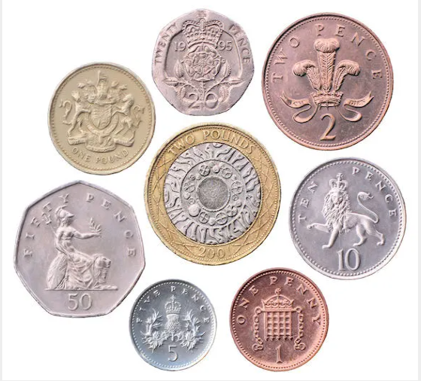
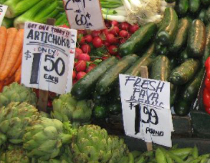
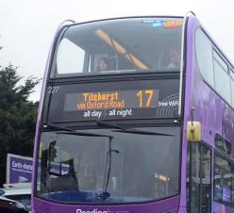
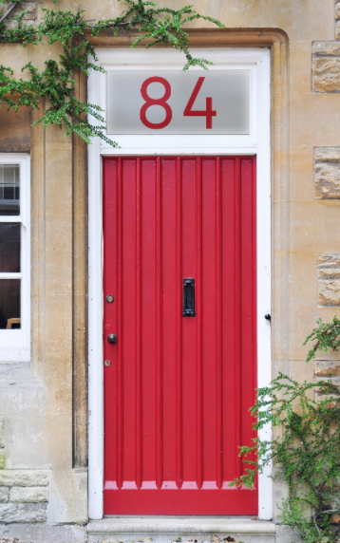
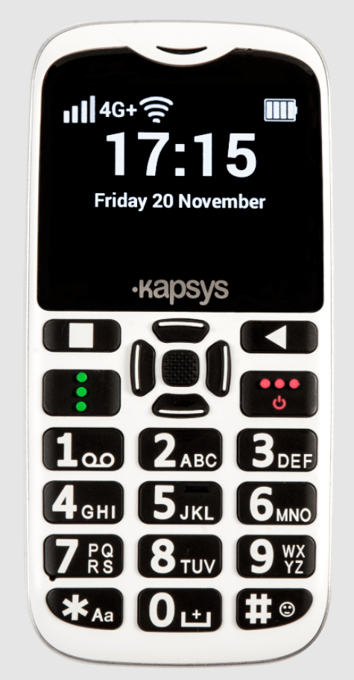
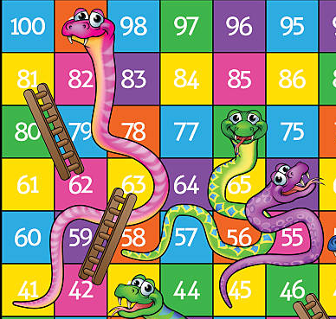
Numbers are amazing and maths is all around us!

Slide 33
Please can each class guess how much money they think we will make as a school to help children who need to feel safe, cared for and loved?
Let me know you answers……

Slide 34
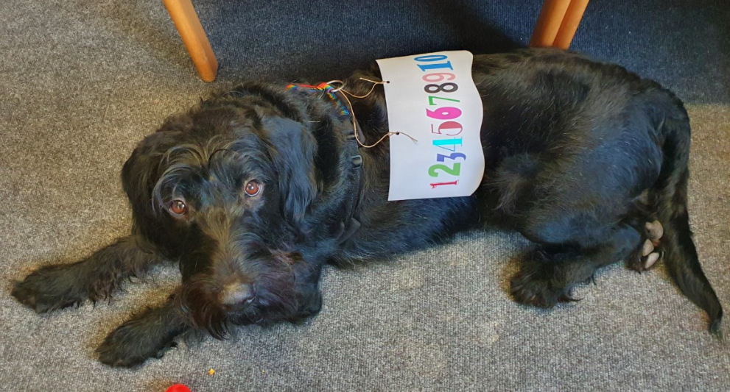
Raise money
and have fun!
Notes:
We will receive a certificate showing how much sponsorship the whole school has raised doing Buddy’s Key Challenge, and what the money will be spent on.

Slide 35
Notes:
Summarise your school plans and remind the children of the date.

