Slide 1
Walter Infant School & Nursery
New Parents to Foundation Stage
June 2024

Slide 2
Welcome to Walter Infant School and Nursery
To be the best I can be!

Slide 3
Our Rationale
Our BIG Curriculum! At Walter Infant School and Nursery we consider ourselves to be a “BIG School for LITTLE PEOPLE”. We have designed a ‘BIG’ curriculum to excite, inspire and foster a desire to learn; we want our children to know more about the world around them and to be happy, confident and successful.
We will encourage our children to have very positive behaviours for learning and to ask BIG questions and for our staff team to support our children in finding authentic, age-appropriate answers to those questions and inspire them to want to know more.
Our children will learn through real-life and practical experiences, as well as through wonderful, awe inspiring fiction texts in which they can ‘see themselves’ and exciting and purposeful non-fiction texts.
Our children will learn inside and outside the classroom, fulfilling and exceeding the requirements of national age-appropriate curriculums in a stimulating, fun and memorable way.

Slide 4
The Foundation Stage Team

Slide 5
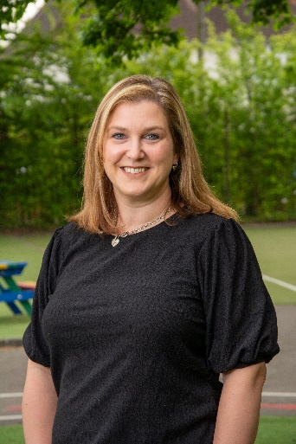
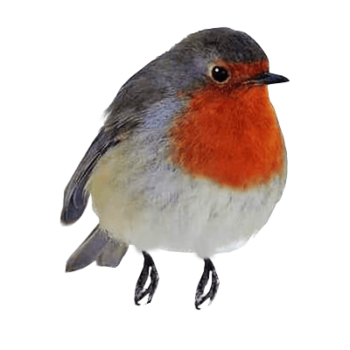
Foundation Stage 1 ROBIN

Slide 6
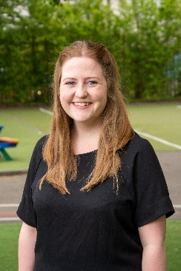
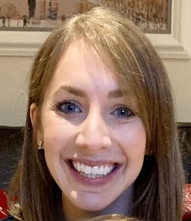
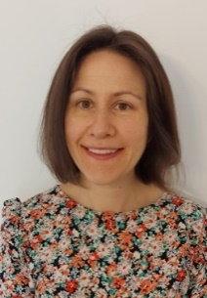
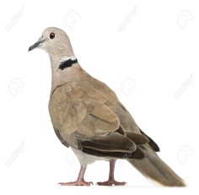
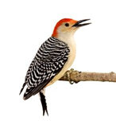
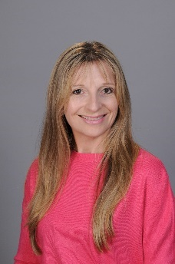
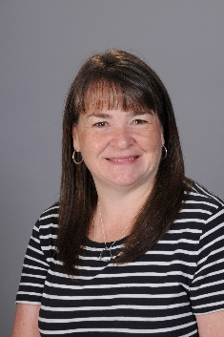
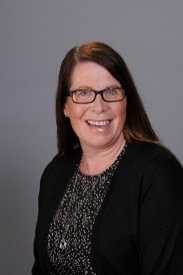
Foundation Stage 2: 3 classes DOVE, MAGPIE AND WOODPECKER

Slide 7
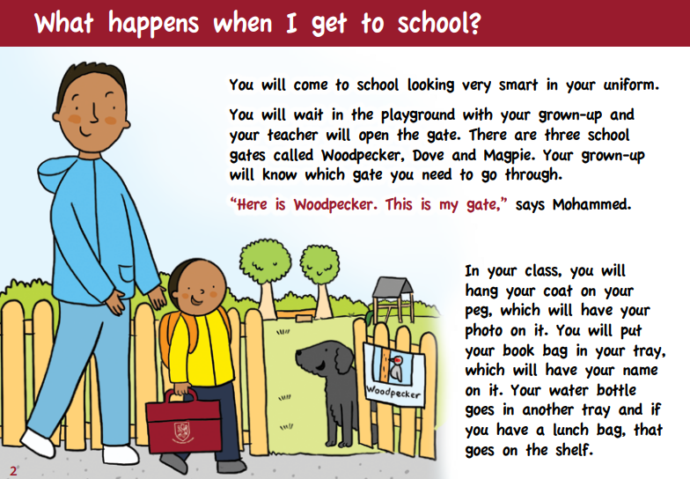

Slide 8
Daily routine in Robin
Robin gate will open at 8:30am and close at 8:40pm
Children will independently walk into the classroom and start putting their belongings away – there will be an adult inside to support them.
Children will sit down for register after exploring the resources
Whole class input – this could be a story, group singing, or a Literacy or Maths input
Small groups and independent learning – both inside and outside of the classroom!
Dough disco and phonics
Home time for our morning children and lunch time for the children who attend for 30 hours
This routine is repeated in the afternoon.

Slide 9
Daily routine in F2
Arrive at your class gate at 8.40
Children will come through the gate independently and into their classrooms to put their belongings away ready for register
Whole class input
Small groups and independent learning
Dough disco and phonics
Lunch
Register
Guided reading
Independent learning
Whole class input
Story and home time

Slide 10
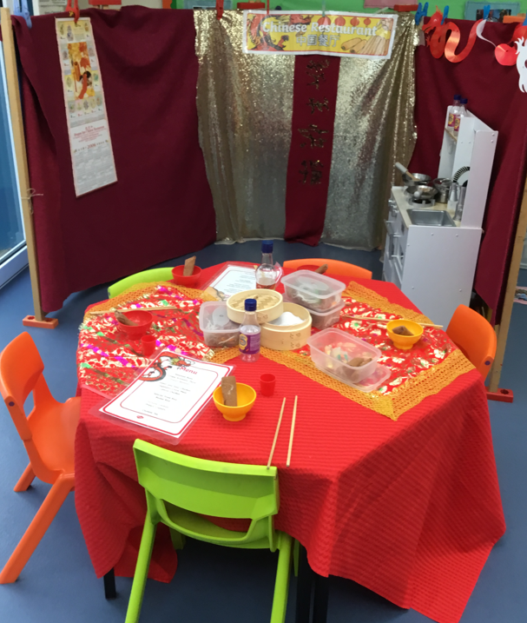
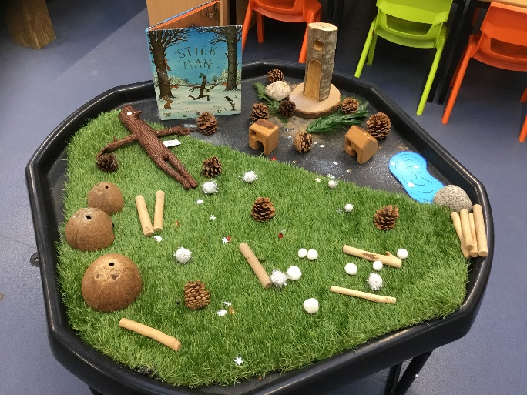
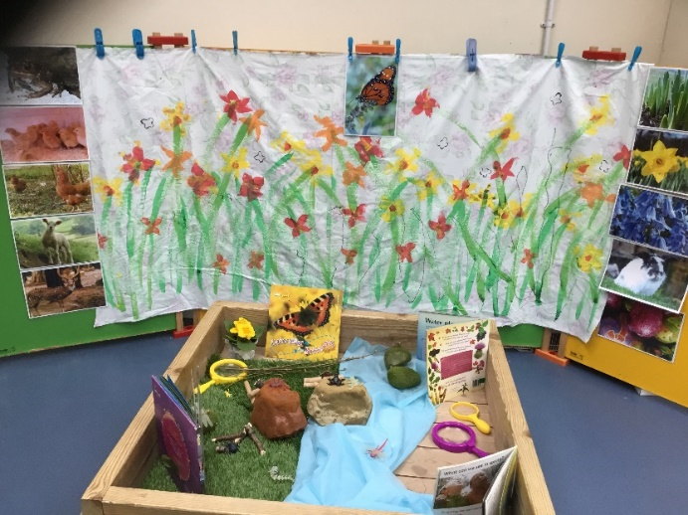
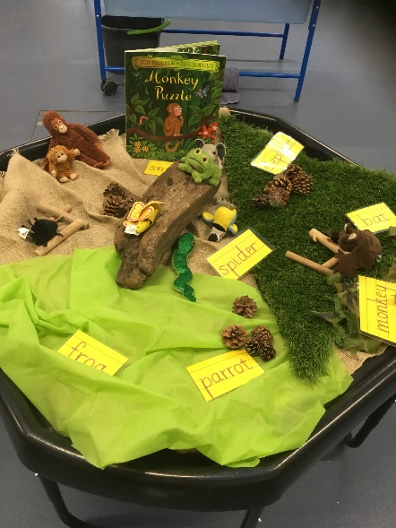
The learning opportunities we provide in Foundation build upon the interests of the children and the things they wish to learn about, partnered with the expertise and creativity of the staff, all of which is reflected in the classrooms and outside learning spaces.

Slide 11
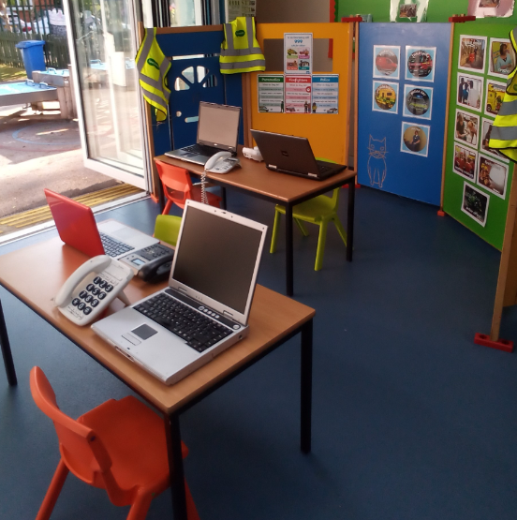
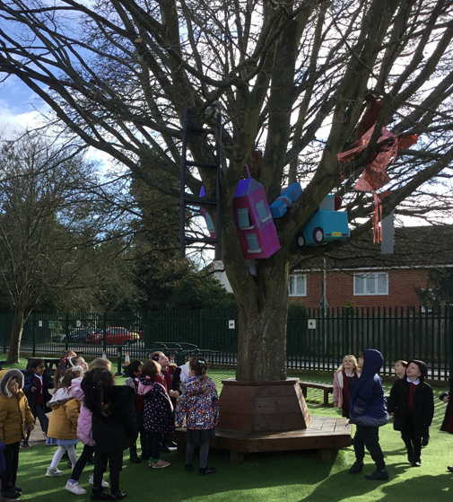
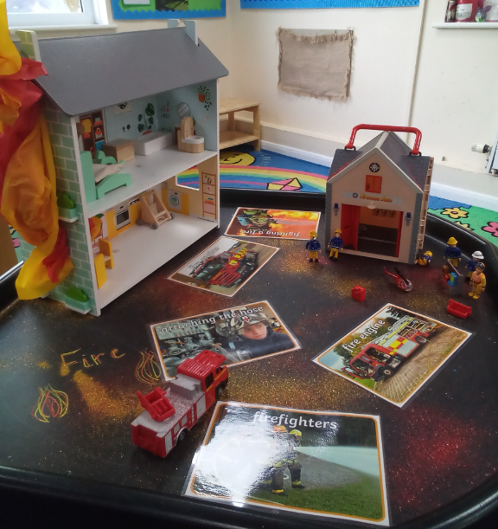
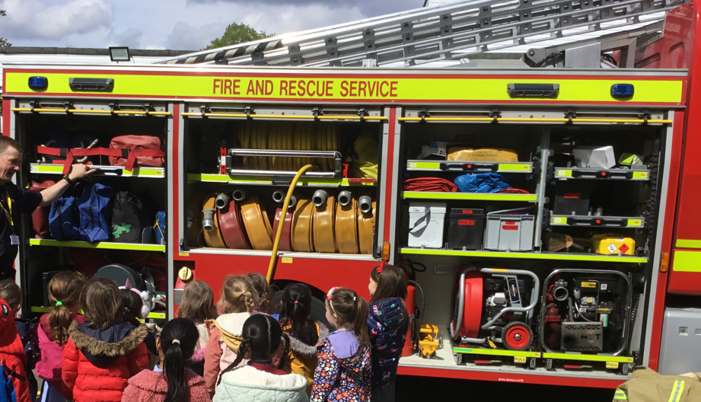
At Walter Infant School and Nursery the children have the opportunity to learn in an environment that is exciting, stimulating, awe-inspiring and memorable.

Slide 12
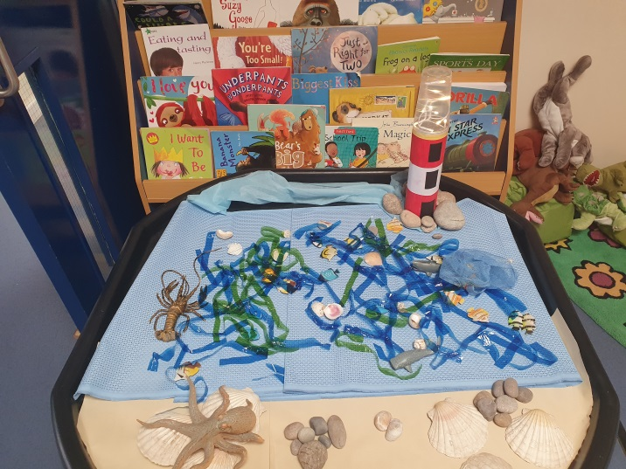
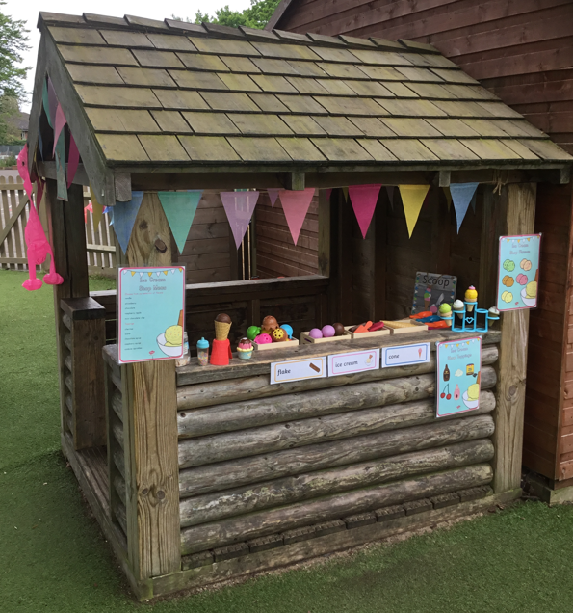
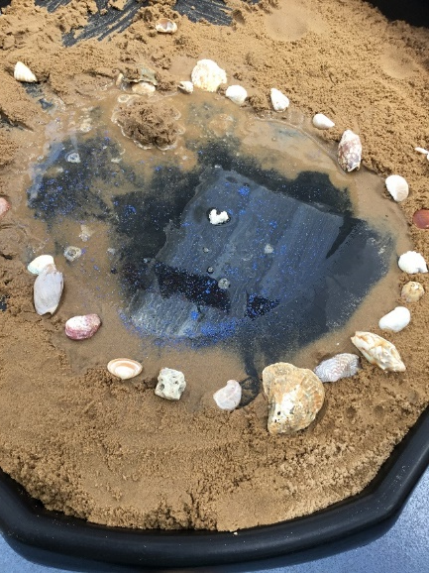
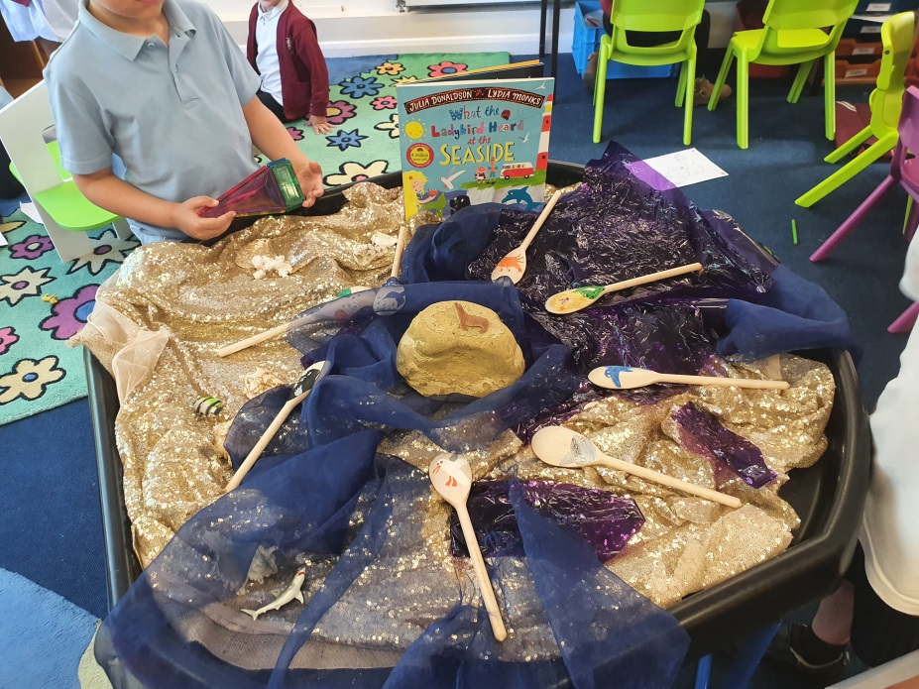

Slide 13
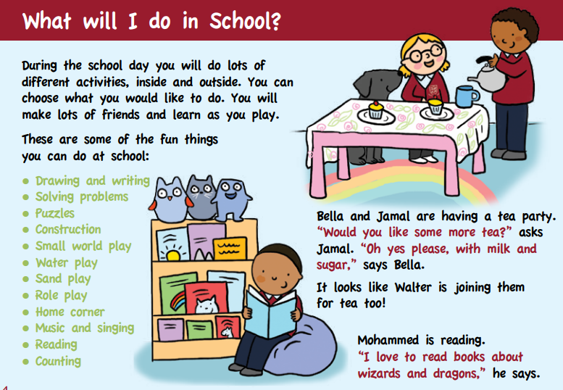
How will your children learn at Walter Infant School and Nursery?

Slide 14
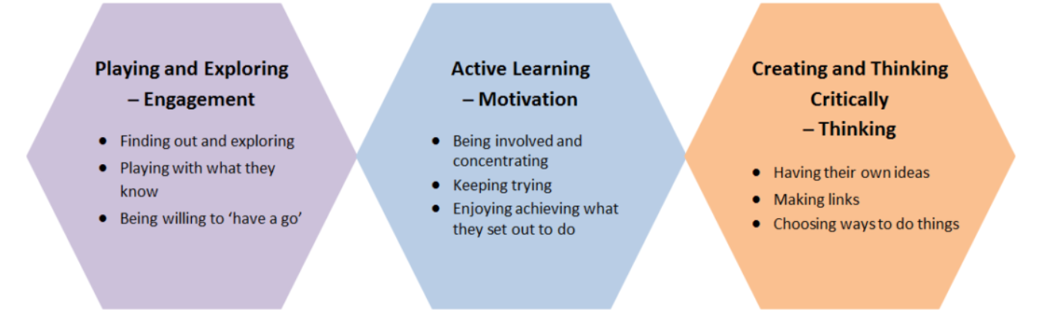
Characteristics of effective learning
Ready
Willing
Able
Notes:
Importance of environment: Opportunities we set up: adult directed – one things comes across is that modelling, guiding, talk with children.
Prime areas are time sensitive – must acquire in EY, as if delayed as consequences in terms of development. Physically bigger but soc/emo struggle. PD – need to develop core strength & refine movements – need to dev 0-5
CLL – research last 10 yrs comm importance – narrow the gap/ chn behind/ in terms of deve – key indicator of what chn can ach at KS1 and KS2 (DM & Ofsted fmwk – statements run through like a stick of rock): Cof EL
Outcomes in reading are dependent on characteristics of effective learning (CoEL), in addition to phonic knowledge – learning to read is difficult, so children need to be able to persevere, be willing to have a go, and not be put off when they make mistakes.
Outcomes in writing are also linked to CoEL as well as to physical development; not just fine motor skills, but upper body and core strength are essential if a child is to be able to write comfortably.
A focus on communication and language is essential if we are to enable children to write meaningfully and for a purpose. As Britton said, “Early literacy floats on a sea of talk”. If a child is unable to sequence and articulate their thoughts in a meaningful way, writing will be very difficult. This is where creative development and role play come into their own. In fact, role play is highlighted as an important feature of early years practice in Bold Beginnings, unfortunately, it isn’t mentioned in the recommendations. Communication and language are also linked to outcomes in maths. Children will find problem-solving and reasoning about numbers and shapes highly problematic if they do not have the right vocabulary, ability to process and confidence to express their thoughts.
Finally, the often overlooked “understanding the world” impacts on outcomes in reading, writing and maths. If children are to be able to really understand texts, to infer, deduce and make predictions, as real readers, they need to understand the world which they are reading about. If they are to write for a purpose, they need to have something to write about. If they are to use maths in meaningful contexts, they need to fully experience and understand those meaningful contexts. He says the what is really important: what they learn is equally important as how you go about it. It has to have equal focus. If a child is involved dynamically in what they are learning then they will demonstrate connections, and creative thinking and motivation in learning more about it. So, the content and progression is equally important as how they learn it.

Slide 15
Adult led activities
Children will have whole class inputs and then will be able to practise the skills learnt in a small group with an adult
Small group work will be focused on writing, reading, maths, speaking activities and will tailored to children’s stage of learning
F2 will have guided reading in a group with a Teacher
Daily phonics sessions
Weekly PE session

Slide 16
Child Initiated Learning
Children will be learning through play and exploration.
Learning through play will be supported and extended by our carefully planned and resourced learning environment as well as through interaction with adults.
Children will be given opportunities to develop the skills they have learnt during adult led activities with increasing independence.
Children will have the opportunity to choose their own learning opportunities and follow their interests
They will be able to explore outside at most times and in most weathers!

Slide 17
Early Learning Goals
There are 17 Early Learning Goals which we will be working towards over the year.
These are used to inform our planning and curriculum and what we aim for all children to achieve by the end of Foundation Stage.
They are split into different areas of learning:

Slide 18
Communication and Language
Listening, Attention and Understanding
Speaking

Slide 19
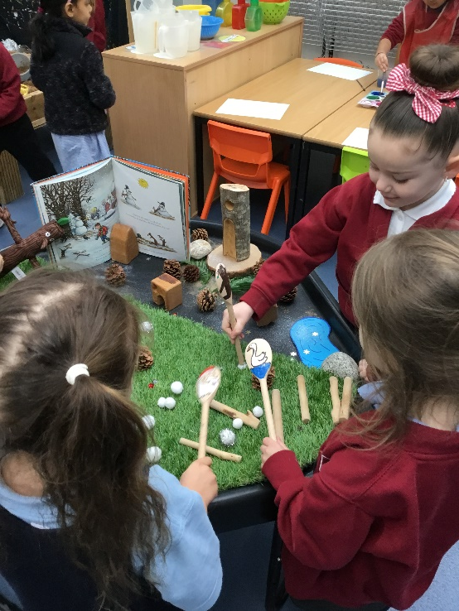
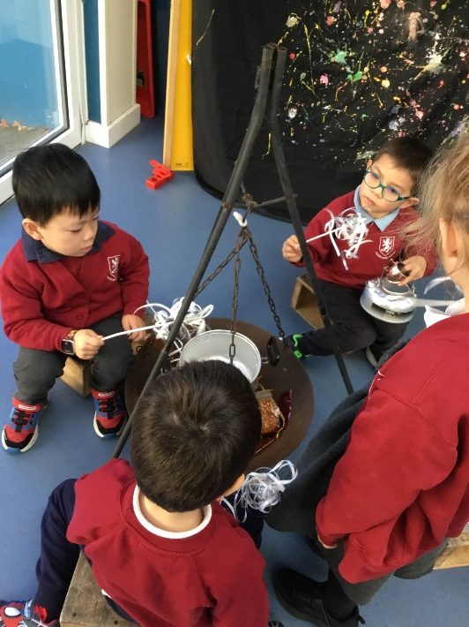
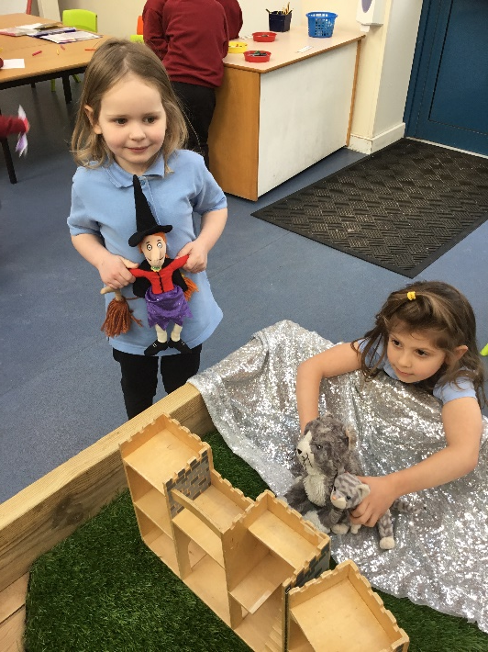
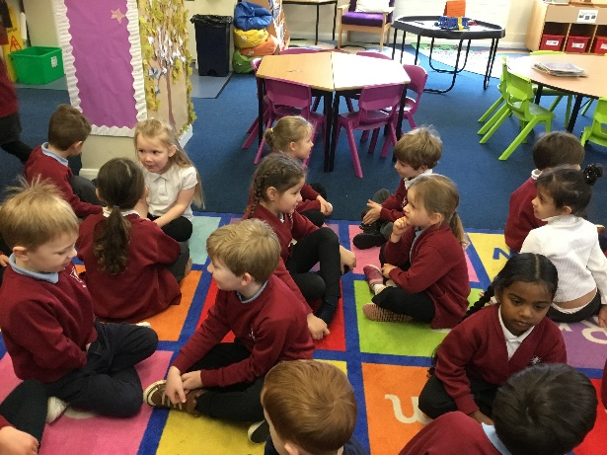
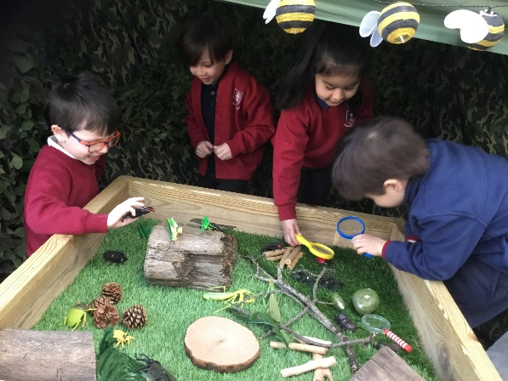
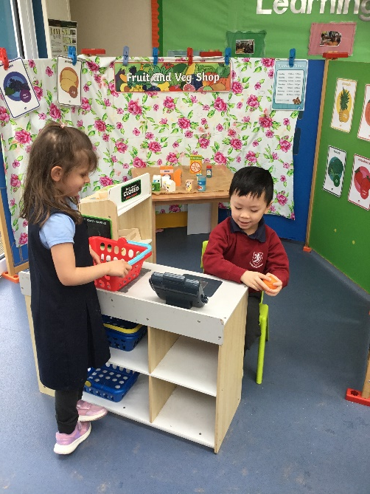

Slide 20
Personal, Social and Emotional Development
Self-Regulation
Managing Self
Building Relationships

Slide 21
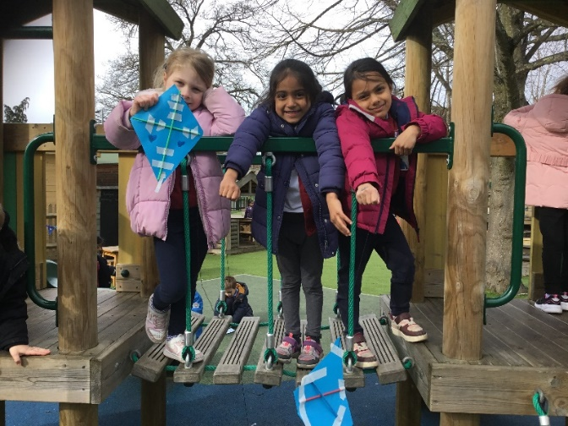
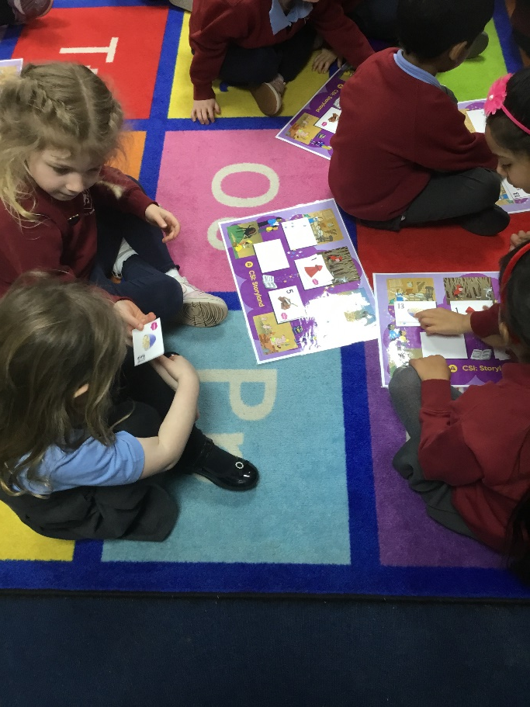
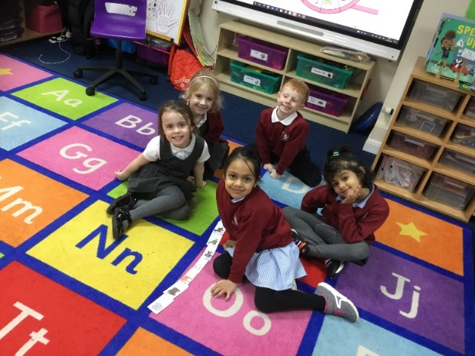
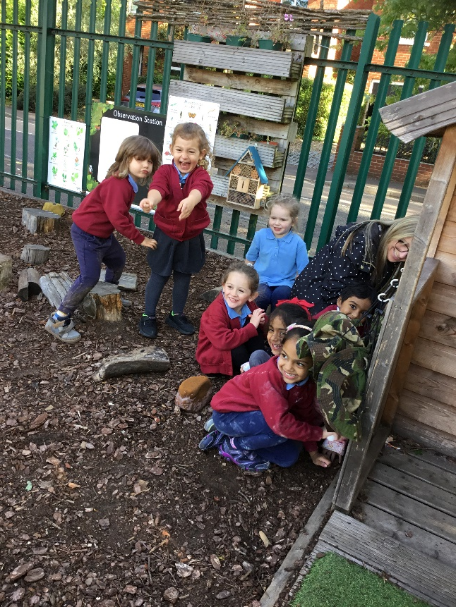
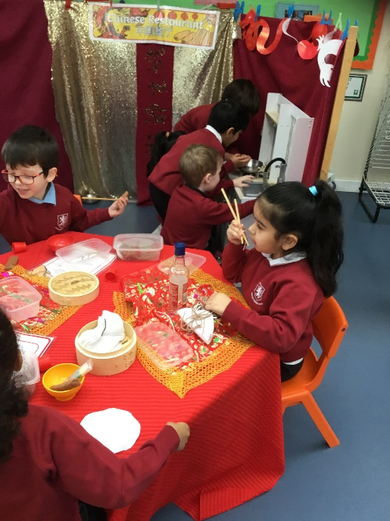
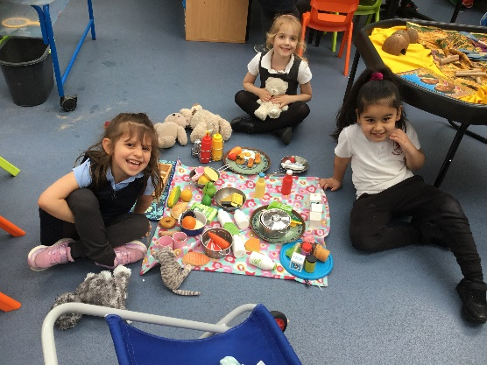

Slide 22
Physical Development
Gross Motor
Fine Motor

Slide 23
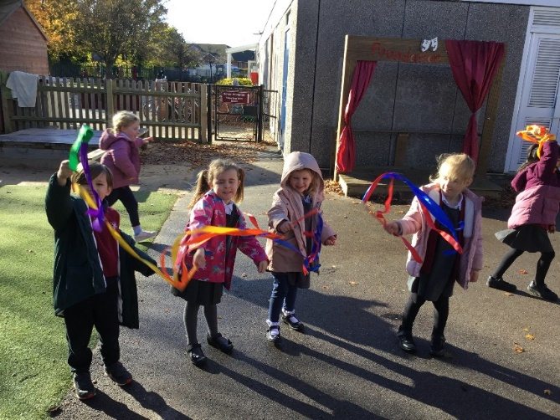
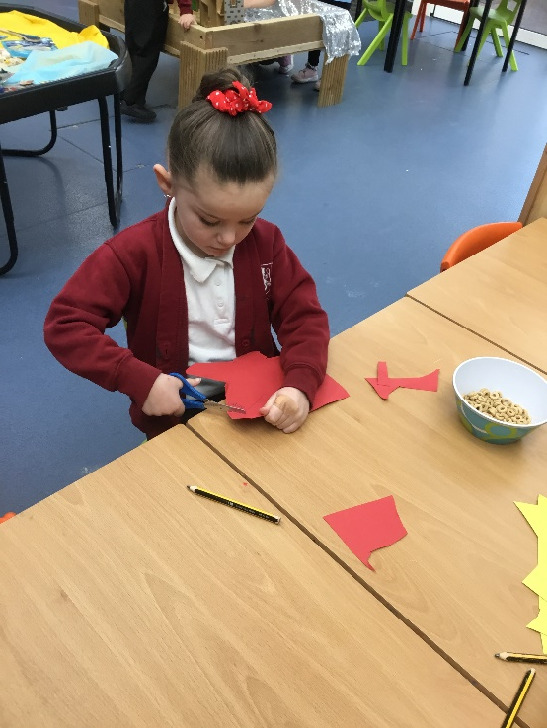
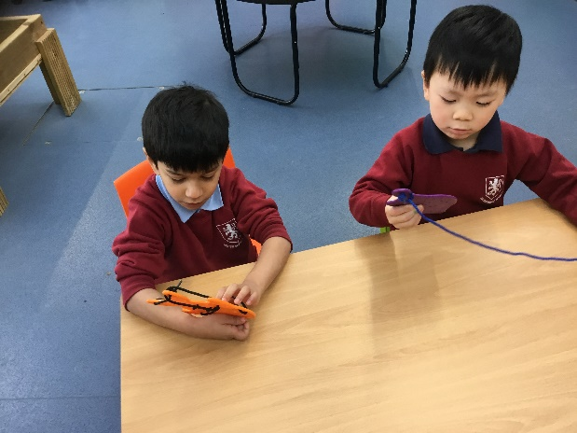
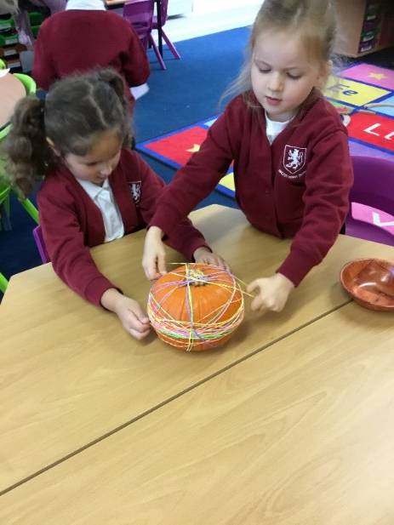
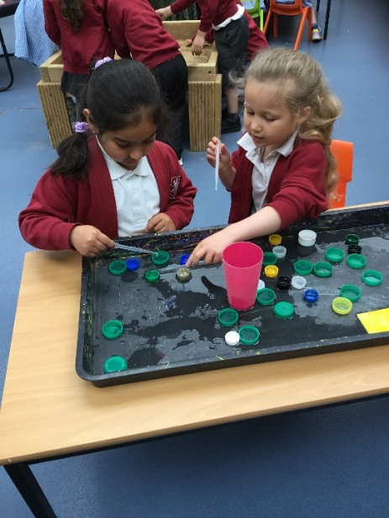
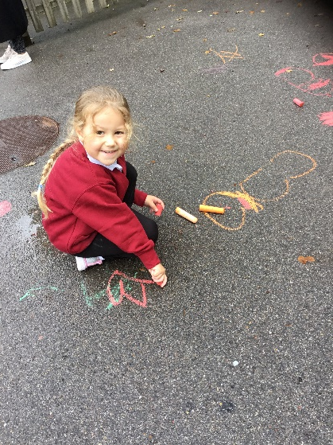
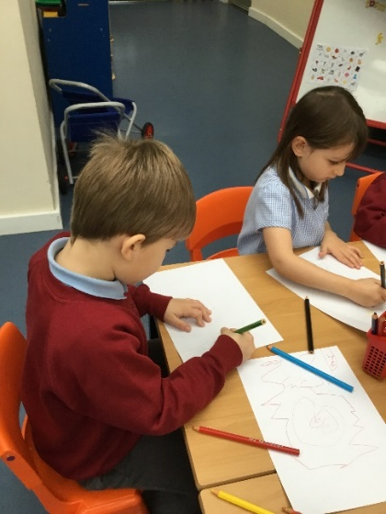

Slide 24
Literacy Development
Comprehension
Word Reading
Writing

Slide 25
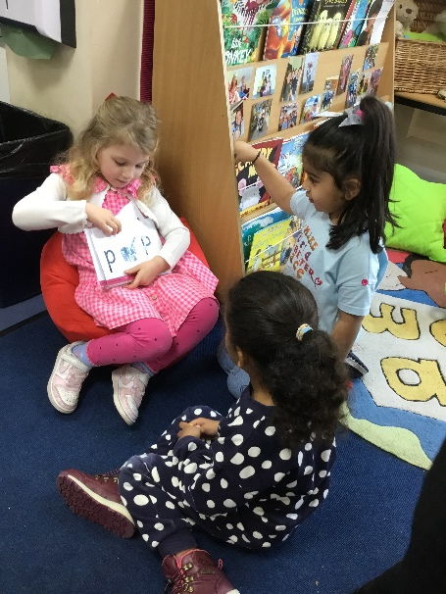
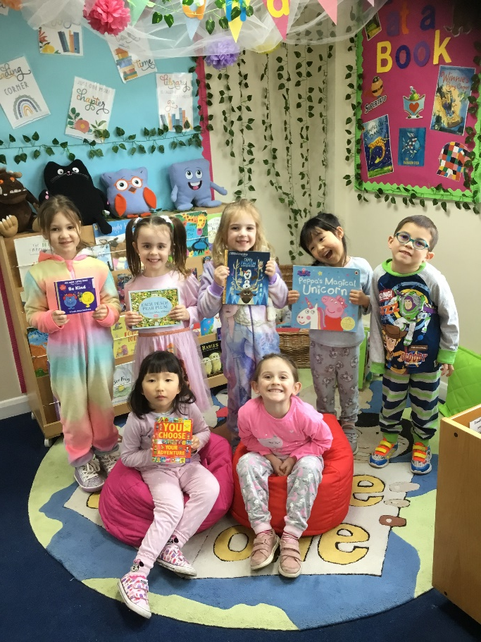
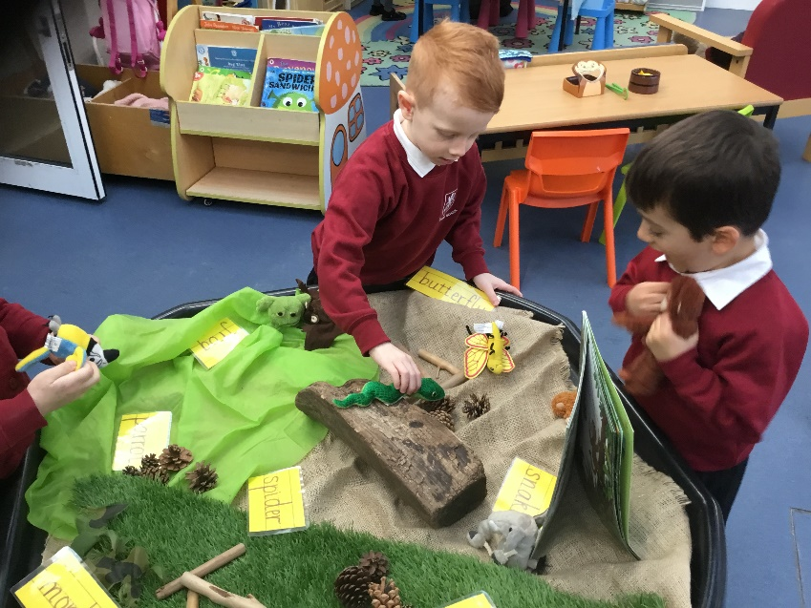
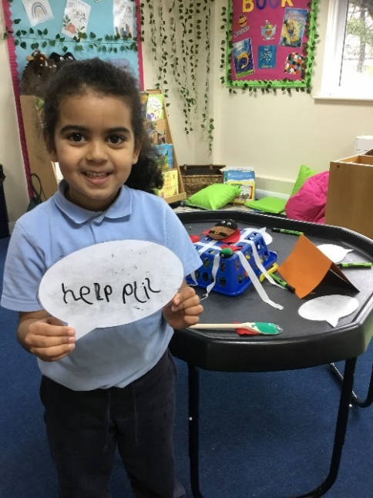

Slide 26
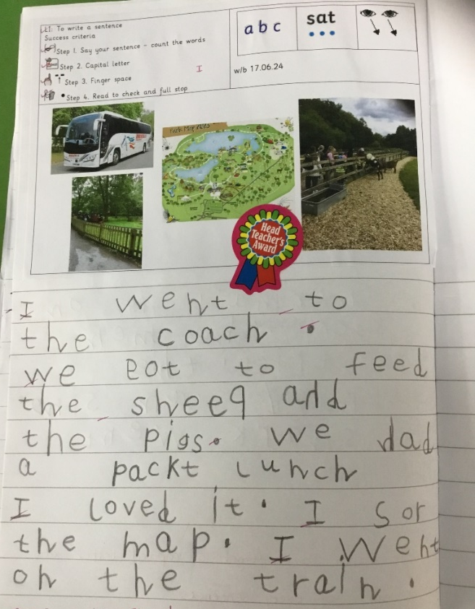
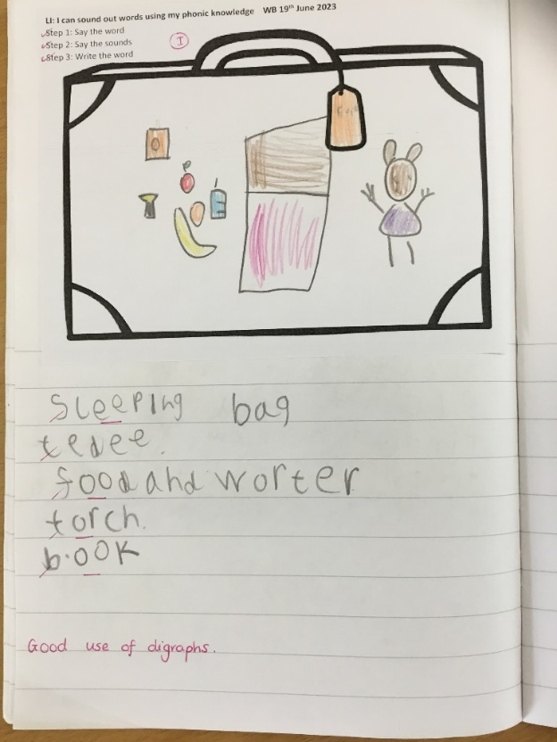

Slide 27
Mathematical Development
Number
Numerical Patterns

Slide 29
Understanding the World
Past and Present
People, Culture and Communities
The Natural World

Slide 32
Expressive Arts and Design
Creating with Materials
Being Imaginative and Expressive

Slide 35
Working Together
Please can you:
Keep us informed of any changes that may impact on your child, for example, a new baby.
Read, sign and comply with our Home School Agreement
Update personal details, including telephone numbers
Ensure that any prescribed medication your child needs is presented at the school office and is correctly labelled and in date. We will not accept it if not.

Slide 36
Working Together
Please be punctual at the beginning and end of the day
Please let us know if you will be late to collect your child from school
Please inform us of the adults who will collect your child from school ~ all families will need a password to share
Please ensure your child attends school unless they are poorly
Please do not take holidays in term time.

Slide 37
Healthy Schools
So that we can be a healthy school;
Please inform us if your child is unwell, or will be absent from school by telephone or email every day they are absent. If we do not hear, we will contact you for safeguarding reasons.
Please keep your child at home if they are unwell.
If your child has sickness or diarrhoea they must stay at home for 48 hours.
Please ensure your child has a named water bottle in school everyday.
Do not bring any products into school that contain nuts, including peanut butter, pesto or coconut.

Slide 39
Rise and Shine club
The club begins at 7:30am, the children will be delivered to their classes at 8:40am.
It is run by our own team of staff.
There is a wide variety of activities are provided including colouring, drawing, construction, table top games. The children will also have the opportunity to access the computer suite and play games available on the learning platform.
Please provide a snack and a drink for your child.
Places in the club are limited, if you would like to register your child please fill in the form in your pack and return to the School Office asap.

Slide 40
Milk and Fruit
If you would like your child to have milk – please register directly with Cool Milk.
The milk is free until the date of your child’s 5th birthday – but they can continue to have milk each day for a small payment.
Every child will have a piece of fruit or a vegetable snack each day, which is provided free of charge.
Please inform the school office of any allergies or intolerances to food or drink.

Slide 41
School Lunches
Universal Free School Meals:
Every child in Foundation Stage and Key Stage 1 is entitled to a Universal Free School Meal.
The children can select from two main choices or a jacket potato.
There is a vegetarian option every day.
The menu is available on the school website and the children will bring a copy home on their first day at school.
If you choose to send a packed lunch, please ensure that it is a healthy lunch without sweets, nuts or unhealthy snacks.

Slide 42
Walter Infant School and Nursery Values

Slide 43
Our Values

Slide 44
Expectations for Behaviour
Treat each other with respect
Be kind and polite to everyone
Tell the truth
Look after the school and the things in it
Move around the school sensibly
Always try your best

Slide 45
Our School Uniform in Foundation Stage
Please send you child to school in clothes that are easy for them to manage by themselves; we suggest elasticated waits for trousers, joggers, shorts or leggings. These can be navy, black or dark grey (please do not choose lighter blues or light grey and no patterns).
You can choose pinafores or summer dresses (tights can be very hard to manage in the winter) some children wear cycling shorts under their dresses.
Polo shirts can be white, sky blue or navy blue depending on your preference; they all look smart.
The children can have cardigans or sweatshirts; these must be burgundy. We sell second hand ones via our PTA or you can order from Gooddies ~ information to order uniform is in your pack.

Slide 46
Trainers with Velcro are best!

Slide 47
Being Ready for School
You can help prepare your child for school by encouraging their independence as much as possible and being positive when talking about school.
Help your child to go to the toilet all by themselves, including wiping and handwashing.
Encourage your child to manage their own clothing such as coats and jumpers ~ but of course we will help (hence no laces!)
Practise recognising their name or the first letter of their name. If practising writing their name please remember to only use a capital at the beginning e.g. Ada, Billy, Clara, Dhruv, Emily etc
Please label all their clothes ~ check out Stickins as they really do work
Always send in a coat – we will go outside in all weathers.

Slide 51
Any questions?
We are so looking forward to your children joining us; we recognise what a big event this is within your family unit and we want to get it right for you and your child.
We hope you have had the opportunity to have a look around the Foundation Stage to see the learning environment.
If you think of anything at all that you didn’t ask or need to know, just get in touch by phone or email.

