Slide 1
Annual General Meeting 27th September 2019
Walter Infant School
Parents Association
Registered Charity No. 280323
Unrestricted

Slide 2
Introductions
Co-Chairs: Emma Leigh & Tina Penman
Secretary: Amy Shakespeare
Treasurer: Rachel Cole
Teachers
Parents

Slide 3
Agenda
Apologies for absence
Minutes of the 2018 Annual General Meeting
Chair’s & Treasurer’s Report for 2018/2019 (ending 31st August 2018)
Election of Officers of the Committee
Chair
Secretary
Treasurer
Ordinary Committee members
Date for 1st committee meeting of the year
Any other business

Slide 4
Absences & Minutes from Previous AGM
Any Absences?
Minutes from previous AGM
Held on 12th October 2018 in the Hall
Available on the school website
Request for proposer - minutes as a fair representation of last year’s meeting?
Request for second

Slide 5
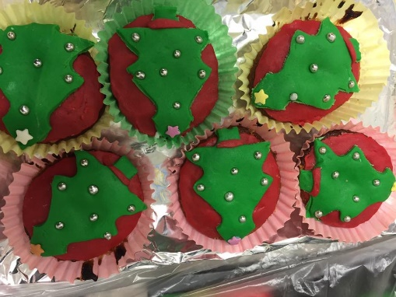
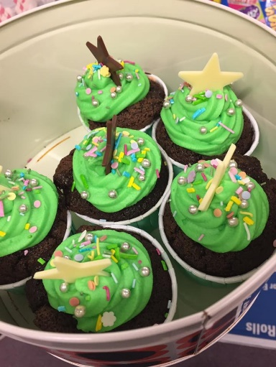
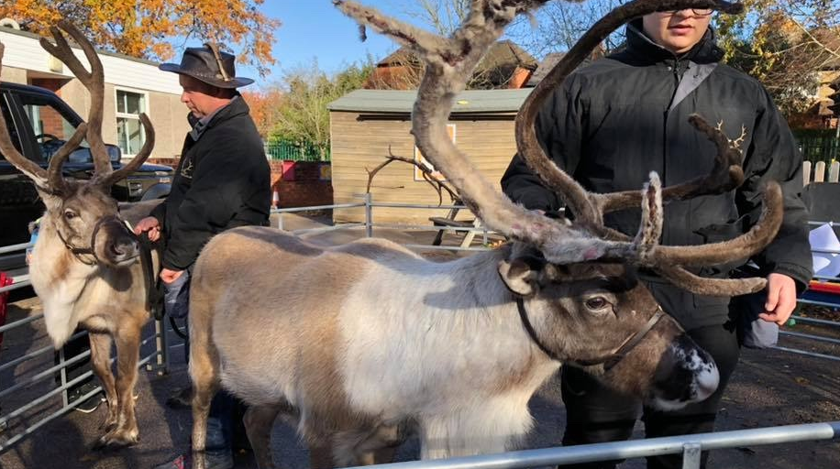
Chair’s & Treasurer’s Report
Highlights from Last Year

Slide 6



Chair’s & Treasurer’s Report
Highlights from Last Year

Slide 7
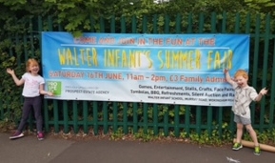


Chair’s & Treasurer’s Report
Highlights from Last Year

Slide 8
Chair’s & Treasurer’s Report
Investments made during 2018/19
At the year end, we had committed to contributing £7,000 towards the new KS1 climbing frame.
The remaining bank balance at the end of the year was £9,522.12 (at 31st Aug 2019)

Slide 9
Chair’s & Treasurer’s Report
Request for proposer – accounts a fair representation?
Request for second

Slide 10

THANK YOU!!!
Parent volunteers
Teachers, in particular Mrs Wheeler, Mrs Prickett, Mr Lee, Mrs Lewis
Fellow committee
This Photo by Unknown Author is licensed under CC BY-NC-ND

Slide 11
Election of PTA Roles
Re-elections of
Co-chairs – Emma Leigh & Tina Penman
Nominations for Treasurer role
Kelsey Guo
??
Nominations for Secretary
Rachel Cole
??
Propose
Second

Slide 12
AOB
Any other business?
Date for 1st committee meeting of the year
Fundraising ideas
Dates for events
Spending ideas

