Slide 1
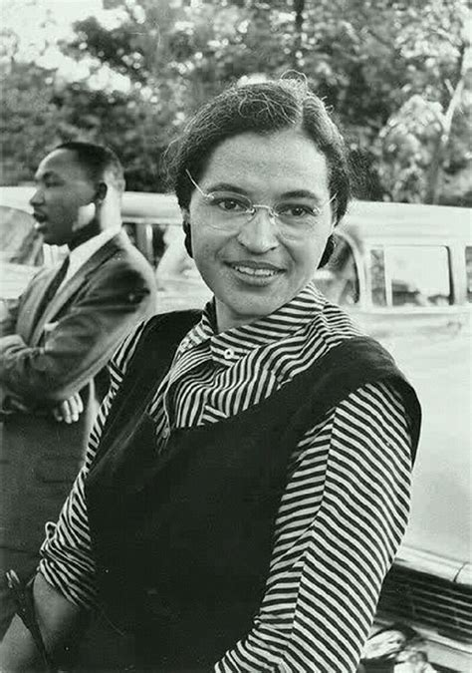
Rosa Parks

Slide 2
Recently, an episode of Doctor Who featured Rosa Parks.
The YouTube link below is a short video clip from that episode showing what happened to Rosa Parks.
https://youtu.be/FPvwKP8G4sA

Slide 3
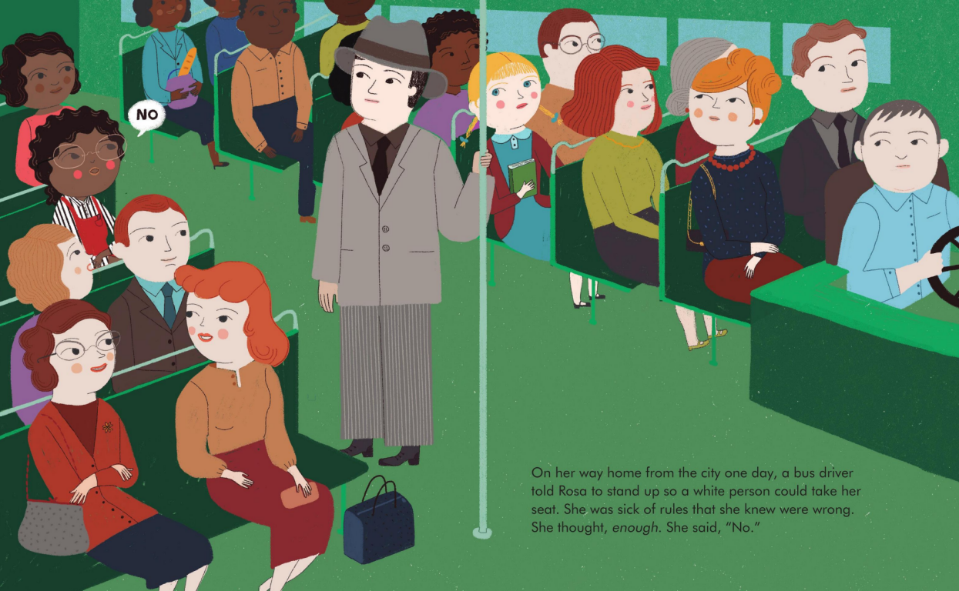
We read the story of Rosa Parks to the children. You can purchase this fabulous book from Amazon.
https://www.amazon.co.uk/Rosa-Parks-Little-People-Dreams/dp/1786030179/ref=sr_1_1?ie=UTF8&qid=1548770474&sr=8-1&keywords=rosa+parks

Slide 5
At Walter Infant School and Nursery we:
Notice and respect similarities and differences between people including physical appearance, background and beliefs, family, religion and language
Understand what bullying behaviour is, and that there are different types of teasing, joking and bullying and that bullying is hurtful and wrong
Learn how to respond appropriately to bullying behaviour, we know what to do and who to tell
Want everyone to have a positive self-image and show that they are comfortable with themselves.
Have a developing awareness of our own needs, views and feelings and we are sensitive to the needs, views and feelings of others.

Slide 6
So…….
Why are we having this assembly?
Some children have been sharing racist jokes – jokes about the colour of people’s skin!
Some children have used racist language that they may have heard on video games or You Tube or they may have heard teenagers or adults using!
Some children have been swearing!

Slide 7
So…….
What should you do if you hear this sort of language?
Tell the person that it is wrong.
Report it to an adult in school.
Tell a grown up at home so that they can let us know.
Racist and disrespectful behaviour will not be tolerated at Walter Infant School and Nursery.

