Slide 1

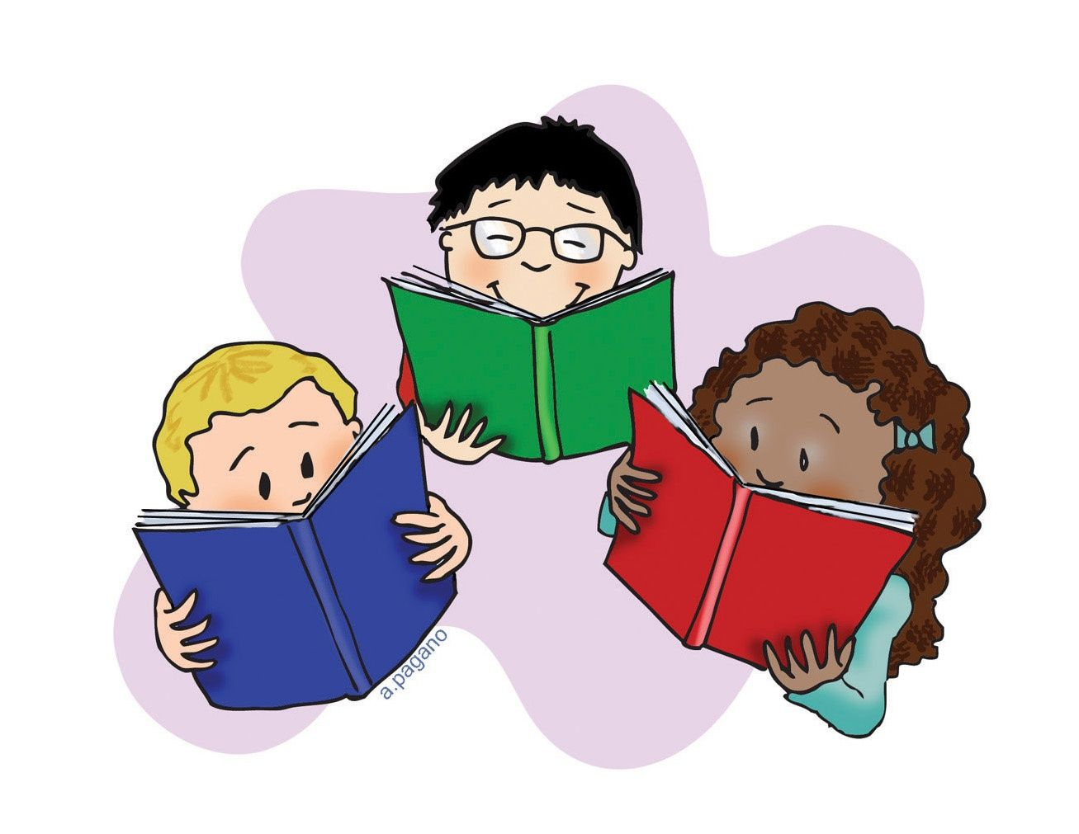

Phonics and Reading
in Key Stage One at
Walter Infant School and Nursery

Slide 2

We teach reading and the associated
skills across the curriculum!

Slide 3

Developing Children’s Spoken Language
The skills for reading develop before children encounter a book. This is driven by the quality of a parent’s talk and the child’s exposure to language and images.
Children need to hear lots of different talk; conversations, instructions, questions, suggestions. They will spend time listening to others, they will absorb the talk around them, mimic it and practise making different sounds and using new words.
We have hundreds of toys and books to stimulate speaking as we try to make all our learning fun.

Slide 4
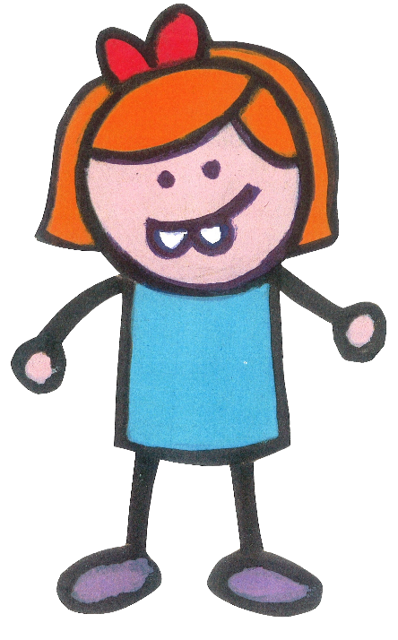
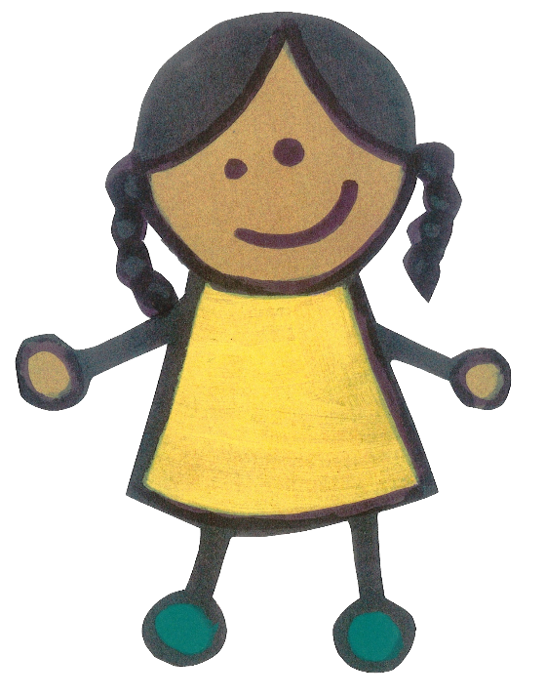


The Simple View of Reading
Reading can be broken down into two processes or dimensions: word recognition and language comprehension. Phonics helps with word recognition or decoding words so they can be read.
Phonics does not help develop language comprehension; the understanding of what is being read. This is done through questioning and discussion before, during and after reading a book or text.

Slide 5

Why Reading Matters
Reading is an essential skill for life. At Walter Infant School and Nursery we dedicate ourselves to ensuring our children are all readers by the time they leave for Junior School. There is much research and many studies which agree that reading brings social, cultural and economic value to a person’s life. If a child cannot read, it can have a life long impact.

Slide 6







Print to Meaning
Phonics gives the children a strategy needed for word recognition only. Language comprehension is primarily developed through our Guided Reading sessions. Phonics is about turning the marks on the page, the symbols or letters into a sound. Below are some examples of this. What do the following symbols mean?

Slide 7
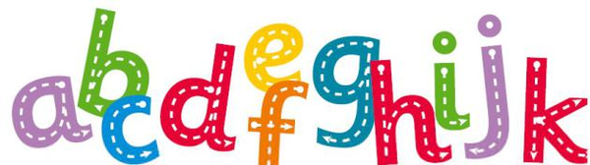

What is Phonics? Why is it so important?
Phonics is a strategy used for word reading or decoding; we also use it for spelling.
Phonics is the prime method for decoding (reading) and encoding (spelling) newly encountered or unfamiliar words.

Slide 8
Technical Vocabulary
Letters – the 26 letters of the alphabet.
Vowel – the letters a, e, i, o, u.
Consonant – all the letters that are not vowels.
Grapheme – the written representation of a sound or phoneme made up of one or more letters.
Phoneme – the smallest possible units of sounds that makes up a word.
Digraph – two letter grapheme (ea, ay)
Trigraph – three letter grapheme (igh, ear)
Quadgraph – four letter grapheme (eigh)
Split digraph – where the letter ‘e’ at the end of the word changes the vowel sound, e.g. snake, flute or mike.
Common exception words – words that are not so easily; or impossible to decode using phonics.
Grapheme-Phoneme correspondence (GPC) – the process of identifying that a grapheme represents a phoneme or sound.
Segment – breaking down words into their smallest possible phonemes or phonemes.
Blend – to join the phonemes or sounds together to make a word.
Decode – when phonics is used for reading.
Encode – when phonics is used for spelling.

Slide 9


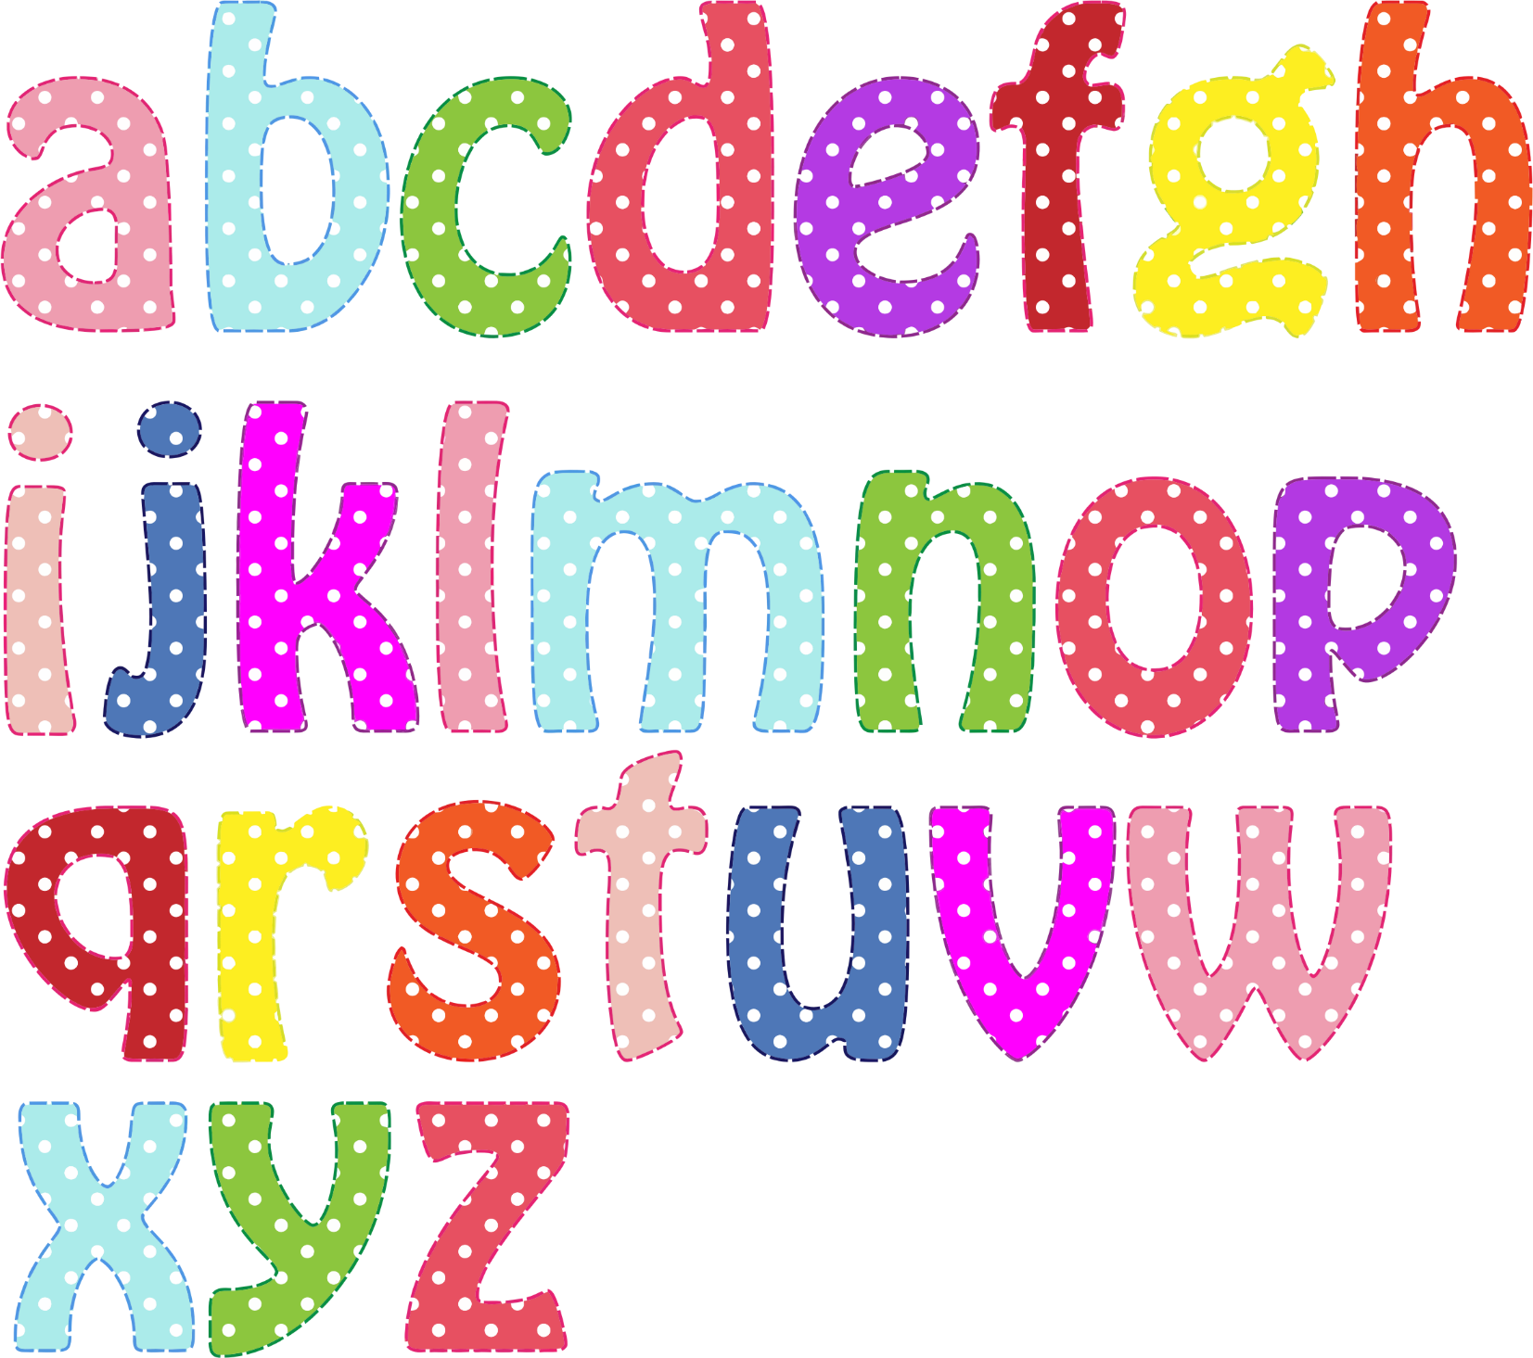

The English Language
There are 26 letters
in the alphabet.
40+ phonemes or sounds in the English language, accounting for regional dialects.
Over 200 graphemes or written representations of these sounds. Sounds or phonemes can have one or more grapheme for example the sound s can be spelt with an ’s’ or a ‘c’.
Notes:
There are 26 letters in the alphabet.
40+ phonemes or sounds in the English language, accounting for regional dialects
Over 200 graphemes or written representations of these sounds. Sounds or phonemes can have one or more grapheme for example the sound s can be spelt with an ’s’ or a ‘c’

Slide 10
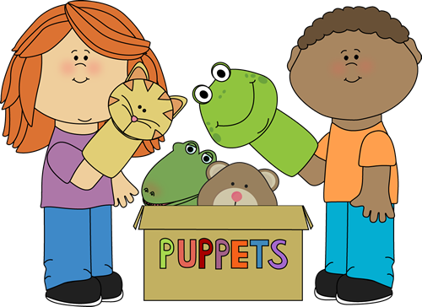
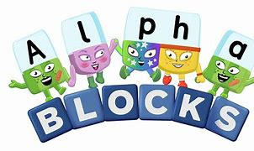
Enunciation and Pronunciation of Phonemes
It is very important to make the sound of each letter or group of letters correctly; we are going to teach you how in a moment or two!
We teach the children how to move their mouths and tongues to pronunciate the sound.
If children have speech and language difficulties this will be much harder for them to do, so they will receive additional support.
Alphablocks, on the BBC website or iPlayer, is very good at teaching the letter names and phonemes or sounds.
Notes:
There are 26 letters in the alphabet.
40+ phonemes or sounds in the English language, accounting for regional dialects
Over 200 graphemes or written representations of these sounds. Sounds or phonemes can have one or more grapheme for example the sound s can be spelt with an ’s’ or a ‘c’

Slide 11

The Added Schwa
This is where things get complicated!!!!!!
The schwa sound is the ‘uh’ sound. It exists in many words in the English language. It is an unstressed vowel sound, where the vowel is neither long or short. It is the most common vowel sound; everyone at school has to be careful not to add it on when saying a phoneme.
m = “mm” and not “muh”
s = “ss” and not “suh”
Also, remember to keep the phonemes ‘clipped’ so they are not elongated. Think of them them as short and snappy.
m = “mm” and not “mmmmmm”
s = “ss” and not “ssssssssssss”
Notes:
There are 26 letters in the alphabet.
40+ phonemes or sounds in the English language, accounting for regional dialects
Over 200 graphemes or written representations of these sounds. Sounds or phonemes can have one or more grapheme for example the sound s can be spelt with an ’s’ or a ‘c’

Slide 12
Letters and Phonemes
There is a difference between letters and phonemes. Think of the word ‘letter’ as the name of the letter and the ‘phoneme’ as the sound it makes; BBC’s Alphablocks illustrates this very well. Do not be afraid to use these interchangeably. Use the letter name when discussing what letters make up a digraph, for example ‘or’ is made up of the letters o and r not ‘oh’ and ‘rrr’ and makes the sound “aw”. Here are some examples with the “k” sound or phoneme.
This is the letter “kay” and it makes the sound “k” as in kite. | This is the letter “see” and it makes the sound “c” as in cat. | This is the digraph “ck” as in wick. It is made up of the letters “see” and “kay”. | This is the digraph “ch” as in school. It is made up of the letters “see” and “aitch”
k | c | ck | ch
Notes:
There are 26 letters in the alphabet.
40+ phonemes or sounds in the English language, accounting for regional dialects
Over 200 graphemes or written representations of these sounds. Sounds or phonemes can have one or more grapheme for example the sound s can be spelt with an ’s’ or a ‘c’

Slide 13
Sound Buttons
We can add sound buttons to words to help the children to segment and blend. We use a dot for a single letter grapheme, a dash for a multi-letter grapheme and a curve for a split digraph. Here are some examples:
c a t
s h o p
t a p e
Notes:
There are 26 letters in the alphabet.
40+ phonemes or sounds in the English language, accounting for regional dialects
Over 200 graphemes or written representations of these sounds. Sounds or phonemes can have one or more grapheme for example the sound s can be spelt with an ’s’ or a ‘c’

Slide 14


The Letter H!
The letter H or h causes a lot of controversy. People call this letter different things. To settle any disagreements at Walter Infant School and Nursery, we inform everyone to say it as “aitch” and not “haytch”.
Ohh look its ‘aitch’!
Notes:
There are 26 letters in the alphabet.
40+ phonemes or sounds in the English language, accounting for regional dialects
Over 200 graphemes or written representations of these sounds. Sounds or phonemes can have one or more grapheme for example the sound s can be spelt with an ’s’ or a ‘c’

Slide 15

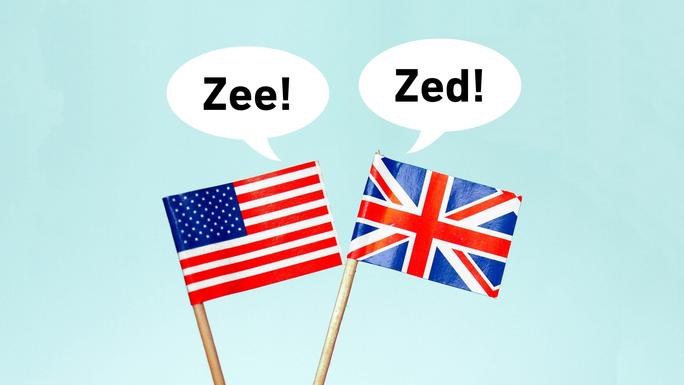
The Letter Z!
The letter Z or z causes a lot of controversy. People call this letter different things. Some people refer to as “zee” and some people refer to it as “zed”. “Zee” is the American name for this letter, this is due to American television programmes and people learning American English more widely. However, in British English, it is called “zed”.
Notes:
There are 26 letters in the alphabet.
40+ phonemes or sounds in the English language, accounting for regional dialects
Over 200 graphemes or written representations of these sounds. Sounds or phonemes can have one or more grapheme for example the sound s can be spelt with an ’s’ or a ‘c’

Slide 16
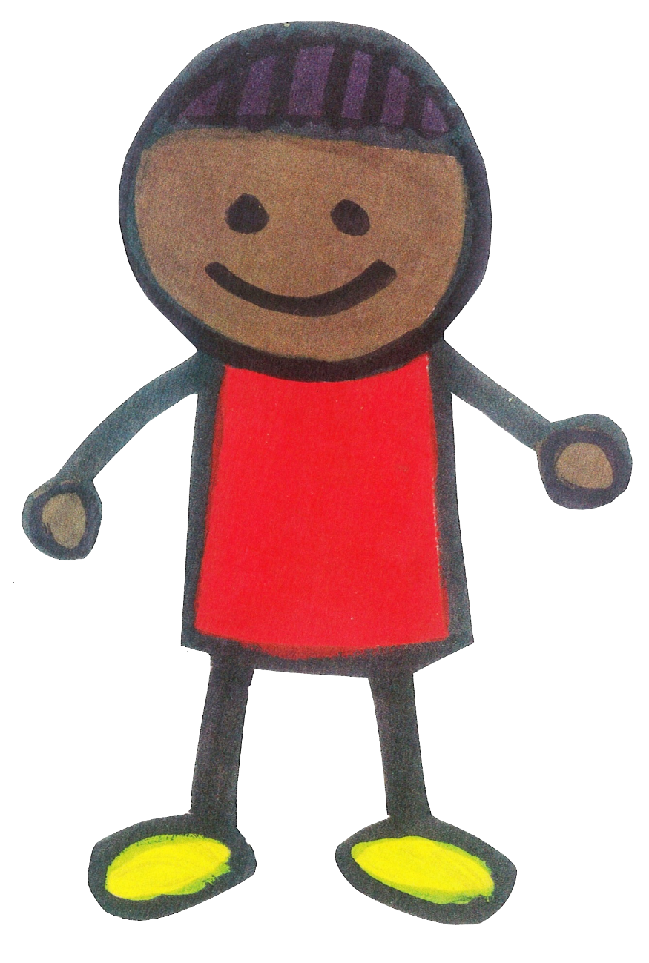
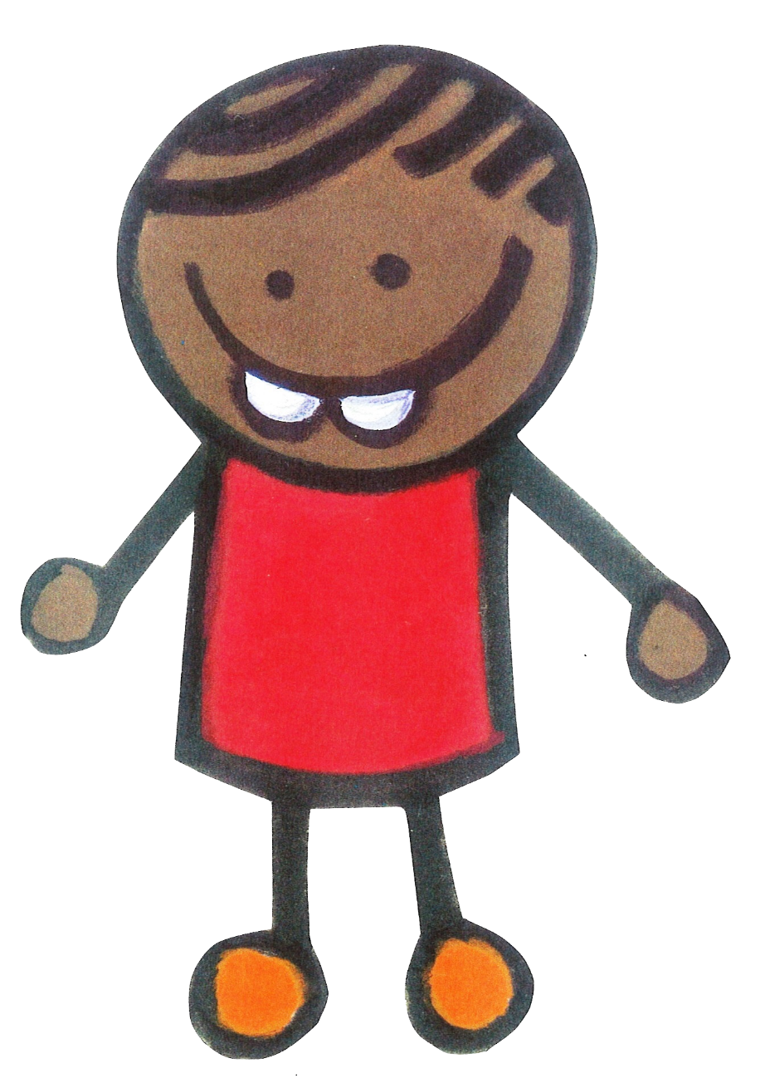




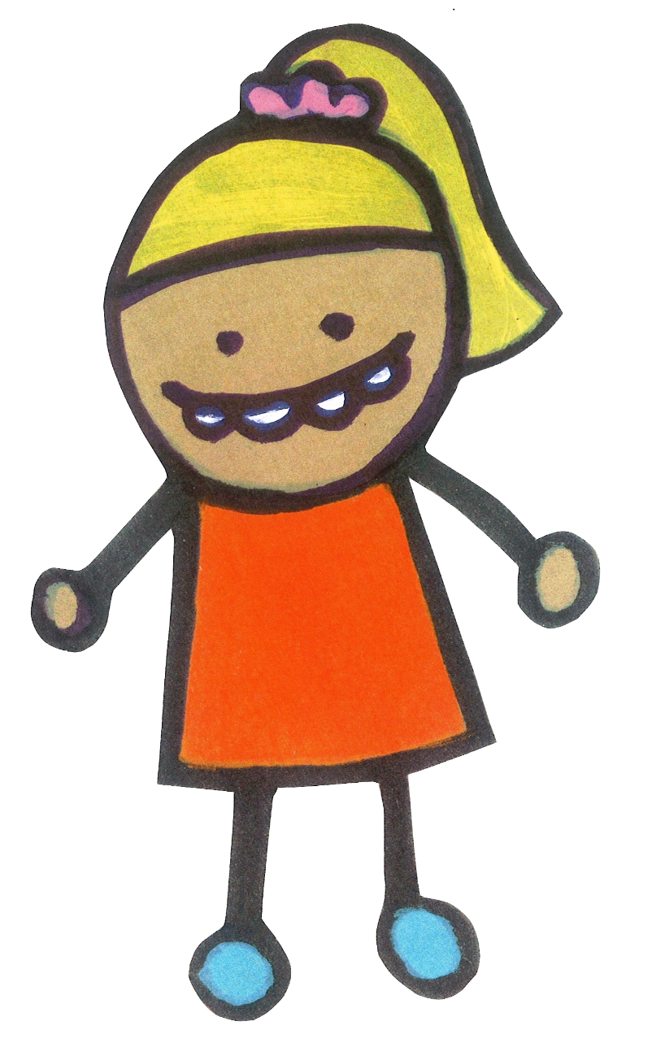
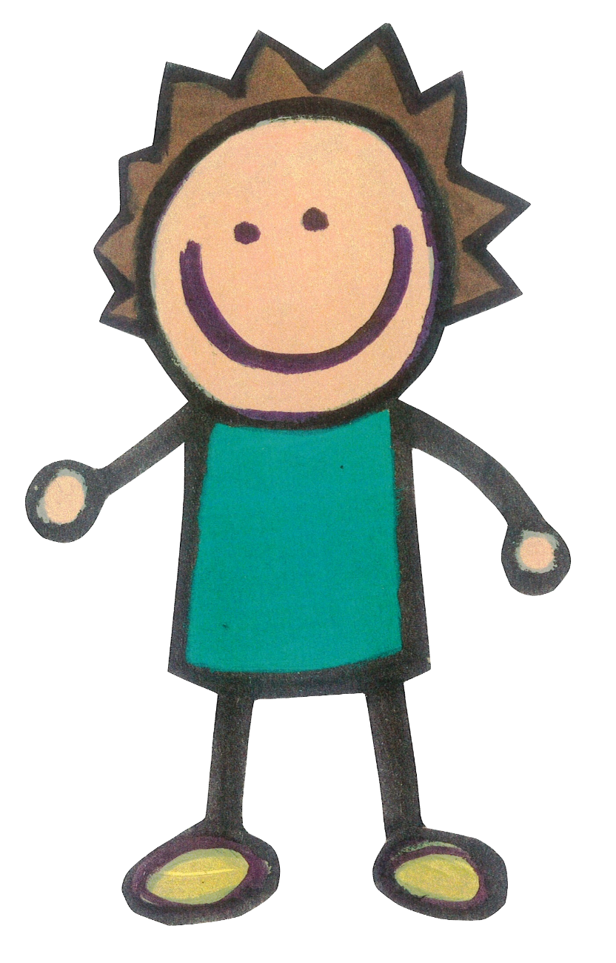
Phonics Taught in Class Groups
Phonics should primarily be taught in the class and by the class teacher. The idea is that all the children develop a broad consolidated base, which provides a secure foundation and that no child is left behind. Any children that are finding the work challenging, will have an opportunity to revisit and secure their knowledge. The idea is that gaps are closed quickly and rapidly. Some children may sit outside of this phonics provision; however, these children will have other barriers to their learning; i.e., children with an EHCP.
Notes:
There are 26 letters in the alphabet.
40+ phonemes or sounds in the English language, accounting for regional dialects
Over 200 graphemes or written representations of these sounds. Sounds or phonemes can have one or more grapheme for example the sound s can be spelt with an ’s’ or a ‘c’

Slide 17
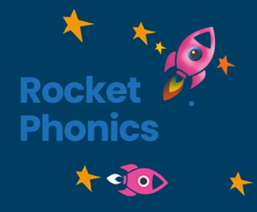
Rocket Phonics
An SSP is a systematic synthetic phonics programme. The Reading Framework and the DfE suggests and strongly urges all schools to select an SSP that best suits their needs. The DfE published a list of approved SSPs for schools to choose from.
An SSP includes a phonics programme, a reading scheme, a method for teaching handwriting and many other things.
We chose Rocket Phonics, as we felt it best reflected our school. It also allowed for a good level of flexibility, whilst ensuring rigor, parity and an holistic approach to teaching reading.

Slide 18
Rocket Phonics Progression
Rocket Phonics uses Colour Bands, similar to our home and guided reading books. They start at the beginning of F2 and progress through the programme, until the end of Year 2.
Pink (A, B & C) | Red (A, B & C) | Yellow |  | Blue | Green | Orange | Turquoise | Purple | Gold | White
Foundation 2 |  |  | Year One |  |  |  | Year Two
Notes:
There are 26 letters in the alphabet.
40+ phonemes or sounds in the English language, accounting for regional dialects
Over 200 graphemes or written representations of these sounds. Sounds or phonemes can have one or more grapheme for example the sound s can be spelt with an ’s’ or a ‘c’

Slide 19

First Steps in Phonics (Phase 1)
Aspect 1 – Environmental Sounds Going on sound walks Making or matching animal sounds Listening for sounds that are all around us Sounds of different weather | Aspect 2 – Instrumental Sounds Exploring sounds using instruments Matching sounds to their instruments Playing instruments alongside stories Making loud and quiet noises | Aspect 3 – Body Percussion Clapping patterns What sounds can we make with different body parts? Develop an awareness of sound patterns and rhythms
Aspect 4 - Rhythm and Rhyme Telling rhyming stories Singing nursery rhymes Counting or clapping the syllables in words Odd one out games, for example cat, dog, mat. | Aspect 5 – Alliteration Listening for the first sound in a word Matching objects that begin with the same initial sound Playing I-spy games | Aspect 6 – Voice Sounds Exploring different mouth movements Making different vocal sounds Using robot voices to sound out words (c-a-t)
Aspect 7 – Oral Blending and Segmenting Games that involve breaking down words into sounds or phonemes and blending. Segmenting words together and then blending.
Generally, these skills are taught during Nursery, or Robin Class at Walter.
These 7 aspects are revised again and again. They are used as a basis for teaching phonics.
Notes:
There are 26 letters in the alphabet.
40+ phonemes or sounds in the English language, accounting for regional dialects
Over 200 graphemes or written representations of these sounds. Sounds or phonemes can have one or more grapheme for example the sound s can be spelt with an ’s’ or a ‘c’

Slide 20
Graphemes and Phonemes
The children have five discrete phonics lessons a week. By the end of Year One, the children are expected to know all the following phonemes and graphemes. We are going to practise these together.
Notes:
In Phase 2 the children learn the first sounds or phonemes. The learn to read and spell words containing these graphemes and phonemes.

Slide 21

s

Slide 22
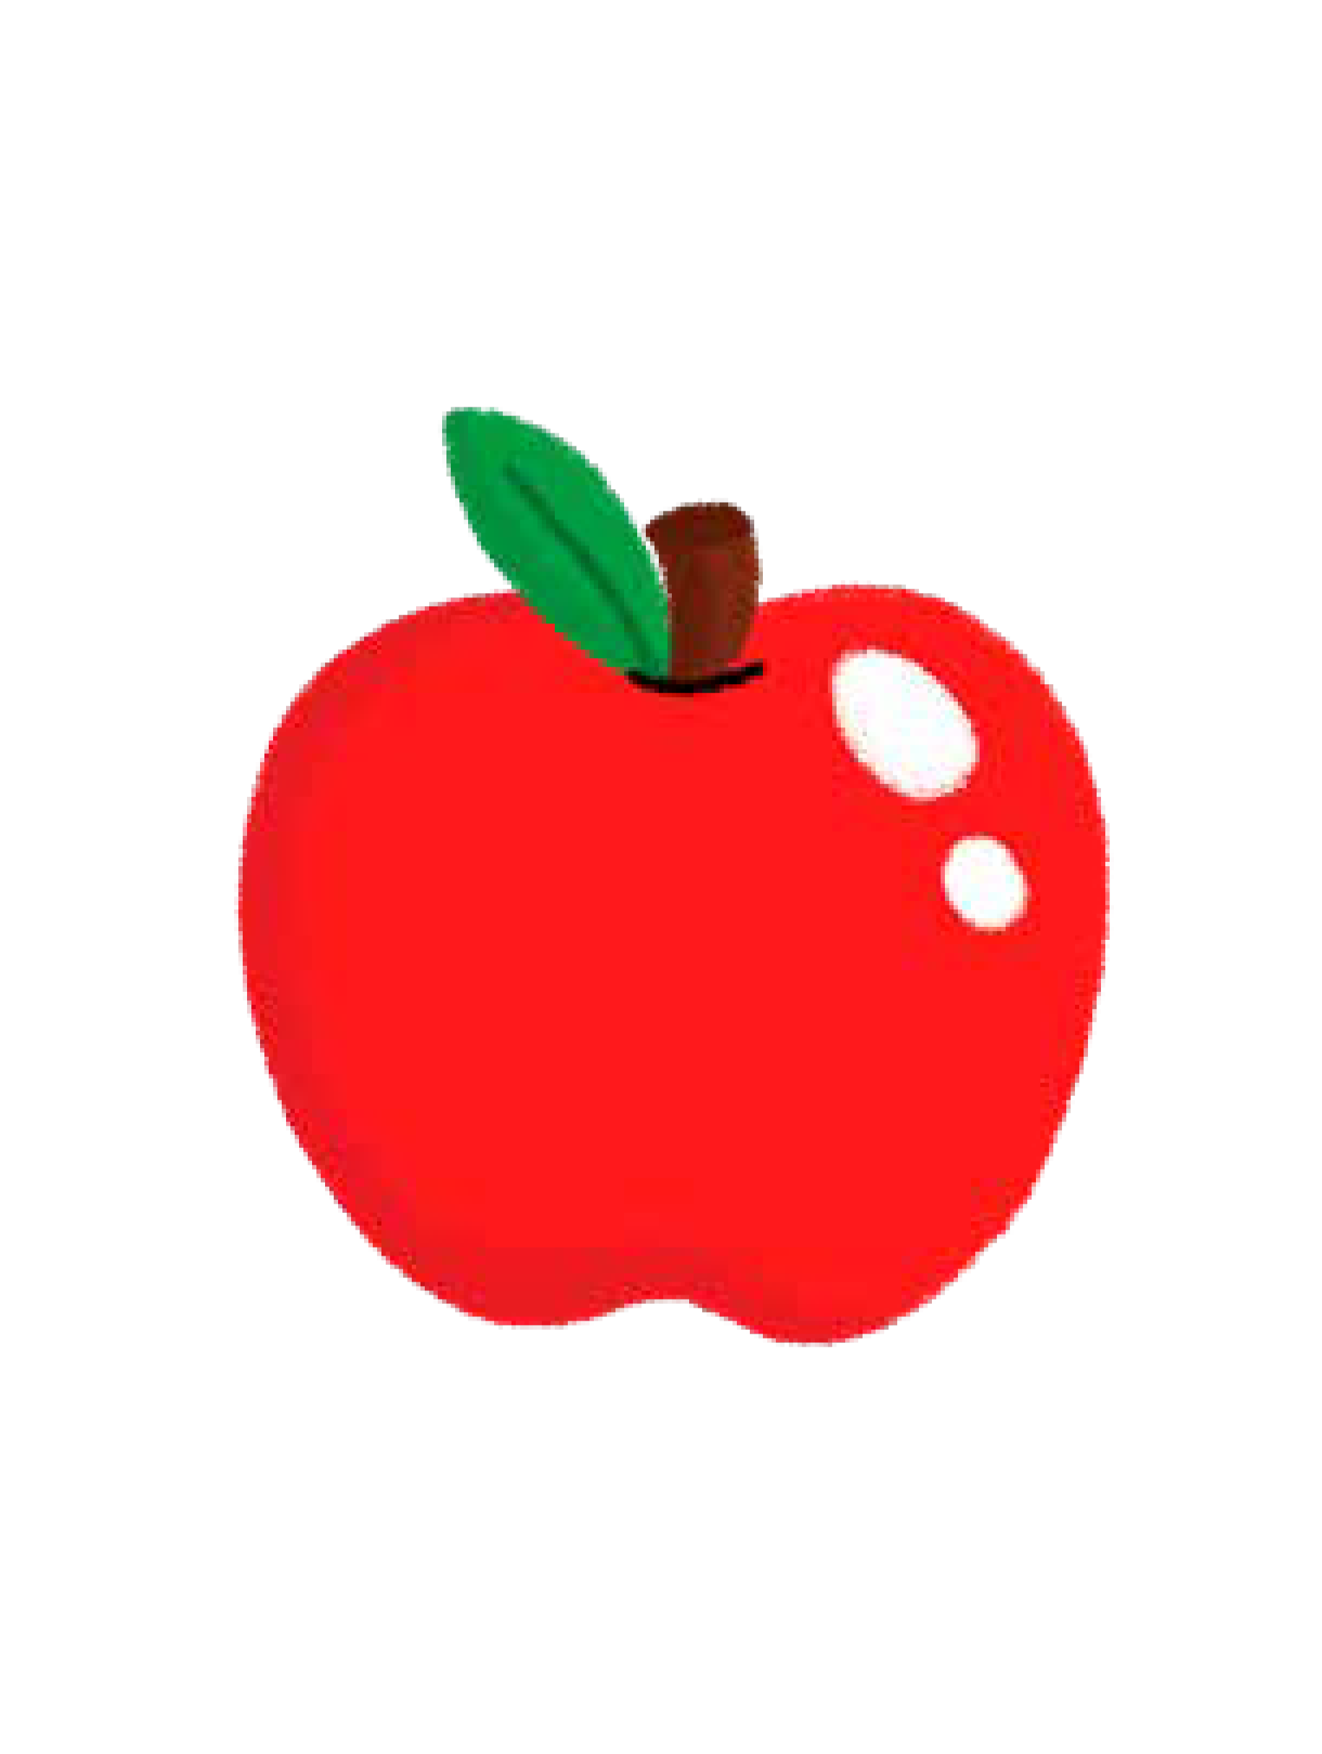
a

Slide 23
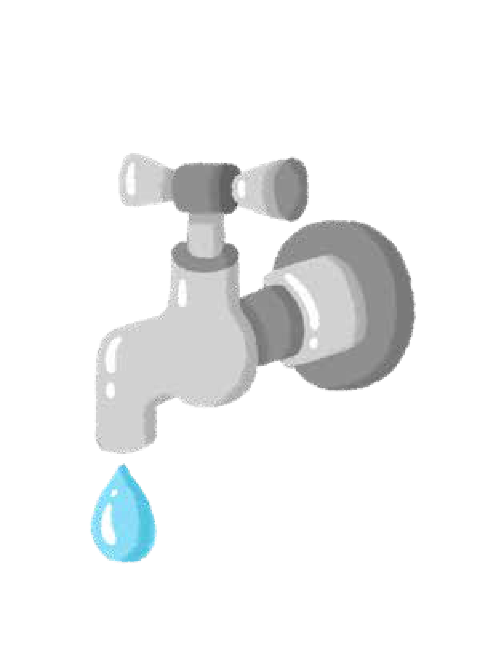
t

Slide 24

p

Slide 25
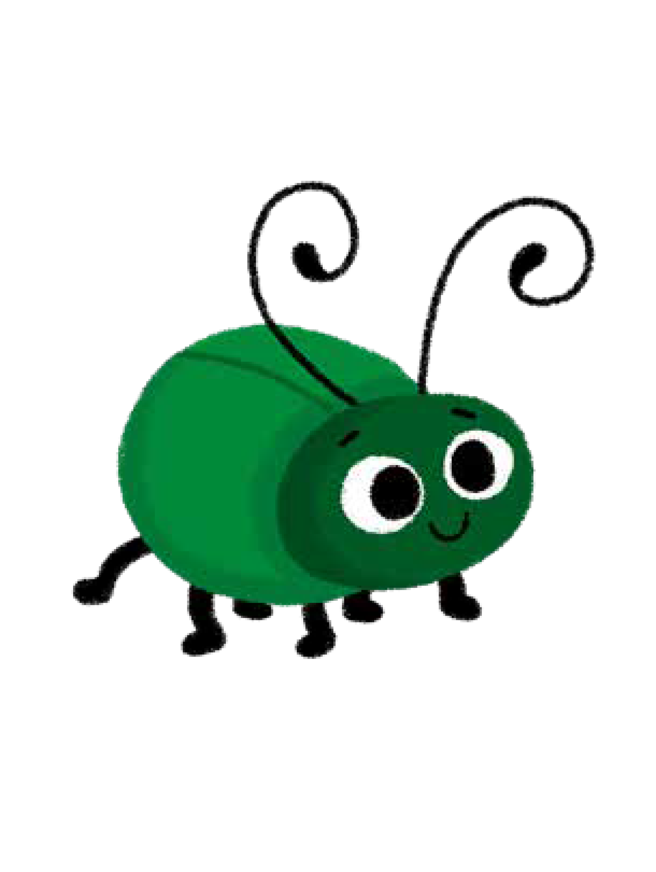
i

Slide 26

n

Slide 27
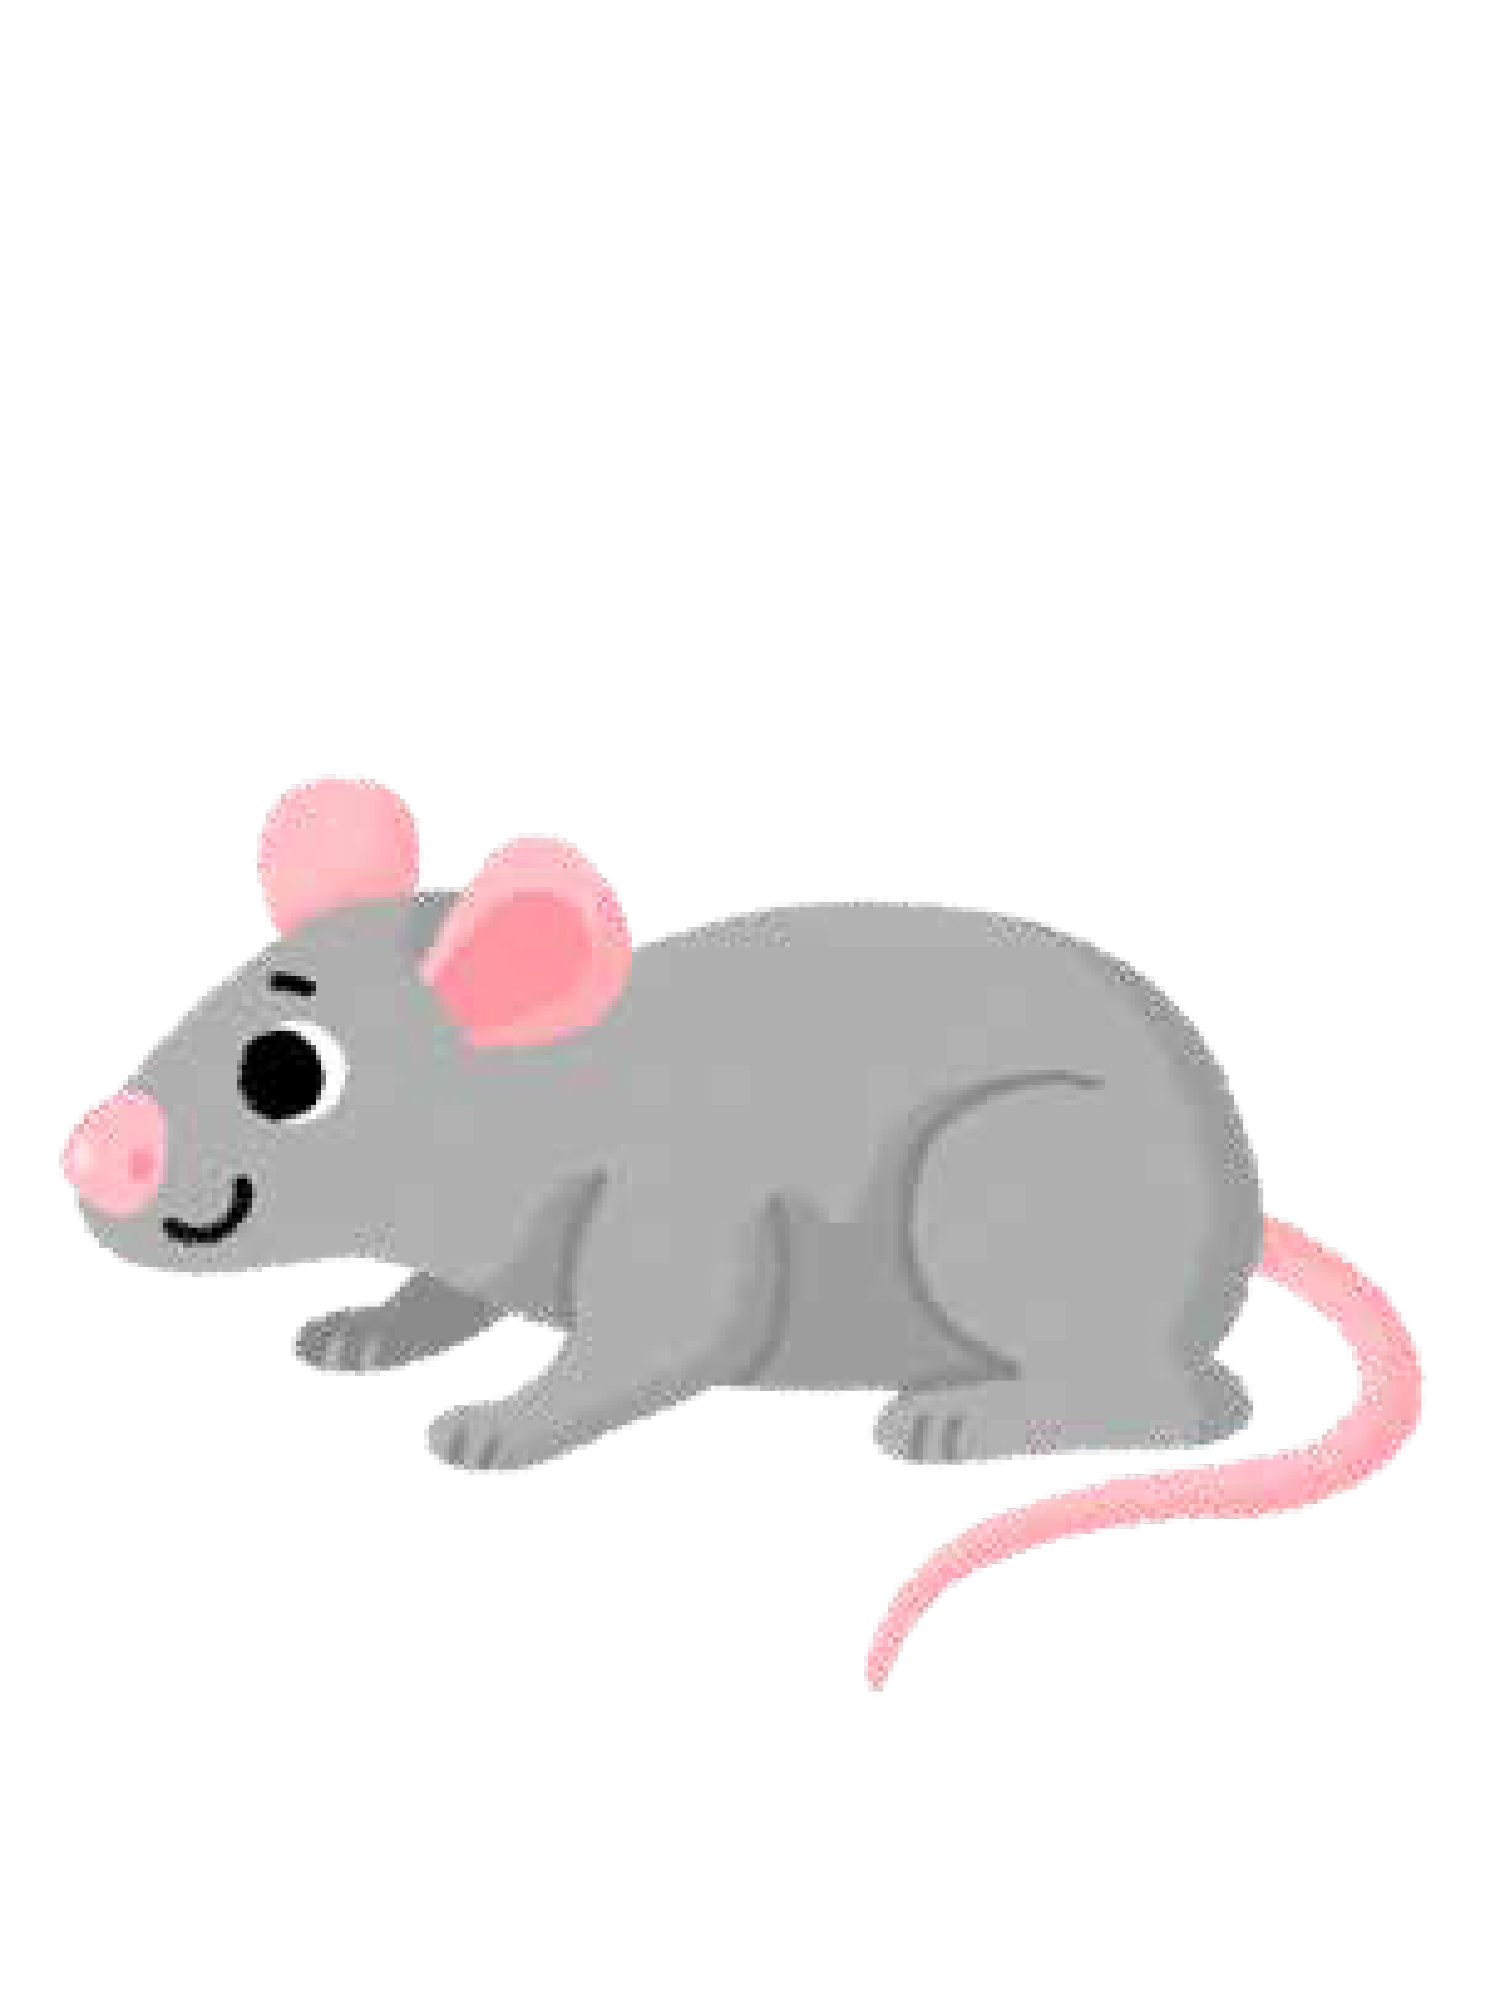
m

Slide 28

d

Slide 29
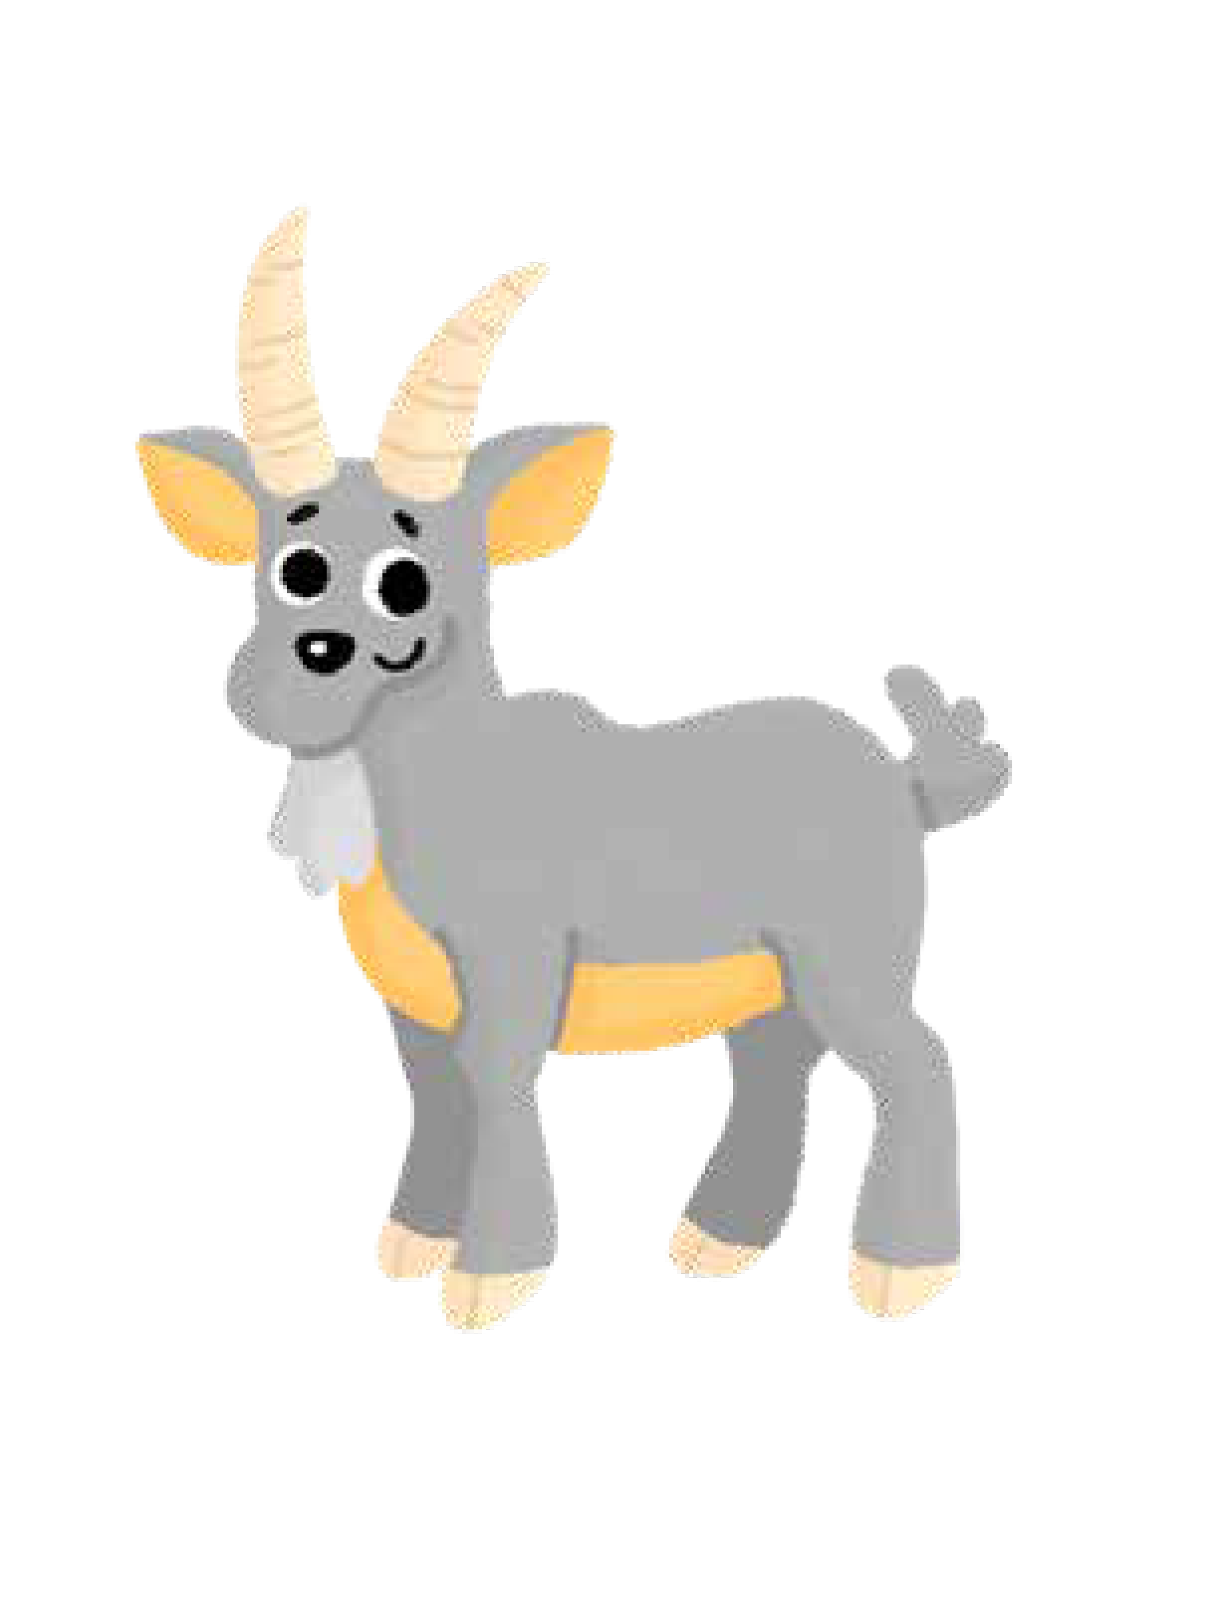
g

Slide 30

o

Slide 31
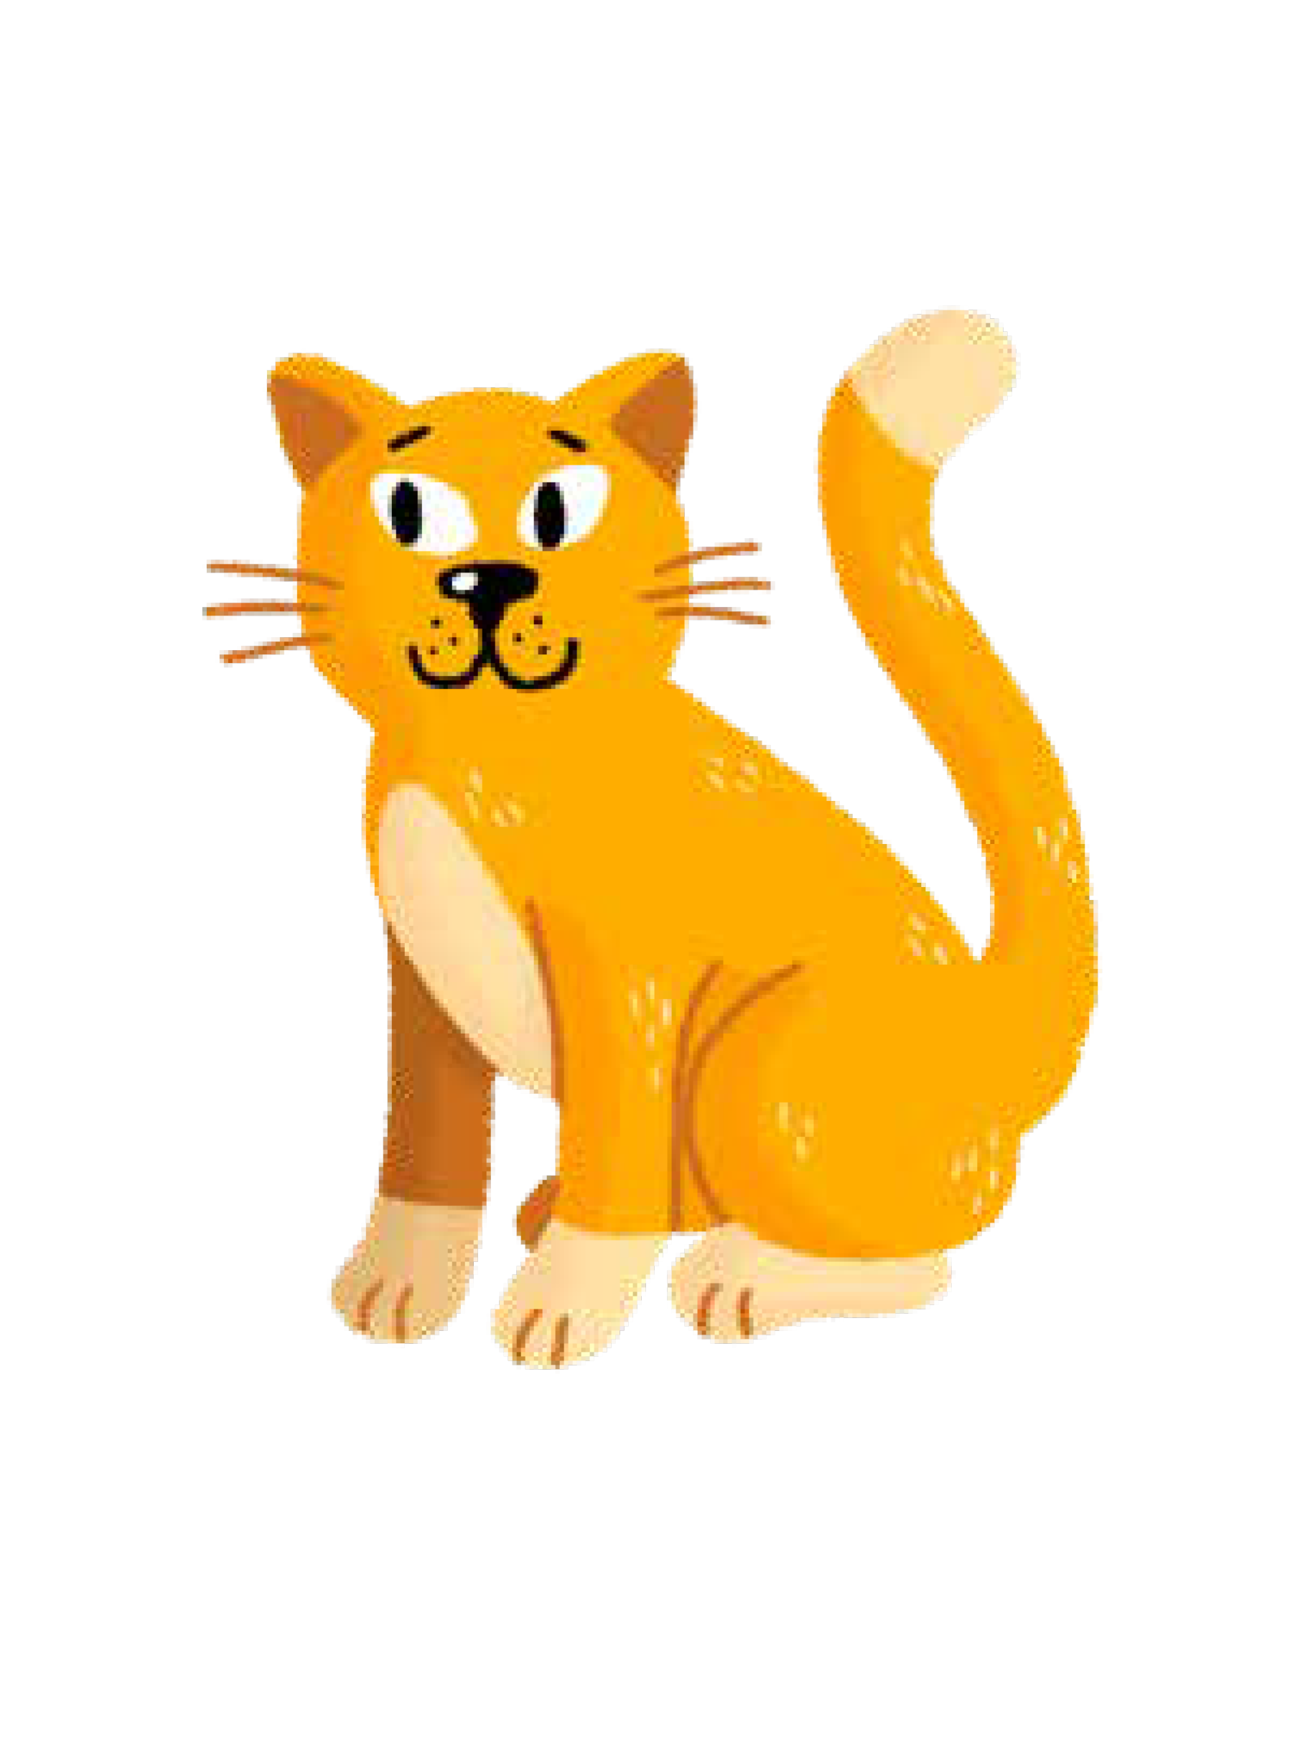
c

Slide 32
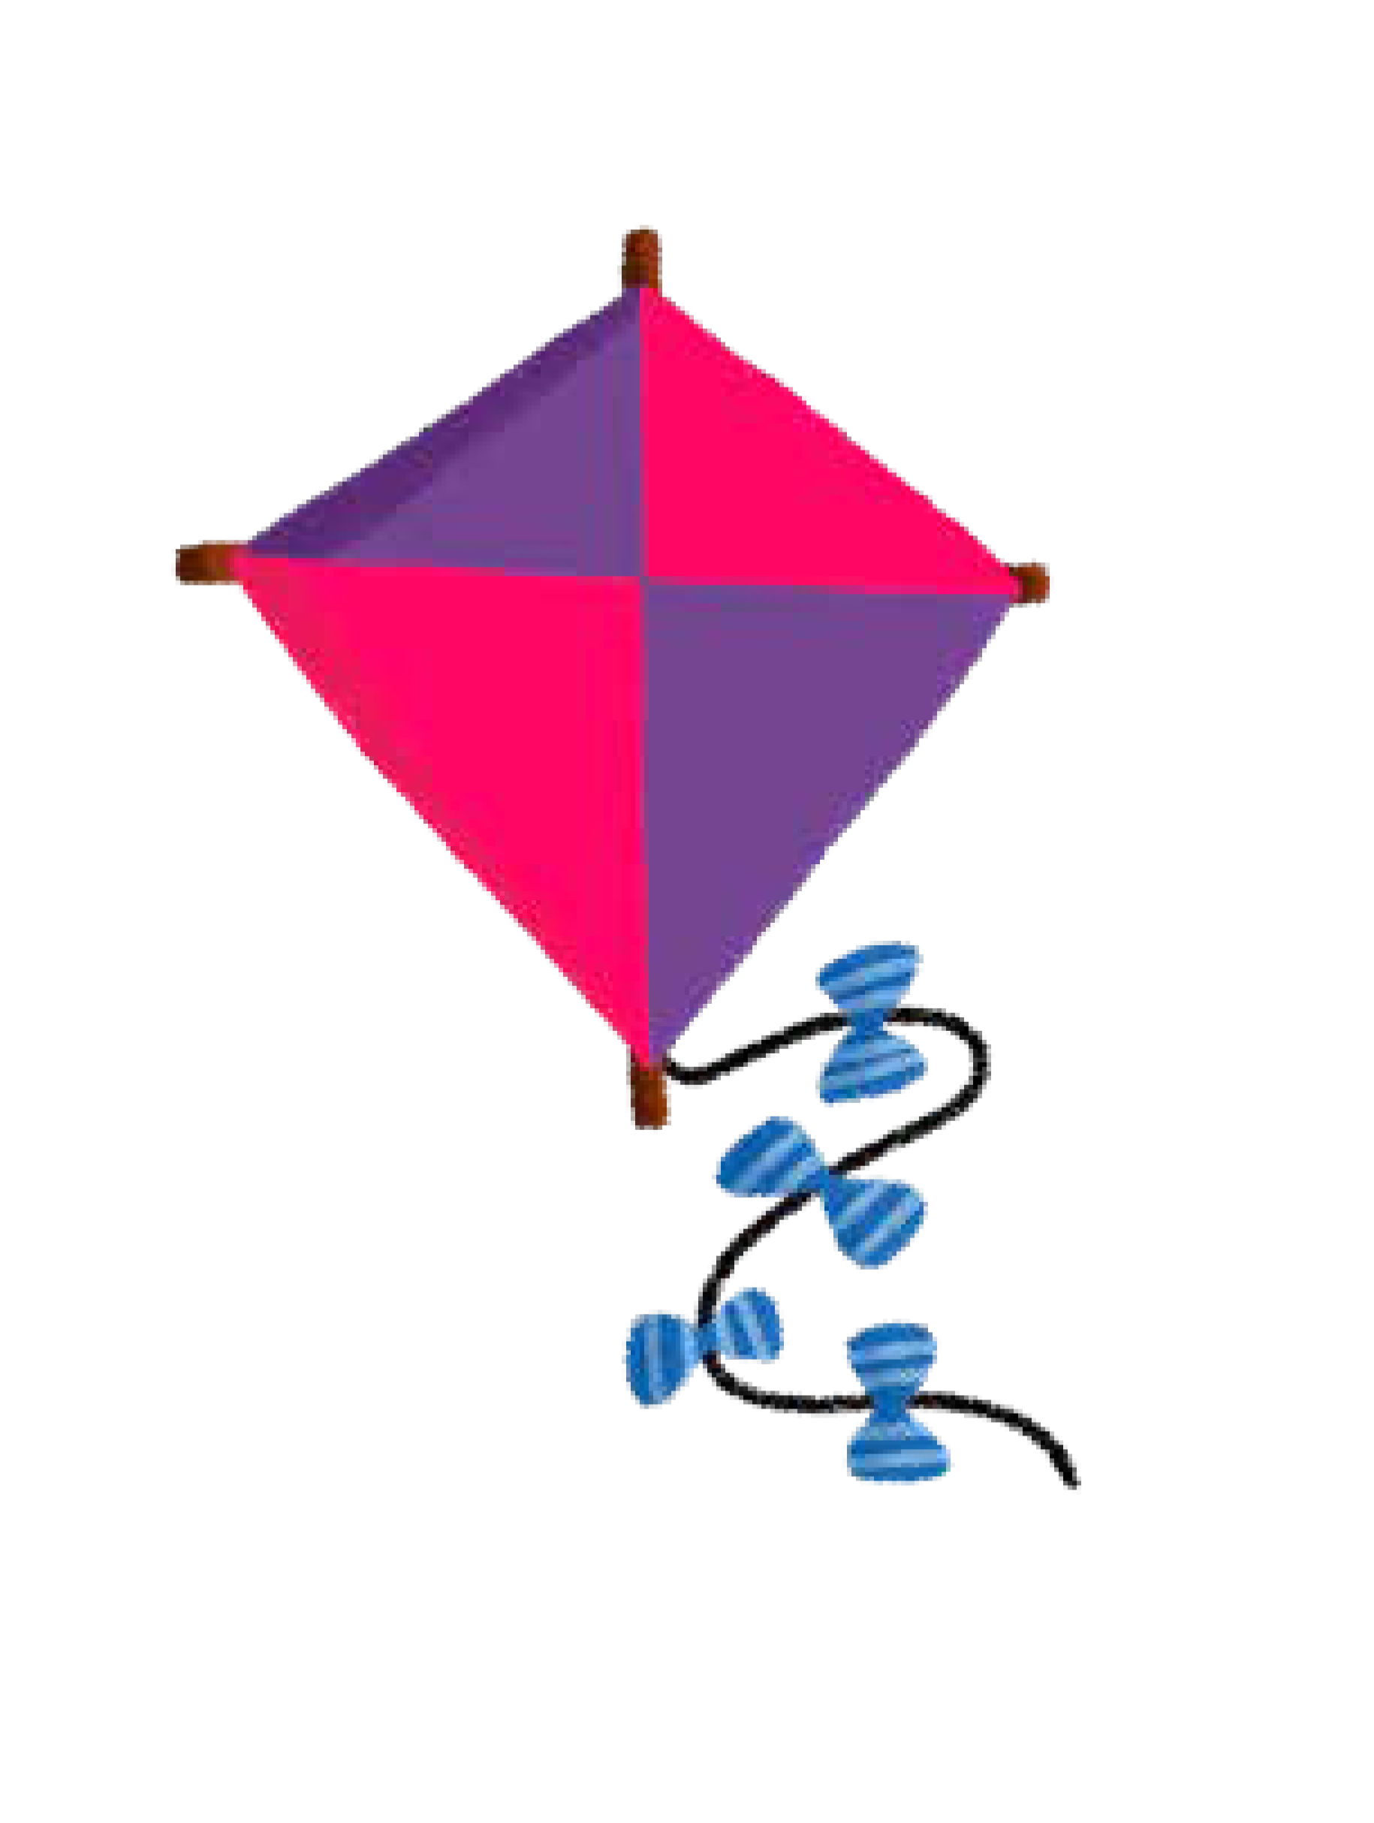
k

Slide 33
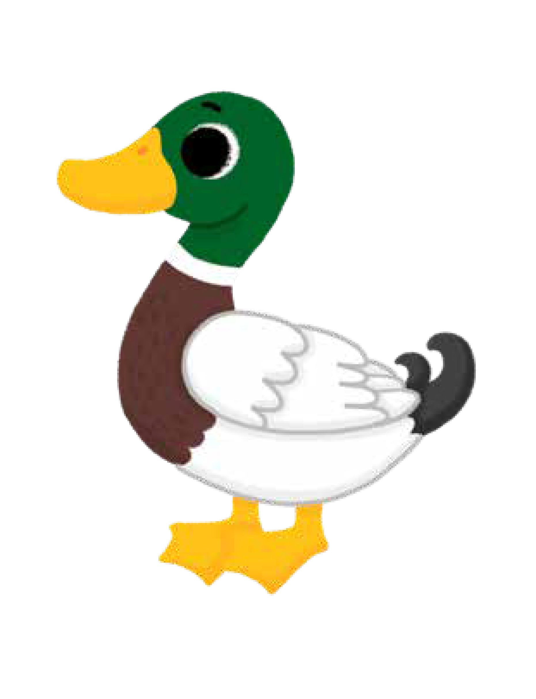
ck

Slide 34

e

Slide 35

u

Slide 36
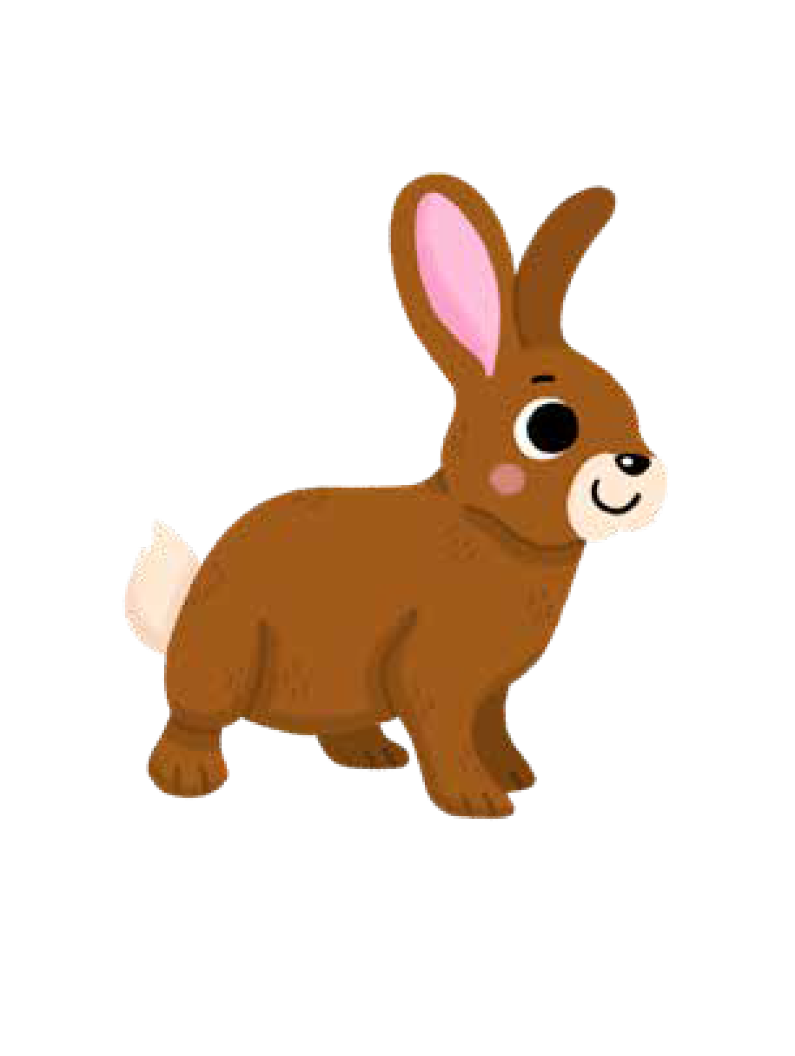
r

Slide 37

h

Slide 38

b

Slide 39
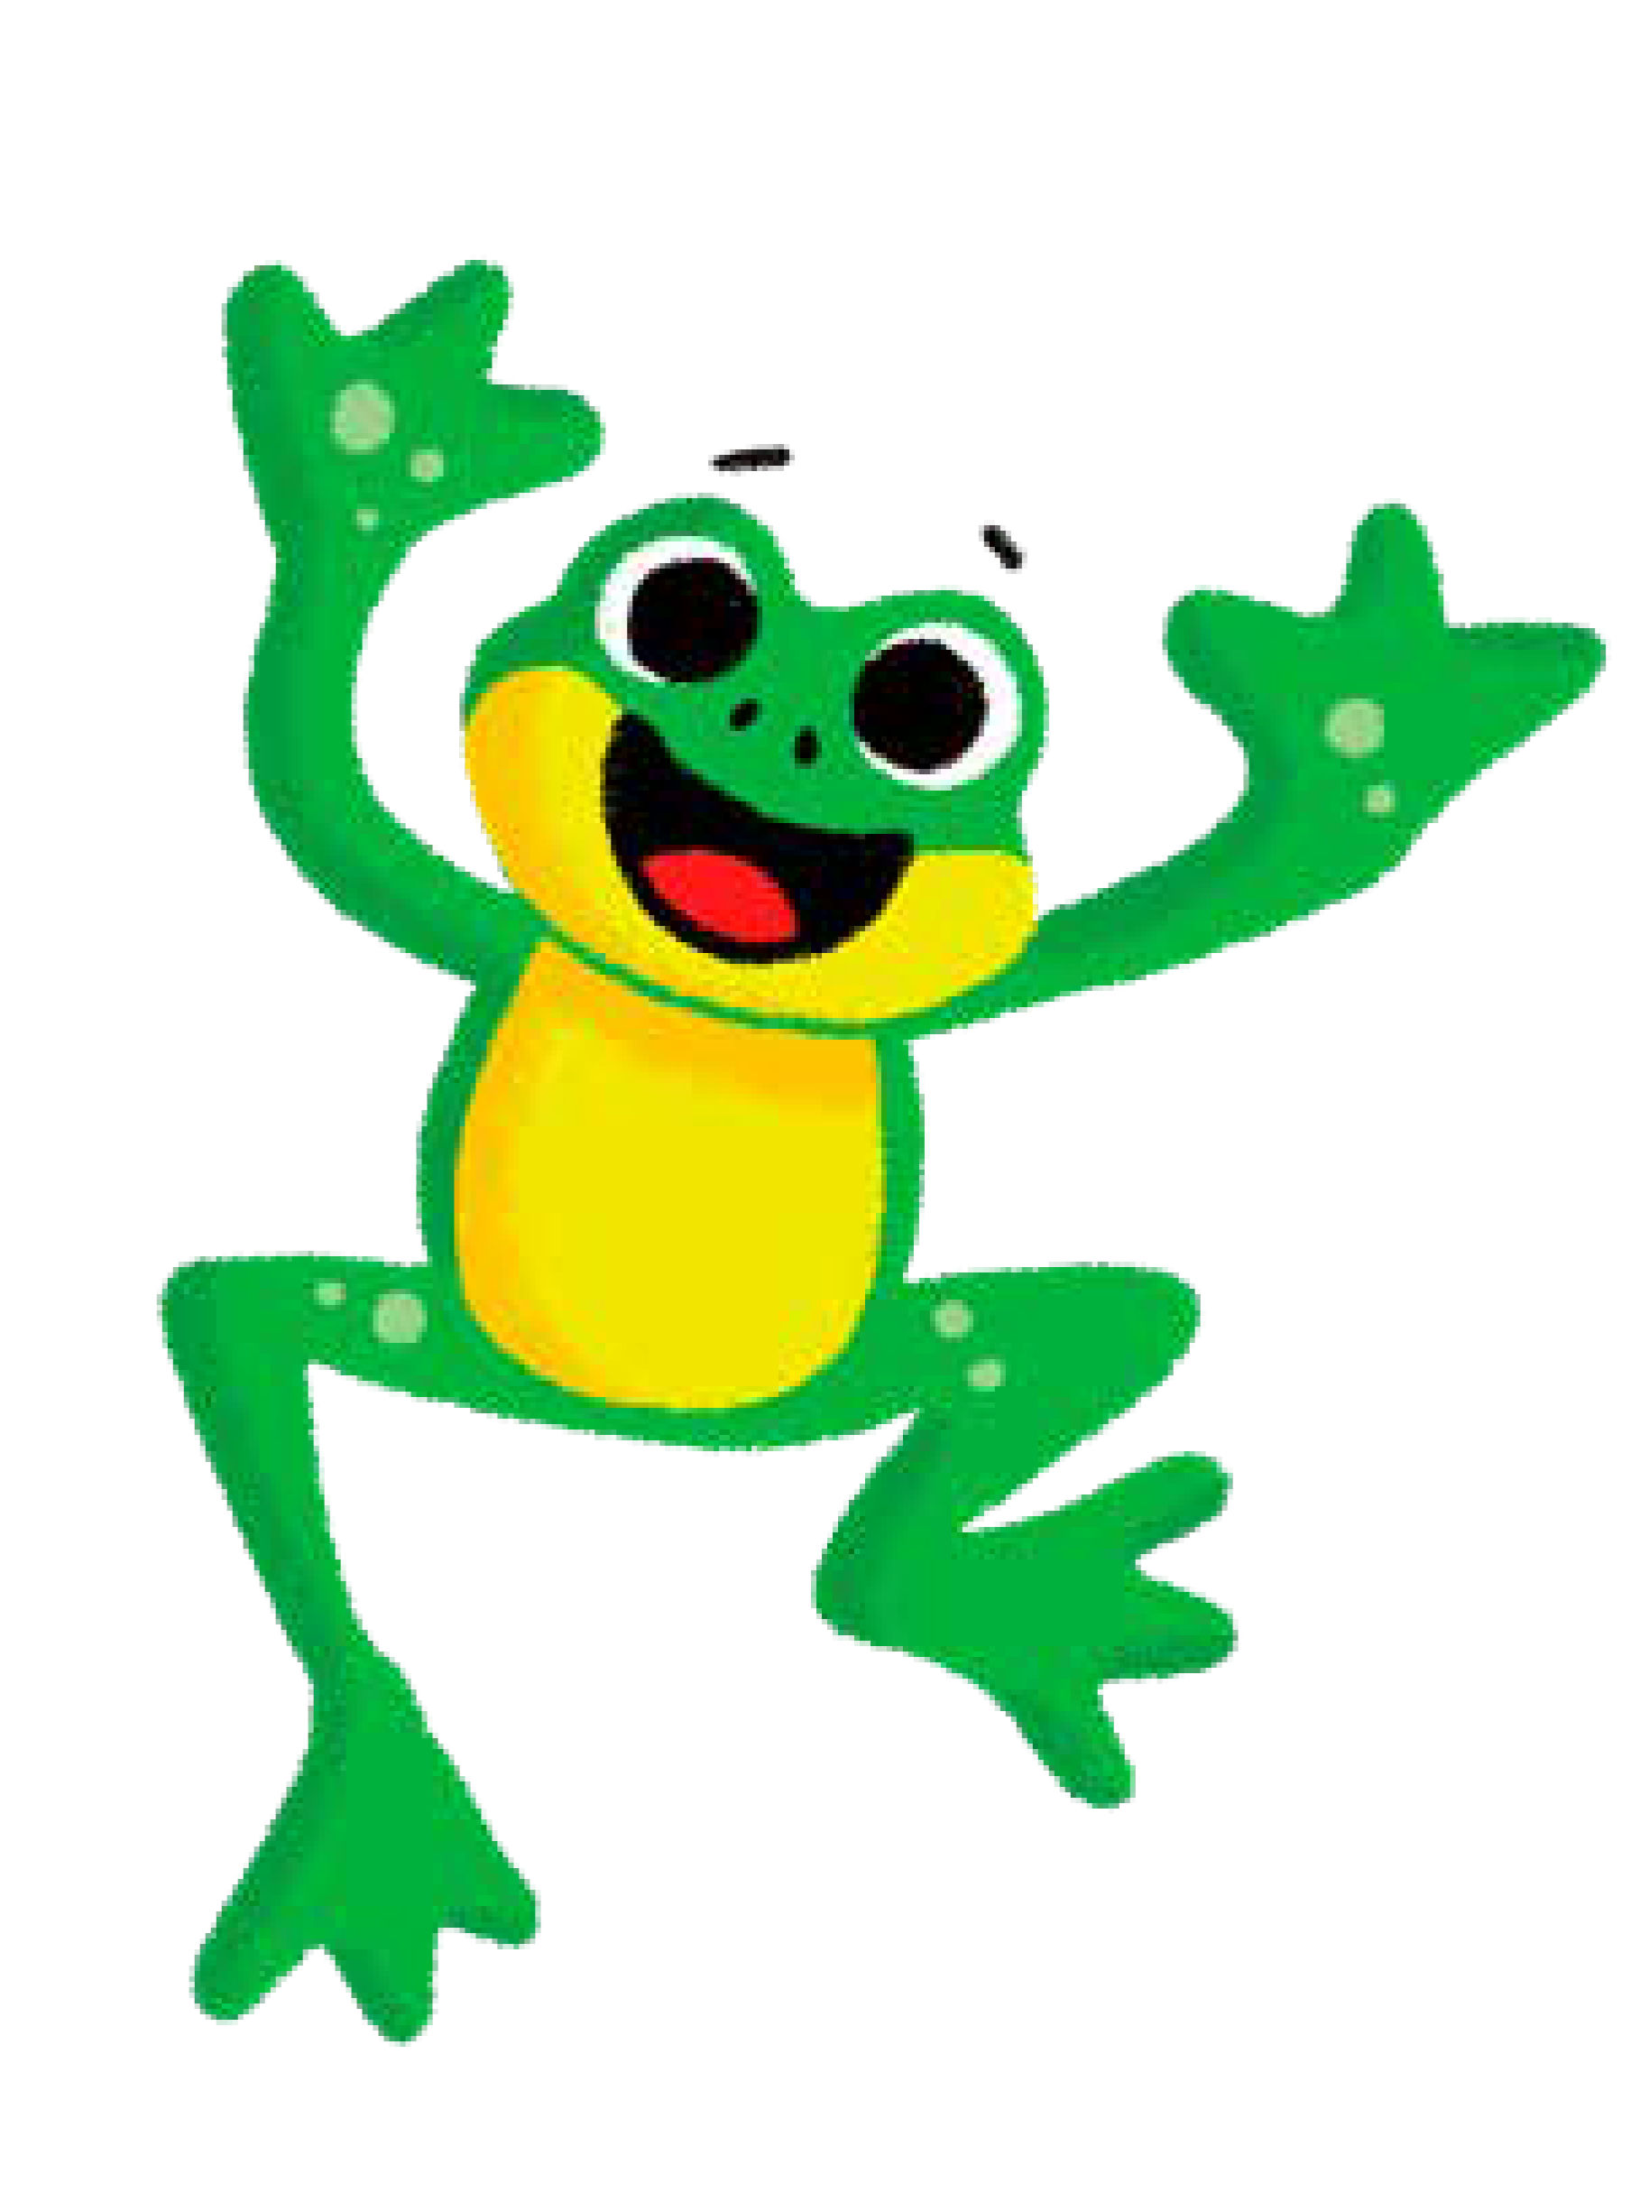
f

Slide 40
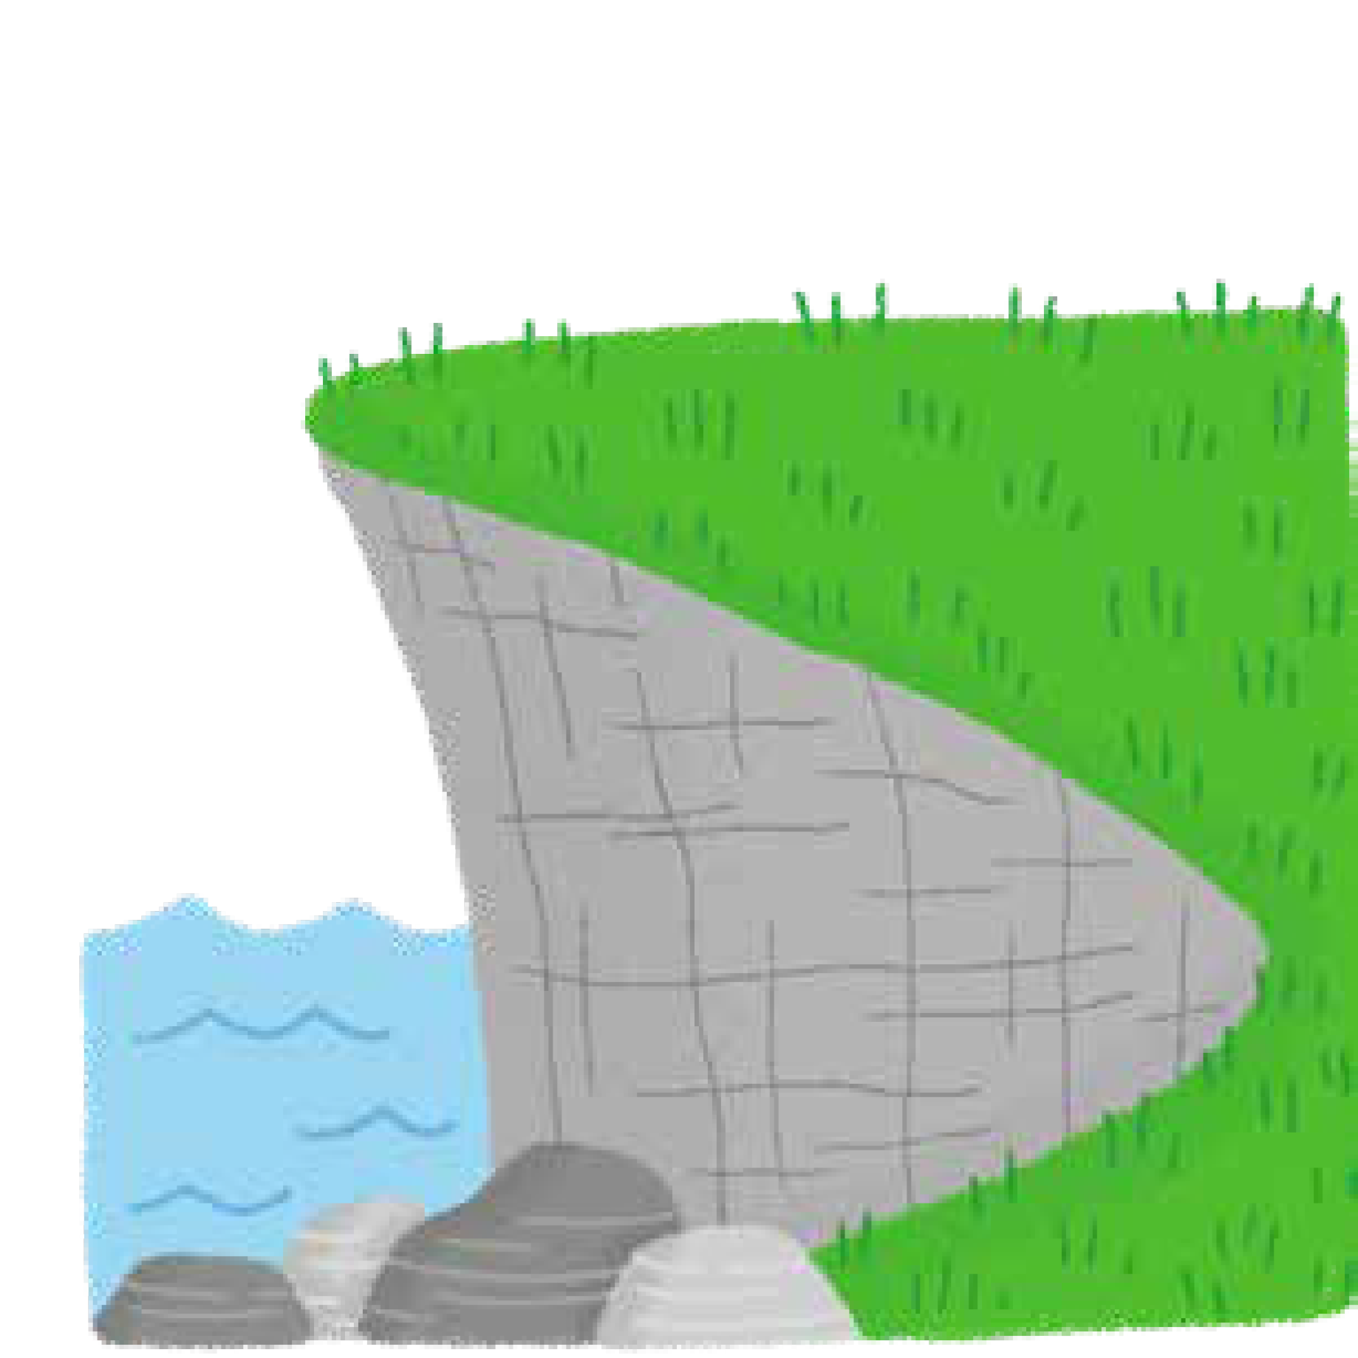
ff

Slide 41
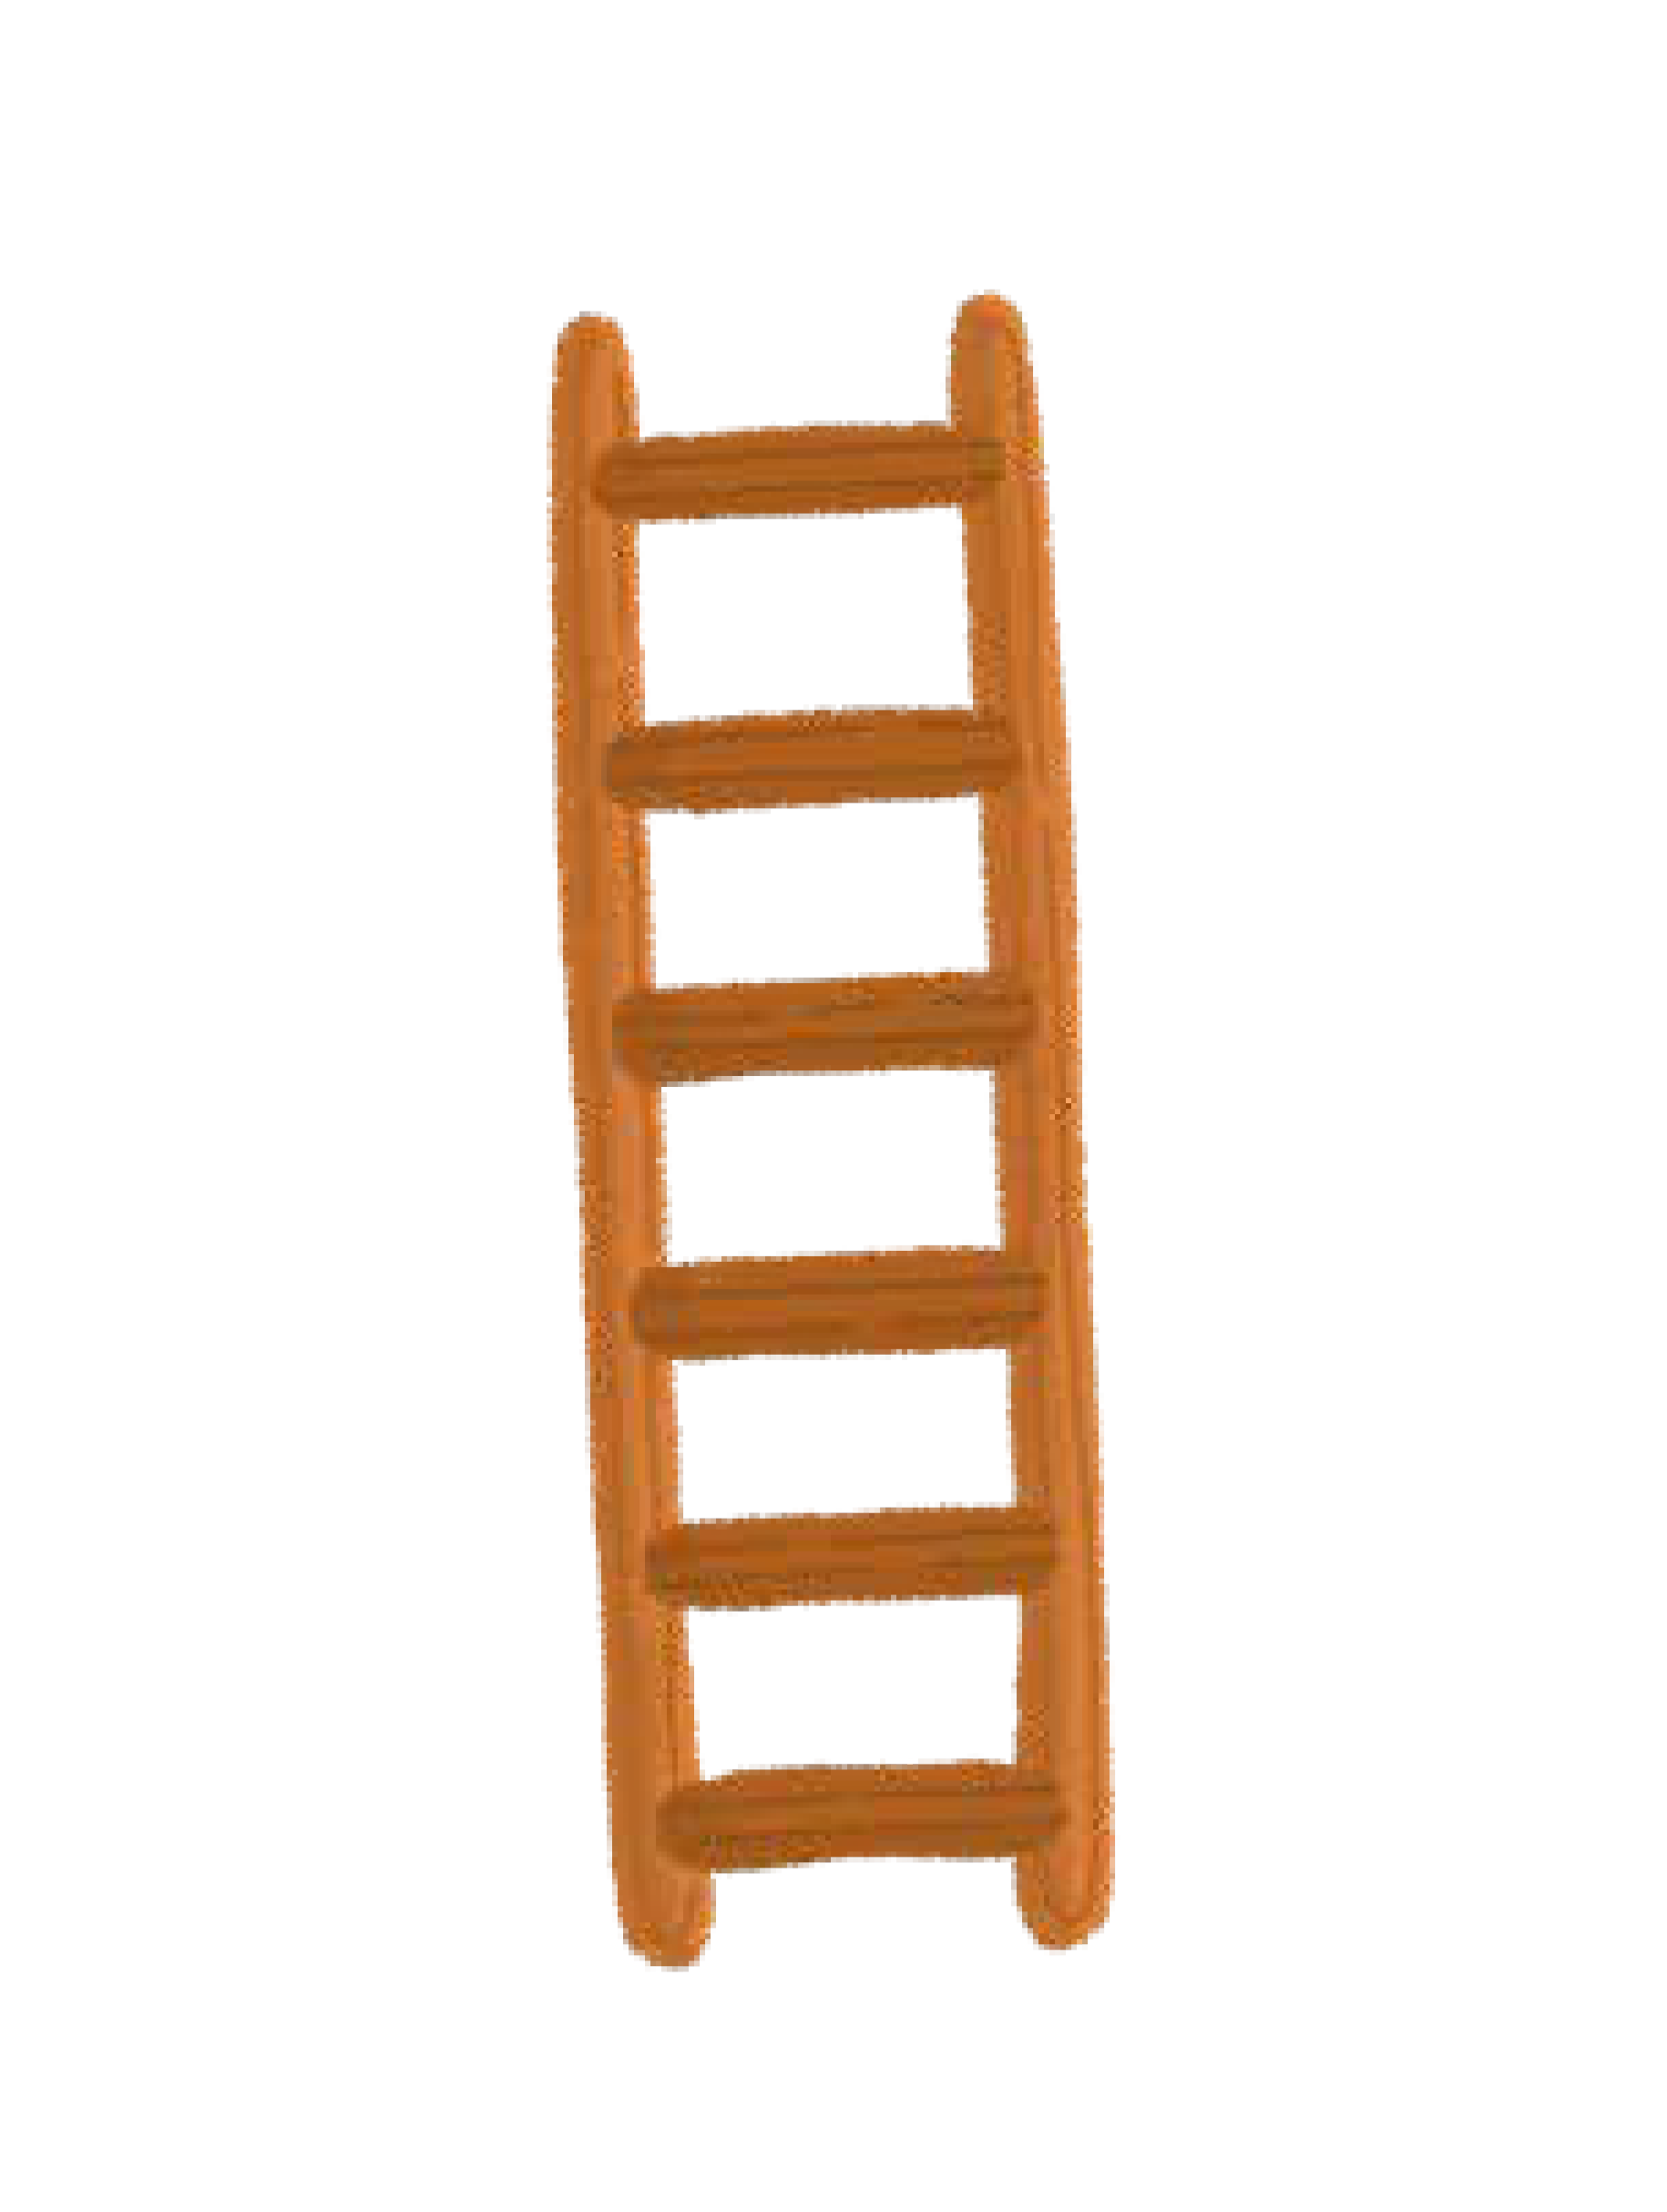
l

Slide 42

ll

Slide 43

ss

Slide 44

j

Slide 45

v

Slide 46
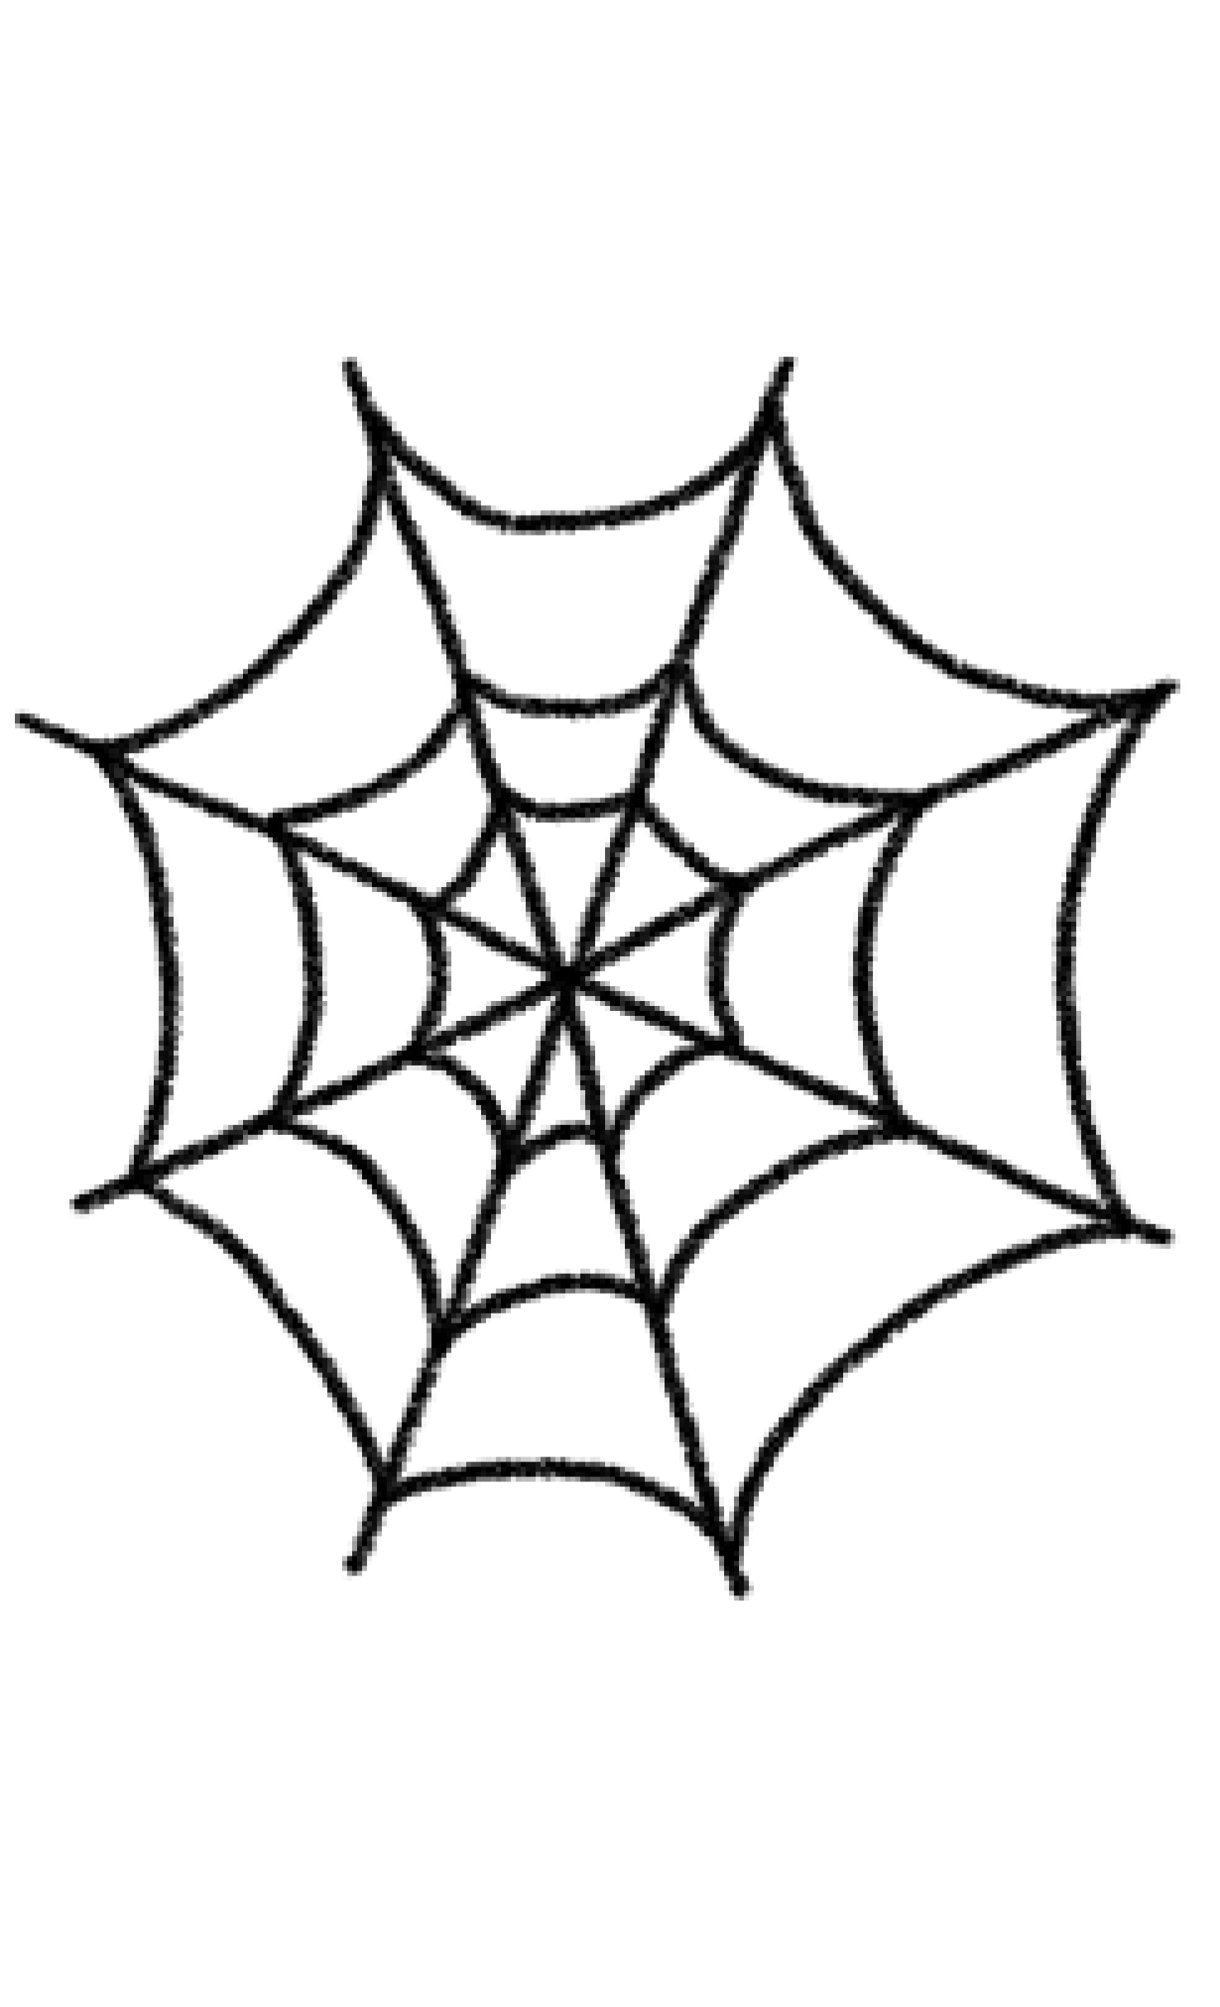
w

Slide 47
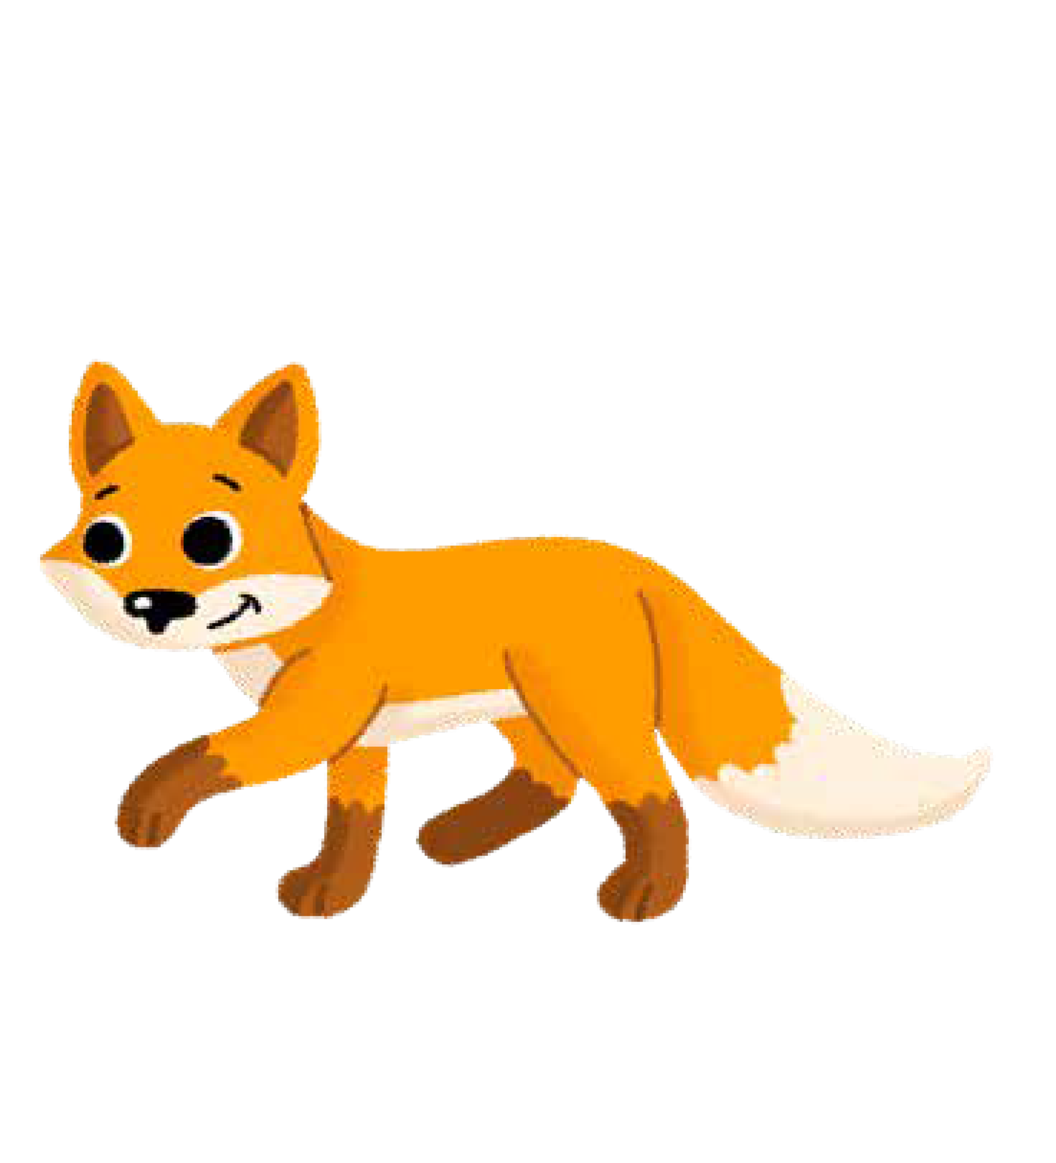
x

Slide 48

y

Slide 49

z

Slide 50

zz

Slide 51
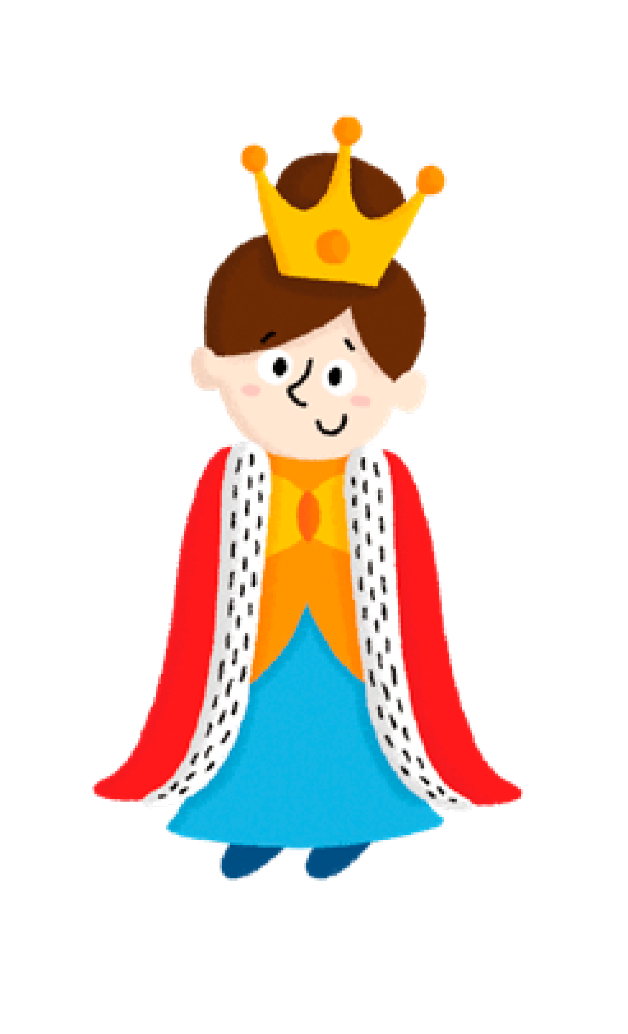
qu

Slide 52
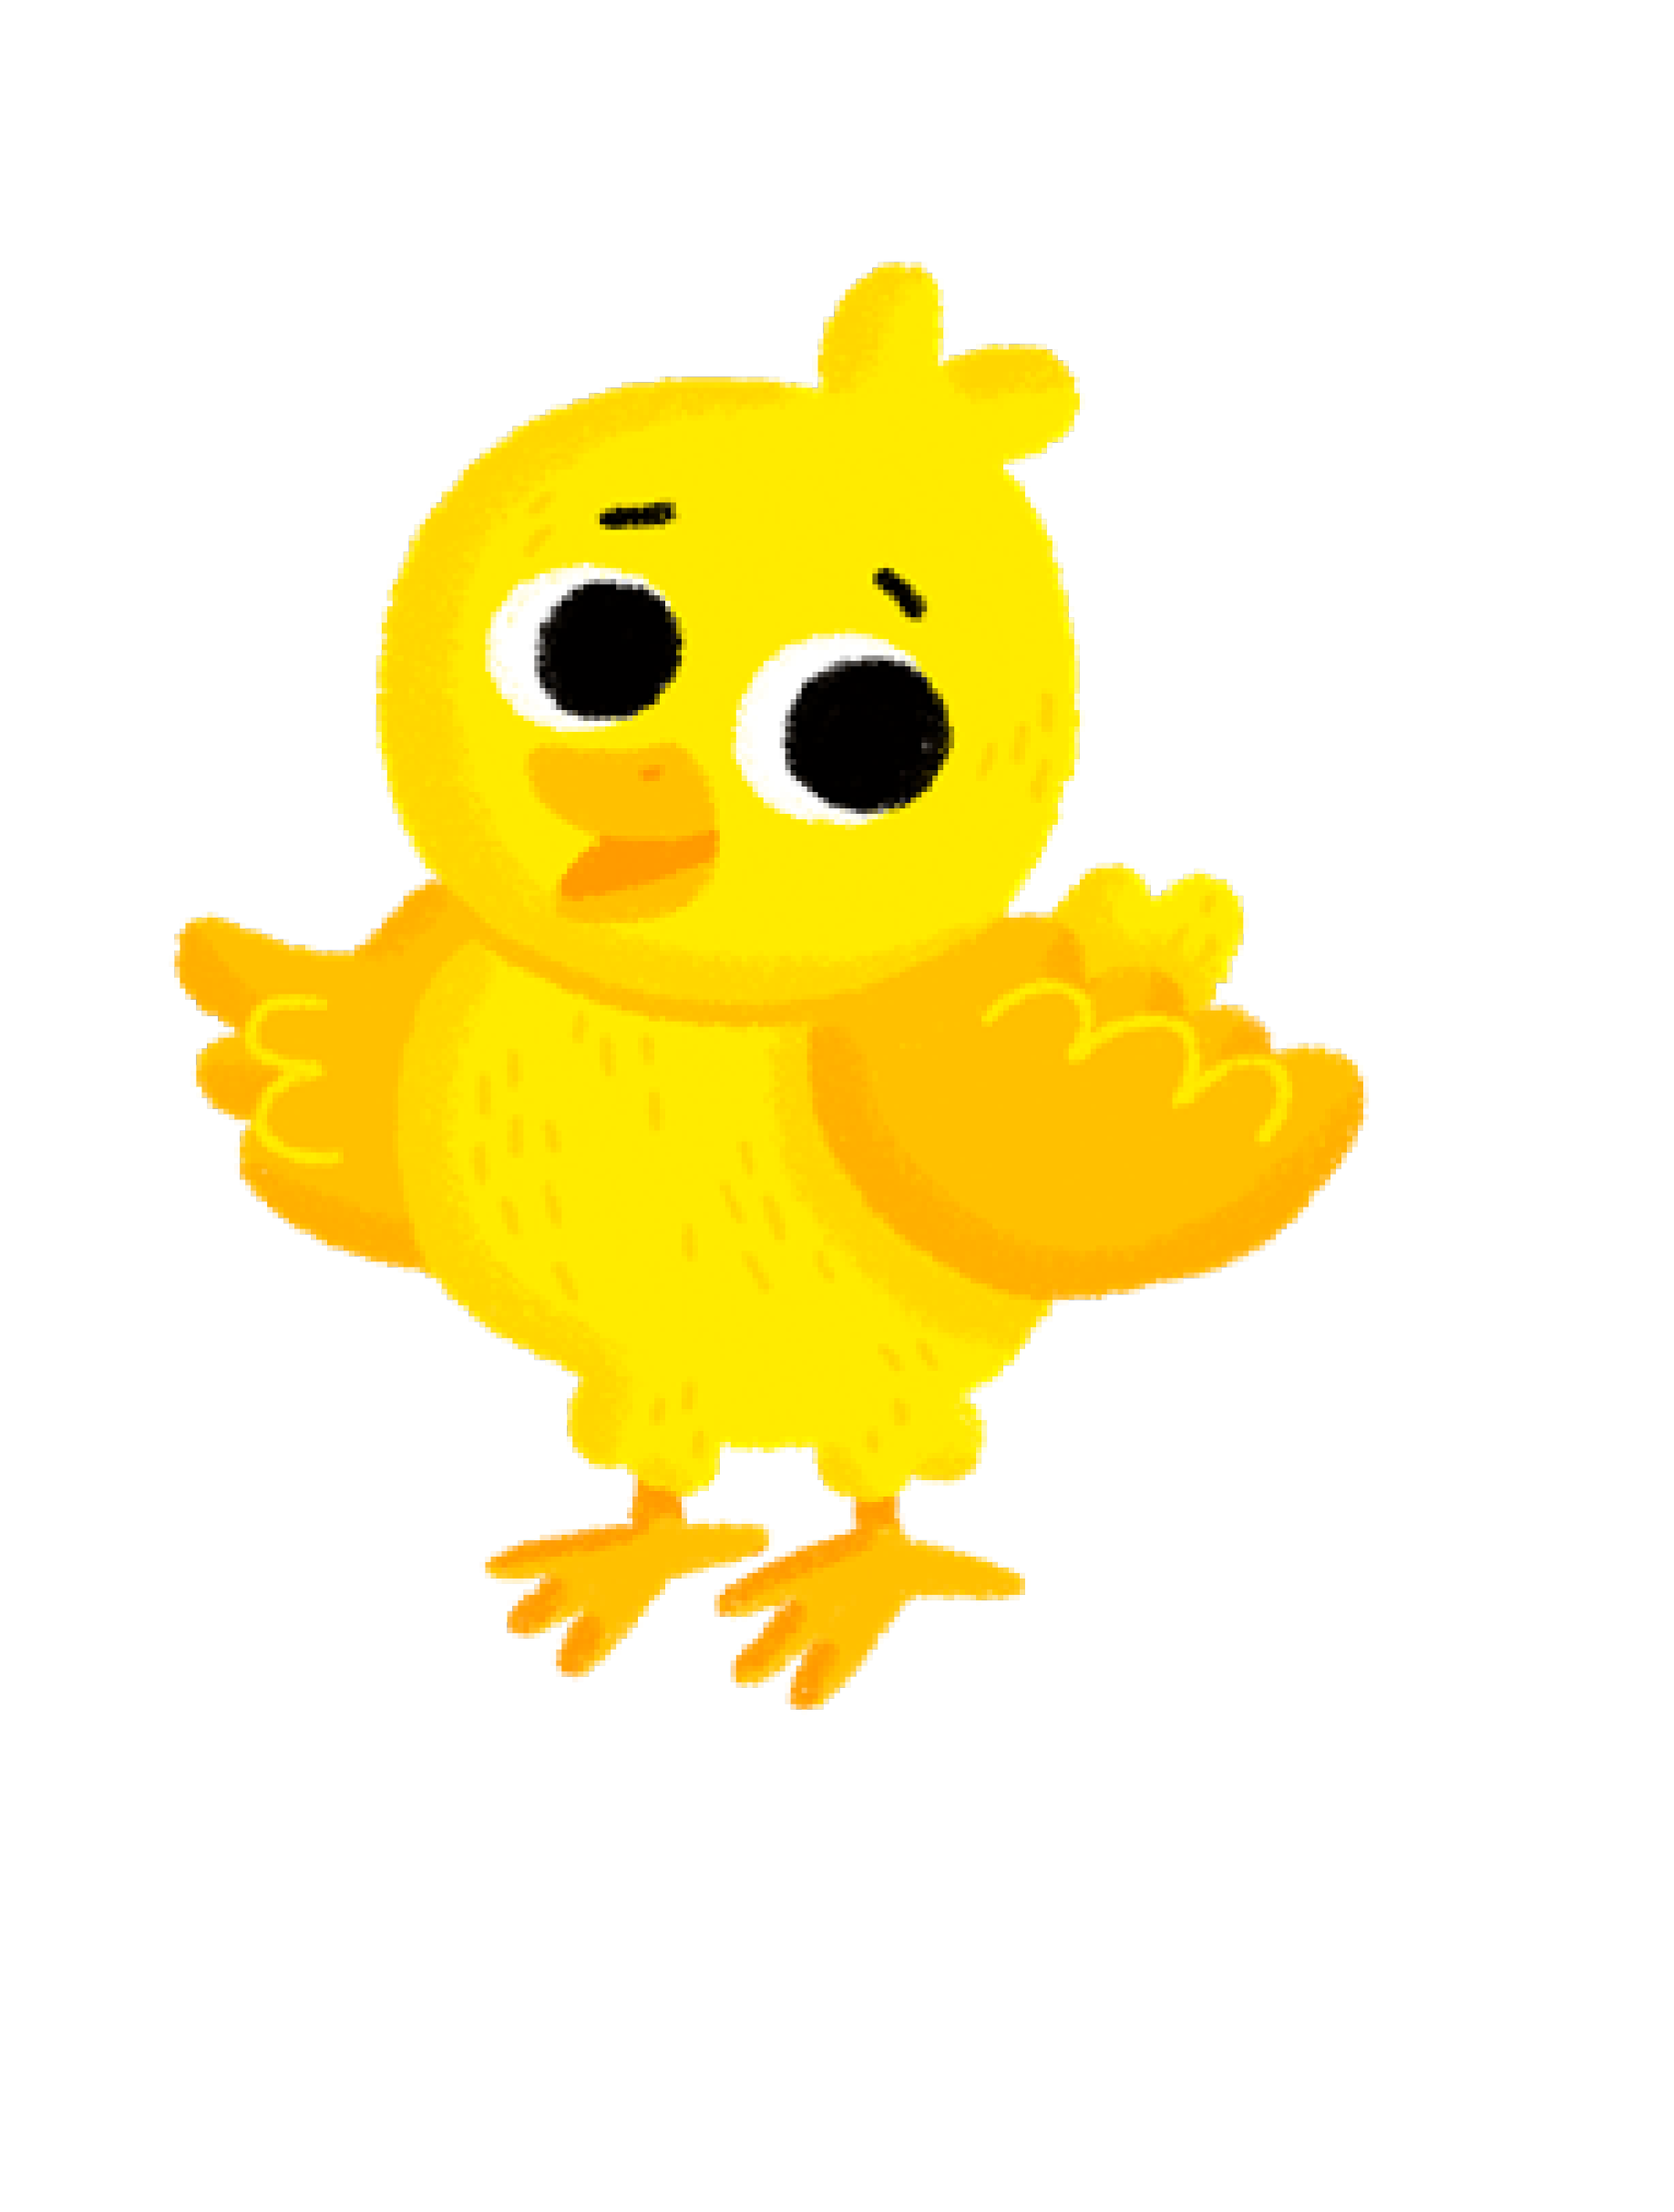
ch

Slide 53
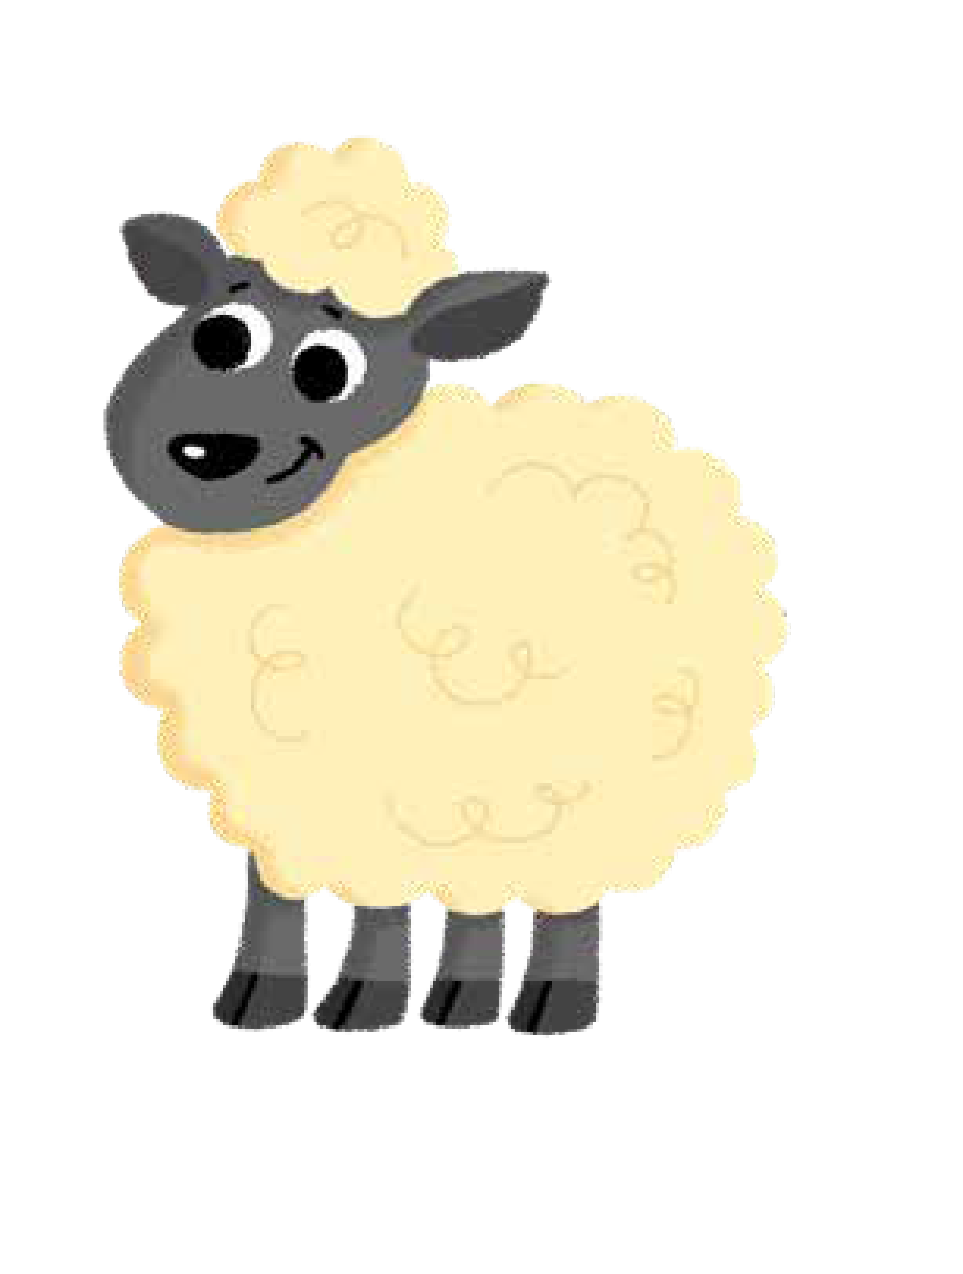
sh

Slide 54

th

Slide 55

ng

Slide 56
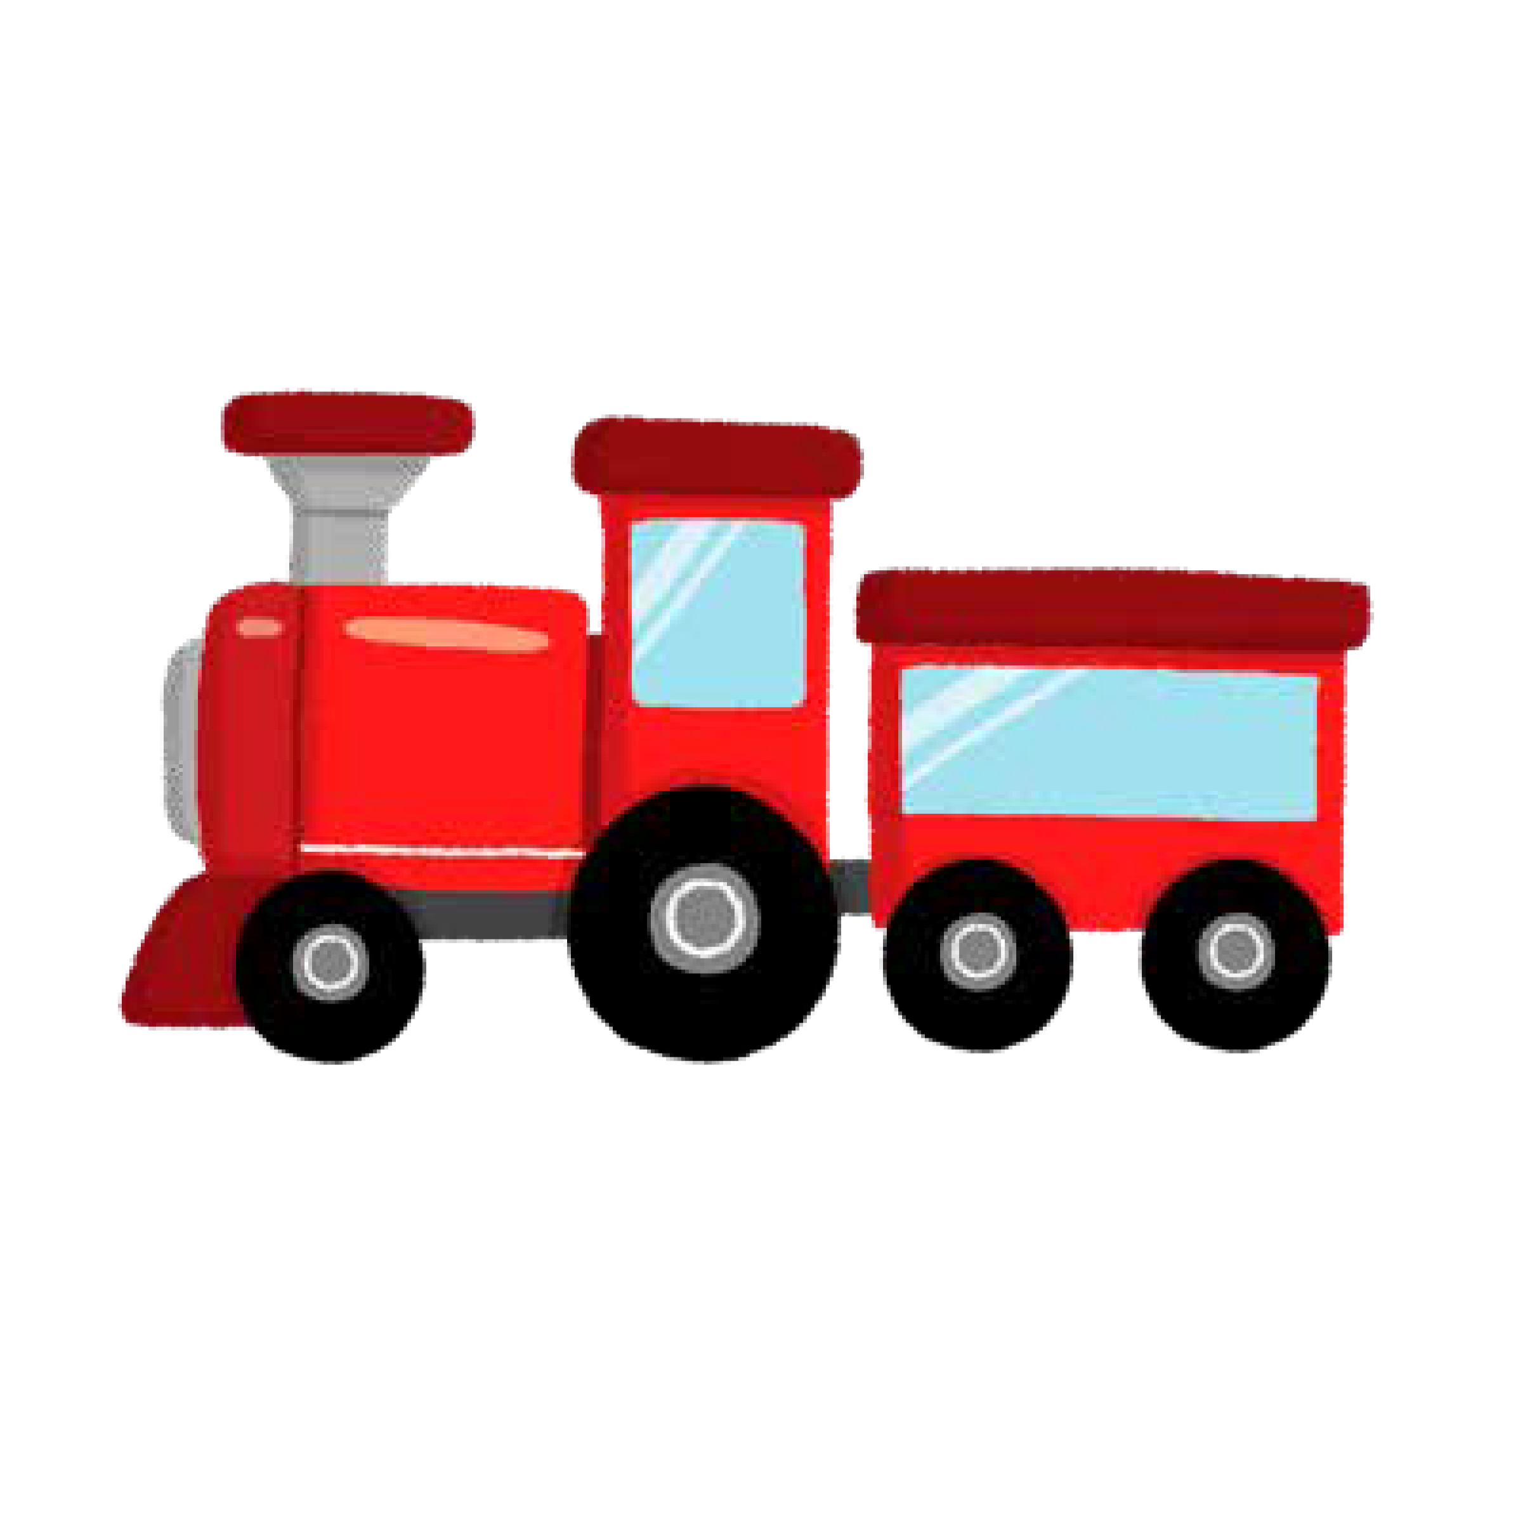
ai

Slide 57

ee

Slide 58

igh

Slide 59

oa

Slide 60

oo

Slide 61

ar

Slide 62
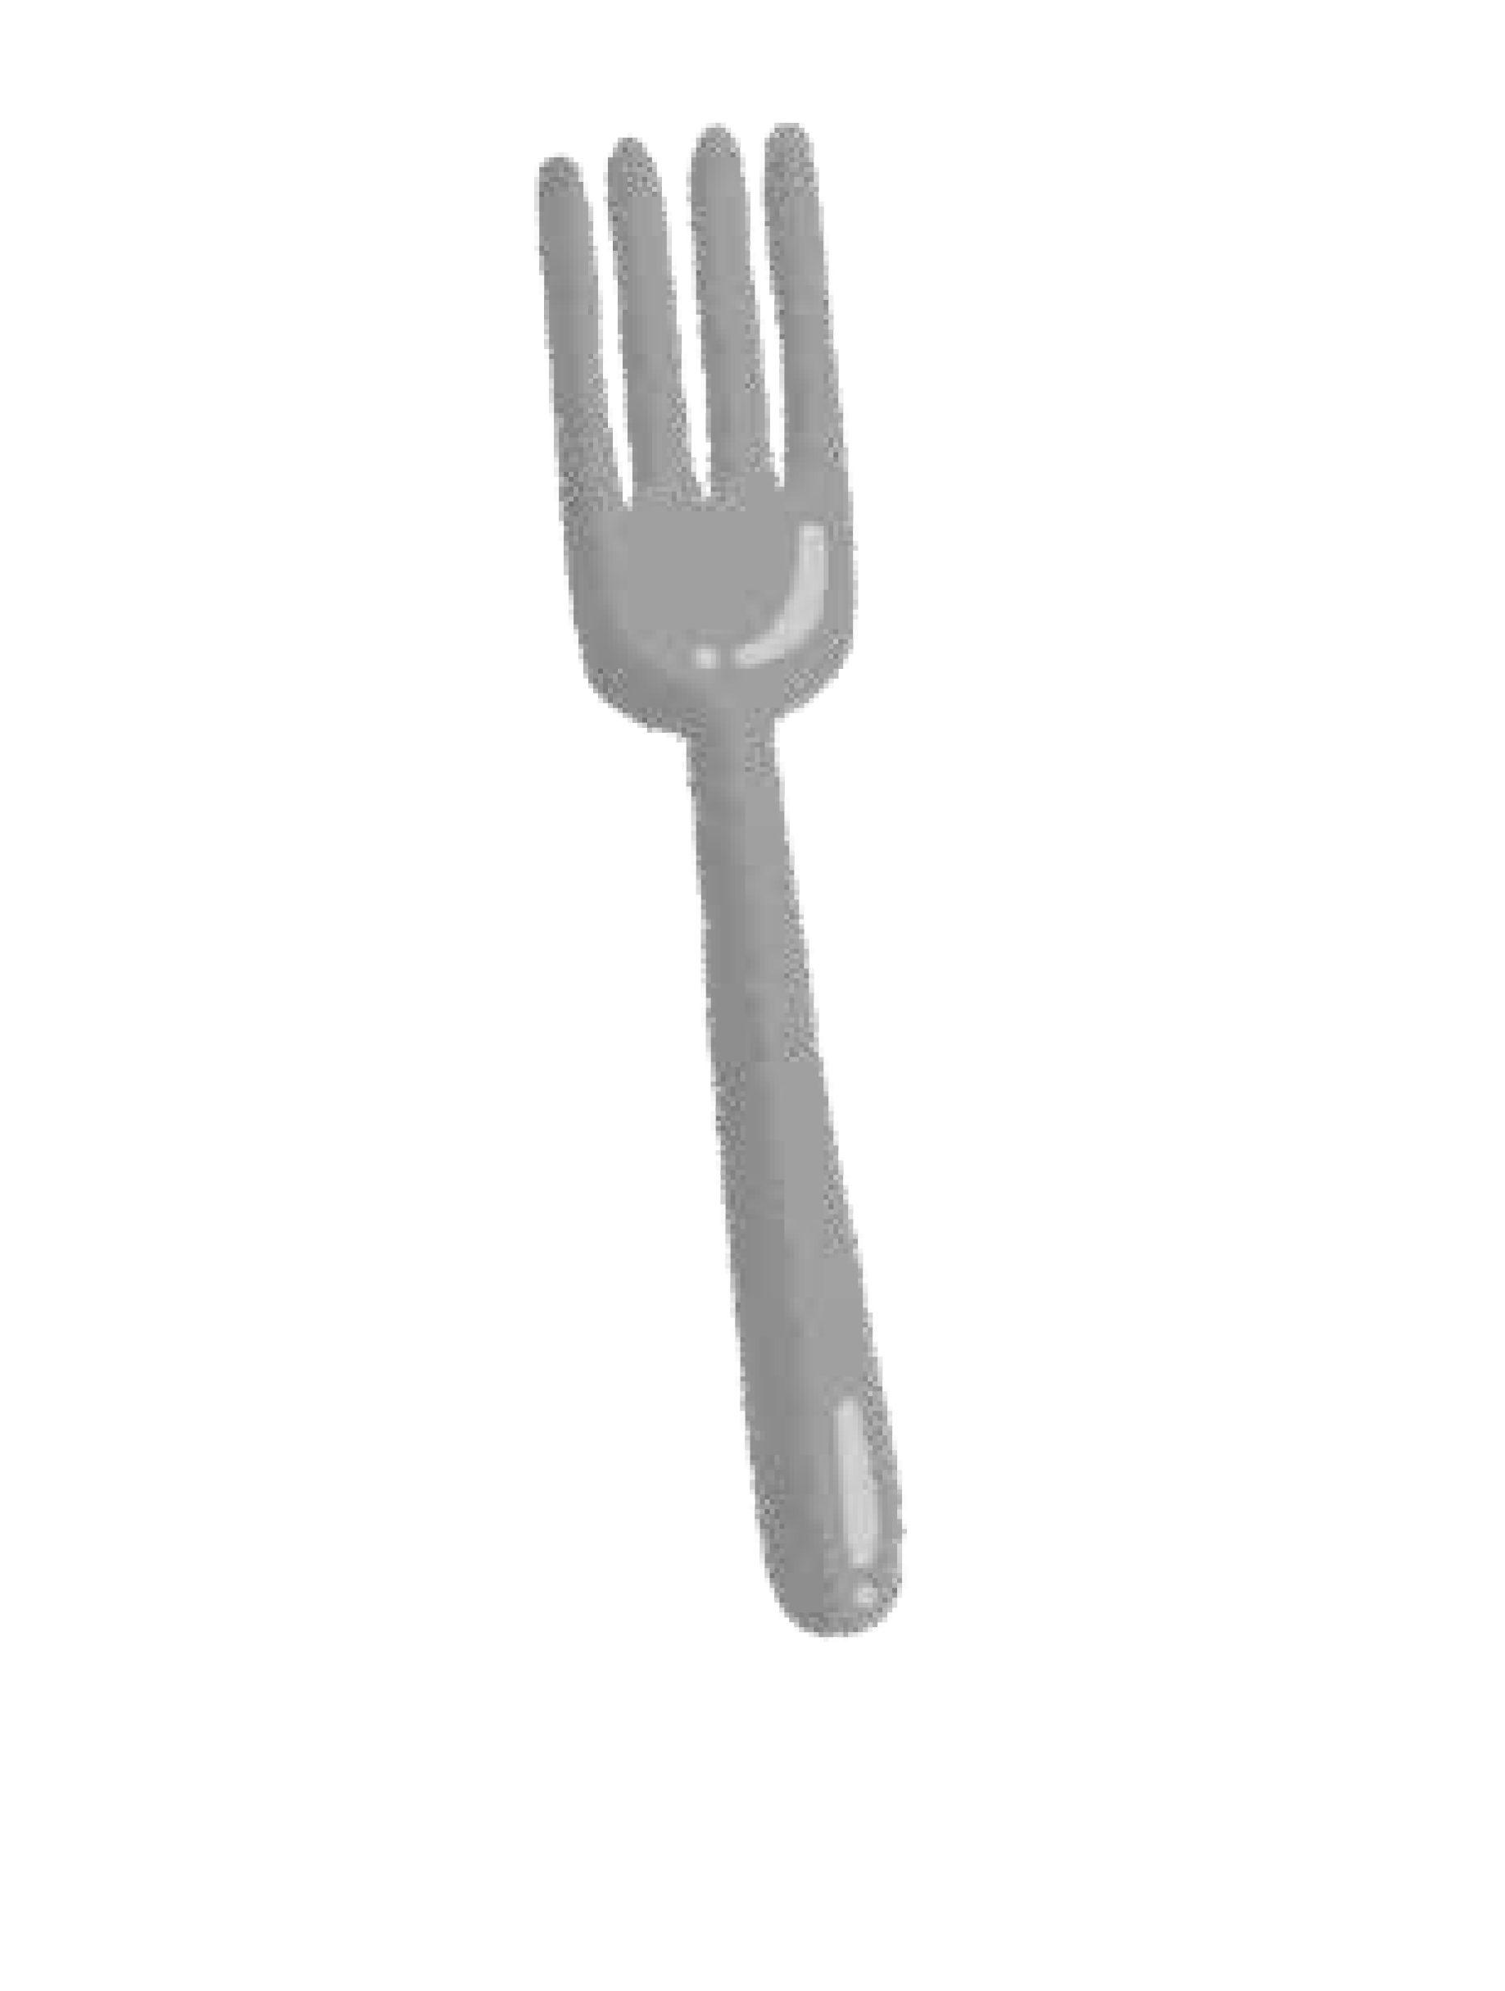
or

Slide 63
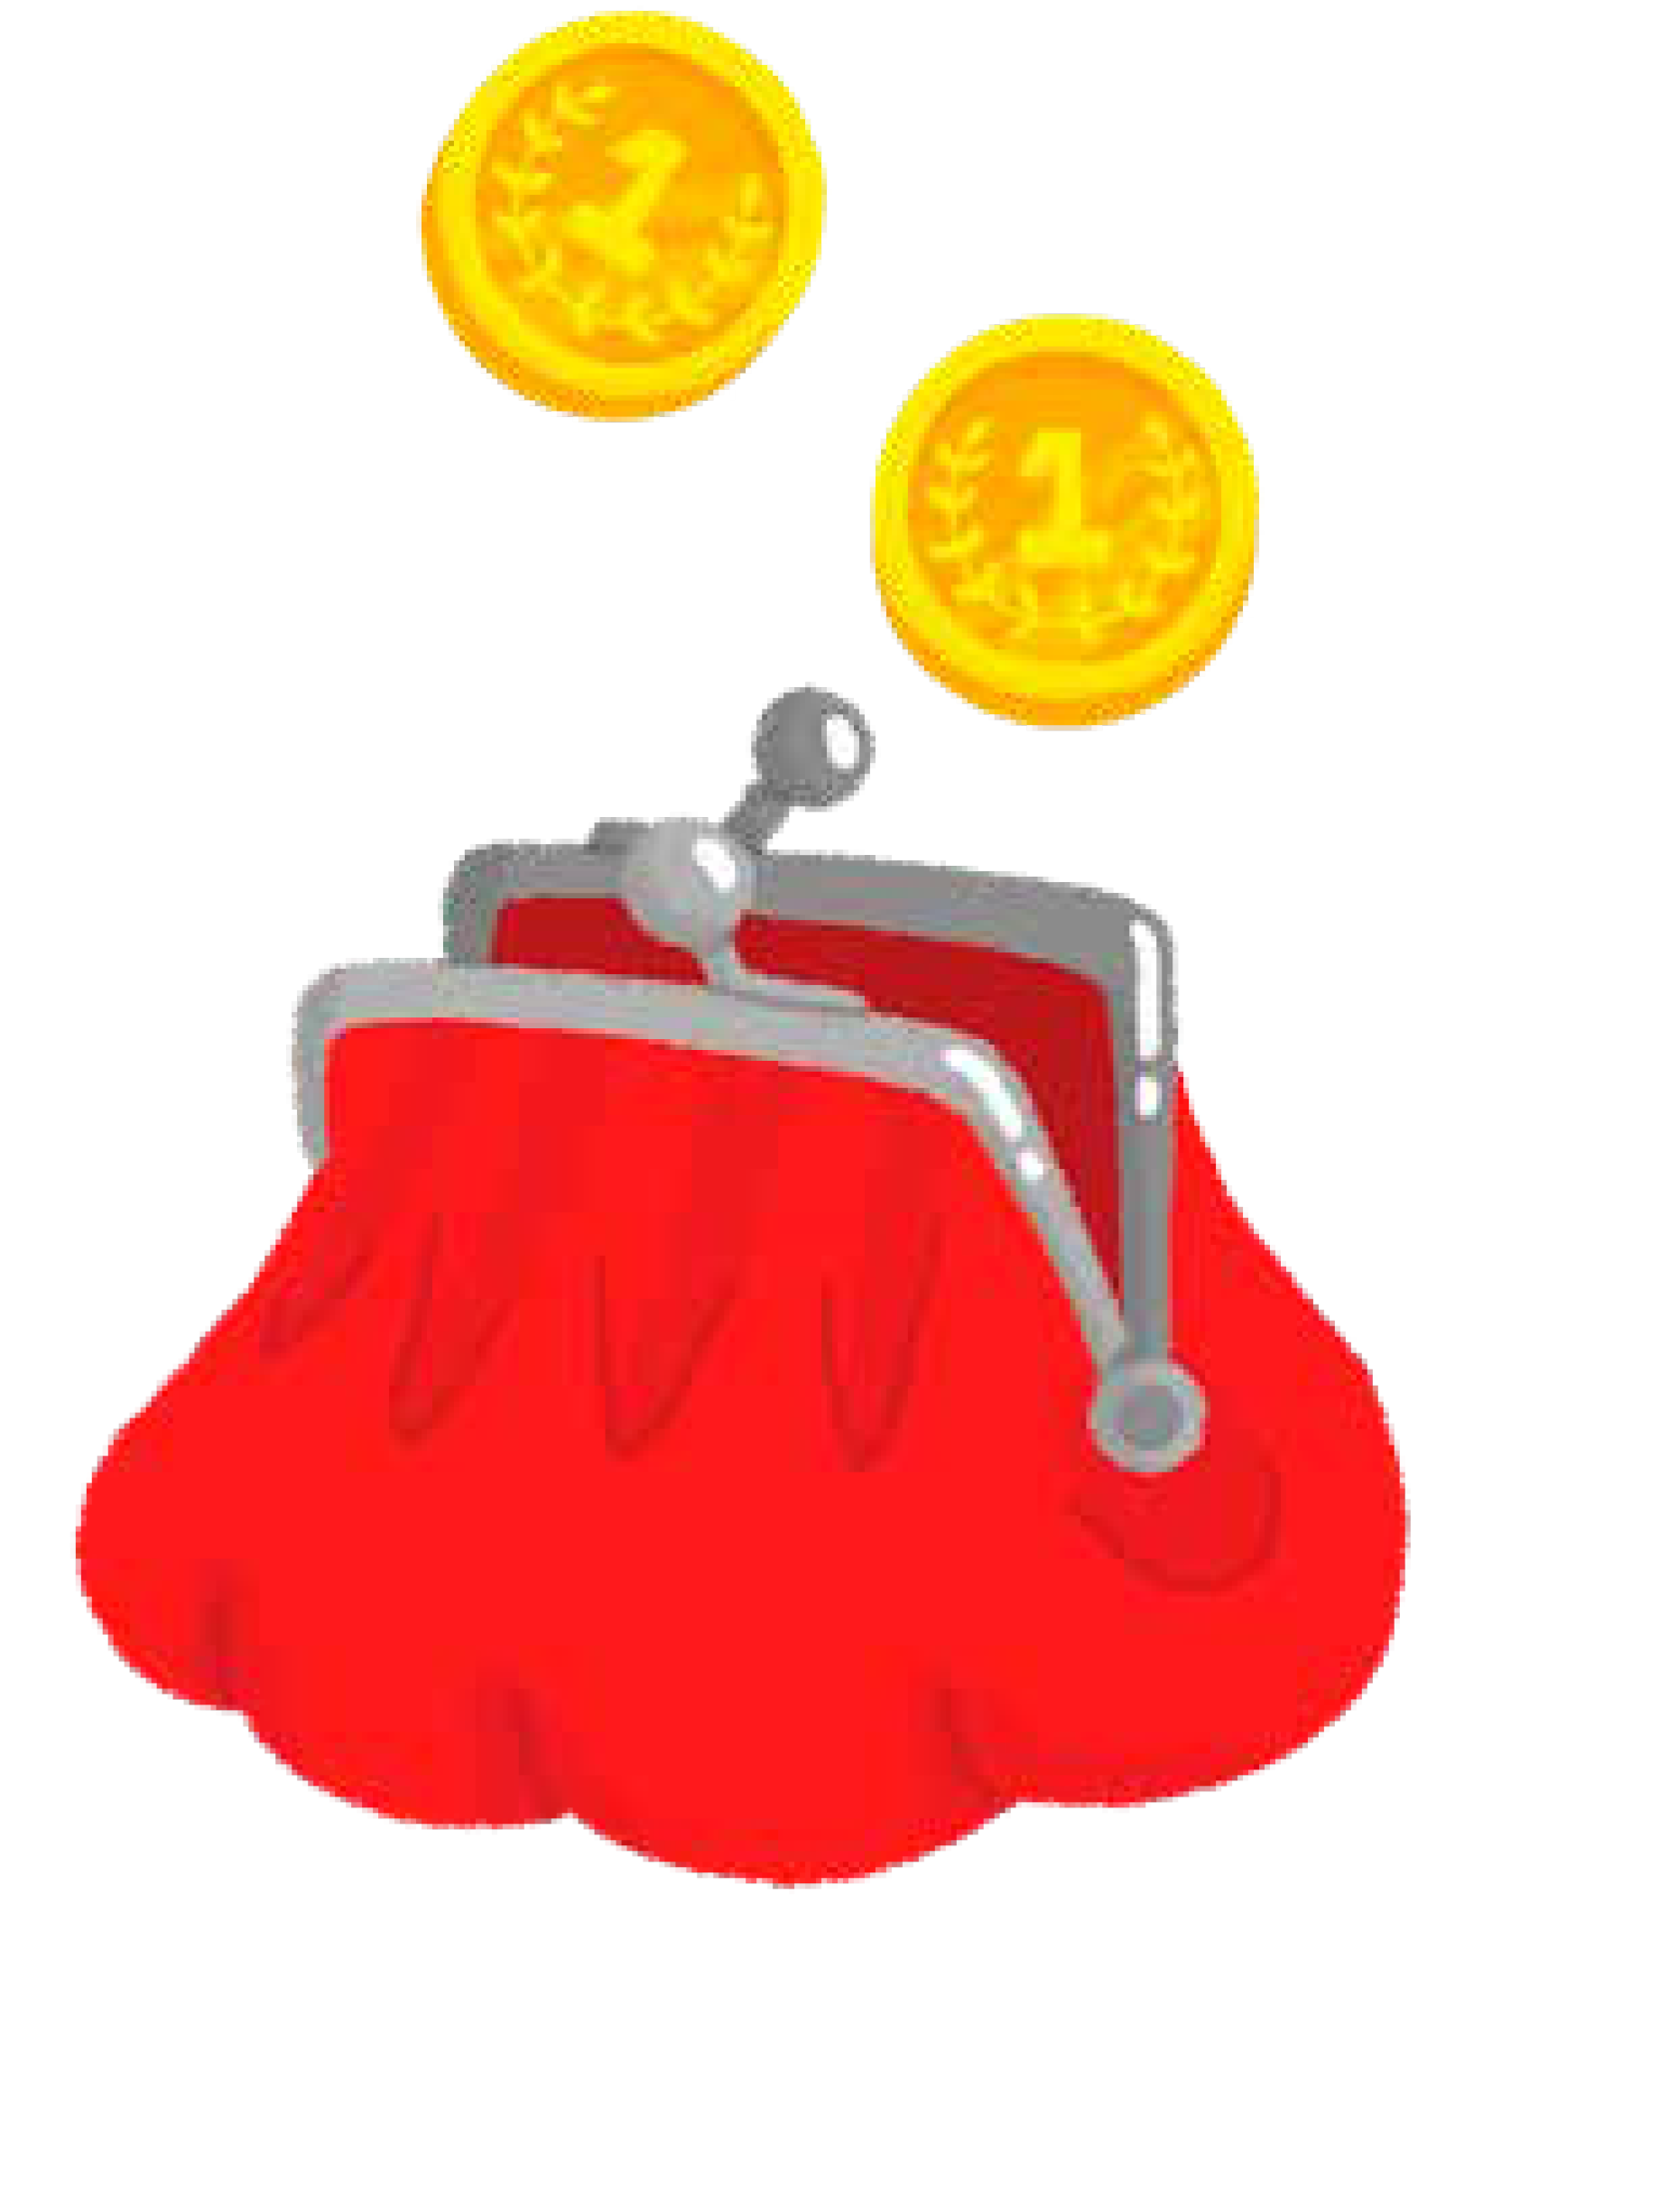
ur

Slide 64
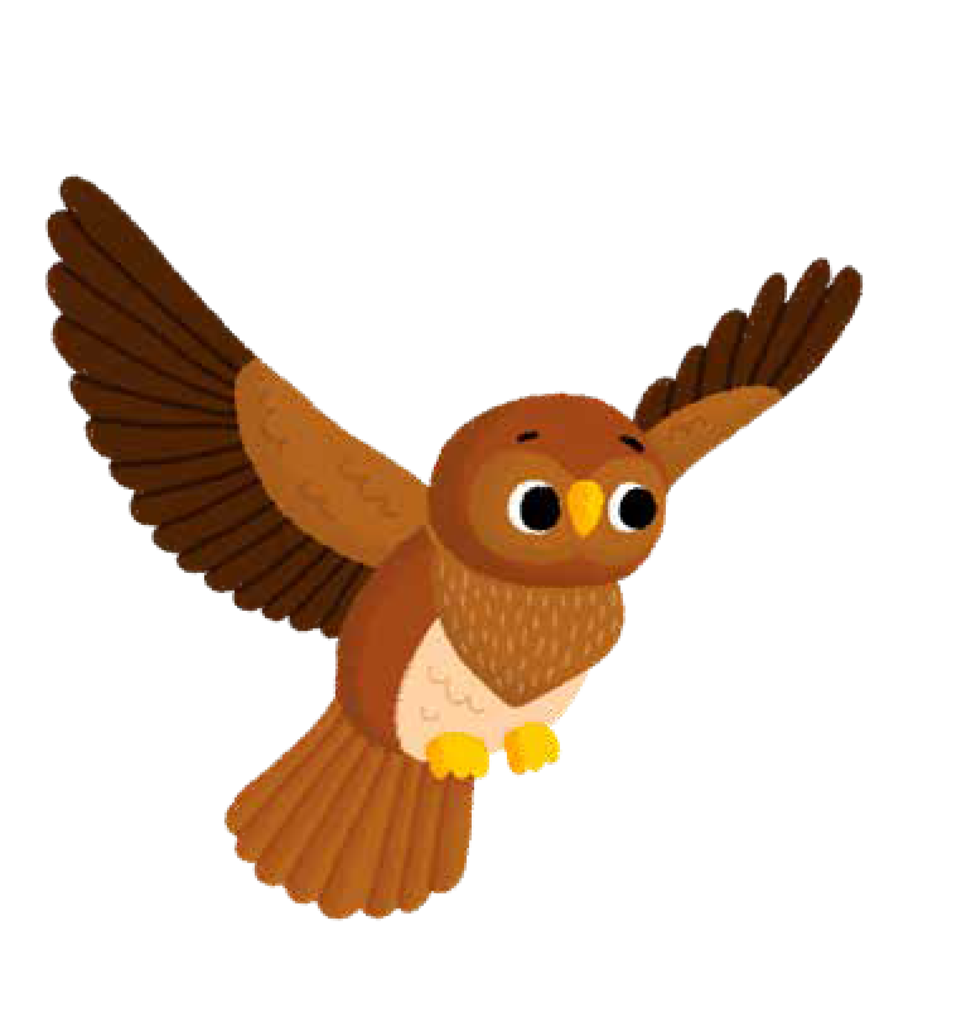
ow

Slide 65

oi

Slide 66
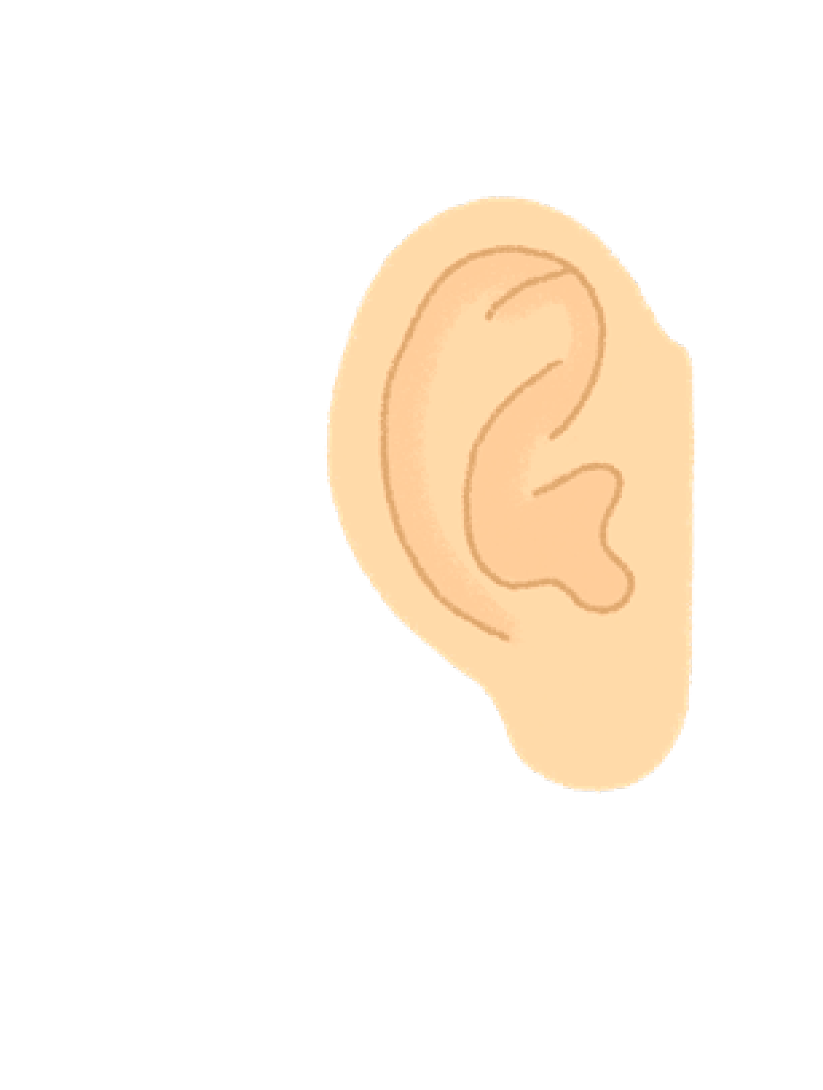
ear

Slide 67
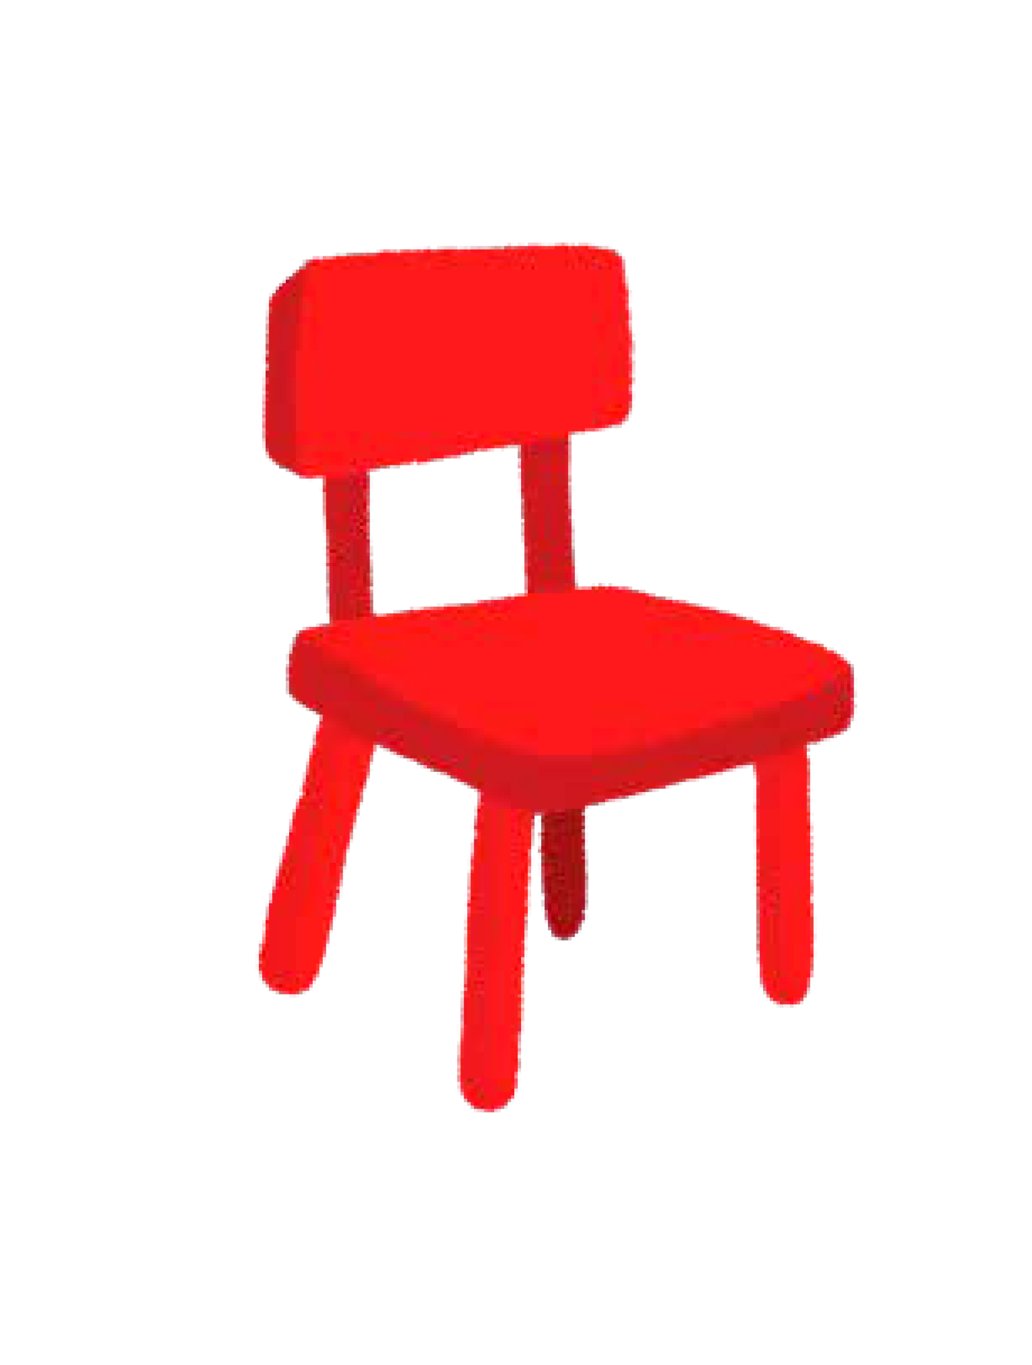
air

Slide 68

ure

Slide 69

er
This phoneme should be
taught as ‘uh’ and not ‘ergh’.

Slide 70

ay

Slide 71
ou

Slide 72
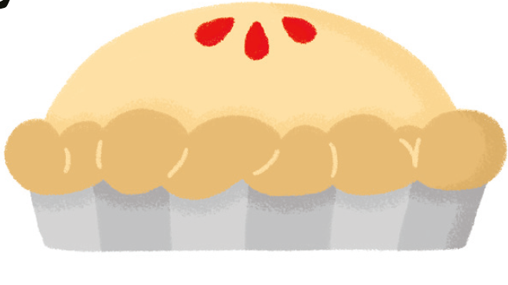
ie

Slide 73
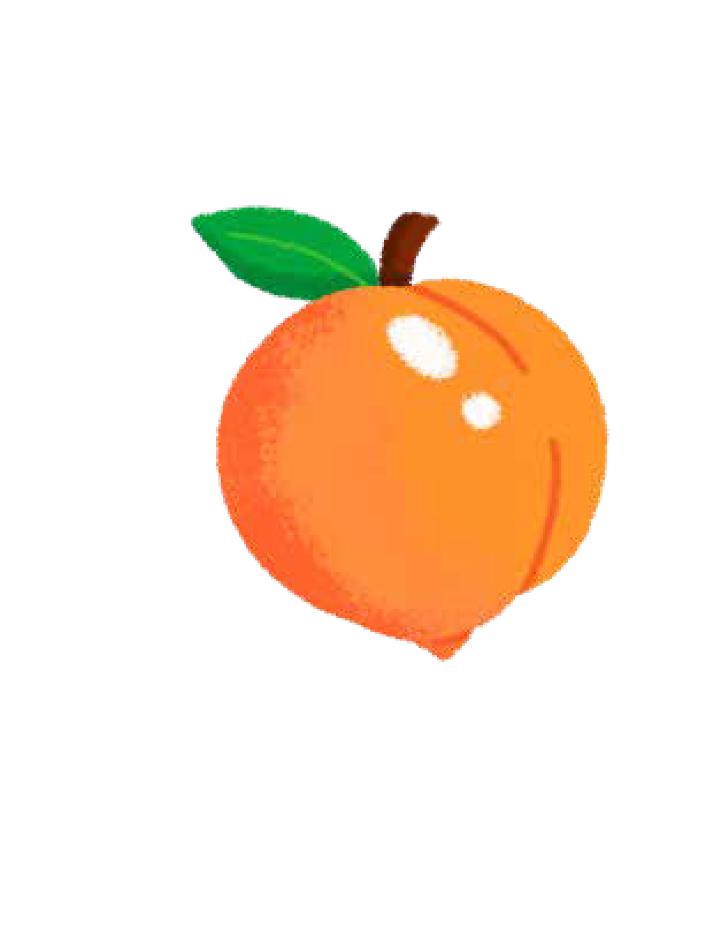
ea

Slide 74
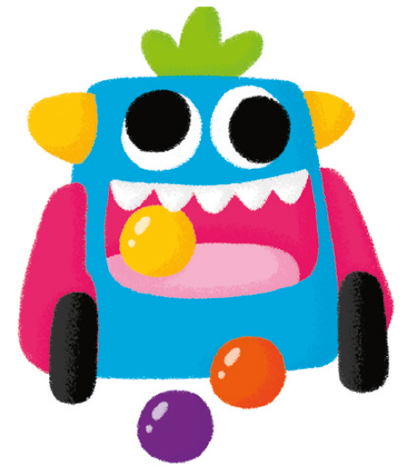
oy

Slide 75
ir

Slide 76
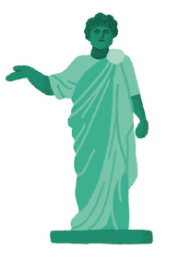
ue

Slide 77
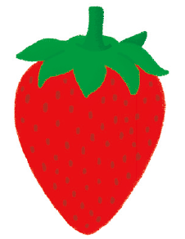
aw

Slide 78
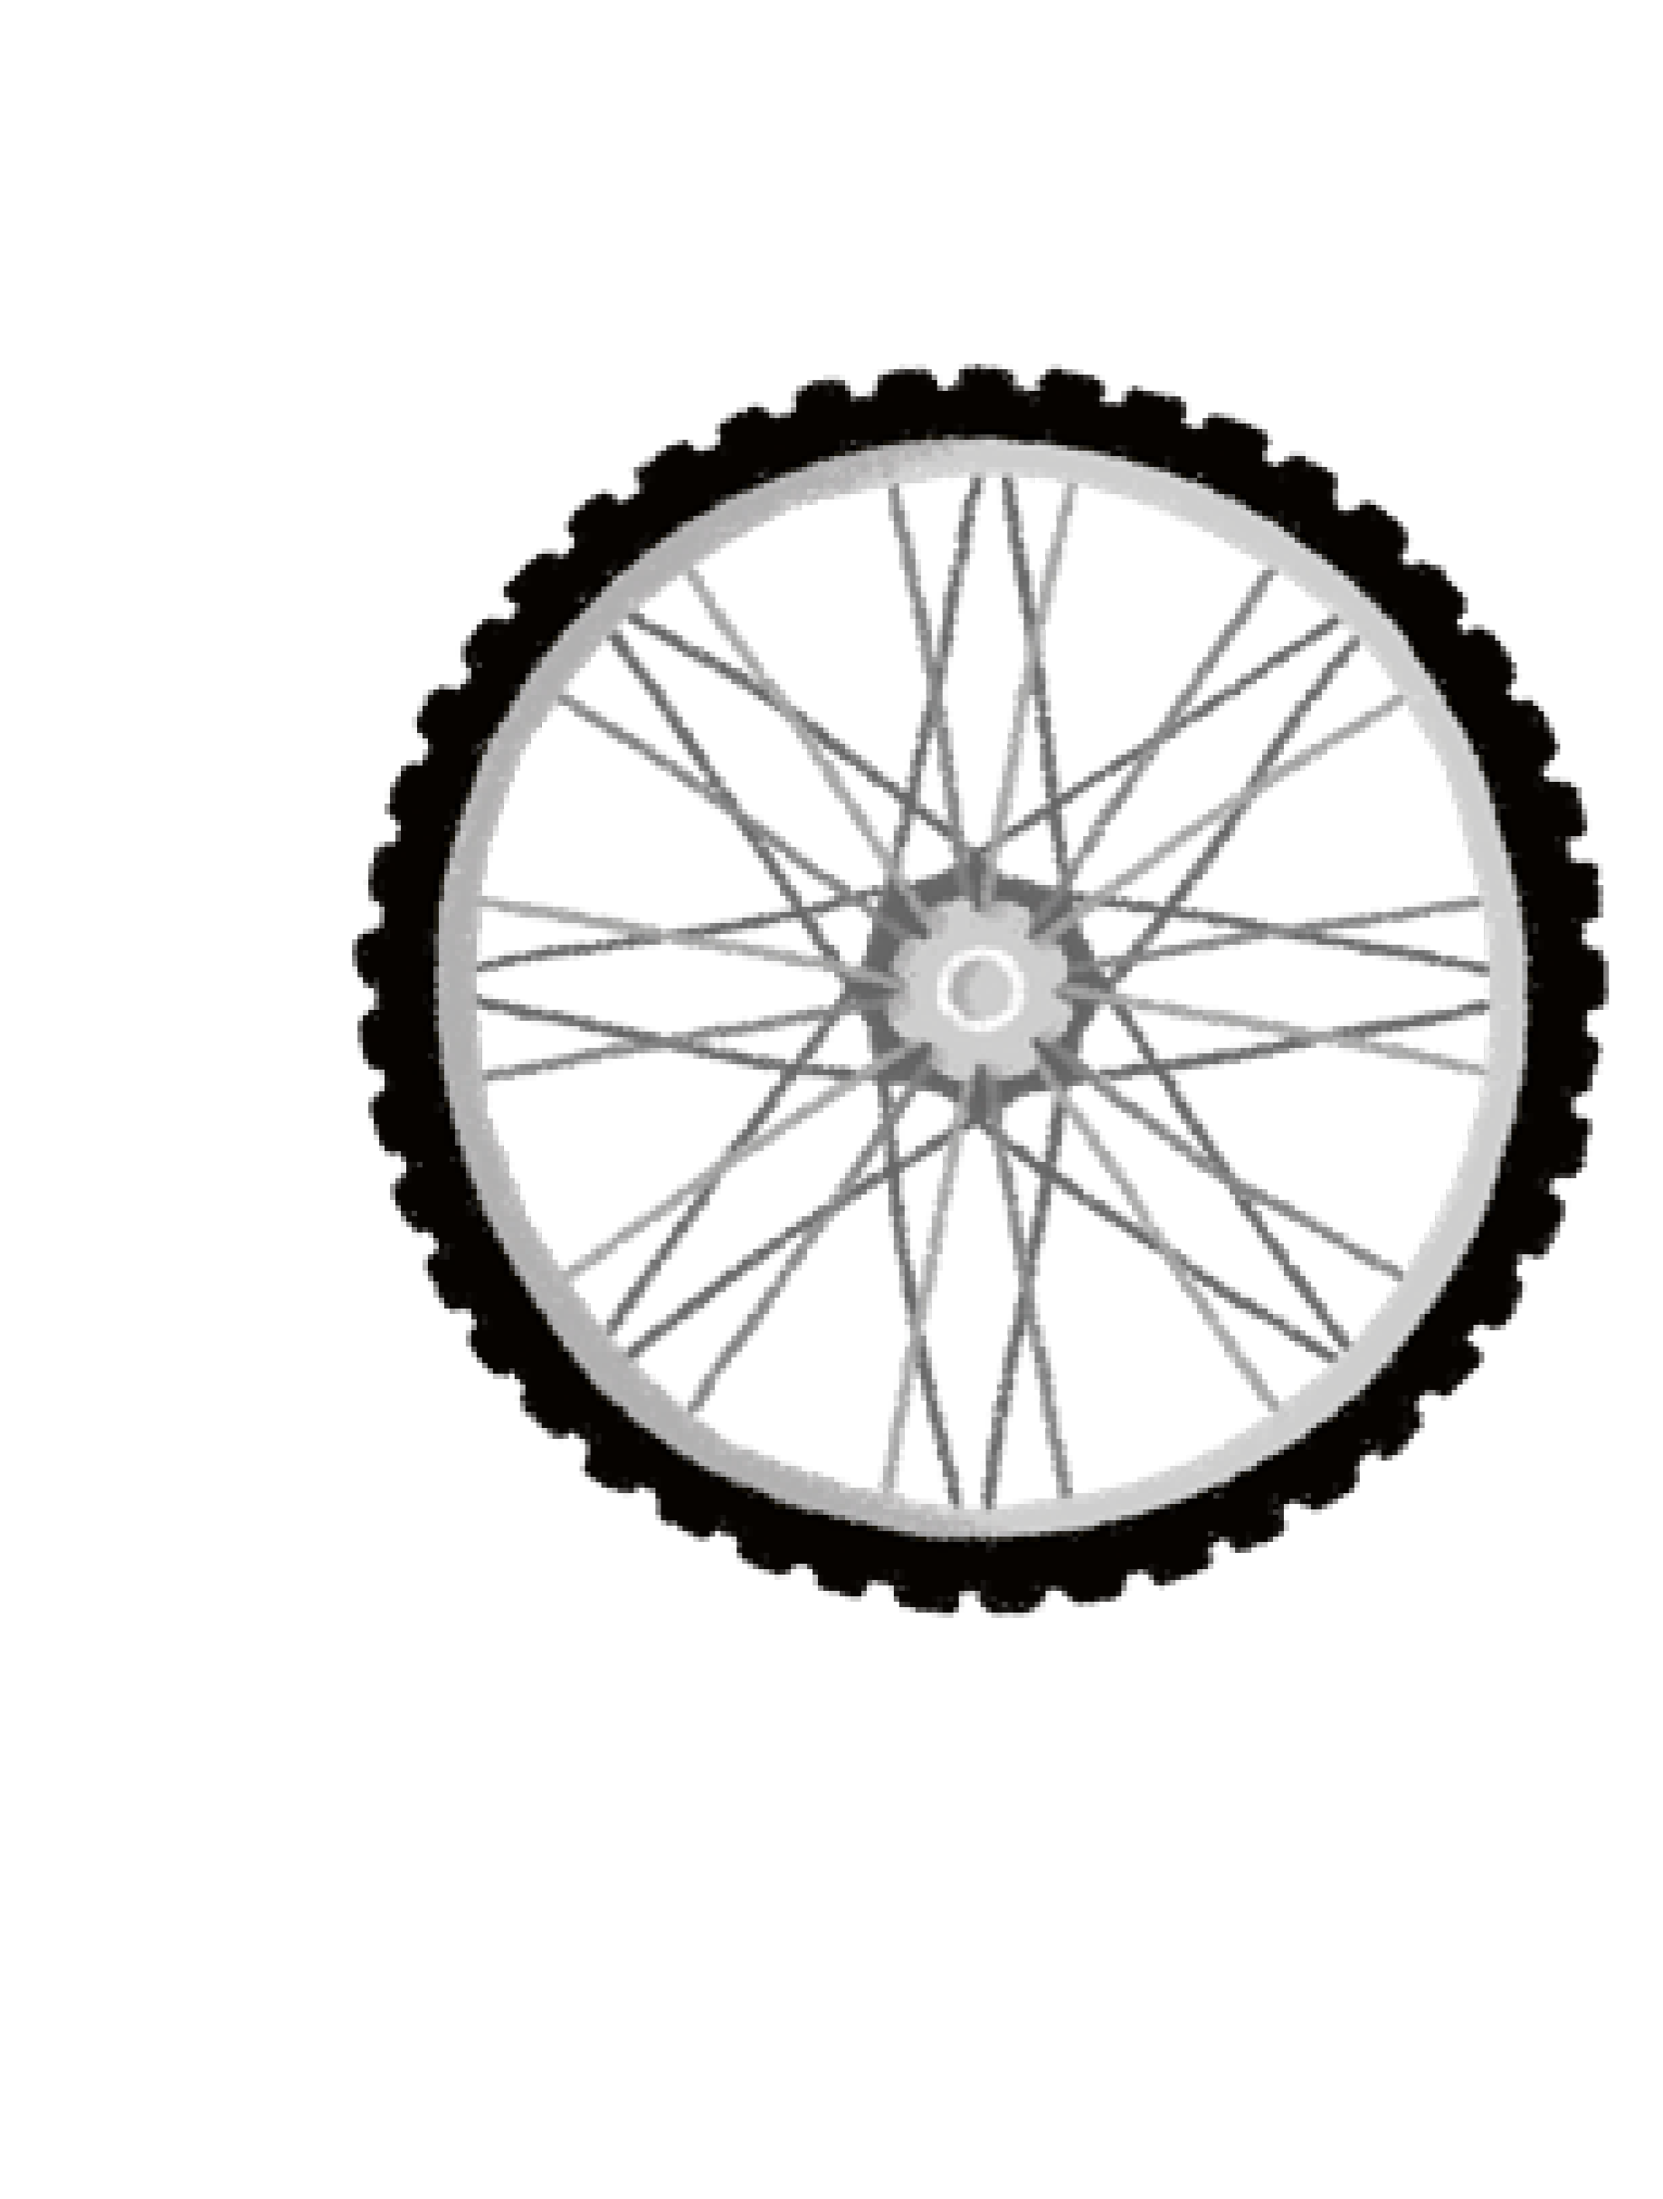
wh

Slide 79

ph

Slide 80

ew

Slide 81
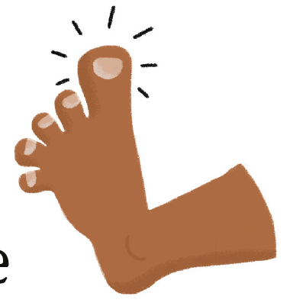
oe

Slide 82
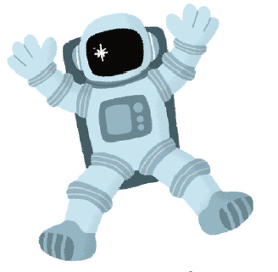
au

Slide 83
ey

Slide 84

a_e

Slide 85

e_e

Slide 86
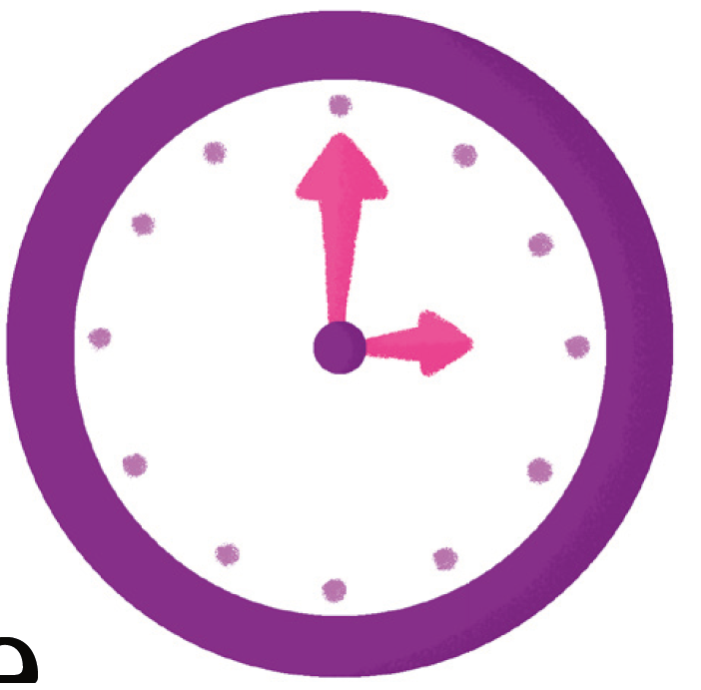
i_e

Slide 87
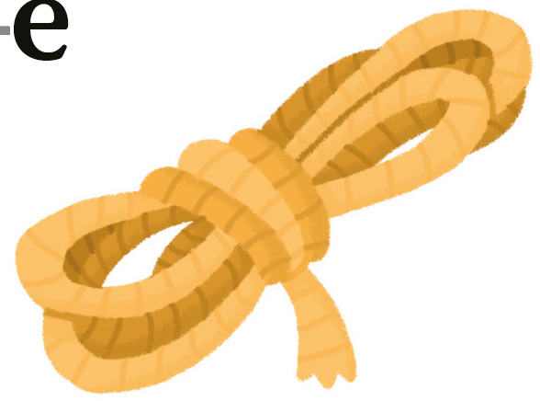
o_e

Slide 88
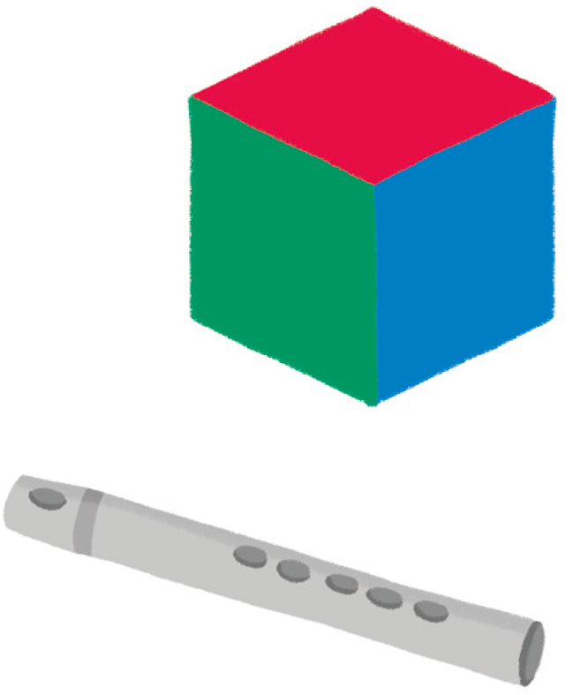
u_e

Slide 89
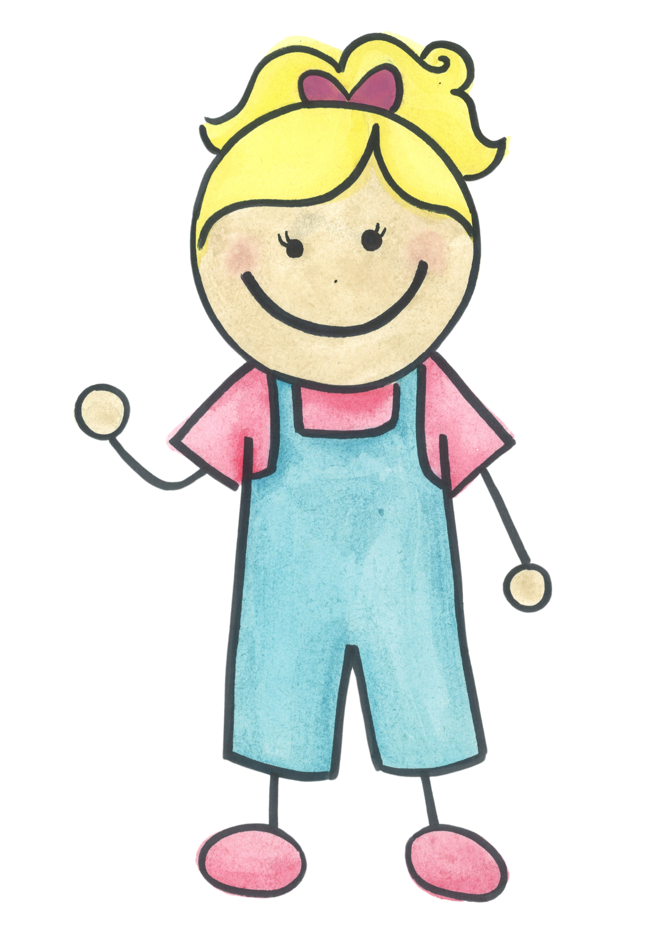

Split Digraph
The split digraph is where the ‘e’, usually at the end of a word, changes the vowel sound in the middle of the word to it’s letter name.
When two vowels go out walking, the first one does the talking!
Notes:
The split digraph is where the ‘e’, usually at the end of a word, changes the vowel sound in the middle.

Slide 90
Alternative Pronunciations
Examples:
a as in hat, acorn or fast
e as in bed or he
i as in tin or mind
o as in hot or no
u (south) as in but, unit or put

Slide 91
Alternative Graphemes
The children learn that some phonemes can have multiple graphemes, for example: ai, ay, a_e, eigh, ey or ei. These are called alternative graphemes. They also learn more common exception words. It is important that the children are encouraged to spell the alternative graphemes by their letter name, for example ‘igh’ is made up of the letters ‘i-g-h’ and not the letter sounds or phonemes.
ai | ay | a_e | eigh | ey | ei
rain | crayon | snake | weight | grey | rein
Notes:
The split digraph is where the ‘e’, usually at the end of a word, changes the vowel sound in the middle.

Slide 92
Common Exception Words Examples
Common Exception Words used to be called tricky words.
They are words that cannot usually be decoded or encoded using phonics although there are some exceptions e.g. out, looked.
I | he | are | said | little | oh
no | she | her | have | one | Mrs
the | we | was | like | were | people
to | me | all | so | there | their
go | be | they | do | what | called
into | you | my | some | when | Mr
 |  |  | come | out | looked
 |  |  |  |  | asked
 |  |  |  |  | could

Slide 93
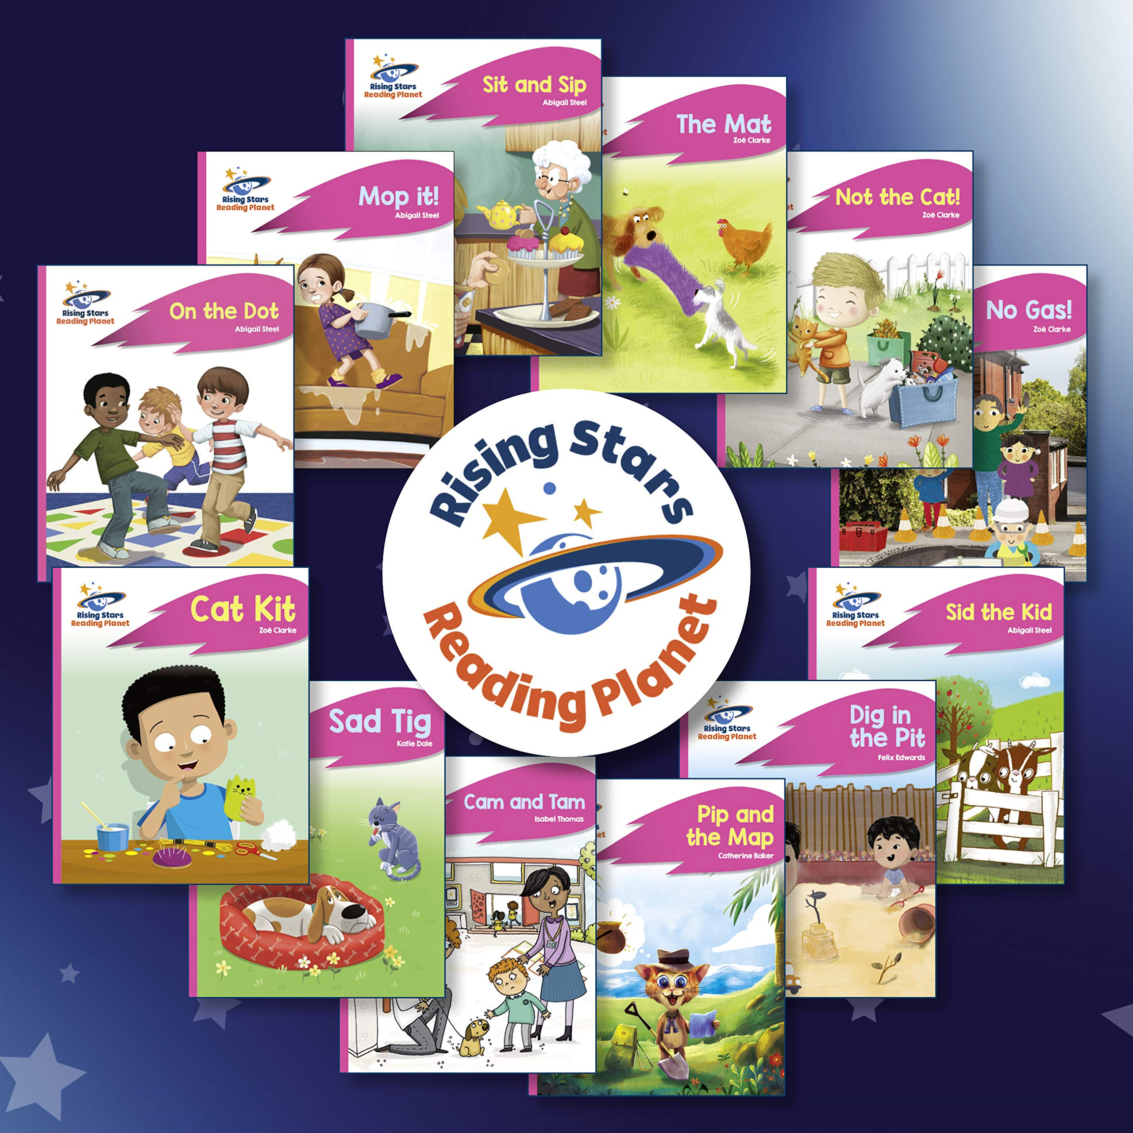
Guided Reading
At Walter Infant School and Nursery, we have adopted a guided reading method for teaching reading.
Our children read with an adult in small groups, which consist of no more than 6 children. The session is led or facilitated by the teacher.
It starts by teaching or consolidating a skill for reading. The children explore the book with the teacher and engage in discussion. This is before, during and after reading. For example, they might discuss the front cover, technical vocabulary or what they thought of the characters.
The children are asked questions and given lots of time to read and explore the text. This allows for high quality discussion, whilst using high quality texts.
Notes:
There are 26 letters in the alphabet.
40+ phonemes or sounds in the English language, accounting for regional dialects
Over 200 graphemes or written representations of these sounds. Sounds or phonemes can have one or more grapheme for example the sound s can be spelt with an ’s’ or a ‘c’

Slide 94
Guided Reading
Our Guided Reading scheme uses a colour banding system. The children progress through the colour bands and these could be considered levels. Below are the end of year expectation for each year group. By the end of F2, most children are securely reading Red Books.
Pink (A, B & C) | Red (A, B & C) | Yellow | Blue | Green | Orange | Turquoise | Purple | Gold | White | Lime | Copper | Topaz
F2 Expected |  | F2 Exceeding
Year One Working Towards |  |  |  | Year One Expected |  |  | Year One Greater Depth
Year Two Working Below KS1 Standards |  |  |  | Year Two Working Towards |  |  |  | Year Two Expected |  |  | Year Two Greater Depth
Notes:
There are 26 letters in the alphabet.
40+ phonemes or sounds in the English language, accounting for regional dialects
Over 200 graphemes or written representations of these sounds. Sounds or phonemes can have one or more grapheme for example the sound s can be spelt with an ’s’ or a ‘c’

Slide 95
Home Reading Books
The children take reading books home regularly.
The children are encouraged to change the books by themselves.
Generally, they take home the colour band below home.
This is to allow the children to practise and consolidate the skills they have been taught in school. It should still be a challenging read, and the children will still need help and support with some words or comprehension of the text.
Please discuss the book before, during and after reading. Use the illustrations to engage in discussion and talk about the characters, the setting or the facts in the book.
The children are expected to re-read the book to help develop fluency.
The children should use their phonics as the prime method for decoding or reading a word. However, if they are struggling, just tell them the word.
It should be a fun activity, that is enjoyable. If your child is having an ‘off day’ then they are not ready to read - leave it for another time.
Notes:
There are 26 letters in the alphabet.
40+ phonemes or sounds in the English language, accounting for regional dialects
Over 200 graphemes or written representations of these sounds. Sounds or phonemes can have one or more grapheme for example the sound s can be spelt with an ’s’ or a ‘c’

Slide 96

Asking questions
Help them understand what they have read by asking questions before, during and after you read with them or listen to them
Before (knowledge of books) ~ Can you point to the title? What do you think this story might be about? What does the blurb tell us?
During (comprehension and prediction) ~ What is happening in the pictures? What has happened so far? What might happen next? What sort of character is…? How do you know?
After (comprehension and opinion) ~ Did you like this book? What did you like most about it? What happened in the story?

Slide 97
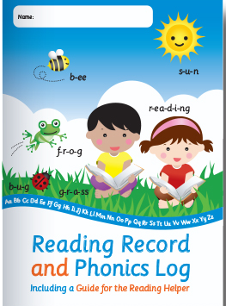
Reading together and decoding new words
Children will use many cueing strategies to help them read the words on the page: they should always try to use the phonics to decode.
You can help by saying “What is the first sound?” Can you sound out (segment) the phonemes?” e.g. shop ~ sh-o-p etc
Do not let your child struggle for too long if they can’t blend the sounds together. Do record the word they found difficult in the reading record.
There will be common exception words in the books that they should not find too tricky to recognise.
If the book is too difficult please mention it in the reading record so that we can check the book is well matched to our SSP.

Slide 98

Children Reading for Pleasure
We foster a love for reading at school; please do the same at home. Explain to your children how much you love to read and regularly share books with them. Talk about your favourite books. Some children will prefer fiction and some will prefer non-fiction. We have a wide variety of both

Slide 99
Let’s take a look at a Rocket Phonics Lesson

Slide 100








We teach phonics daily. The children and the adults love their Rocket Phonics lessons. All phonic sessions start with revisiting what they children have previously learned through the use of flash cards.

Slide 101


The main teaching of the phonics session is done through a shared guided reading text. This is presented on the interactive whiteboard, as a big book.

Slide 102
The teacher reads through the story and shares the sound or phoneme for the lesson. The children have the opportunity to respond to questions and activities.

Slide 103



Once the teaching is done, the children complete an activity in their workbooks. The tasks are designed so the children can demonstrate what they have learned and to practise their skills further. Adult support is still available if needed.

Slide 104

Our lowest attainers or lowest “20%” of readers receive a personalised provision to suit their needs and learning ability. This might include reading more easily decodable texts, additional phonics or extra reading throughout the week. This is to help them to continue to make progress.

Slide 105

Home Access to Rocket Phonics
The children have access to Rocket Phonics at home. The login details will be sent home once this has been setup. Please scan the QR Code or visit: https://walter.eschools.co.uk/storage/secure_download/NXk2d0VUUFJSTzlFa0p0Nm9xV1g5dz09 for more information.

Slide 106

Our Team of Experts
Mrs Hargreaves, as the Head Teacher, has ultimate responsibility for the children’s learning in school. Mrs Hargreaves has a thorough understanding of how children develop their phonic skills and learn to read.
Mr Lee is the school’s lead for English, Literacy, Reading and Phonics across the school. He specialised in English whilst at university and has worked with many schools to improve their teaching of reading.

Slide 107

A Team of Experts within our School
We have an amazing team of experts in our school. All of our staff are committed to ensuring that our provision is adapted to meet the needs of all our children and our year group leaders ensure that our children have access to wonderful resources, all of which are treated with the utmost respect by children and adults alike.

Slide 108

Any Questions?

