Slide 1
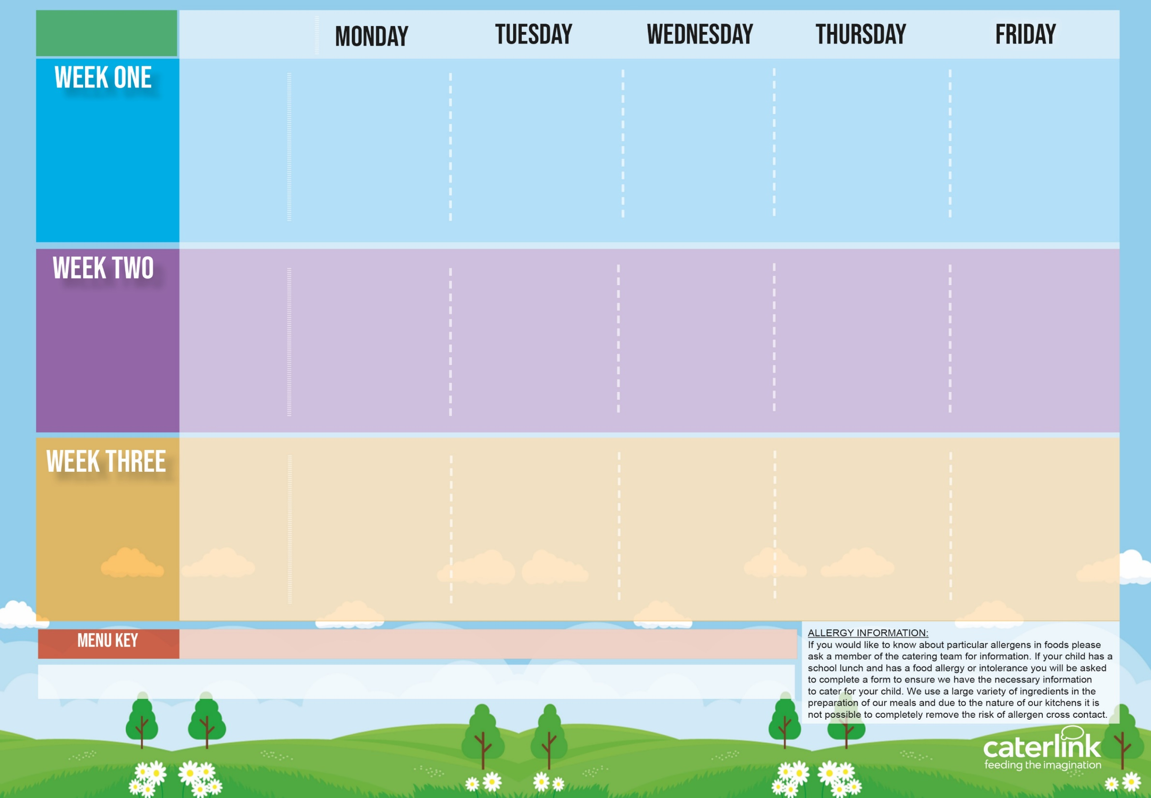
Spring Summer
2024
Option One
Option Two
Vegetables
Dessert
NEW Vegetable Stack with Rice | Beef Lasagne | Sausages, Roast Potatoes & Gravy | Burger with Potato Wedges & Tomato Sauce | Fishfingers with Chips & Tomato Sauce
Cheese & Tomato Pizza with Pasta Salad | Vegetarian Lasagne | Tomato Pasta | Vegan Burger with Potato Wedges & Tomato Sauce | BBQ Quorn with Chips
Vegetables of the Day | Vegetables of the Day | Vegetables of the Day | Vegetables of the Day | Vegetables of the Day
Freshly Chopped Fruit Salad | Jelly with Mandarins | NEW Berry Mousse | NEW Iced Biscuit | Vanilla Shortbread
15/04/2024
06/05/2024
03/06/2024
24/06/2024
15/07/2024
09/09/2024
30/09/2024
21/10/2024
Option One
Option Two
Vegetables
Dessert
Chicken Curry With Rice | Greek Chicken Pitta with Rice, Tzatziki & Salad | Roast Chicken, Stuffing, Roast Potatoes, & Gravy | Penne Bolognaise | Fishfingers with Chips & Tomato Sauce
Vegetable Curry With Rice | Cheese Whirl with Rice, Tzatziki & Salad | Tomato Pasta | Vegan Penne Bolognaise | NEW Vegan Sausage Roll with Chips & Tomato Sauce
Vegetables of the Day | Vegetables of the Day | Vegetables of the Day | Vegetables of the Day | Vegetables of the Day
NEW Chocolate Brownie | Iced Vanilla Sponge | Fruit Medley | Apple Crumble with Ice Cream | Oaty Cookie
22/04/2024
13/05/2024
10/06/2024
01/07/2024
22/07/2024
16/09/2024
07/10/2024
Option One
Option Two
Vegetables
Dessert
NEW All-Day Vegetarian Breakfast | Chicken Paella with Patatas Bravas or Veggie Meatballs with Patatas Bravas | Roast Gammon, New Potatoes or Mashed Potatoes & Gravy | NEW Chicken Fajitas with Rice | Fishfingers with Chips & Tomato Sauce
Vegan Chilli with Rice | or Veggie Meatballs with Patatas Bravas | Tomato Pasta | Macaroni Cheese | Cheese & Bean Pasty with Chips
Vegetables of the Day | Vegetables of the Day | Vegetables of the Day | Vegetables of the Day | Vegetables of the Day
Fruit with Ice Cream | Syrup Snap Biscuit | Fruit Platter | Chocolate Shortbread | Summer Lemon Cake
29/04/2024
20/05/2024
17/06/2024
08/07/2024
02/09/2024
23/09/2024
14/10/2024
Added Plant Power
Wholemeal
Vegan
Chef’s Special
Available Daily: - Freshly cooked jacket potatoes with a choice of fillings - Bread freshly baked on site daily- Daily salad selection

Slide 2
Spring Summer
2024
Option One
Option Two
Vegetables
Dessert
V250 Vegetable Stack with SD84 Rice | B52 Beef Lasagne With SD50 Garlic Bread | P3/ C6 Sausages, SD82 Roast Potatoes & SD118 Gravy | BB1 SD17 Burger with SD6 Potato Wedges & SD14 Tomato Sauce | F6 Fishfingers with SD5 Chips & SD14 Tomato Sauce
V231 Cheese & Tomato Pizza with SB9 Pasta Salad | V108 Vegetable Curry With SD84 Rice | PRIV225 Tomato Pasta | V236 SD17 Vegan Burger with SD6 Potato Wedges & SD14 Tomato Sauce | V205 BBQ Quorn with SD5 Chips
Vegetables of the Day | Vegetables of the Day | Vegetables of the Day | Vegetables of the Day | Vegetables of the Day
D223 Freshly Chopped Fruit Salad | D235 Jelly with Mandarins | D248 Berry Mousse | D250 Iced Biscuit | D57 Vanilla Shortbread
15/04/2024
06/05/2024
03/06/2024
24/06/2024
15/07/2024
09/09/2024
30/09/2024
21/10/2024
Option One
Option Two
Vegetables
Dessert
PRIV108 Vegetable Curry with Rice Or PRIV242 Vegetarian Lasagne | Yamas GR1 Greek Chicken Pitta with GR5 Rice, GR3 Tzatziki & GR4 Salad | C4/C5 Roast Chicken, SD40 Stuffing, SD82 Roast Potatoes, & SD118 Gravy | B48 SD125 Penne Bolognaise | F6 Fishfingers with SD5 Chips & SD14 Tomato Sauce
 | GR2 Cheese Whirl with GR5 Rice, GR3 Tzatziki & GR4 Salad | PRIV225 Tomato Pasta | V233 SD125 Vegan Penne Bolognaise | V251 Vegan Sausage Roll with SD5 Chips & SD14 Tomato Sauce
Vegetables of the Day | Vegetables of the Day | Vegetables of the Day | Vegetables of the Day | Vegetables of the Day
D249 Chocolate Brownie | D177 Iced Vanilla Sponge | D224 Fruit Medley | D242 Apple Crumble with D13 Ice Cream | D85 Oaty Cookie
22/04/2024
13/05/2024
10/06/2024
01/07/2024
22/07/2024
16/09/2024
07/10/2024
Option One
Option Two
Vegetables
Dessert
V249 All-Day Vegetarian Breakfast | Fiesta Espanol FE1 Chicken Paella with FE4 Patatas Bravas or FE2 Veggie Meatballs with FE4 Patatas Bravas | P5 Roast Gammon, SD2 New Potatoes or SD1 Mashed Potatoes & SD118 Gravy | C92 Chicken Fajitas with SD84 Rice | F6 Fishfingers with SD5 Chips & SD14 Tomato Sauce
V239 Vegan Chilli with SD84 Rice | or Veggie Meatballs with Patatas Bravas | PRIV225 Tomato Pasta | V11 Macaroni Cheese | V191 Cheese & Bean Pasty with SD5 Chips
Vegetables of the Day | Vegetables of the Day | Vegetables of the Day | Vegetables of the Day | Vegetables of the Day
D166 Fruit with D13 Ice Cream | D219 Syrup Snap Biscuit | D225 Fruit Platter | D80 Chocolate Shortbread | D168 Summer Lemon Cake
29/04/2024
20/05/2024
17/06/2024
08/07/2024
02/09/2024
23/09/2024
14/10/2024
Added Plant Power
Wholemeal
Vegan
Chef’s Special
Available Daily: - Freshly cooked jacket potatoes with a choice of fillings - Bread freshly baked on site daily- Daily salad selection

